Slide 1

Fatemeh Kiaie

Slide 2
Outline
Origination of the data set
Demographic information of the input
Input Data Relationship
Output and trends

Slide 3
Data Set Information and Goal
UCI data set website
Marketing campaigns of a Portuguese banking institution.
Number of features: 20
Number of entities: 45,211

Slide 4
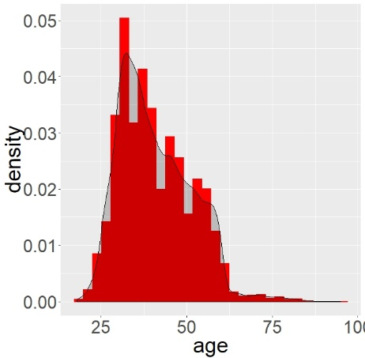
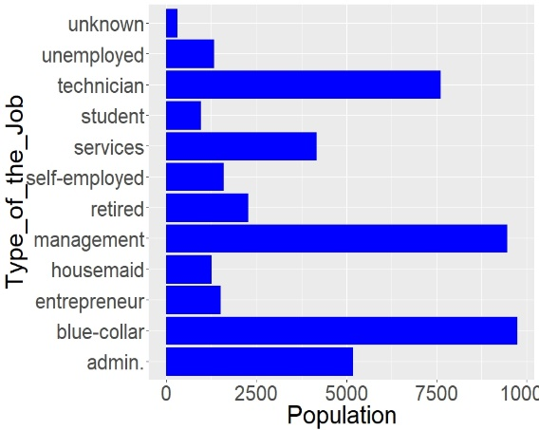
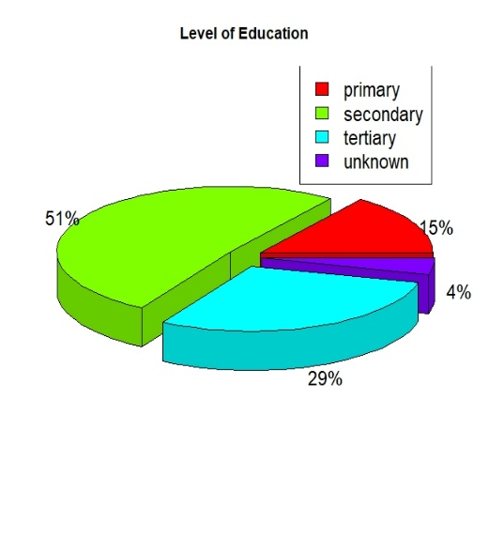
Demographic Information of the input

Slide 5
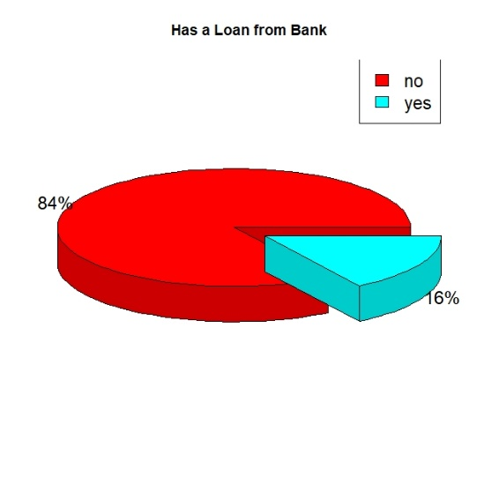
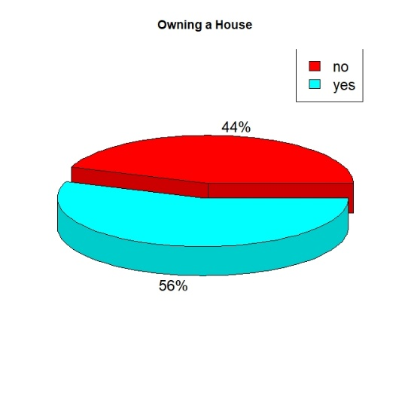
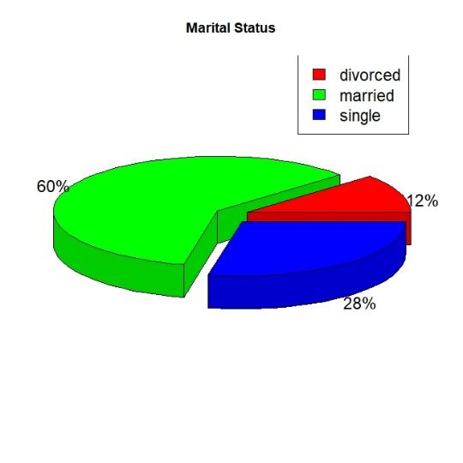
Demographic Information of the input

Slide 6
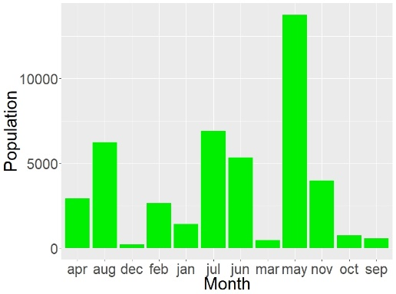
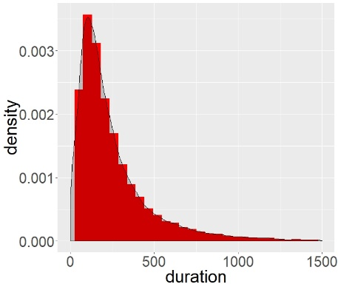
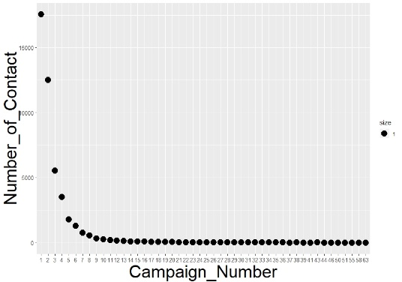
Demographic Information of the input

Slide 7
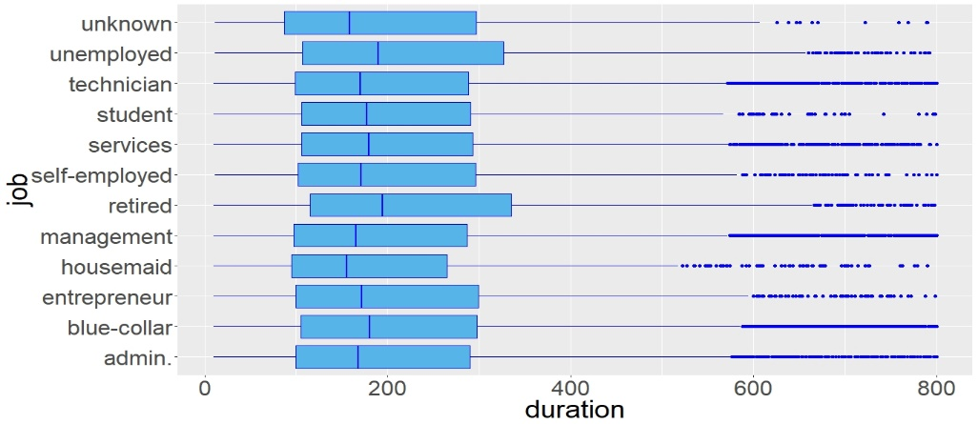
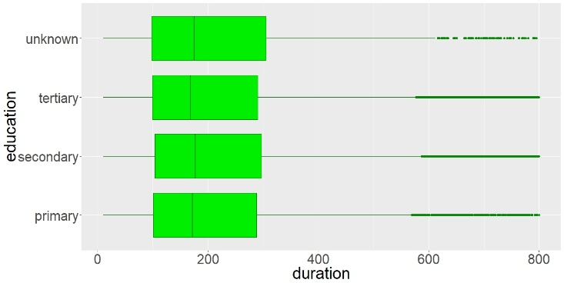
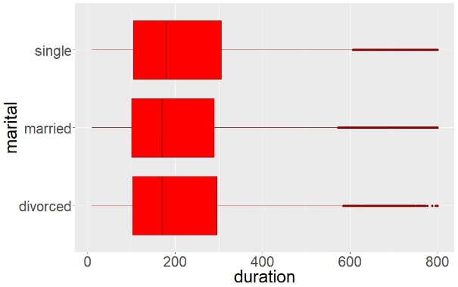
Input Data Relationship

Slide 8
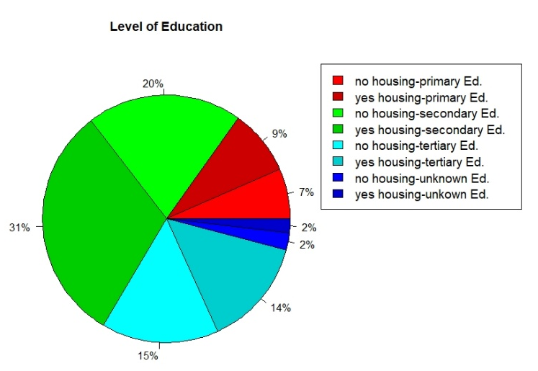
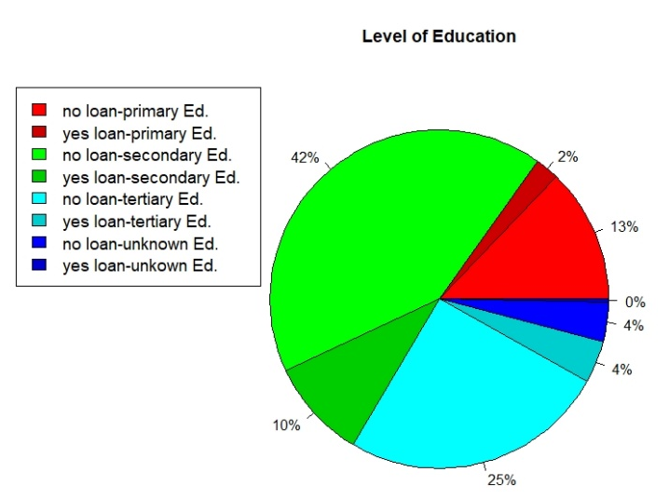
Input Data Relationship

Slide 9
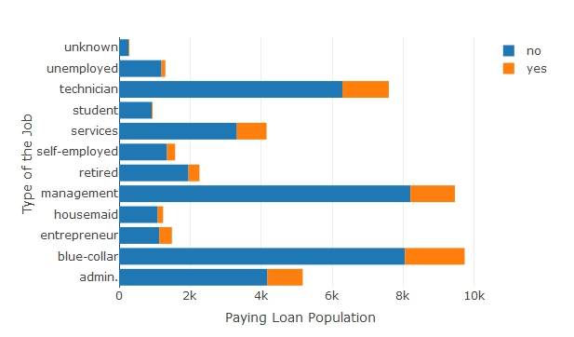
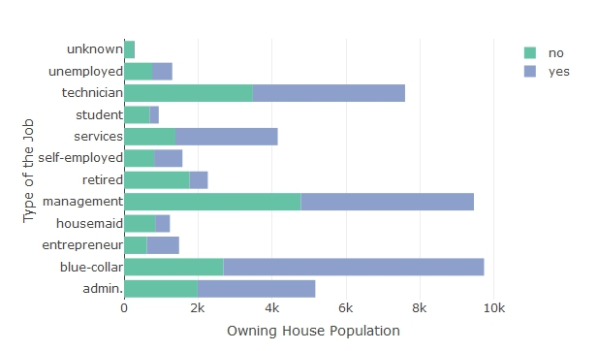
Input Data Relationship

Slide 10
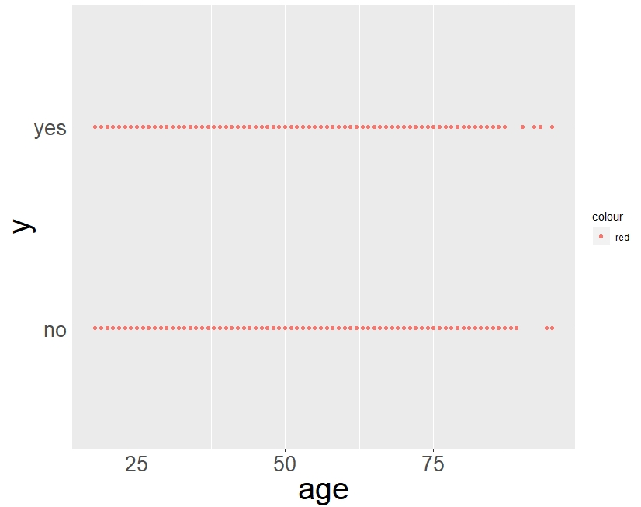
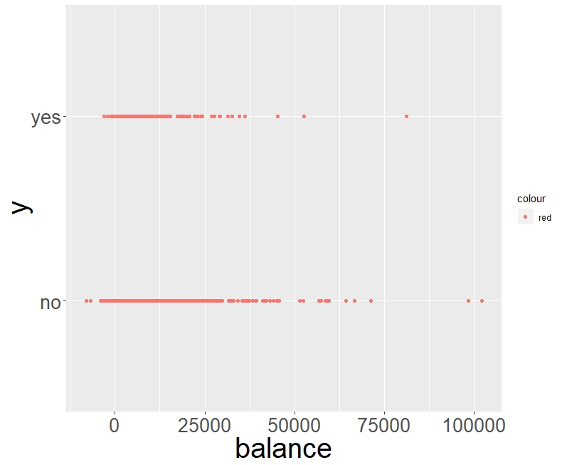
Outputs and Trends

Slide 11

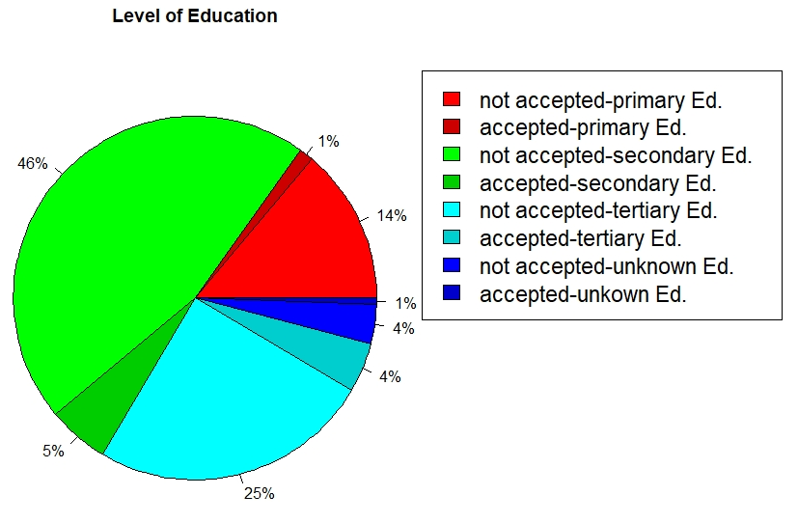
Outputs and Trends

Slide 12
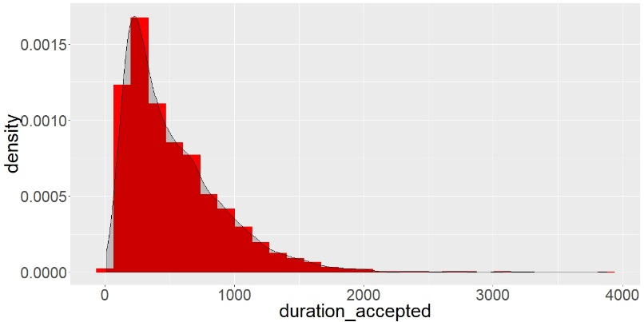
Outputs and Trends

Slide 13
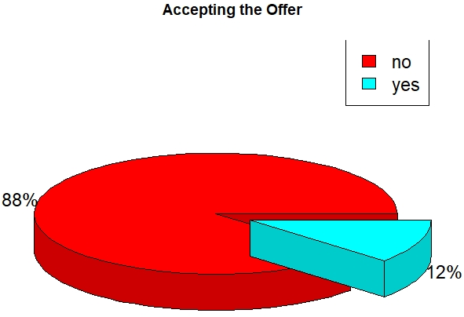
Outputs and Trends

Slide 14
Conclusion
In order to get the better results, higher education students with the average balance will more likely accept the offer with the average call duration of 537.29 second.

