Slide 1

FAKE NEWS DETECTION
Fatemeh Kiaie

Slide 2

Outline
Introduction to data set
Input data pre-processing and exploration
Models
Results
Conclusion

Slide 3
Outline
Introduction to data set
Input data pre-processing and exploration
Models
Results
Conclusion

Slide 4

Data Set Information and Goal
Fake News Detection Dataset

Slide 5
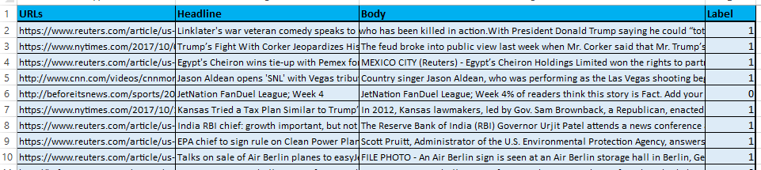
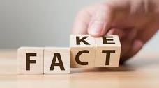
Data Set Information
Number of features: 4
Number of Records: 3352
Number of targets: 1

Slide 6
Outline
Introduction to data set
Data pre-processing and exploration
Classification models
Results
Conclusion

Slide 7
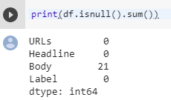
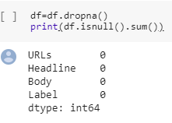
Data Pre-processing
Removing Missing Values
\
Removing Duplicate
Concatenating Headline and Body Columns

Slide 8
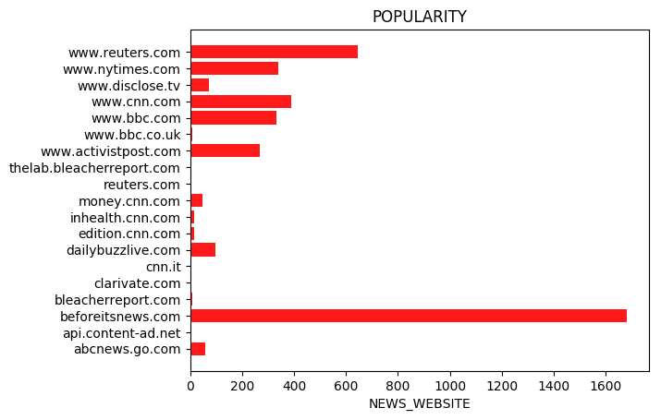
Data Exploration

Slide 9
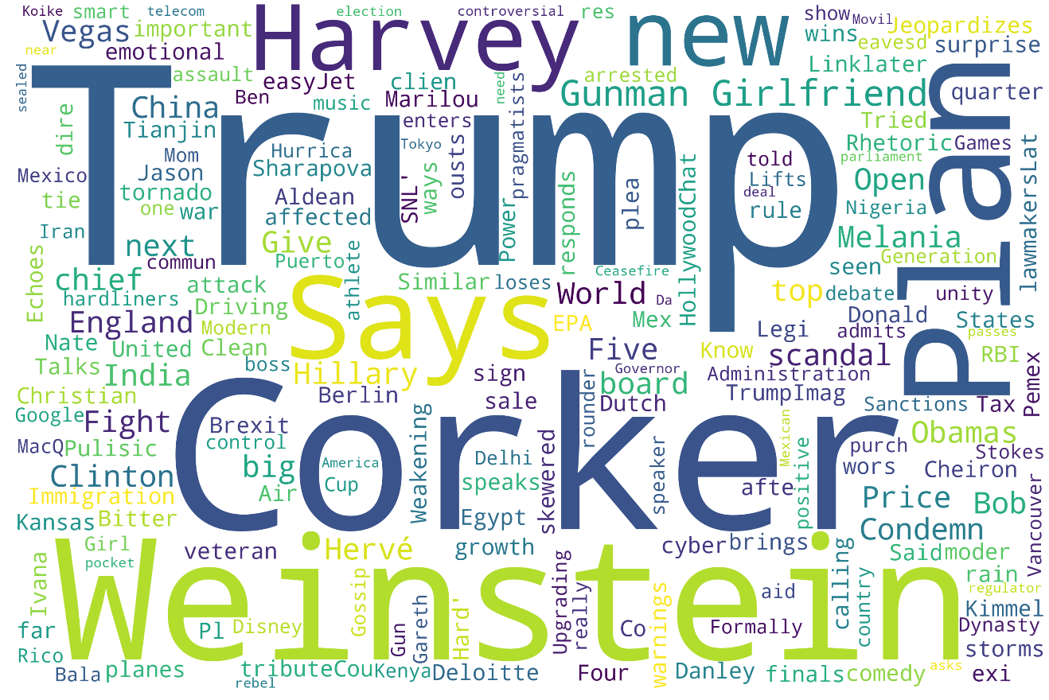
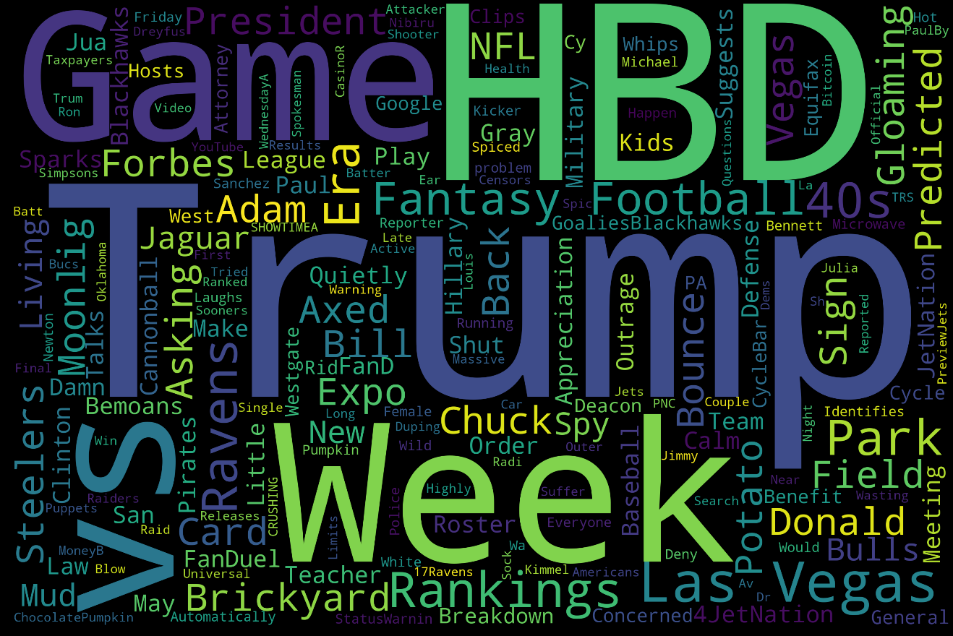
Data Exploration
FACT NEWS
FAKE NEWS

Slide 10
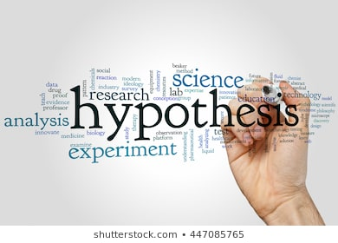
Hypothesis Generation
The words with uncertainty will be more frequent in the Fake news.

Slide 11
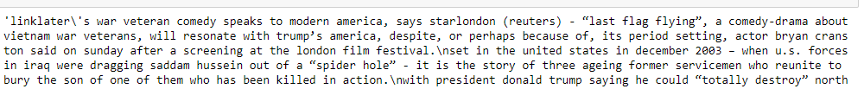

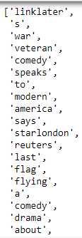
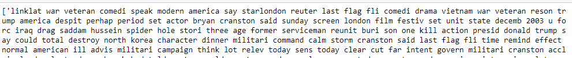
Input Pre-processing
Machine Learning
Text Lowerization
Remove Punctuation
Tokenization
Stemming and
lemmatize
Stop Word Removal
Deep Learning

Slide 12
Outline
Introduction to data set
Input data pre-processing and exploration
Models
Results
Conclusion

Slide 13
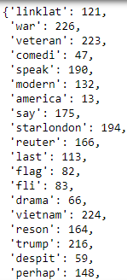
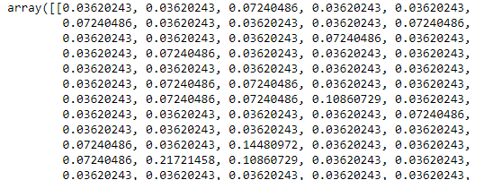
Classification Models – Machine Learning
TFI-DF
Logistic Regression
Random Forest
KNN

Slide 14
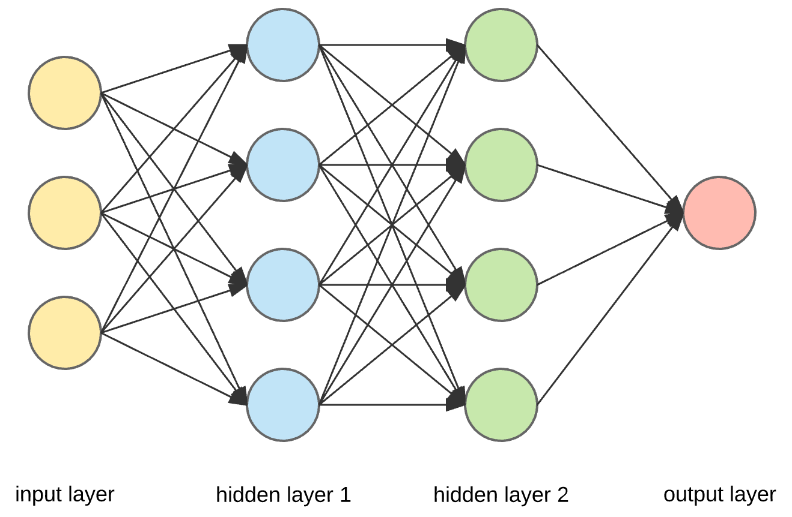
Classification Models – Deep Learning
Neural Network
RNN vs CNN
CNN will learn to recognize patterns across space.
CNN will learn to recognize components of an image (e.g., lines, curves, etc.) and then learn to combine these components to recognize larger structures (e.g., faces, objects, etc.).
RNN will similarly learn to recognize patterns across time.
So a RNN that is trained to translate text might learn that "dog" should be translated differently if preceded by the word "hot".
\

Slide 15
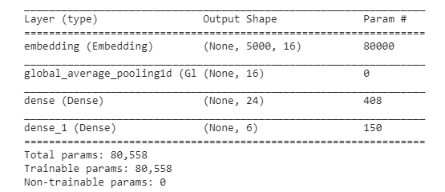
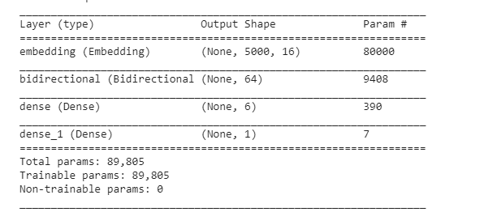
Classification Models – Deep Learning
\
RNN
GRU
Word Embedding
Example:
I was born in “Iran”, that’s why I can speak “Persian”.

Slide 16
Outline
Introduction to data set
Input data pre-processing and exploration
Models
Results
Conclusion

Slide 17
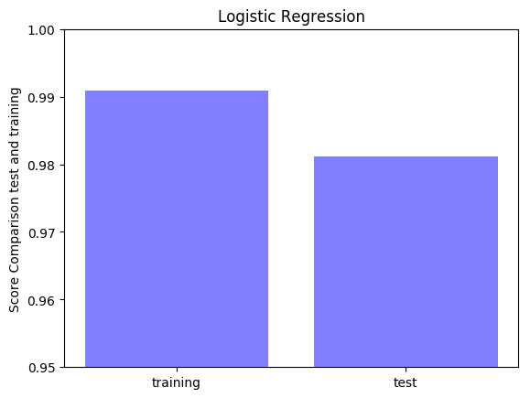
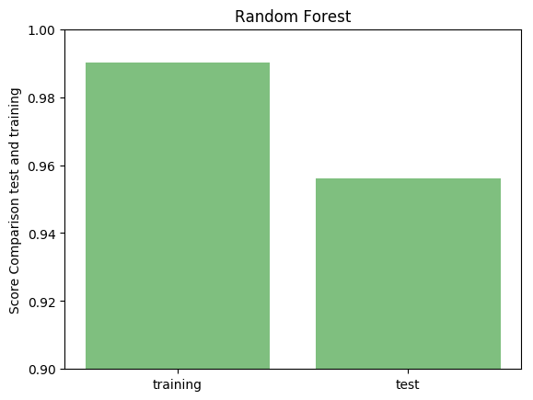
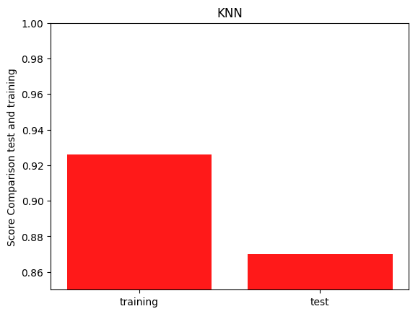
Results – Machine learning
Score: 0.981
Score: 0.952
Score: 0.874

Slide 18
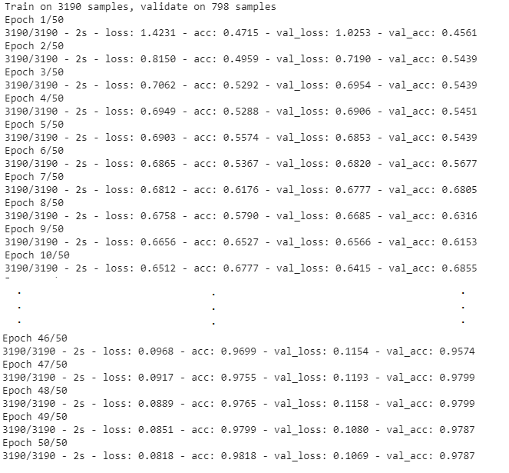
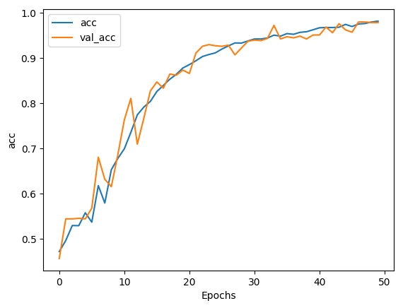
Results – Deep Learning (RNN)
Accuracy over the Epochs

Slide 19
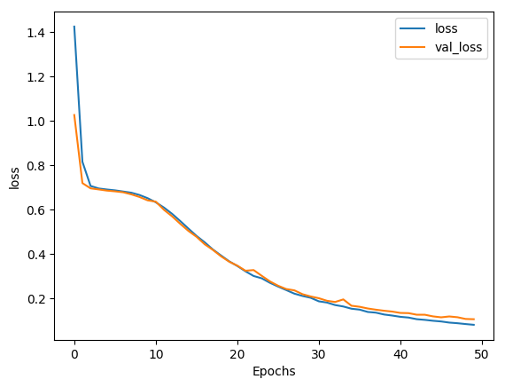
Results – Deep Learning (RNN)
Loss over the Epochs

Slide 20
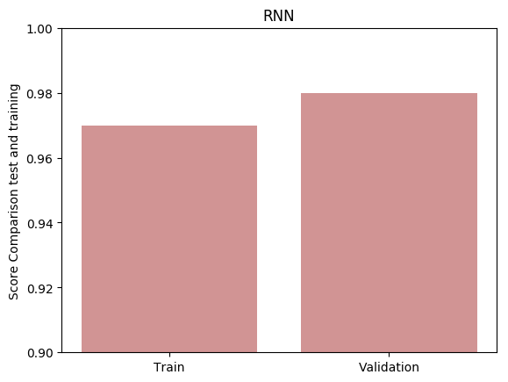
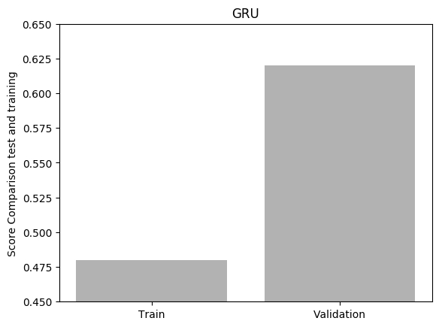
Results – Deep Learning
Score: 0.979
Score: 0.624

Slide 21
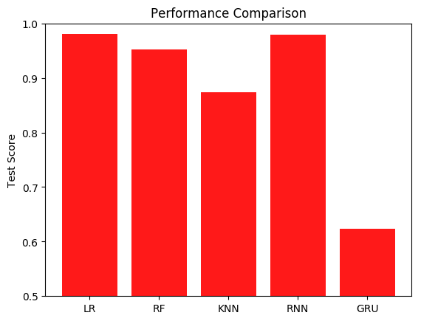
Results

Slide 22
Outline
Introduction to data set
Input data pre-processing and exploration
Models
Results
Conclusion

Slide 23
CONCLUSION
Machine learning algorithms are performing pretty good as RNN does,
Best learning method is not necessary the most complicated,
The over fitting is negligible; however, in general it is higher in RF,
More Epoch is required to get better results in GRU.

