Slide 1

Fatemeh Kiaie

Slide 2
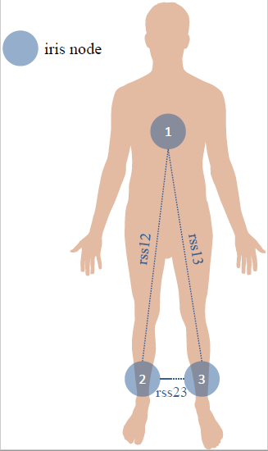
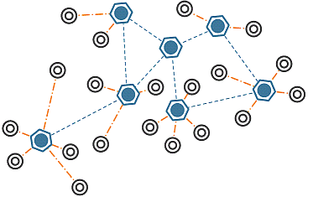
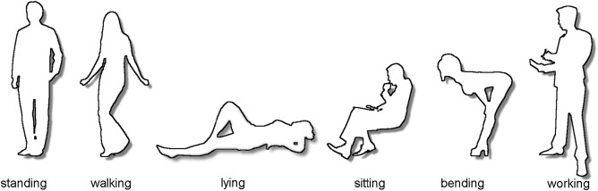
Data Set
UCI AReM Dataset

Slide 3
Data Set Description
Number of Attributes: 8
[time', 'avg_rss12', 'var_rss12', 'avg_rss13', 'var_rss13', 'avg_rss23', 'var_rss23', 'detected_activity'],
Number of Rows: 42239

Slide 4
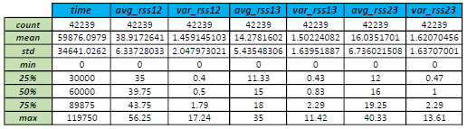
Data Set Description

Slide 5
Data Preprocessing
- Removing Unnecessary Columns:
‘time’
Missing value handling
No missing value
avg_rss12 | 0
var_rss12 | 0
avg_rss13 | 0
var_rss13 | 0
avg_rss23 | 0
var_rss23 | 0
detected_activity | 0

Slide 6
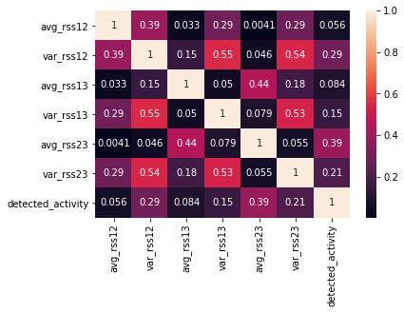
Data Preprocessing
- Correlation Analysis:
Chi2 test result:
Avg_rss12 is correlated at significant level 0.05
Var_rss12 is correlated at significant level 0.05
Avg_rss13 is correlated at significant level 0.05
Var_rss13 is correlated at significant level 0.05
Avg_rss23 is correlated at significant level 0.05
Var_rss23 is correlated at significant level 0.05

Slide 7
Data Preprocessing
Encoding Categorical Data
‘’detected_activity'
Target and input separation
“detected_activity” is the target and the rest are the inputs
Scaling and Normalization
No need for scaling

Slide 8

Data Preprocessing
RFE
Only “var_rss23” remained as the dominant feature
Selected Ranking is: [5 2 4 3 1]

Slide 9
Training the model
Split the data and train the model using the linear regression model

Slide 10
Performance Evaluation
Accuracy Score
0.9318181818181818
Confusion Matrix
[[ 852 0 0 0 0 0 0]
[ 0 0 720 0 0 0 0]
[ 0 0 1822 0 0 0 0]
[ 0 0 0 1751 0 0 0]
[ 0 0 0 0 1762 0 0]
[ 0 0 0 0 0 1906 0]
[ 0 0 0 0 0 0 1747]]

Slide 11
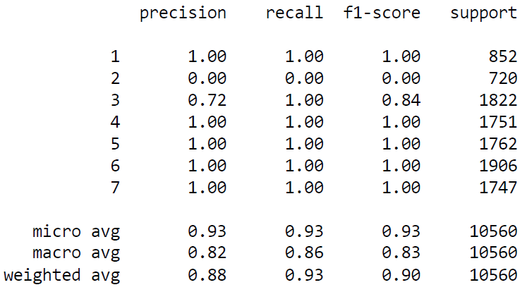
Performance Evaluation

Slide 12
Performance Evaluation without Elimination
Accuracy Score
0.881534090909091
Confusion Matrix
[[ 840, 4, 8, 0, 0, 0, 0],
[ 1, 303, 174, 160, 82, 0, 0],
[ 0, 1, 1716, 24, 81, 0, 0],
[ 0, 0, 19, 1621, 111, 0, 0],
[ 0, 0, 60, 225, 1416, 61, 0],
[ 0, 0, 0, 15, 75, 1741, 75],
[ 0, 0, 0, 0, 0, 75, 1672]

Slide 13
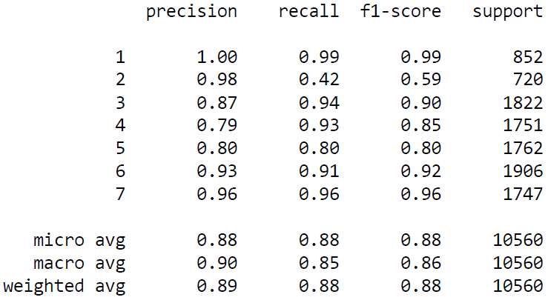
Performance Evaluation Without Elimination

Slide 14
Performance Improvement
4-folds modeling
Maximum Score: 0.9335227272727272
Best Model intercept: [ 13.09003088, 0.73509311, 0.70465072, -0.8417617 , -2.50141104, -5.5760216 , -38.81091931]
Best Model Coefficient:
[[-8.838609 ],
[-1.0523147 ],
[-0.59081606],
[-0.17374003],
[ 0.19798333],
[ 0.76869241],
[ 5.98287748]]]

Slide 15
Conclusion
IN Logistic Regression model features elimination improved the model score by about 6% and 4fold improved the model score by about 0.1%

