Slide 1

Fatemeh Kiaie

Slide 2
Outline
Introduction to data set
Input data pre-processing
Classification models
Results
Conclusion

Slide 3
Outline
Introduction to data set
Input data pre-processing
Classification models
Results
Conclusion

Slide 4
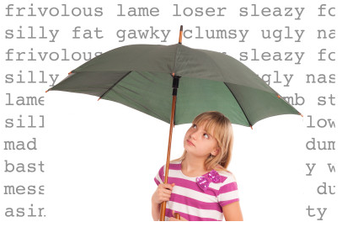
Data Set Information and Goal
Toxic Comments Dataset

Slide 5
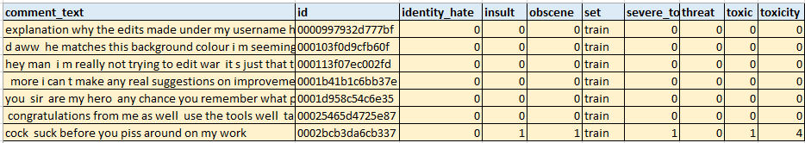

Data Set Information and Goal
Number of features: 10
Number of entities: 3
Number of targets: 6 Multi-Label Classification
Number of Records: 159572

Slide 6
Outline
Introduction to data set
Input data pre-processing
Classification models
Results
Conclusion

Slide 7
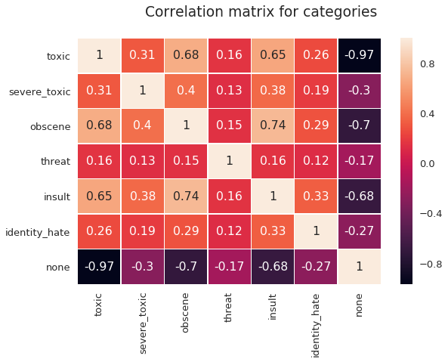
Input Pre-processing
Removing unnecessary columns: id and set
Correlation among rest
\

Slide 8
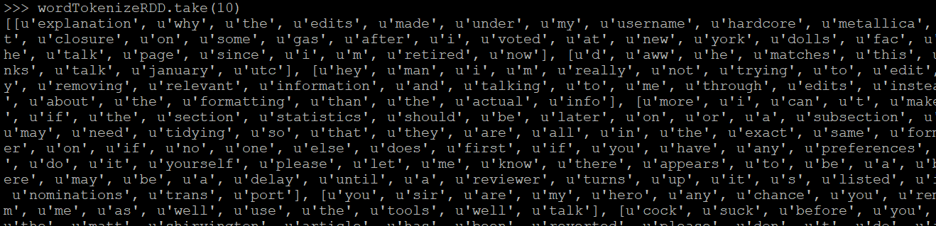
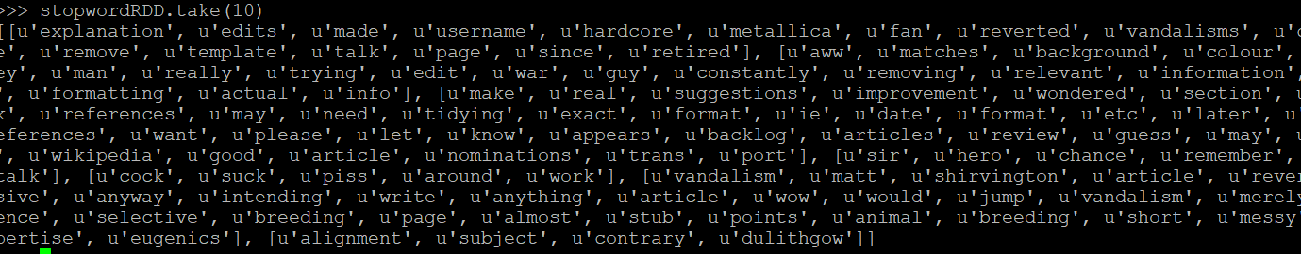
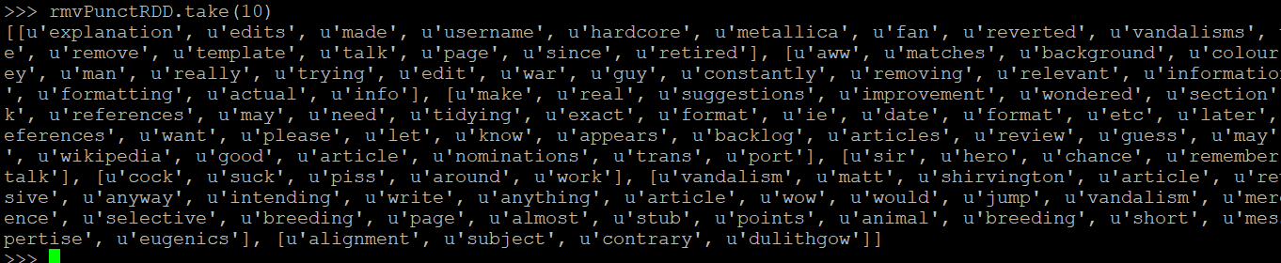
Input Pre-processing
Text Lowerization
Tokenization
Stop Words Removal
Punctuation Removal
Leminization
TF-IDF

Slide 9
Outline
Introduction to data set
Input data pre-processing
Classification models
Results
Conclusion

Slide 10
Classification Models
Logistic Regression Multi-Label (target) Classification
Decision Tree Multi-label (targets) Classification
max_Depth = 2
\

Slide 11
Outline
Introduction to data set
Input data pre-processing
Classification models
Results
Conclusion

Slide 12
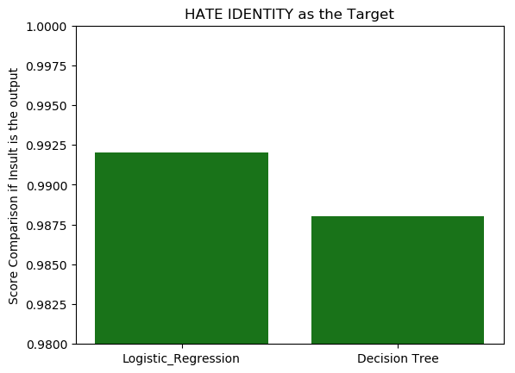
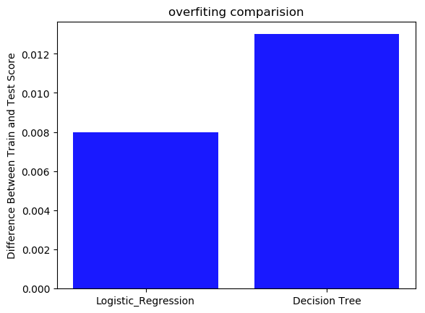
Results – HATE IDENTITY As Target
Confusion Matrix for LR
([[ 2475., 17.] [ 23., 0.]])

Slide 13
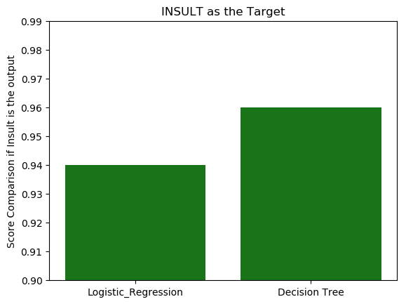
Results – Insult As Target
Confusion Matrix for DT
([[ 2340., 14.] [ 98., 65.]])

Slide 14
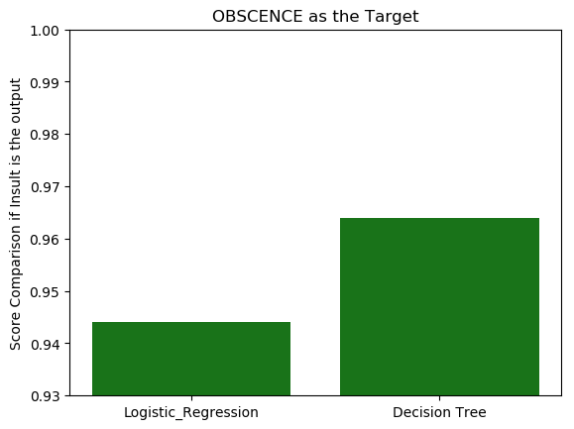
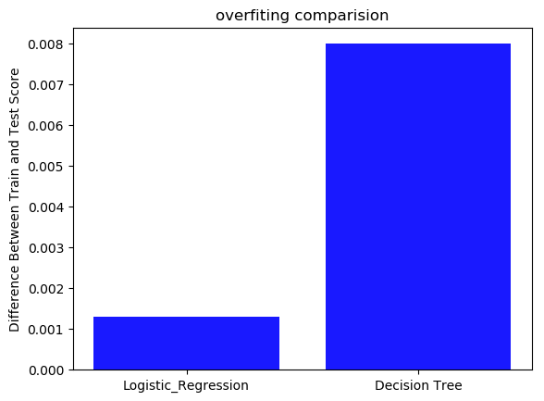
Results – OBSCENCE As Target
Confusion Matrix for DT
([[ 2356., 19.] [ 85., 64.]])

Slide 15
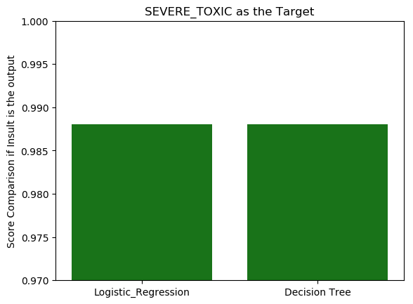
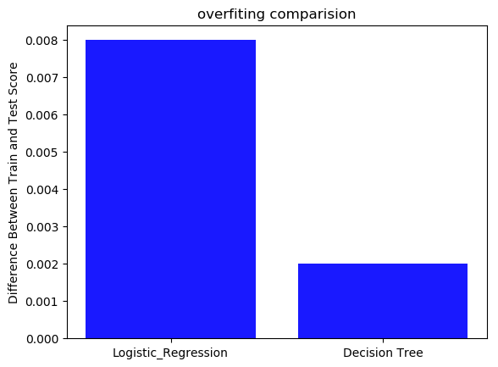
Results – SEVERE TOXIC As Target
Confusion Matrix for DT
([[ 2457., 24.] [ 15., 29.]])

Slide 16
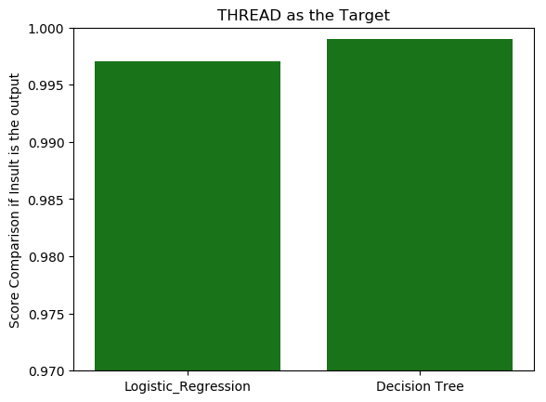
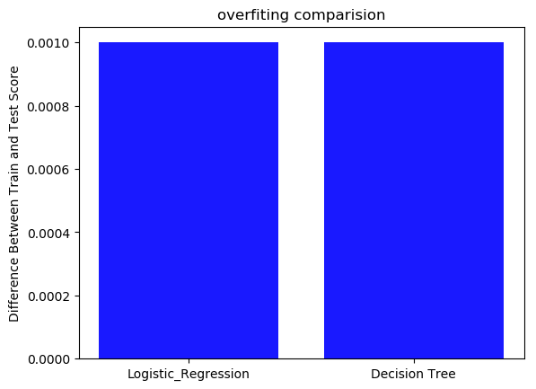
Results – THREAD As Target
Confusion Matrix for DT
([[ 2499., 13.] [ 5., 6.]])

Slide 17
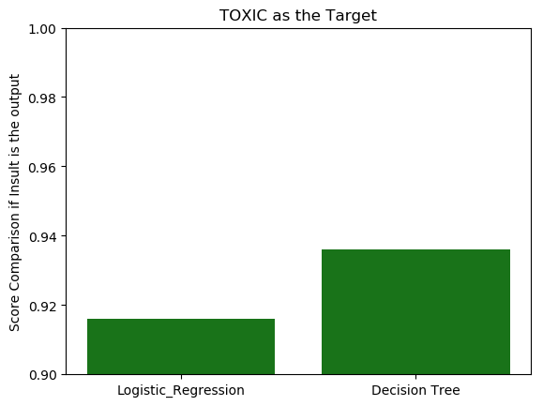
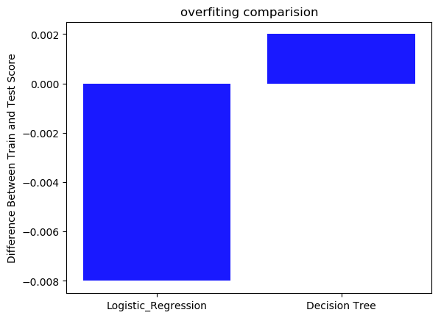
Results – TOXIC As Target
Confusion Matrix for DT
([[ 2265., 17.] [ 154., 85.]])

Slide 18
CONCLUSION
Both algorithms are performing pretty good and decision tree performs a little better compare with Logistic Regression
Models are performing best in detecting THREAT as it is easy to label in the dataset
The overshooting is negligible; however, in general it is higher in DT

