Slide 1

Student: Fatemeh Kiaie

Slide 2
Outline
Introduction
Cleaning and Exception Report
EDA
Feature Engineering
Modeling and Results
Conclusion

Slide 3
Outline
Introduction
Cleaning and Exception Report
EDA
Feature Engineering
Modeling and Results
Conclusion

Slide 4

Introduction
Data set information
Physical information including:
x, y, z, depth, table
Color
Clarity
Carat
Goal

Slide 5
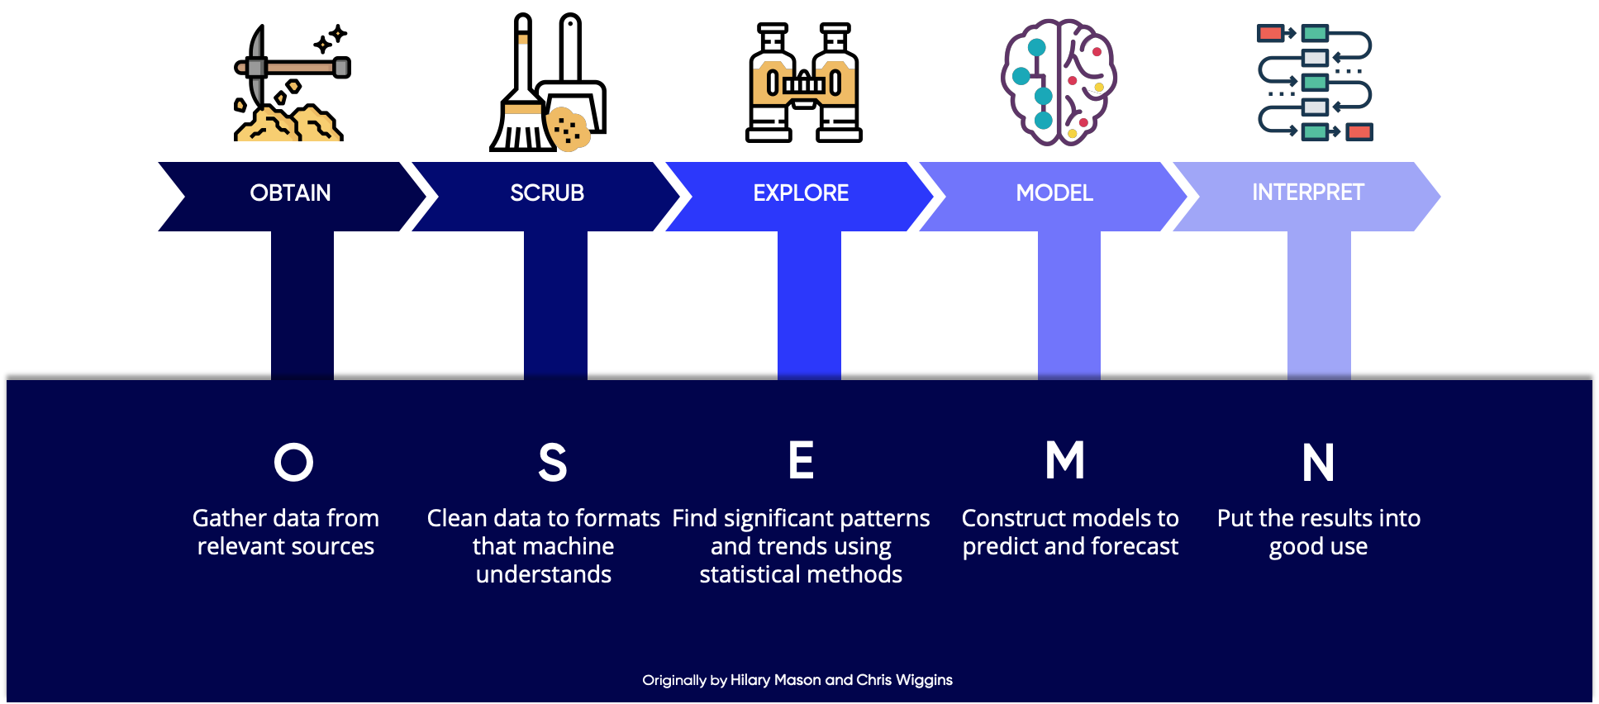

Introduction – Data Science Process FLOW

Slide 6
Outline
Introduction
Cleaning and Exception Report
EDA
Feature Engineering
Modeling and Results
Conclusion

Slide 7



Introduction – Cleaning Data
Zero missing
289 duplicate records
20 invalid records ({x or y or z} = 0)

Slide 8
Outline
Introduction
Cleaning and Exception Report
EDA
Feature Engineering
Modeling and Results
Conclusion

Slide 9
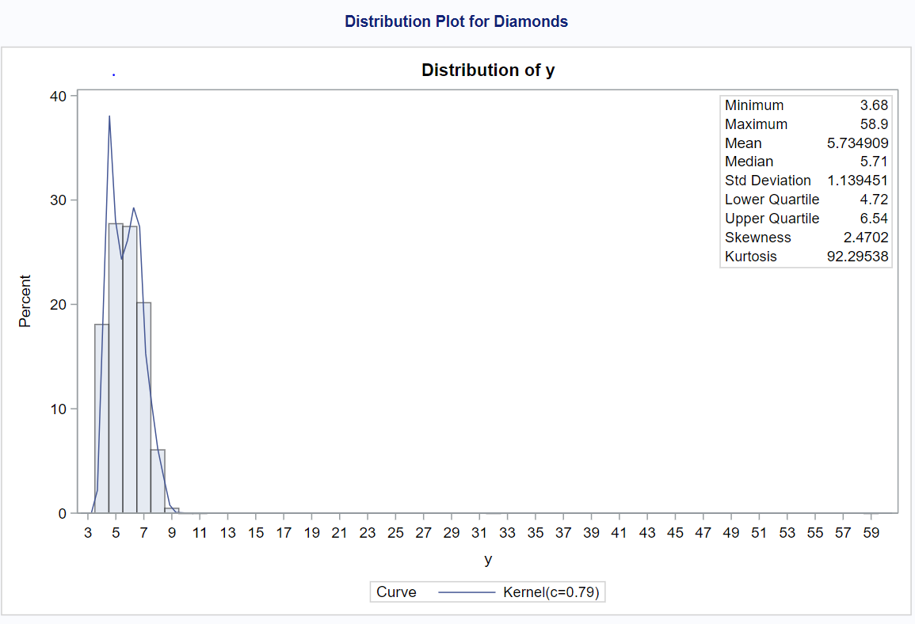
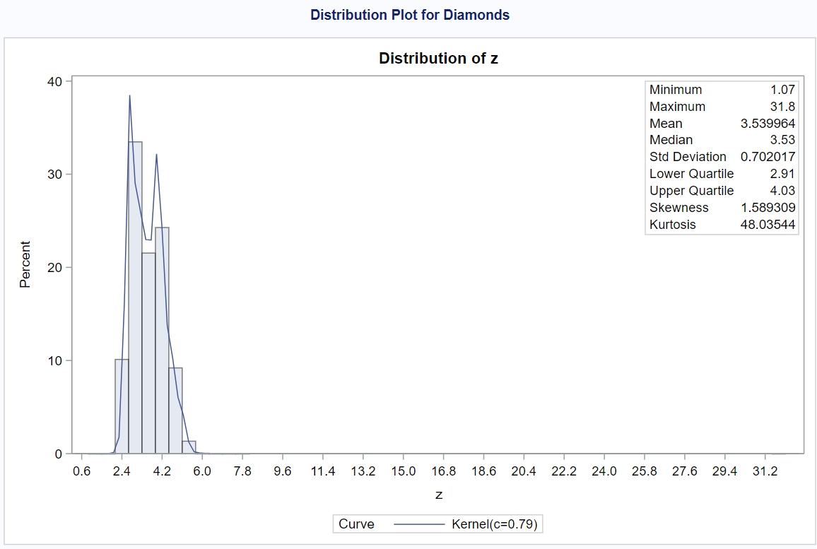
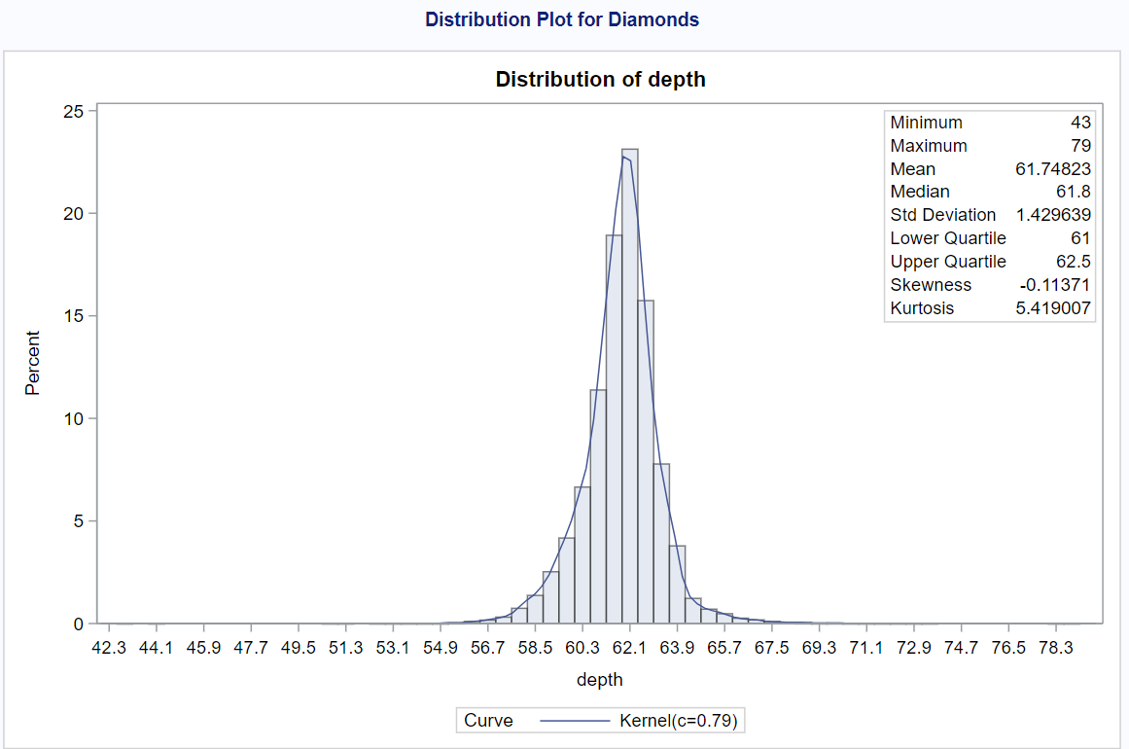
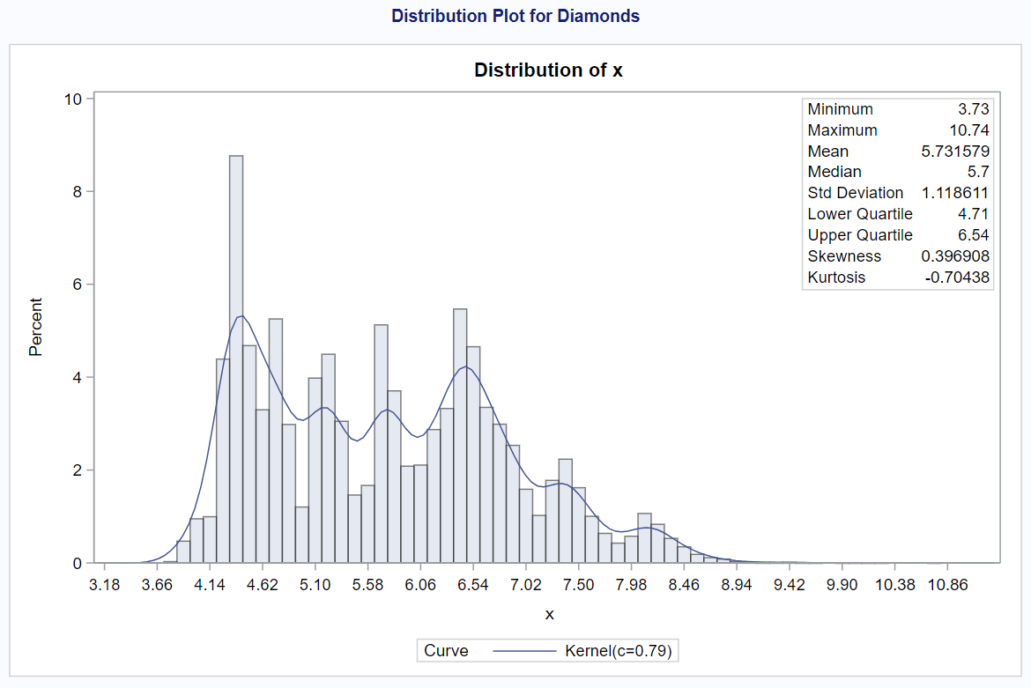
EDA – Features Individually
X
Mean= 5.731
Y
Mean= 5.734
Z
Mean= 3.539
Depth
Mean= 61.74
Y, Z and Depth are following the normal distribution

Slide 10
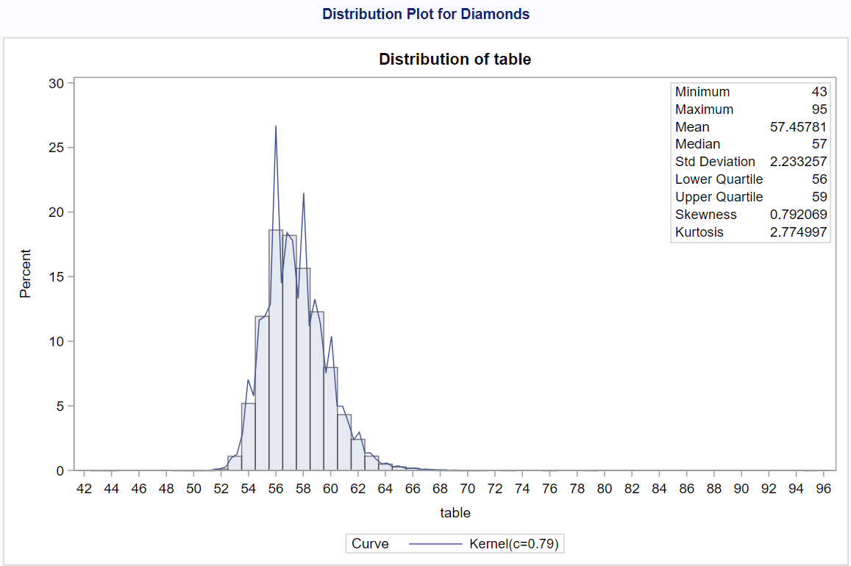
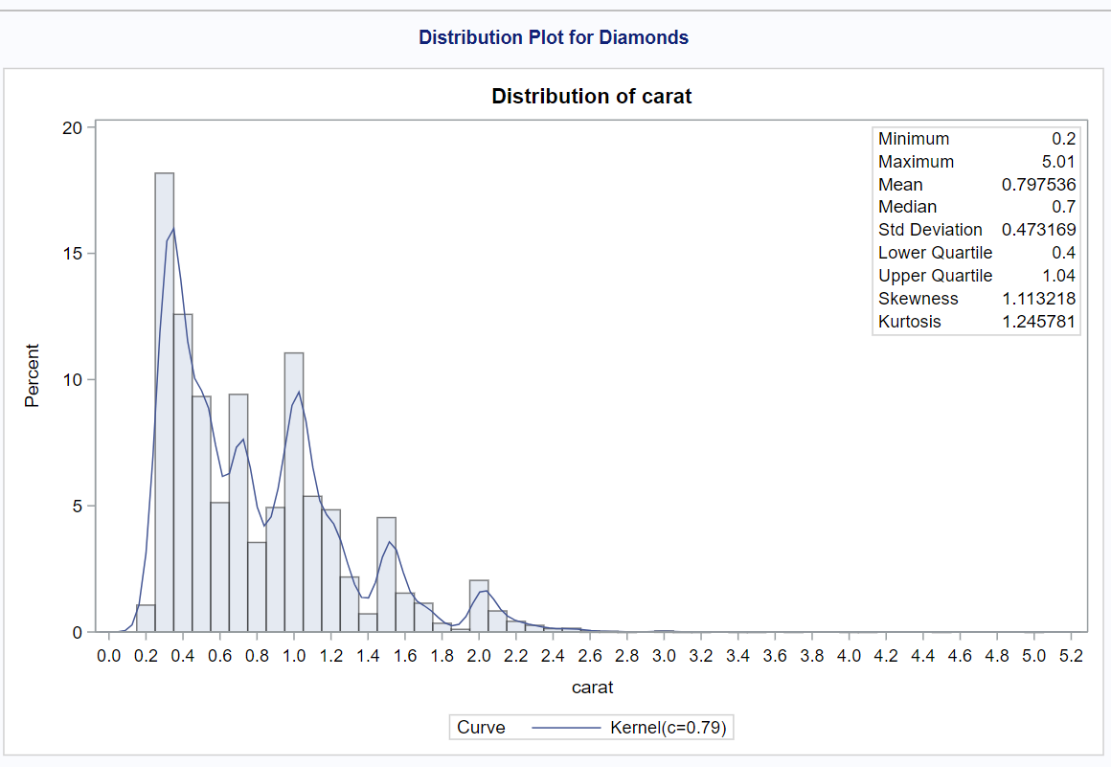
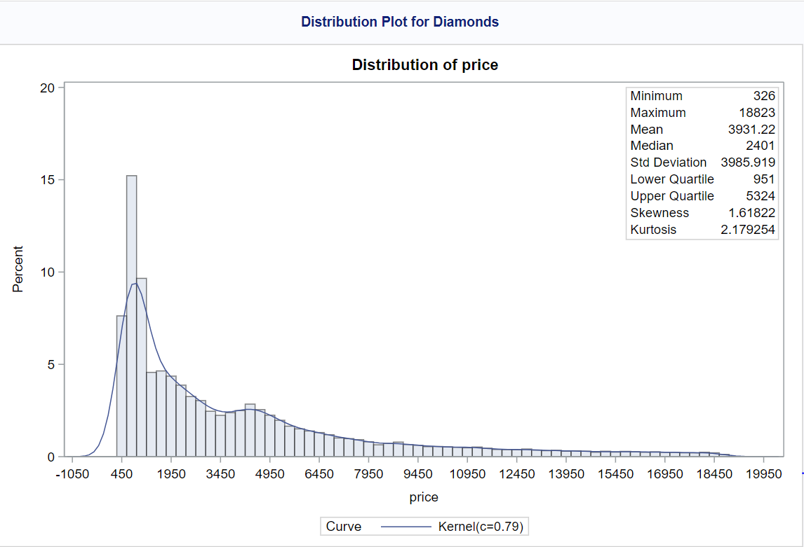
EDA – Features Individually
Table
Mean= 57.45
Carat
Mean= 0.79
Price
Mean= 3931.22
Table is following the normal distribution
Price is right skewed graph not normal, can be transformed to normal

Slide 11
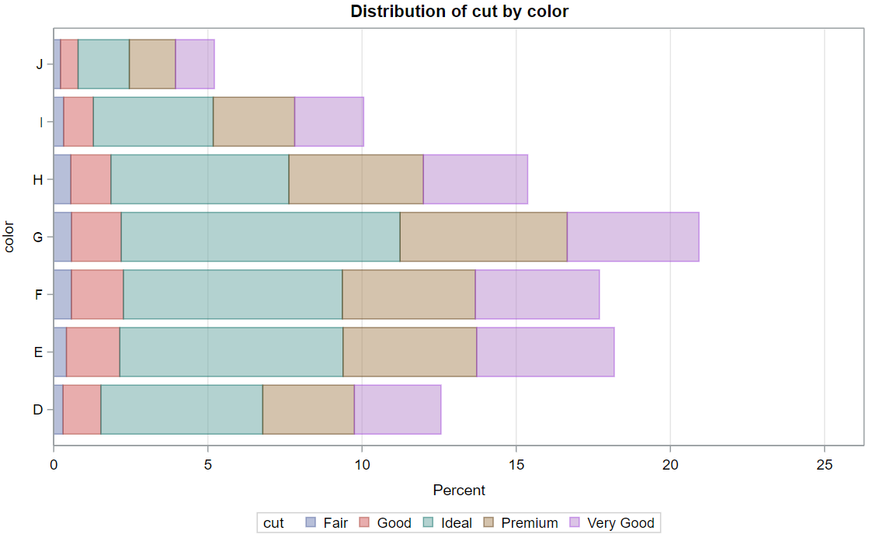
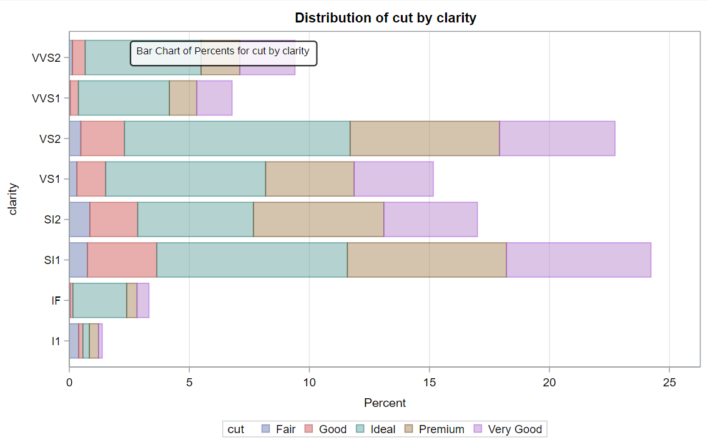
EDA - Categorical Features
Ideal cut with G color and VS2 clarity have maximum distribution

Slide 12
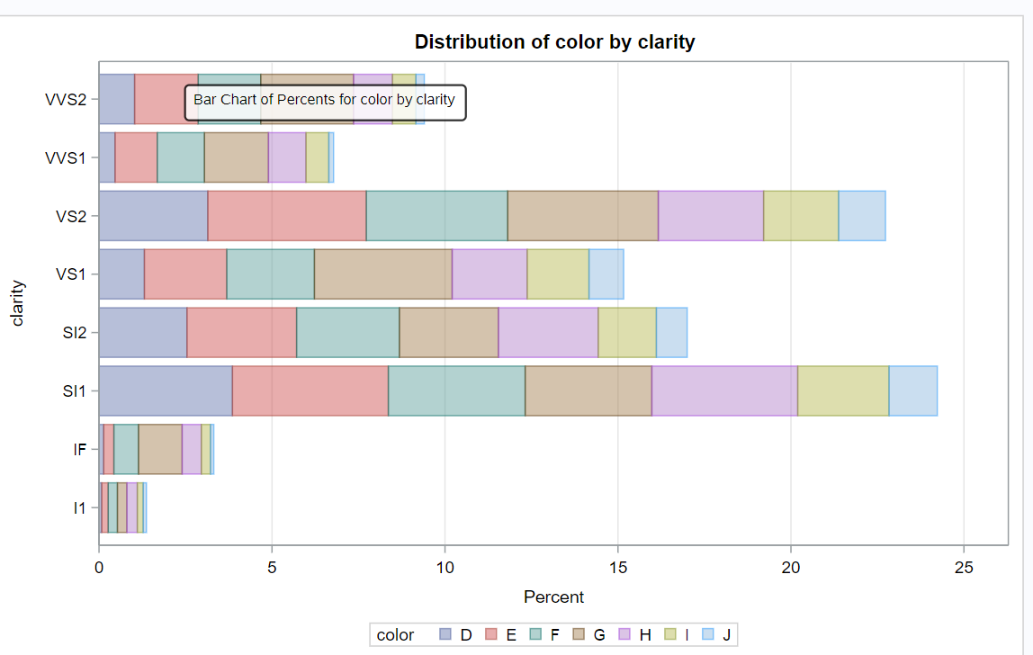
EDA - Categorical Features
Distribution is more uniform when it comes to color and clarity

Slide 13
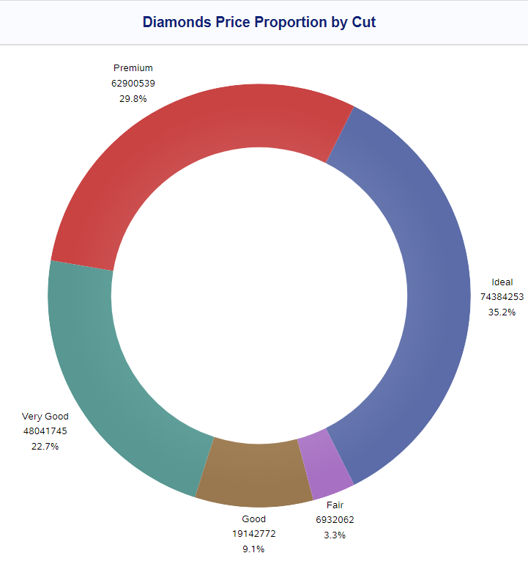
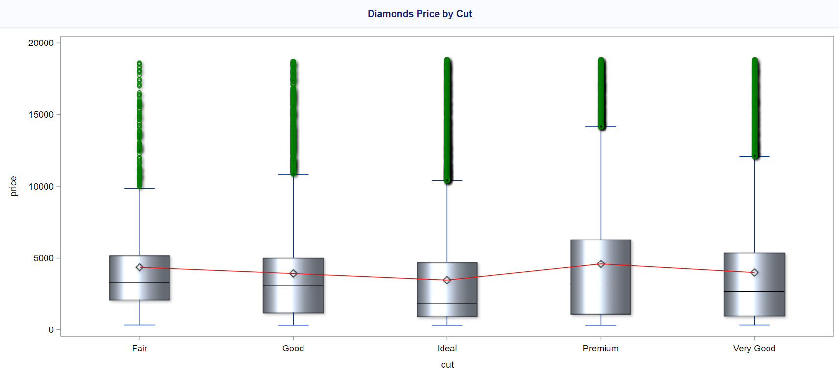
EDA – Numerical and Categorical Features
Ideal cut is more affordable and therefore more popular
Premium cut is expensive and therefore brings more price

Slide 14
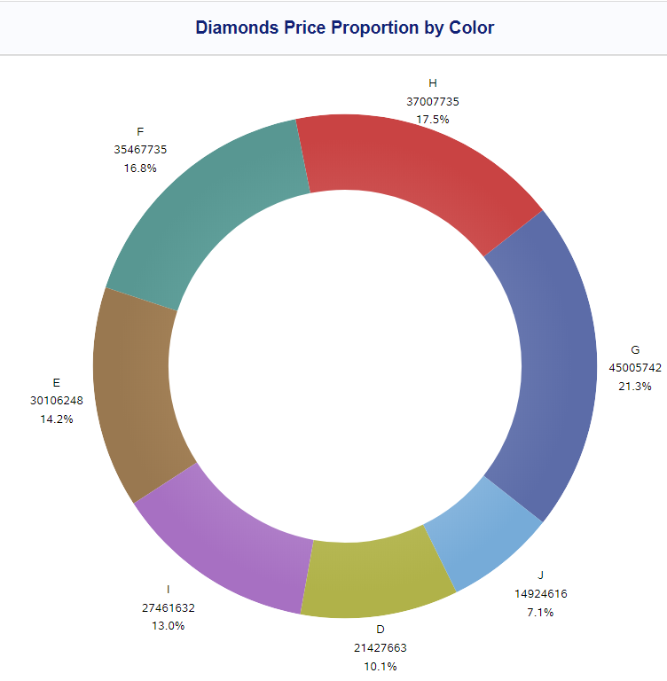
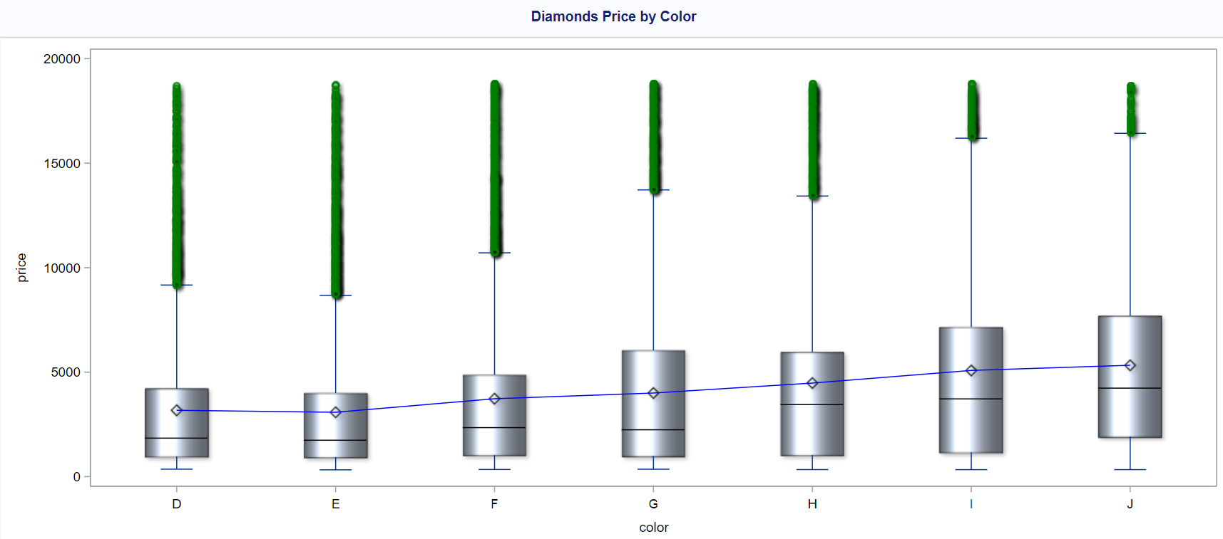
EDA – Numerical and Categorical Features
G, E, F, H color has affordable price and therefore more popular
J is not a favorable color, and not worth it for its high price

Slide 15
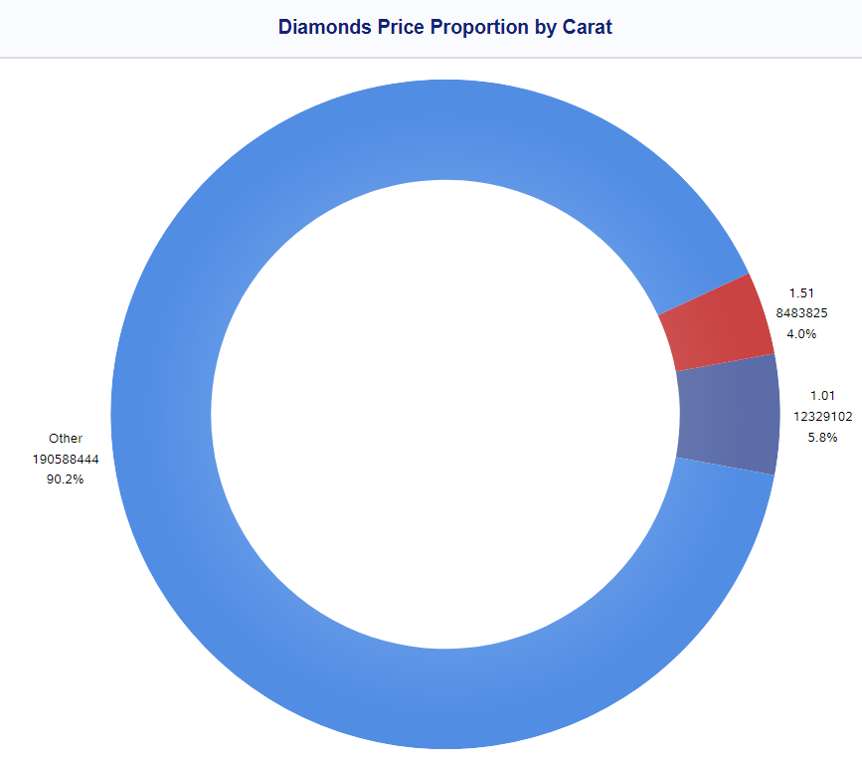
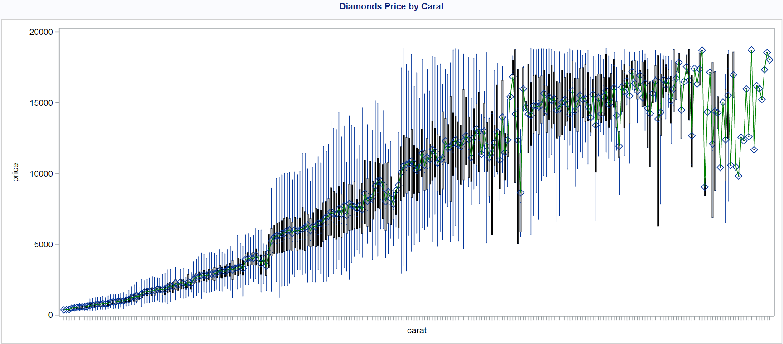
EDA – Numerical and Categorical Features
The varieties of carat price is huge. It can be considered a continues variable
The carat value of 1.01 and 1.51 are the most popular (standard carat)

Slide 16
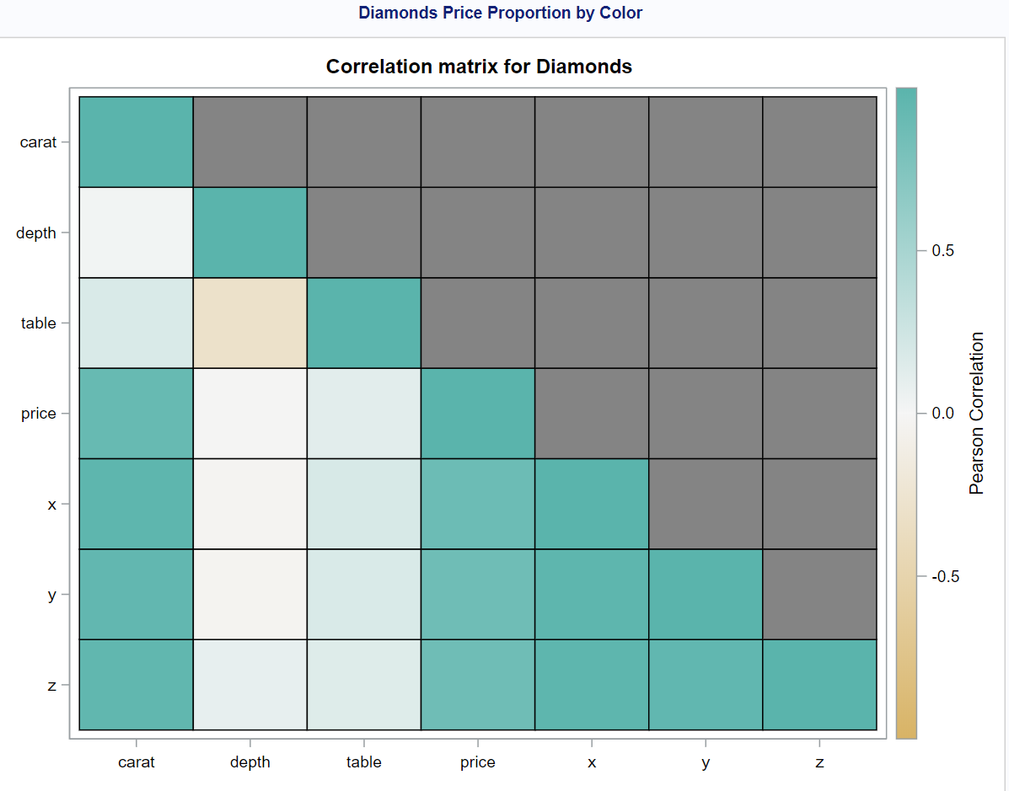
EDA – Numerical FEATURES
High correlation between price and x, y, z, carat.
Low correlation between price and depth, table

Slide 17
Outline
Introduction
Cleaning and Exception Report
EDA
Feature Engineering
Modeling and Results
Conclusion

Slide 18
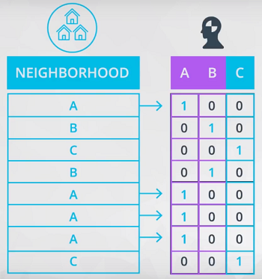
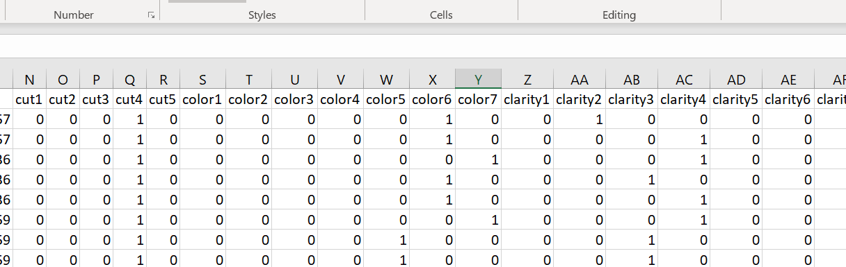
Feature Engineering and Dummy variables
Cut
Color
Clarity

Slide 19
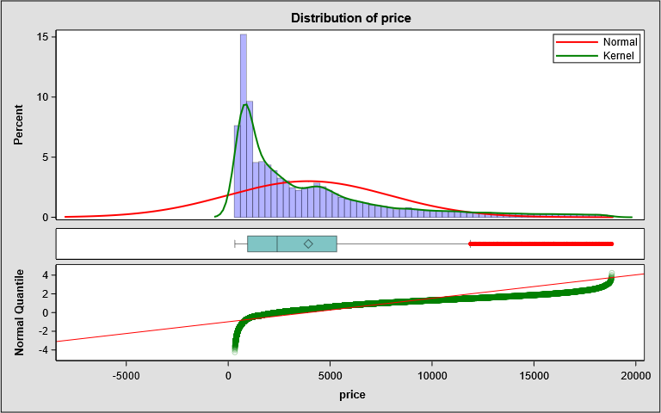
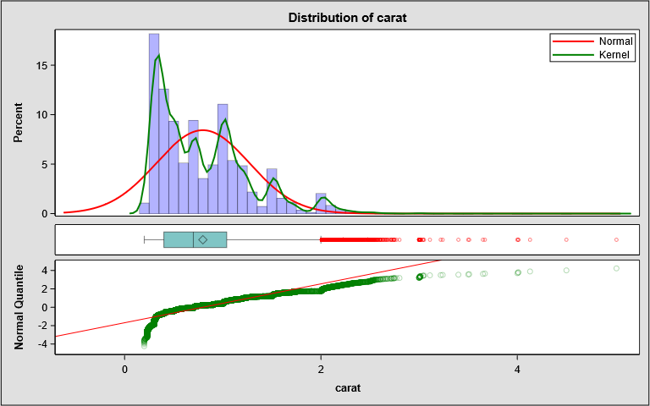
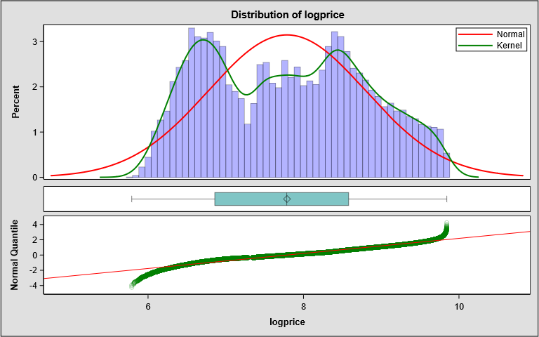
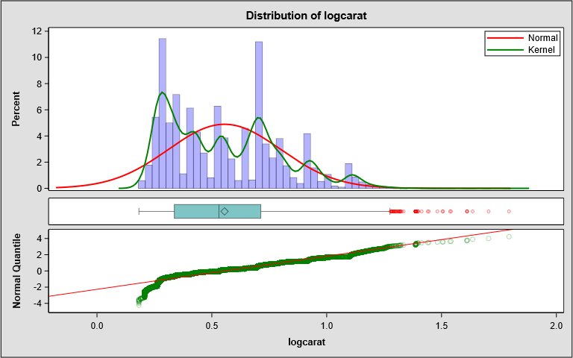
Feature Engineering and Normalization

Slide 20
Outline
Introduction
Cleaning and Exception Report
EDA
Feature Engineering
Modeling and Results
Conclusion

Slide 21
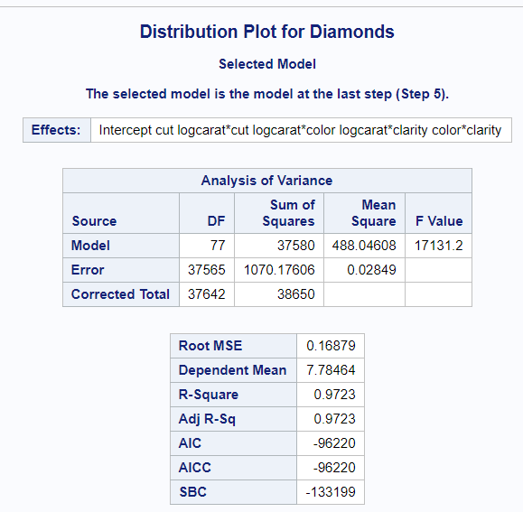

Model and training the machine
ModelC=logcarat|cut|color|clarity

Slide 22
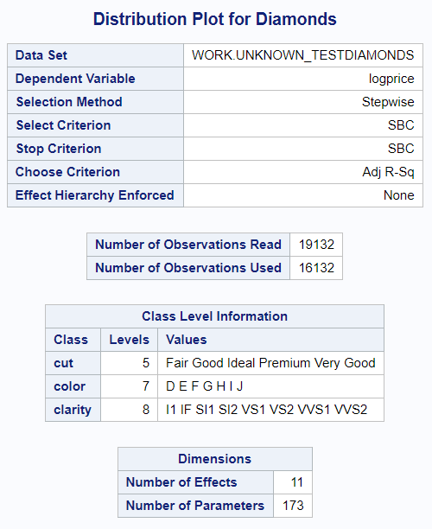
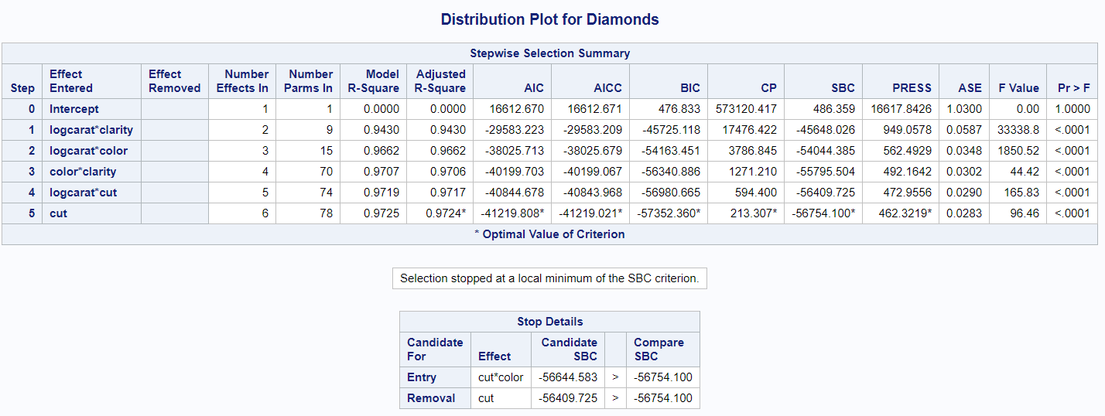
Model Evaluation and Results

Slide 23
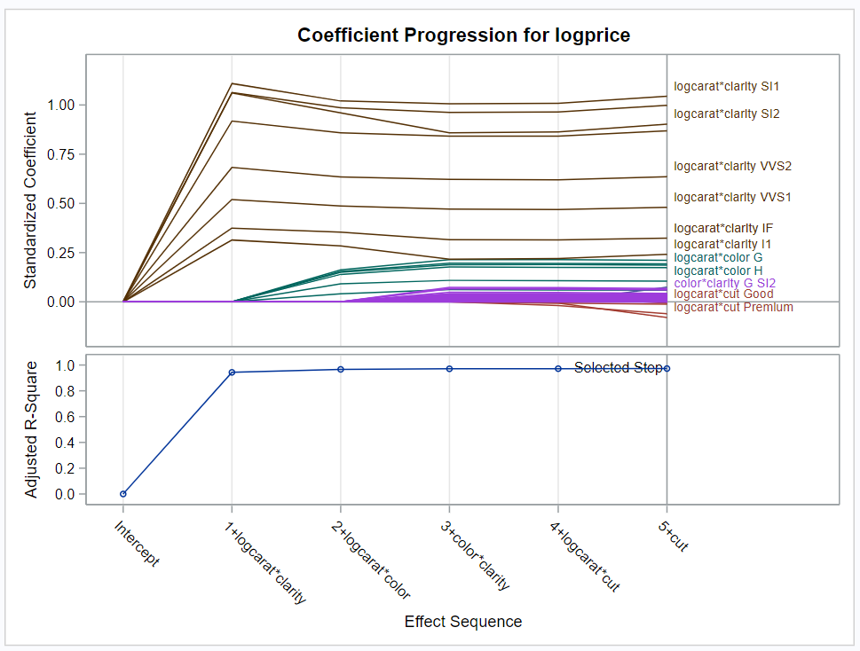
Model Evaluation and Results

Slide 24
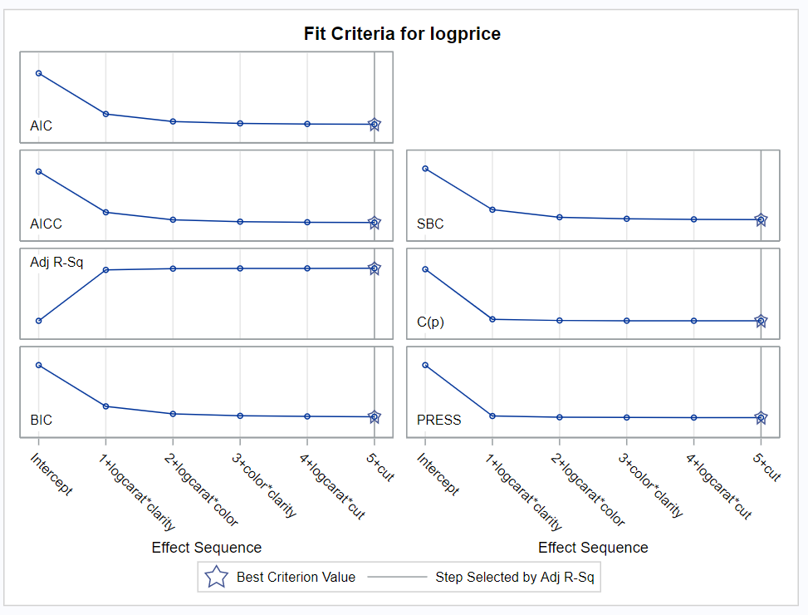
Model Evaluation and Results

Slide 25
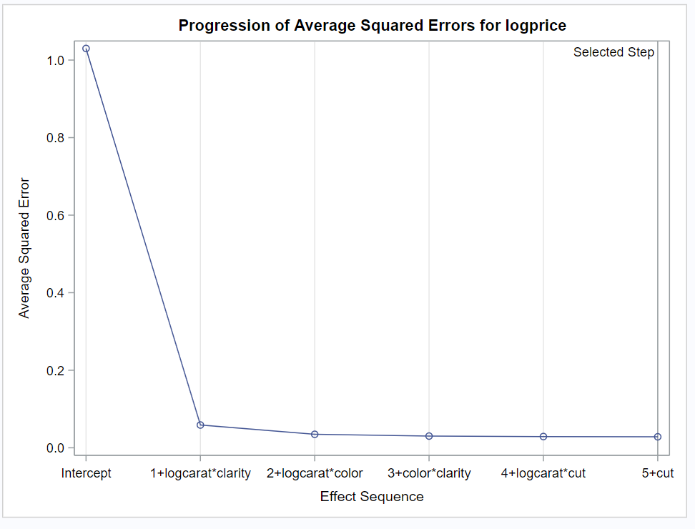
Model Evaluation and Results

Slide 26
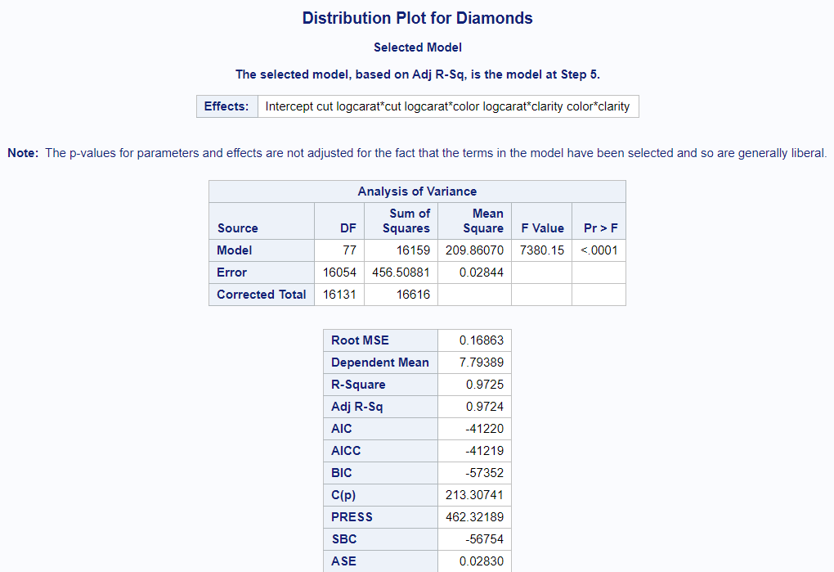
Model Evaluation and Results

Slide 27
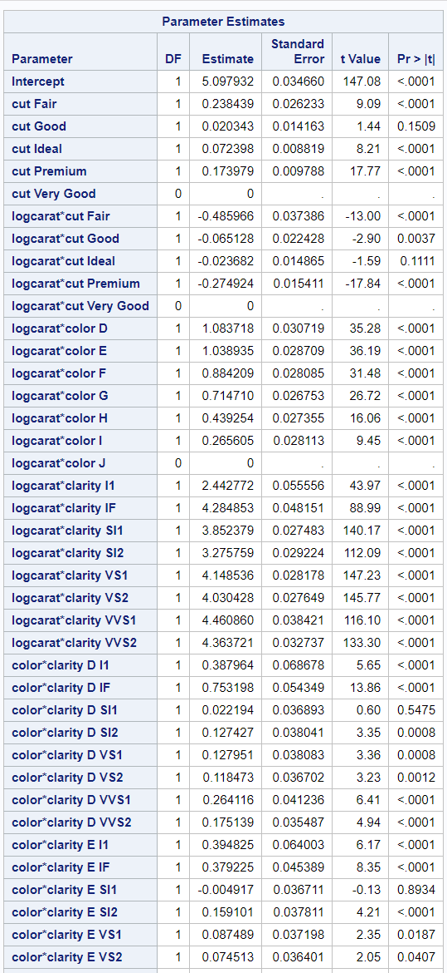
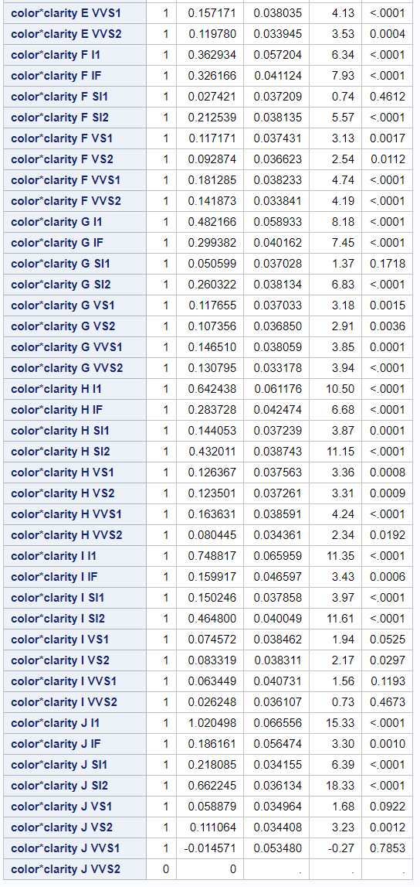
Model Evaluation and Results

Slide 28
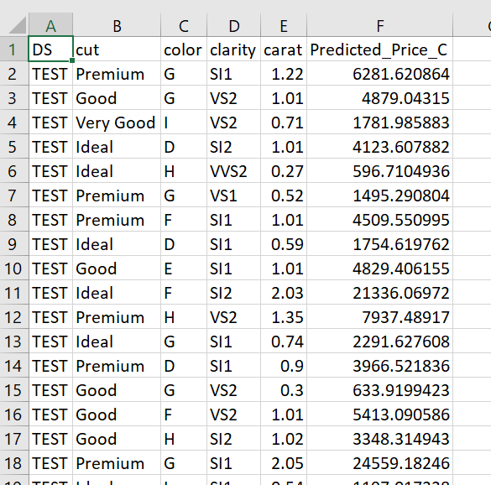



Results-predicted price for test dataset

Slide 29
Outline
Introduction
Cleaning and Exception Report
EDA
Feature Engineering
Modeling and Results
Conclusion

Slide 30
Conclusion
With SAS using Proc GLMSELECT and Proc Log and following Data Science Process Flow we can predict the price of diamond with the accuracy above 97.5% .
If you were interested in a 1.5 carat diamond with a Very Good cut and a VS2 clarity rating, how much would the model predict you should pay for it?
Logprice = 5.114068879 + 4.348410395 * logcarat + 0 * cut (very good) + 0.133169096 * clarity(VS2)
Logprice = 5.114068879 + 4.348410395 * log(1.5) + 0 * 1 + 0.133169096 * 1
Price = 10,214.34
What price do you recommend the jewelry company to bid?
Total predicted price for 3000 diamonds is 12,261,458.95
I recommend that the bid price should be 8,583,021.26

Slide 31
Conclusion
What strikes you about this comparison? After seeing this plot, do you feel confident in the model’s ability to predict prices?
Predicted prices are distributed linearly but old diamond prices are non-linear.
According to the model, if a diamond is 1 carat heavier than another with the same cut, how much more should I expect to pay? Why?
For 0.54 carat, D color, VS1 clarity and good cut we have e^(5.318127 + ln(.54+1)(-0.044844 + 0.871416 +
4.101698))-1 which comes out to $1712.11277234 and for a 1.54 carat we get e^(5.318127 + ln(1.54+1)(- 0.044844 + 0.871416 + 4.101698))-1 and it’ll be valued at $20171.6554478

Slide 32


