Slide 1
Finding Cheating Students
Introduction to information retrieval
Fatemeh Karimi

Slide 2
Project structure
Detecting answer similarities
Calculating person similarities
Detecting cheats
Displaying results

Slide 3
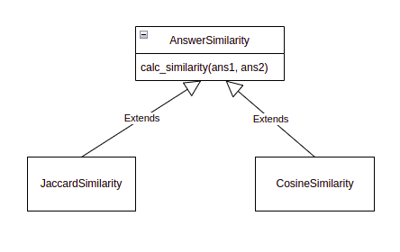
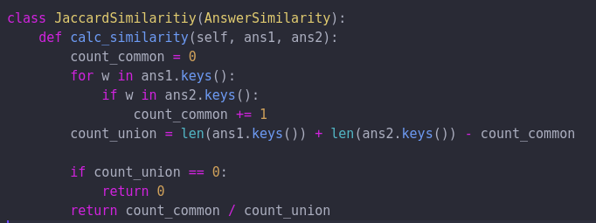
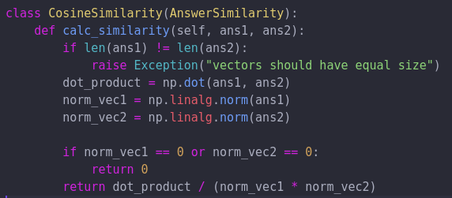
Detecting answer similarities

Slide 4
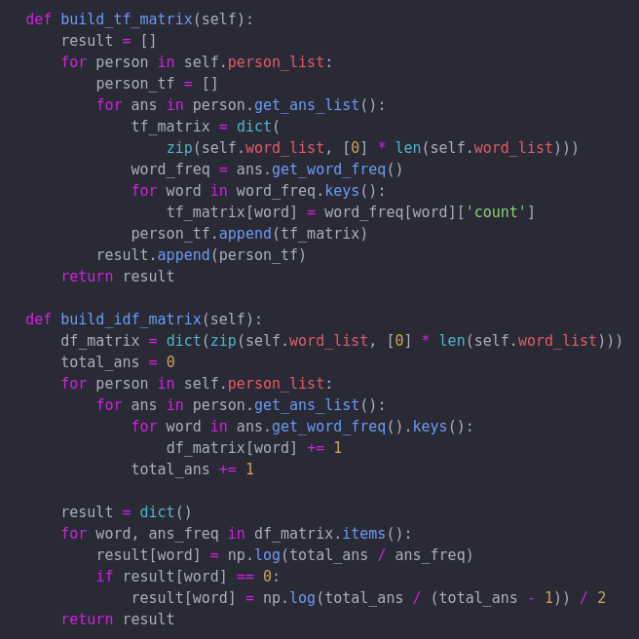
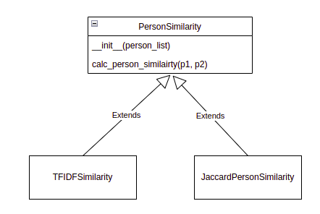
Calculating person similarity

Slide 5
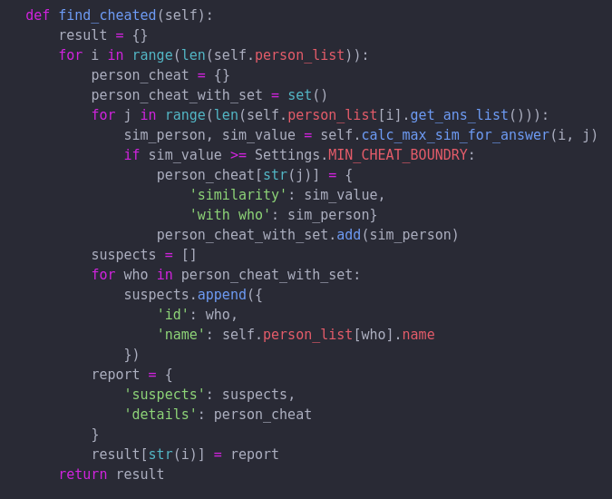
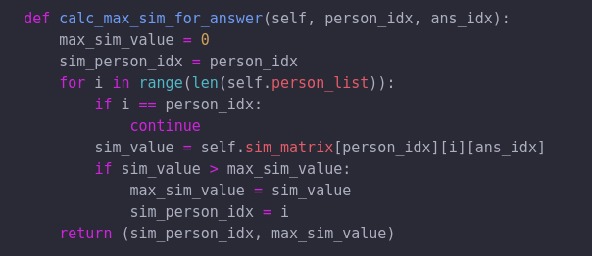
Detecting cheats

Slide 6
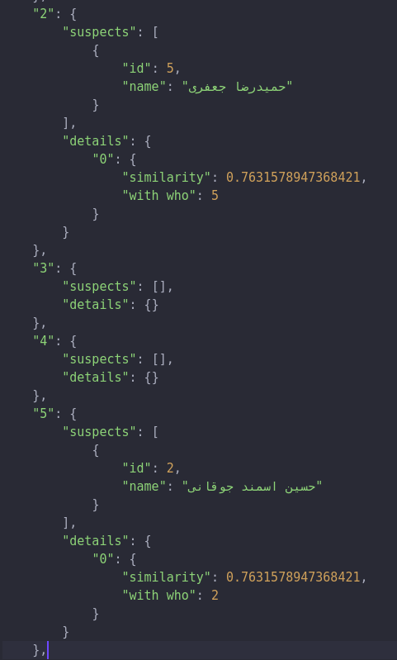
Displaying results

