Slide 1
In the name of GOD
Subject
Credit Card Fraud Detection:
A Realistic Modeling and a Novel Learning Strategy
Lecture
Machine Learning
Masters
Dr.Yaqmaee & Shokri
By
Havva Askari

Slide 2
CREDIT card fraud detection is a relevant problem that draws the attention of machine learning and computational intelligence communities, where a large number of automatic solutions have been proposed
The main contributions of this paper are as follows.
We describe the mechanisms regulating a real-world FDS, and provide a formal model of the articulated classification problem to be addressed in fraud detection.
2) We introduce the performance measures that are considered in a real-world FDS.
3) Within this sound and realistic model, we propose an effective learning strategy for addressing the above challenges, including the verification latency and the alert– feedback interaction. This learning strategy is tested on a large number of credit card transactions.

Slide 3
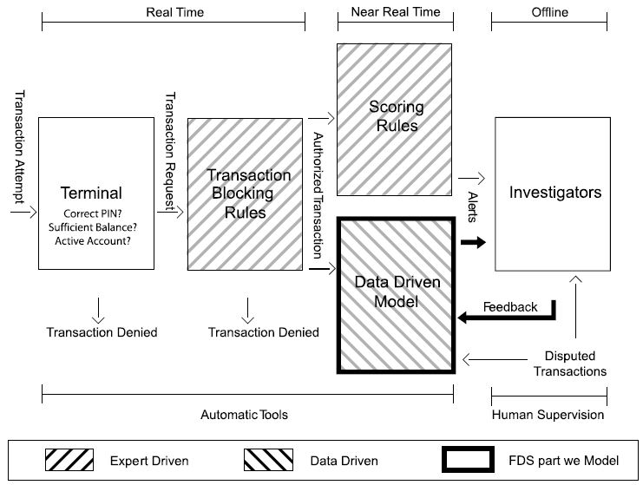
Here we describe the main peculiarities and the operating conditions of a real-world FDS, inspired by the one routinely used by our industrial partner. Fig. 1 illustrates the five layers of control typically employed in an FDS: 1) the terminal; 2) the transaction-blocking rules; 3) the scoring rules; 4) the data-driven model (DDM); and 5) the investigators. Layers 1)–4) fully implement automatic controls, while layer 5) is the only one requiring human intervention.
Figure 1: Scheme illustrating the layers of control in an FDS. Our focus is mainly on the DDM and the alert–feedback interaction, which regulates the way recent supervised samples are provided.

Slide 4
REAL-WORLD FDS
1. Layers of Controls in an FDS : 1) the terminal; 2) the transaction-blocking rules; 3) the scoring rules; 4) the data-driven model (DDM); and 5) the investigators.
2. Features Augmentation : Any transaction request is described by few variables such as the merchant ID, cardholder ID, purchase amount, date, andm time. All transaction requests passing the blocking rules are entered in a database containing all recent authorized transactions, where the feature-augmentation process starts.
3. Supervised Information : Overall, there are two types of supervised information: 1) feedbacks provided by investigators that are limited in number but refer to recent transactions and 2) delayed supervised transactions, which are the vast majority for which the labels become available after several days
4. System Update : Customers’ spending behavior evolves and fraudsters continuously design new attacks, and thus their strategies also change over time.

Slide 5
PROBLEM FORMULATION
alerts
Feed-backs
delay
Here, we model the classification problem to be addressed in a real-world FDS, providing a formal description of the alert–feedback interaction and presenting suitable performance measures.

Slide 6
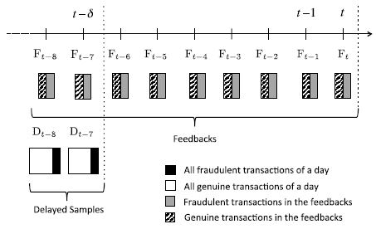
Fig. 2 illustrates the different types of supervised information available in an FDS.
In fact, alerts in a real-world FDS are typically raised online while transactions are being processed, without having to rank all transactions in Tt . Similarly, the delayed supervised couples do not come all at once, as each disputed transactions might take less (or possibly more) than δ days.
Figure 2: Supervised samples available at the end of day t include: 1) feedbacks [F(·)] and 2) delayed couples [D(·)] occurred before t − δ days. In this plot, we have assumed δ = 7. Patterns indicate different labels, and the size of these regions indicates balanced/unbalanced class proportions.

Slide 7
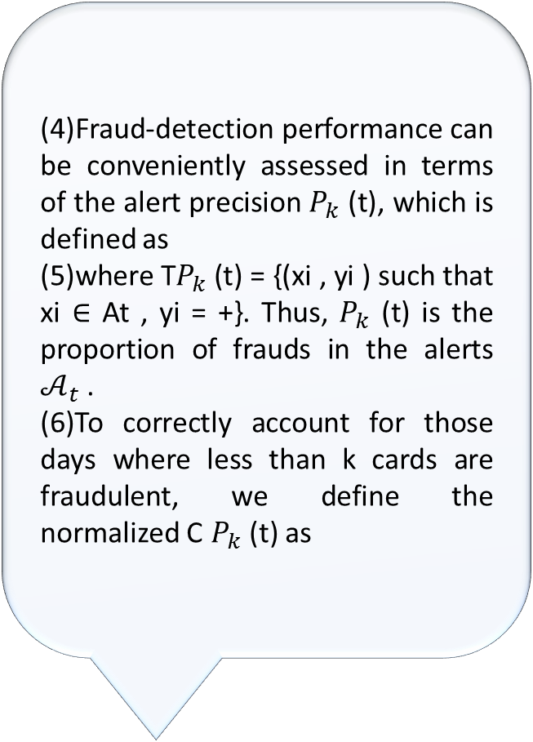
precision
card precision
Normal-ized
(4)Fraud-detection performance can be conveniently assessed in terms of the alert precision $P_{k}$ (t), which is defined as
(5)where T$P_{k}$ (t) = {(xi , yi ) such that xi ∈ At , yi = +}. Thus, $P_{k}$ (t) is the proportion of frauds in the alerts $𝒜_{t}$ .
(6)To correctly account for those days where less than k cards are fraudulent, we define the normalized C $P_{k}$ (t) as

Slide 8
RELATED WORKS
Data-Driven Approaches in Credit Card Fraud Detection :
Both supervised and unsupervised methods have been proposed for credit card fraud detection purposes.
Performance Measure for Fraud Detection :
The typical performance measure for fraud-detection problems is the AUC . AUC can be estimated by means of the Mann–Whitney statistic and its value can be interpreted as the probability that a classifier ranks frauds higher than genuine transactions
Major Challenges to be Addressed in a Real-World FDS :
As anticipated in Section I, the major challenges to be addressed when designing an FDS include: 1) handling the class imbalance, since legitimate transactions far outnumber the fraudulent ones; 2) handling the concept drift since the statistical properties of both frauds and genuine transactions evolve with time; and 3) operating with a small number of recent supervised transactions, provided in the form of investigators’ feedback.

Slide 9
PROPOSED LEARNING STRATEGY
Feed-backs
delay
precision

Slide 10

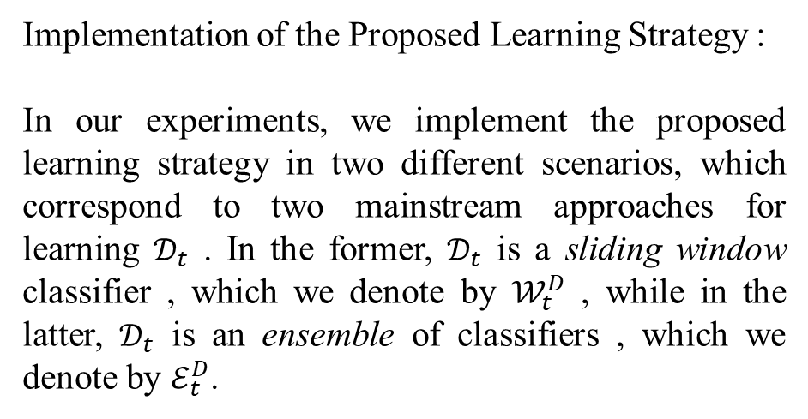
EXPERIMENTS
Implementation of the Proposed Learning Strategy :
In our experiments, we implement the proposed learning strategy in two different scenarios, which correspond to two mainstream approaches for learning $𝒟_{t}$ . In the former, $𝒟_{t}$ is a sliding window classifier , which we denote by $𝒲_{t}^{D}$ , while in the latter, $𝒟_{t}$ is an ensemble of classifiers , which we denote by $ℰ_{t}^{D}$.
A. Our Data Sets :
We use two large data set of online e-commerce transactions from European credit card holders, Even though these transactions are not initiated from a physical terminal, they undergo the same process described in Fig. 1. In Table I, we provide all the information about these data sets, which we denote as 2013 and 2014–2015, and in particular, we stress the extreme class imbalance since frauds account for about 0.2% of all transactions.
Table 1: DATA SETS

Slide 11
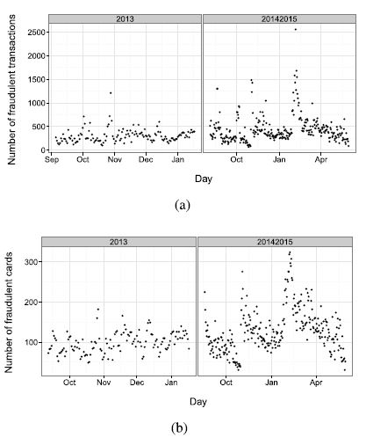
Figure 3 :Number of fraudulent transactions and cards per day in the data sets described in Table 1. It emerges that there are more fraudulent transactions than cards, meaning that some cards have received more than a fraud. (a) Number of fraudulent transactions. (b) Number of fraudulent cards.

Slide 12
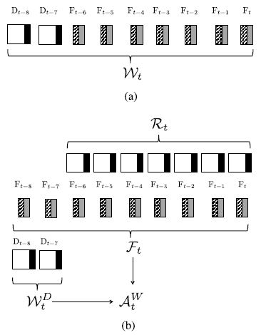
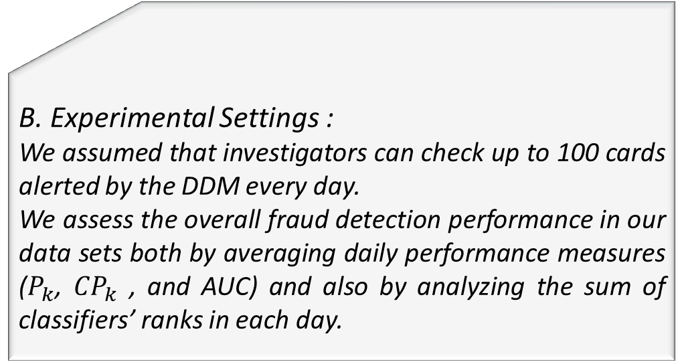
B. Experimental Settings :
We assumed that investigators can check up to 100 cards alerted by the DDM every day.
We assess the overall fraud detection performance in our data sets both by averaging daily performance measures ($P_{k}$, ${CP}_{k}$ , and AUC) and also by analyzing the sum of classifiers’ ranks in each day.
Figure 4: Supervised information used by the classifiers considered in our experiments. In this illustrative example, we set δ = 7, M = 2 and Q = 7 + 2 = 9. (a) Pooling together all labeled transactions. (b) Separating feedbacks and delayed samples.

Slide 13
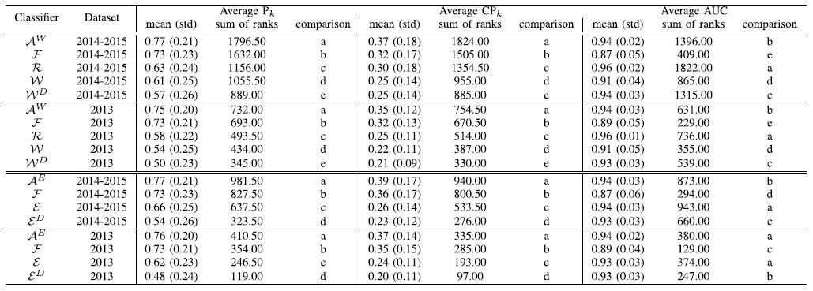
C. Separating Feedbacks From Delayed Supervised Samples :
In this experiment, we have also included the ideal classifier ℛ_𝑡 that is trained on all transactions authorized between day t and t−δ. This classifier is considered an ideal counterpart of sliding window classifiers, which unrealistically assume that investigators can everyday assign the correct label to each authorized transaction.
Table 2: FRAUD-DETECTION PERFORMANCEWHEN USING 15 DAYS OF TRANSACTIONS (δ = 7, M = 8, AND Q = 15)

Slide 14
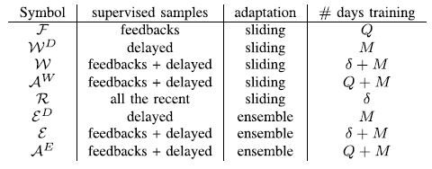
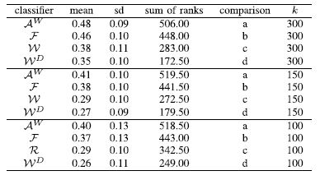

Table 3: CLASSIFIERS CONSIDERED IN OUR EXPERIMENTS
Table 4: AVERAGE ${NCP}_{k}$ WHEN k ≥ 100 IN THE 2013 DATA SET (δ = 15).
D. Concept Drift :
In this section, we first analyze the 2014–2015 data set that contains more than 54 million transaction authorized over 10 months and show that this stream is affected by concept drift.

Slide 15
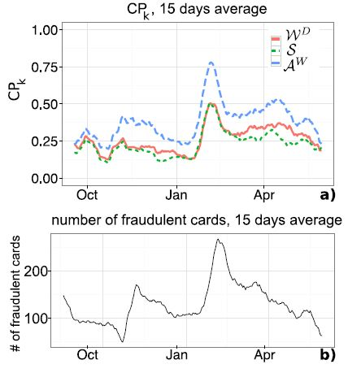
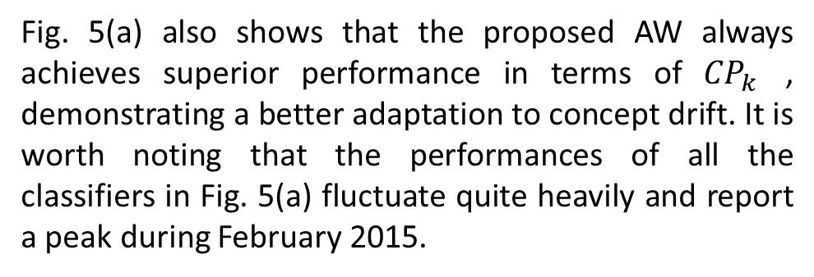

Fig. 5(a) also shows that the proposed AW always achieves superior performance in terms of ${CP}_{k}$ , demonstrating a better adaptation to concept drift. It is worth noting that the performances of all the classifiers in Fig. 5(a) fluctuate quite heavily and report a peak during February 2015.
Figure 5:(a) Values of ${CP}_{k}$ for S, $𝒲^{𝒟}$, and $𝒜^{W}$ on data set 2014–2015. (b) Number of fraudulent cards on the same period. For the visualization sake, these values have averaged over a sliding window of 15 days. The peak of ${CP}_{k}$ in (a) corresponds to the peak in number of fraudulent cards in (b). This result confirms that the classifiers become more precise in those days characterized by a large number of fraudulent cards.

Slide 16
weight
Proba-bility
E. Sample Selection Bias due to Alert–Feedback Interaction :
Here we investigate whether importance weighting, a mainstream solution to correct SSB, can successfully compensate for the SSB introduced by the alert–feedback interaction.

Slide 17
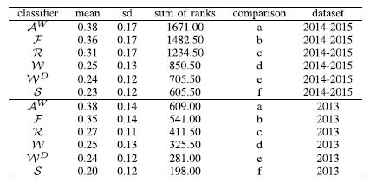
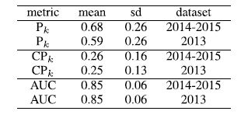

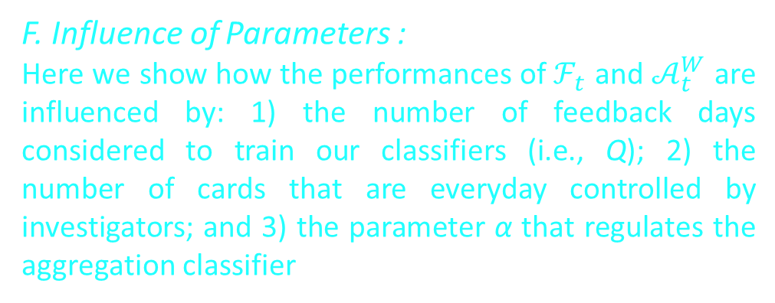

Table 5: AVERAGE $P_{k}$, ${CP}_{k}$ , AND AUC FOR $ℱ_{t}$ WHEN Q = 15.
Table 6: AVERAGE ${CP}_{k}$ WHEN USING 30 DAYS (δ = 15, M = 15, AND Q = 30).
Table 5 reports the performance achieved when correcting the SSB using weights provided by (10) and it emerges that these are lower than the performance achieved by F in Table 2.
F. Influence of Parameters :
Here we show how the performances of $ℱ_{t}$ and $𝒜_{t}^{W}$ are influenced by: 1) the number of feedback days considered to train our classifiers (i.e., Q); 2) the number of cards that are everyday controlled by investigators; and 3) the parameter α that regulates the aggregation classifier

Slide 18
Conclusions
The majority of works addressing the fraud detection problem in credit card transactions unrealistically assume that the class of each transaction is immediately provided for training the classifier.
Our experiments on two vast data sets of real-world transactions show that, in order to get precise alerts, it is mandatory to assign larger importance to feedbacks during the learning problem.
Future work concerns the study of adaptive and possibly nonlinear aggregation methods for the classifiers trained on feedbacks and delayed supervised samples.

Slide 19
Thank You For Watching

