Slide 1
Image generation using text summarization
2023.03.27
App-solutely Mobile
Fatemeh Pesaran Zadeh
Hyeondeok Jang
Sehee Kim
Keogh Patrick Ross
Notes:
Hello, everyone, we are absolutely-mobile team.
The title of

Slide 2
Contents
Introduction (Motivation & Usage scenario)
Existing solution and problem
The key solution idea to tackle the problem
The proposed scheme
Project plan

Slide 3
Introduction

Slide 4
Motivation
Visualization of Text: Summarization of text can help condense large amounts of information into a concise form.
Educational Purposes: Generating images based on text summarization can be particularly useful in educational contexts.
Social Media: Generating images based on text summarization can also be helpful in social media platforms, especially when the text limit is limited.
Notes:
What we want to do is visualizing the text. Since Humans are more familiar with images than text, showing the image which condenses the large amounts of information to user can help to understand the context in short time.
It can be used at various domain including the education or social media domain. I will give you some examples at next slide.

Slide 5

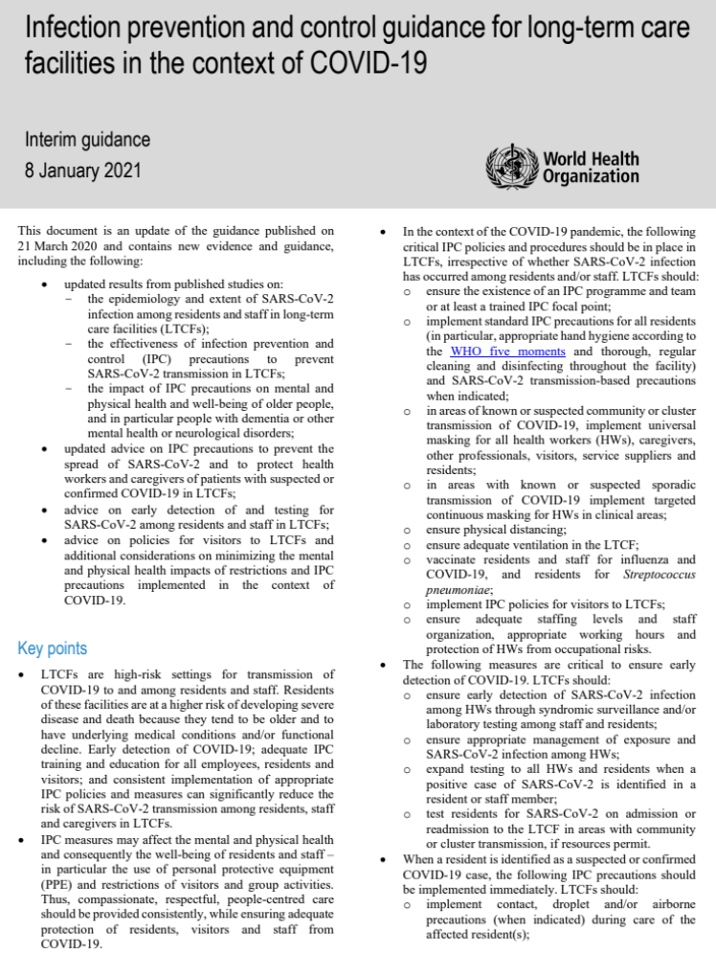




Usage Scenario
Quick review for articles and long context using mobile device
antibody production rate : xx %
Vaccinated rate by country
Notes:
There are several usage scenarios. First, it could be used for quick reviewing the articles, books and whatever have long context using mobile devices. Since most devices have small screen, it is not suitable to read long context. We need to scroll the screen to read it and sometime we get lost in long context. However, with the summarizing images, we can quick review the long context with well-organized images. It can help reader to understand the long context with condensed information.

Slide 6



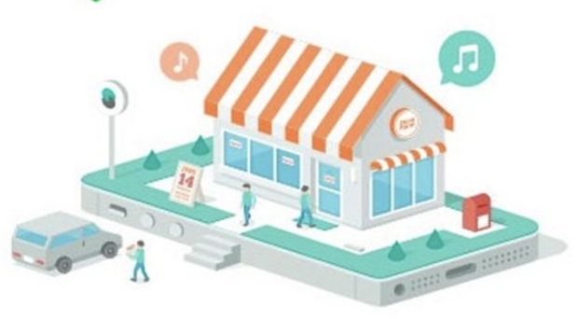
Usage Scenario
Generate the images summarizing context at the chat application
How’s the work going?
How’s the work going?
Unread message 999+
Unread message 999+
What we need to do is ~~
Previous messages
Okay, yesterday ~~~
Today ~~~
Tomorrow ~~~
Yesterday
Today
Tomorrow
Brief idea: 2023.03.27
View More
proposal ~~~
Mid-project ~~~
Final-project ~~~
XX is invited to the chat
View More
Let’s talk about it tomorrow
View More
Okay.
XX is invited to the chat
Explain the long context with some images
Show some images summarizing previous messages
Notes:
Additionally, we can use it at the chat application like kakao or wechat.
Let’s imagine our boss ask us some questions. Though we sent long text, however, he doesn’t have enough time to read carefully. With our application, some images and brief summary can help our boss to understand it in short time.
We can imagine another example. I was invited at a chatting room or couldn’t follow up the chat for long time. There are thousands of messages, and we need to read all messages. Our system can provide the brief images and summary for previous chat.

Slide 7
Existing work
Notes:
There are existing works to summarize the news article into image-based contents.

Slide 8
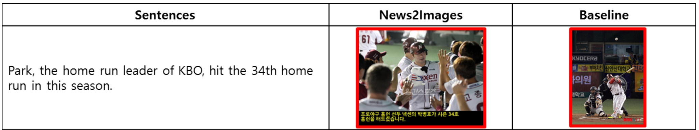
Existing work
News2Images: Automatically Summarizing News Articles into Image-Based Contents via Deep Learning [1]
Abstract: Generating compact image-based contents from news documents (return retrieved image)
[1] Ha, Jung-Woo, et al. "News2Images: Automatically Summarizing News Articles into Image-Based Contents via Deep Learning." INRA@ RecSys. 2015.
Notes:
For example, News2Image, which is studied by naver research team, returns the retrieved image based on the text. We will search more papers for baseline later. However, most of the existing paper are some problems to use the application in real time.

Slide 9
Problems

Slide 10
Problems
Generating images from summarized text could be a challenging task. Some of the main challenges are:
Lack of details: Summarized text often lacks the level of detail required to generate accurate and realistic images. This can result in images that are too generic or fail to capture the main point of the original text.
Complexity: Some text maybe too complex to be easily converted to images.
Limited training data: Generating high-quality images from text requires large amount of training data. However, it can be challenging to find enough data that captures the full range of concepts and context that need to be represented.
Notes:
Now I will talk about the challenges in this area which directed us to want to explore more about this topic.
Generating images based on summarization text can be a challenging task, and there are several potential challenges that can arise in this process. Some of the main challenges are:
Lack of detail: Summarized text often lacks the level of detail required to generate accurate and realistic images. This can result in images that are too generic or fail to capture the nuances of the original text.
Complexity: Some texts may be too complex to be easily converted into images. For example, scientific articles or technical documents may contain a lot of specialized terminology and mathematical equations that are difficult to visualize.
Limited training data: Generating high-quality images from text requires large amounts of training data. However, it can be challenging to find enough relevant data that accurately captures the full range of concepts and contexts that need to be represented.

Slide 11
The Key Solution
Notes:
obviously coming up with a solution for all challenges won’t be possible specially for the short amount of time that we have therefore, we decided to address two of main challenges through this semester.

Slide 12
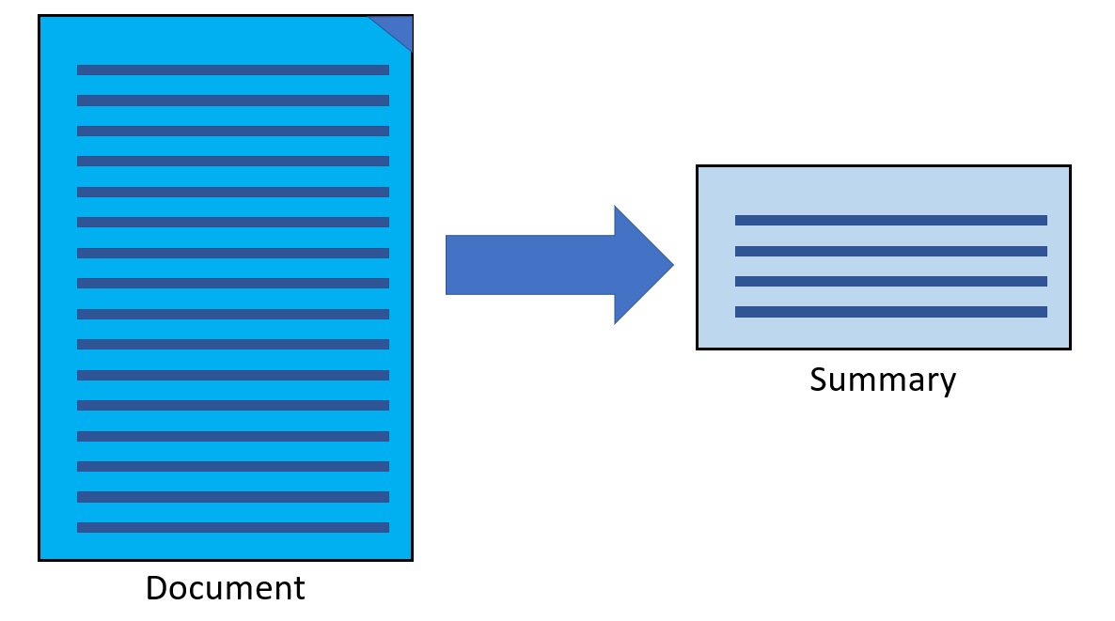
The Key Solutions
Solution to the lack of details:
Breaking down the text into smaller chunks or segments and generate images for each segment. This can help to capture more detailed information about specific aspects of the text and reduce the risk of missing important details.
Notes:
One key solution to the lack of detail problem in generating images from summarized text is to break down the text into smaller chunks or segments and generate images for each segment. This can help to capture more detailed information about specific aspects of the text and reduce the risk of missing important details.

Slide 13
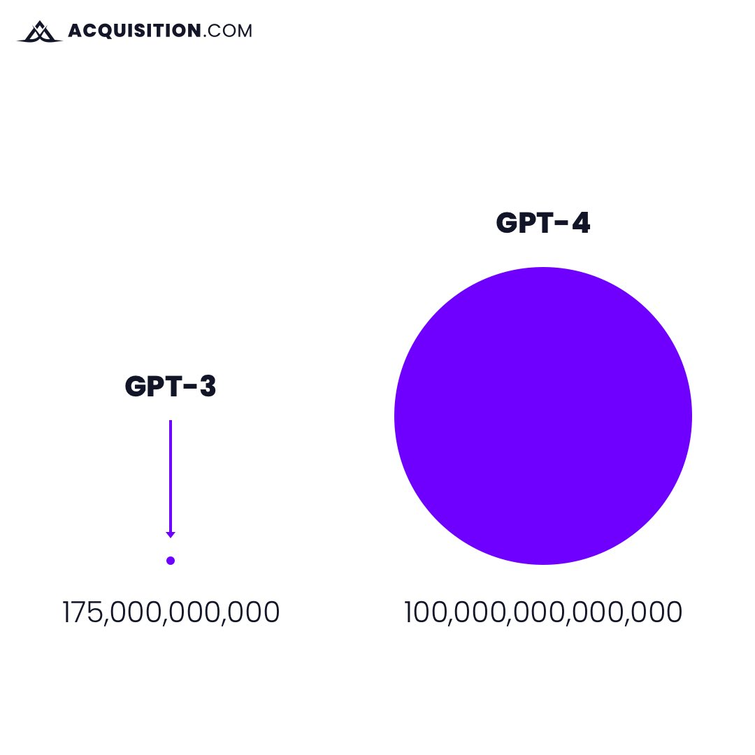
The Key Solutions
Solution to the limited dataset:
There are zero-shot NLP models that can be used that there won’t be a need of training or fine-tuning the model on a big dataset. One of commonly used zero-shot NLP model is T5. However, we could use recent models with the higher accuracy such as ChatGPT or GPT4.
The first dot is the amount of data Chat GPT 3 was trained on.The second is what chat GPT 4 is trained on.
Notes:
One of key solution to the limited dataset problem is using zero-shot models.
Zero-shot summarization models are useful for generating summaries in languages or domains where training data is limited or non-existent
To make sure everybody is understanding what is zero-shot models I will briefly explain it to you guys.
Zero-shot summarization models are a type of natural language processing (NLP) model that can generate summaries for text that they have not been explicitly trained on. This means that the model can summarize a piece of text in a language or domain that it has not been trained on, without requiring any additional training or fine-tuning.
The term "zero-shot" refers to the fact that the model is able to generate summaries without any explicit training on the specific language or domain of the input text. Instead, zero-shot summarization models are pre-trained on a large corpus of text in multiple languages and domains, and they use this training to learn to summarize text in a generalized way.
Zero-shot summarization models typically use a combination of encoder-decoder architectures and attention mechanisms to generate summaries. The encoder processes the input text and generates a representation of the text, which is then fed into the decoder to generate the summary.
One popular example of a zero-shot summarization model is the T5 model (Text-to-Text Transfer Transformer), which was developed by Google AI Language. The T5 model is a large-scale language model that can perform a wide range of NLP tasks, including summarization, translation, and question answering, among others.
or even we can use more recent models such as ChatGPT or GPT4 and compare the generated summary.

Slide 14
Expected Technical Challenges and Solutions

Slide 15
Expected Technical Challenges
Technical Challenge: Latency
Both Text Summarization and Text-to-Image Generation models would need to run on cloud
Text Summarization especially: GPT-4
Compared to models that can be completely run locally, latency is a possible technical challenge
Solutions
Have both or one of the models be one that can be run locally
Sacrifice accuracy
Notes:
An expected technical challenge is latency.
We expect that both the text summarization and text to image generation models would be fairly large, and therefore would need to run on a cloud.
In the case of text summarization, it would be necessary, as the model we expect to use, GPT-4, is currently only available as an online API.
In this case, data would have to be sent back and forth between the mobile device and cloud, which would cause latency. This would be a disadvantage compared to models that could run locally.
A possible solution to this would be have both or one of the models to be changed into models that can be run locally. However, this may cause the system to lose its strength on accuracy.

Slide 16
Evaluation Strategy

Slide 17
Evaluation Strategy
Use evaluation metrics for both text summarization and text-to-image generation
Text Summarization
ROUGE-1, ROUGE-2, ROUGE-L[1]
ROUGE is a metric designed to evaluate text summarization by comparing to summarization created manually by people[2]
ROUGE-1, ROUGE-2: Types of ROUGE-N. ROUGE-N uses n-grams for evaluation.
ROUGE-L: Uses Longest Common Subsequence(LCS) for evaluation
[1]https://paperswithcode.com/sota/text-summarization-on-gigaword
[2]Lin, Chin-Yew. "Rouge: A package for automatic evaluation of summaries." Text summarization branches out. 2004.
Notes:
We expect to use evaluation metrics for both text summarization and text to image generation to evaluate our system.
For text summarization, we would use ROUGE-1, ROUGE-2, and ROUGE-L to evaluate our summarized text.

Slide 18
Evaluation Strategy
Use evaluation metrics for both text summarization and text-to-image generation
2. Text-to-Image Generation
Frechet Inception Distance (FID)[1]
FID is an improved version of Inception Distance[3]
Compares generated images and real images to evaluate their likeness[2]
[1]https://paperswithcode.com/sota/text-to-image-generation-on-coco
[2]Yasunaga, Michihiro, et al. "Retrieval-Augmented Multimodal Language Modeling." arXiv preprint arXiv:2211.12561 (2022).
[3]Heusel, Martin, et al. "Gans trained by a two time-scale update rule converge to a local nash equilibrium." Advances in neural information processing systems 30 (2017).
Notes:
For text to image generation, we will use FID, or Frechet Inception Distance to evaluate the image created from the summarized text.

Slide 19
Project Plan

Slide 20
Project Plan
Task | Week 5 | Week 6 | Week 7 | Week 8 | Week 9
Initial presentation
Review existing literature and finalise tasks
Collect test data
Text summarisation
Text-to-image generation
Analyse findings and success of work so far
Notes:
We expect to use evaluation metrics for both text summarization and text to image generation to evaluate our system.
For text summarization, we would use ROUGE-1, ROUGE-2, and ROUGE-L to evaluate our summarized text.

Slide 21
Project Plan
Task | Week 10 | Week 11 | Week 12 | Week 13 | Week 14 | Week 15
Midterm presentation
Begin writing main body of the paper
Write conclusion and suggest areas for future research
Finalise the paper and proofread
Final presentation
Notes:
We expect to use evaluation metrics for both text summarization and text to image generation to evaluate our system.
For text summarization, we would use ROUGE-1, ROUGE-2, and ROUGE-L to evaluate our summarized text.

Slide 22
Final deliverable and success criteria

Slide 23
Final deliverable and success criteria
The paper should clearly and concisely state the research question being addressed
The paper should demonstrate how to effectively summarise pieces of text and generate images based on this summary
The analysis of the data should be thorough and well-supported, and the conclusions drawn should be based on sound evidence
The methodology used in the study should be well-designed and appropriate for addressing the research question, and the data collection and analysis methods should be rigorous and appropriate for the study
The paper should make an original contribution to the field, whether by presenting new findings or providing a novel perspective on existing research

