Slide 1
SPINN: Synergistic Progressive Inference of Neural Networks over Device and Cloud
2023.05.24
App-solutely Mobile
Fatemeh Pesaran Zadeh
Sehee Kim
Notes:
Hello, everyone, we are absolutely-mobile team.
The title of the project is image generation using text summarization

Slide 2
Index
Introduction
Background
Design
Evaluation
Conclusion
Notes:
We will present the contents in this order.
At first I will cover the introduction and the other members will cover the rest contents.

Slide 3
Introduction

Slide 4
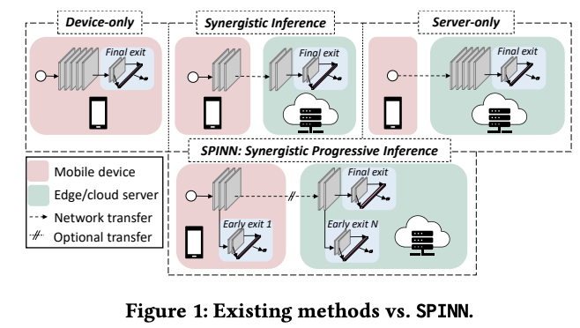
Introduction
CNNs are widely used in mobile applications, but sustaining high-performance inference on mobile devices is challenging due to their computational demands and the diversity of devices.
Offloading CNN processing to cloud-based servers is a popular alternative, but it can be problematic for mission-critical and high-mobility applications due to dynamic connectivity conditions and uncertain cloud availability.
The proposed solution is SPINN, a distributed inference system that combines device-cloud computation and progressive inference to achieve fast and robust CNN inference across diverse settings.
SPINN introduces a novel scheduler that co-optimizes the early-exit policy and CNN splitting at runtime to adapt to dynamic conditions and meet user-defined service-level requirements.
Quantitative evaluation shows that SPINN outperforms state-of-the-art collaborative inference approaches by up to 2x in achieved throughput under varying network conditions.
SPINN also reduces server cost by up to 6.8x and improves accuracy by 20.7% under latency constraints, while ensuring robust operation in uncertain connectivity conditions.
Compared to cloud-centric execution, SPINN offers significant energy savings, making it a more efficient solution.

Slide 5
Background Overview
Offloading
Device-only

Slide 6
Background Overview
Offloading
Server-only

Slide 7
Background Overview
Offloading
Synergistic Inference

Slide 8
Background Overview
Offloading

Slide 9
Proposed System
Overview:
The proposed system, SPINN, uses a progressive inference approach to address mentioned limitations.
SPINN distributes progressive early-exit models across devices and servers.
There is always an on-device exit available, ensuring a result is always accessible.
Early exits along the convolutional neural network (CNN) provide varying levels of accuracy.
SPINN allows adjusting the acceptable prediction confidence as a tunable parameter, balancing accuracy and speed.
A novel run-time scheduler is proposed to jointly tune the split point and early-exit policy of the progressive model.
The scheduler tailors the deployment to meet application performance requirements in dynamic conditions.

Slide 10
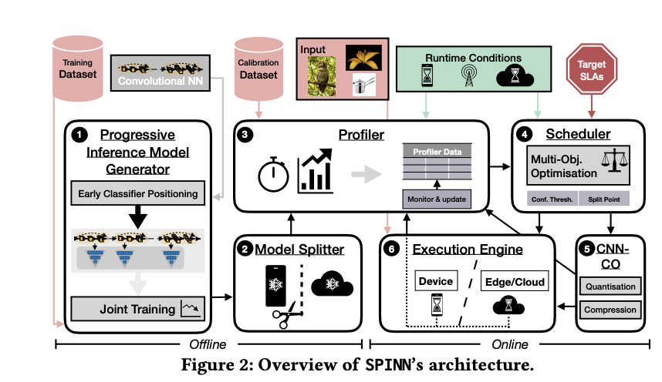
SPINN’s Architecture
Progressive Inference Model Generator:
Early Exits: The placement of intermediate classifiers within the network architecture to allow for early predictions and optimization of computational resources.
Training scheme: The process of jointly training all classifiers in the network from scratch, utilizing a specific cost function and fixed placement of early exits to optimize accuracy and address the issue of "overthinking" during classification.
Early exit policy: PIMG introduces an early-exit policy to determine which classifier is used for a given input.

Slide 11
SPINN’s Architecture
Model Splitter:
The model splitter is responsible for:
Defining the potential split points
Identifying them automatically in the given CNN

Slide 12
SPINN’s Architecture
Profiler:
Offline Stage: In the offline stage, the system performs measurements and calculations prior to deployment. It involves two types of measurements: device-independent and device-specific.
Runtime Stage: In the runtime stage, the system continuously monitors the device and server load, as well as the network connectivity conditions. It refines the estimates obtained during the offline stage based on real-time observations.

Slide 13
SPINN’s Architecture
Dynamic Scheduler:
Distribute computation across cloud and device, decide early-exit policy progressive inference
Hard constraints, soft constraints
Algorithm: Update profile parameters → all infeasible solutions discarded → lexicographic optimisation of the user-prioritised soft targets

Slide 14
SPINN’s Architecture
Dynamic Scheduler - Deployment:
Scheduler is on client side
Run time
Scheduler yields low-source utilisation → deployment without throttling
SPINN only re-evaluates candidate configurations

Slide 15
SPINN’s Architecture
CNN Communication Optimiser:
Alleviate communication bottleneck caused by intermediate data
Two stages
First stage: exploits CNN’s resilience to low-precision representation
Second stage: exploits observation that activation data is amenable to compression

Slide 16
SPINN’s Architecture
Distributed Execution Engine:
SPINN replaces module and tensor functions with custom wrapper
Execution graph in directed acyclic graph(DAG) form
Custom wrapper’s operations:
Normal execution: when layer is to run locally → calls original function
Offload execution: layer select as partition point → offloading request(inputs, subsequent layer dependencies)
Resume execution: request → inputs and dependencies injected into respective layers → execution continued on remote side
Early exit: intermediate classifier executed → wrapper evaluates prediction confidence → if above threshold then terminate early

Slide 17
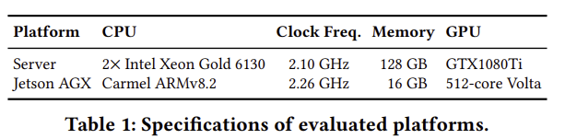
Evaluation
Experimental Setup:
Three different power profiles: 30W(full power), 10W(low power), underclocked 10W
Effect of limited computation capacity: linearly scale up CNN computation time of server side
Network conditions of offloading: average bandwidth and latency across national carriers(3G, 4G, 5G)
Models used for evaluation: ResNet-50, ResNet-56, VGG16, MobileNetV2, Inception-v3
Datasets and Training
Dataset: CIFAR-100, ImageNet
Training:
Use preprocessing steps of each model
Convert models to progressive early-exit networks → trained jointly scratch-to-end
Use model’s training parameters(except MobileNetV2)
Notes:
Results of the two methods are the same

Slide 18
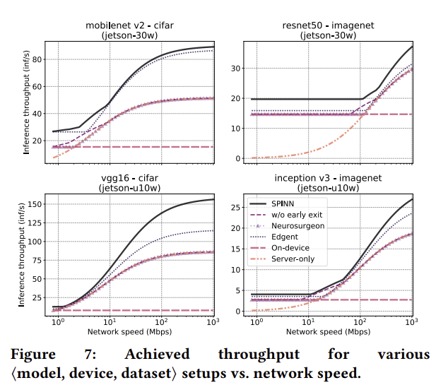
Evaluation
Performance Comparison - Throughput Maximisation:
On-device: same throughput independent of network variation
Server-only: follows available bandwidth
Edgent: trajectory similar to server-only but higher throughput
Neurosurgeon: constrained connectivity → on-device, bandwidth increase → off-load whole computation
Ablated SPINN: extreme bandwidth → follow Neurosurgeon, middle bandwidth → better throughput
Notes:
Results of the two methods are the same

Slide 19
Evaluation
Performance Comparison - Throughput Maximisation:
SPINN: best performance
Attributed to bandwidth and data-locality-aware scheduler choices on the early-exit policy and partition point
Low bandwidth: select device-only, outperform due to early-exit
Mid-range bandwidth: CNN-CO → better utilization of available bandwidth
High bandwidth: optimised early-exit scheme
Takes advantage of input’s classification difficulty to exit early, avoid wasteful data transfers
Notes:
Results of the two methods are the same

Slide 20
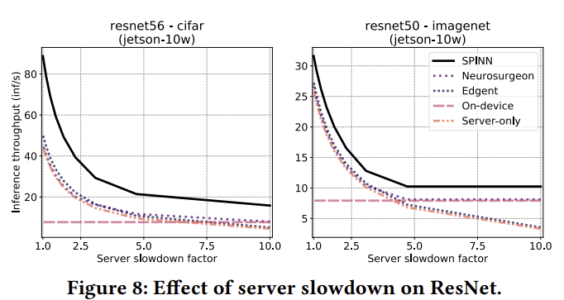
Evaluation
Performance Comparison - Server-Load Variation
Vary load at remote end
Linearly scale the latency of server execution by slowdown factor
Low server load: similar to high-bandwidth performance
High server load: Performance deteriorates (except server-only)
Neurosurgeon: adapts policy → executes greater part of CNN on client side
Edgent: deteriorates quickly
SPINN: scheduler manages to adapt
Notes:
Results of the two methods are the same

Slide 21
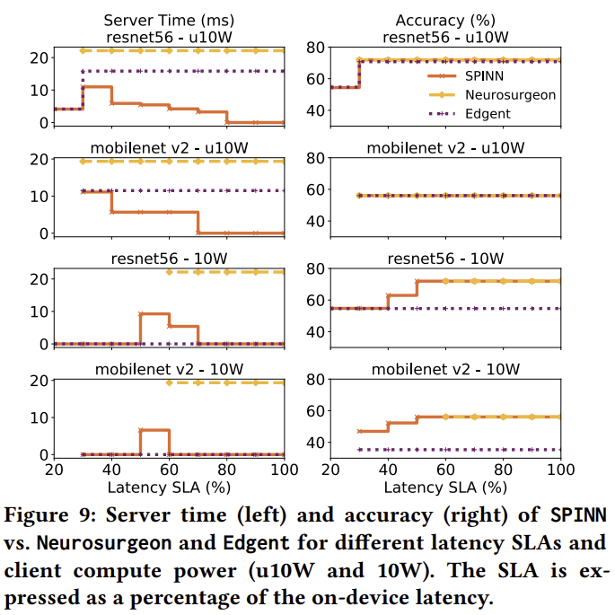
Evaluation
Case Study: Latency-drive SLAs at minimal server cost
Assess performance under deadlines
CNN-based application that meets strict latency SLAs at maximum accuracy and minimal server-side cost
Computation time and accuracy achieved for two device profiles with different compute capabilities
Notes:
Results of the two methods are the same

Slide 22
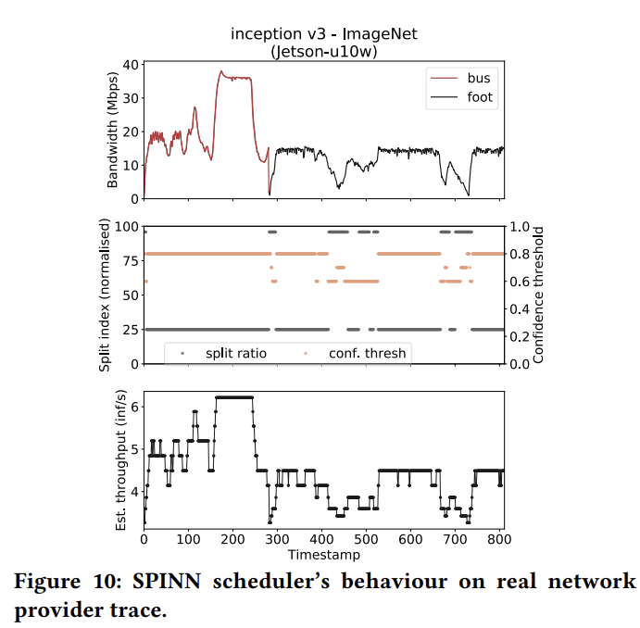
Evaluation
Runtime Overhead and Efficiency
Deployment Overhead
Scheduler executes in max 14ms
Memory consumption: in the order of few KBs
Network Variation
Low bandwidth: SPINN → device-only
Lower confidence threshold → less conservative exit-early policy
Impact on accuracy is minimal
High bandwidth:
Earlier split point
Scheduler adapts system to running conditions
Notes:
Results of the two methods are the same

Slide 23
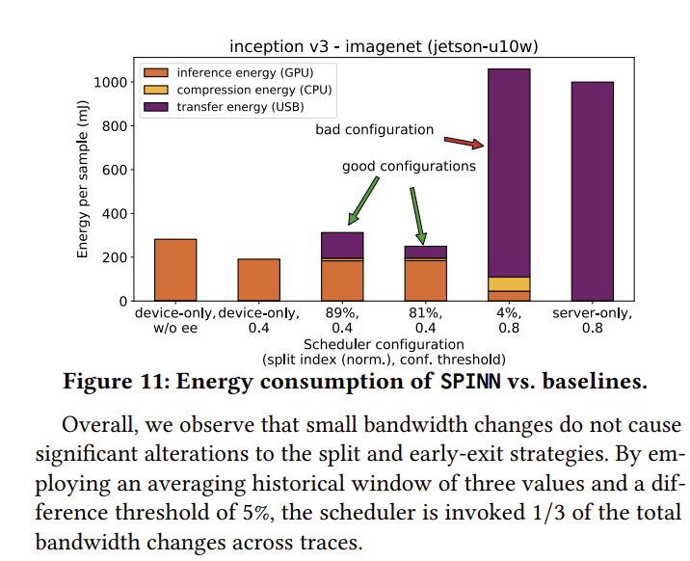
Evaluation
Energy Consumption
Device-only with early-exit: benefit compared to no early-exit
Bad configuration: excessively large transfer size → large compression and transfer energy overheads
Server-only: dominated by network transfer
SPINN scheduler:
Deployments are more energy-efficient than full offloading, on part with on-device
Faster end-to-end processing than on-device
Add energy as scheduler optimisation metric → decision space amenable to energy-driven optimisation
Notes:
Results of the two methods are the same

Slide 24
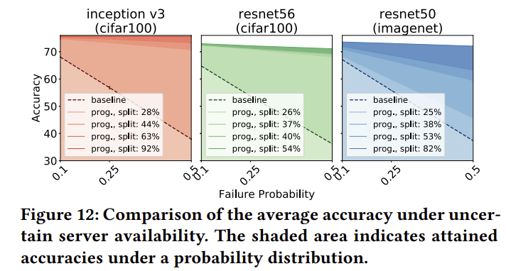
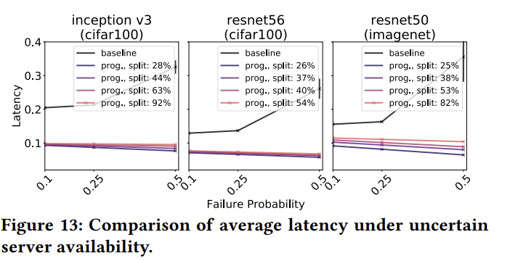
Evaluation
Constrained Availability Robustness
Evaluate SPINN’s robustness under constrained availability of the remote end
Accuracy across various fail rates
Latency improvement
Accuracy comparison
Baseline: no usable result locally on-device → misclassify
SPINN: server unavailable → most confident result up to split point
Latency comparison
Compare SPINN to sing-exit offloaded variant of same networks
Non-progressive baseline latency is much higher
Failure probability increase → SPINN’s latency decreases slightly
Notes:
Results of the two methods are the same

Slide 25
Discussion
SPINN and the current ML landscape
The status-quo deployment of CNNs: maintenance of to models - cloud, device
Significant deployment overheads
Two-model approach: Time-, resource-expensive
Lightweight model needs to be fine-tuned through several training steps
SPINN and lightweight compressed networks
Can be combined for further gains
SPINN can be adopted for pre-trained models
SPINN enables highly customised deployment
Adjusted to maintain performance in mobile environment
Limitations and future work
Scheduler does not explicitly optimise for energy or memory consumption of client
Limit split points to outputs of ReLU layers
Assumes models are available for both client and server
Explore multi-client settings, simultaneous asynchronous inferences on single memory copy
Regression tasks, recurrent neural networks

Slide 26
Conclusion
SPINN: distributed progressive inference engine
Challenge: partition inference across device-server
Run-time scheduler
Jointly tune early-exit policy and partitioning scheme
Robustness
High performance in diverse settings, does not sacrifice accuracy and availability

Slide 27
Thank you for listening!

