Slide 1

On the impact of the quality of pseudo-labels on the self-supervised speaker verification task
Abderrahim Fathan, Jahangir Alam, Woo Hyun Kang
Dec 2nd, 2022, NeurIPS 2022.
NeurIPS 2022

Slide 2
Introduction & Motivation
Labeled datasets can be expensive and time-consuming to obtain.
Label noise can significantly impact the performance.
Memorization effects: deep models tend to fit easy (clean) patterns in the pseudo-labels first, and then overfit the hard and complex (noisy) patterns gradually.
How to mitigate the memorization effects of label noise ?
There are generally 2 groups of methods to learn from noisy data:
Approaches focusing on creating noise-robust algorithms to learn directly from noisy labels
Label-cleansing approaches that aim to remove or correct mislabeled data.
We differ from the above approaches by studying the behavior of speaker verification neural networks trained in settings with various realistic label noise generated by several clustering algorithms.
Explore the effectiveness of mixup regularization to reduce the memorization effects of noisy labels by studying two variants of mixup: the instance input-level i-mix & the latent space-level l-mix.
Which aspects of the pretext task/pseudo-labels have an impact on the downstream task (e.g., speaker verification performance) ?

Slide 3
Experiments
Studied Clustering algorithms:
Classical algorithms: GMM, variational GMM, K-means, BIRCH, CURE, Agglomerative Hierarchical Clustering (AHC), Divisive Hierarchical Clustering (DHC).
Deep models: IMSAT, DEC, DeepCWRN, SOM.
Analyzed Clustering metrics:
7 Supervised metrics: Unsupervised clustering accuracy (ACC), Normalized Mutual Information (NMI), Adjusted MI (AMI), Completeness, Homogeneity, Purity, Fowlkes-Mallows index (FMI).
3 Unsupervised metrics: Silhouette score, Calinski-Harabasz score (CHS), Davies-Bouldin score (DBS).
Dataset: VoxCeleb2

Slide 4
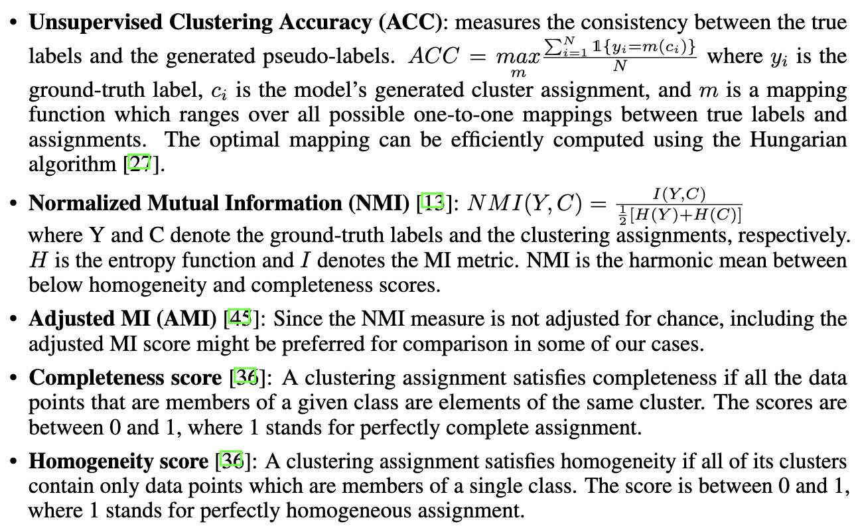
Clustering metrics [1]

Slide 5
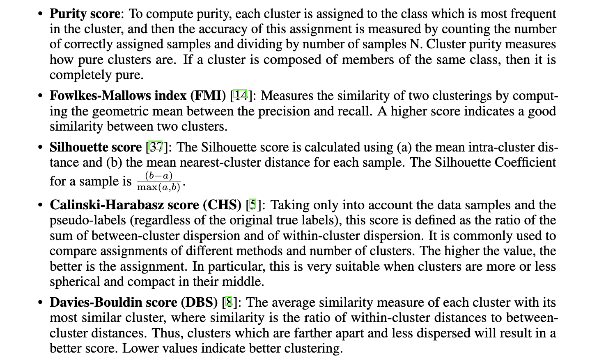
Clustering metrics [2]

Slide 6
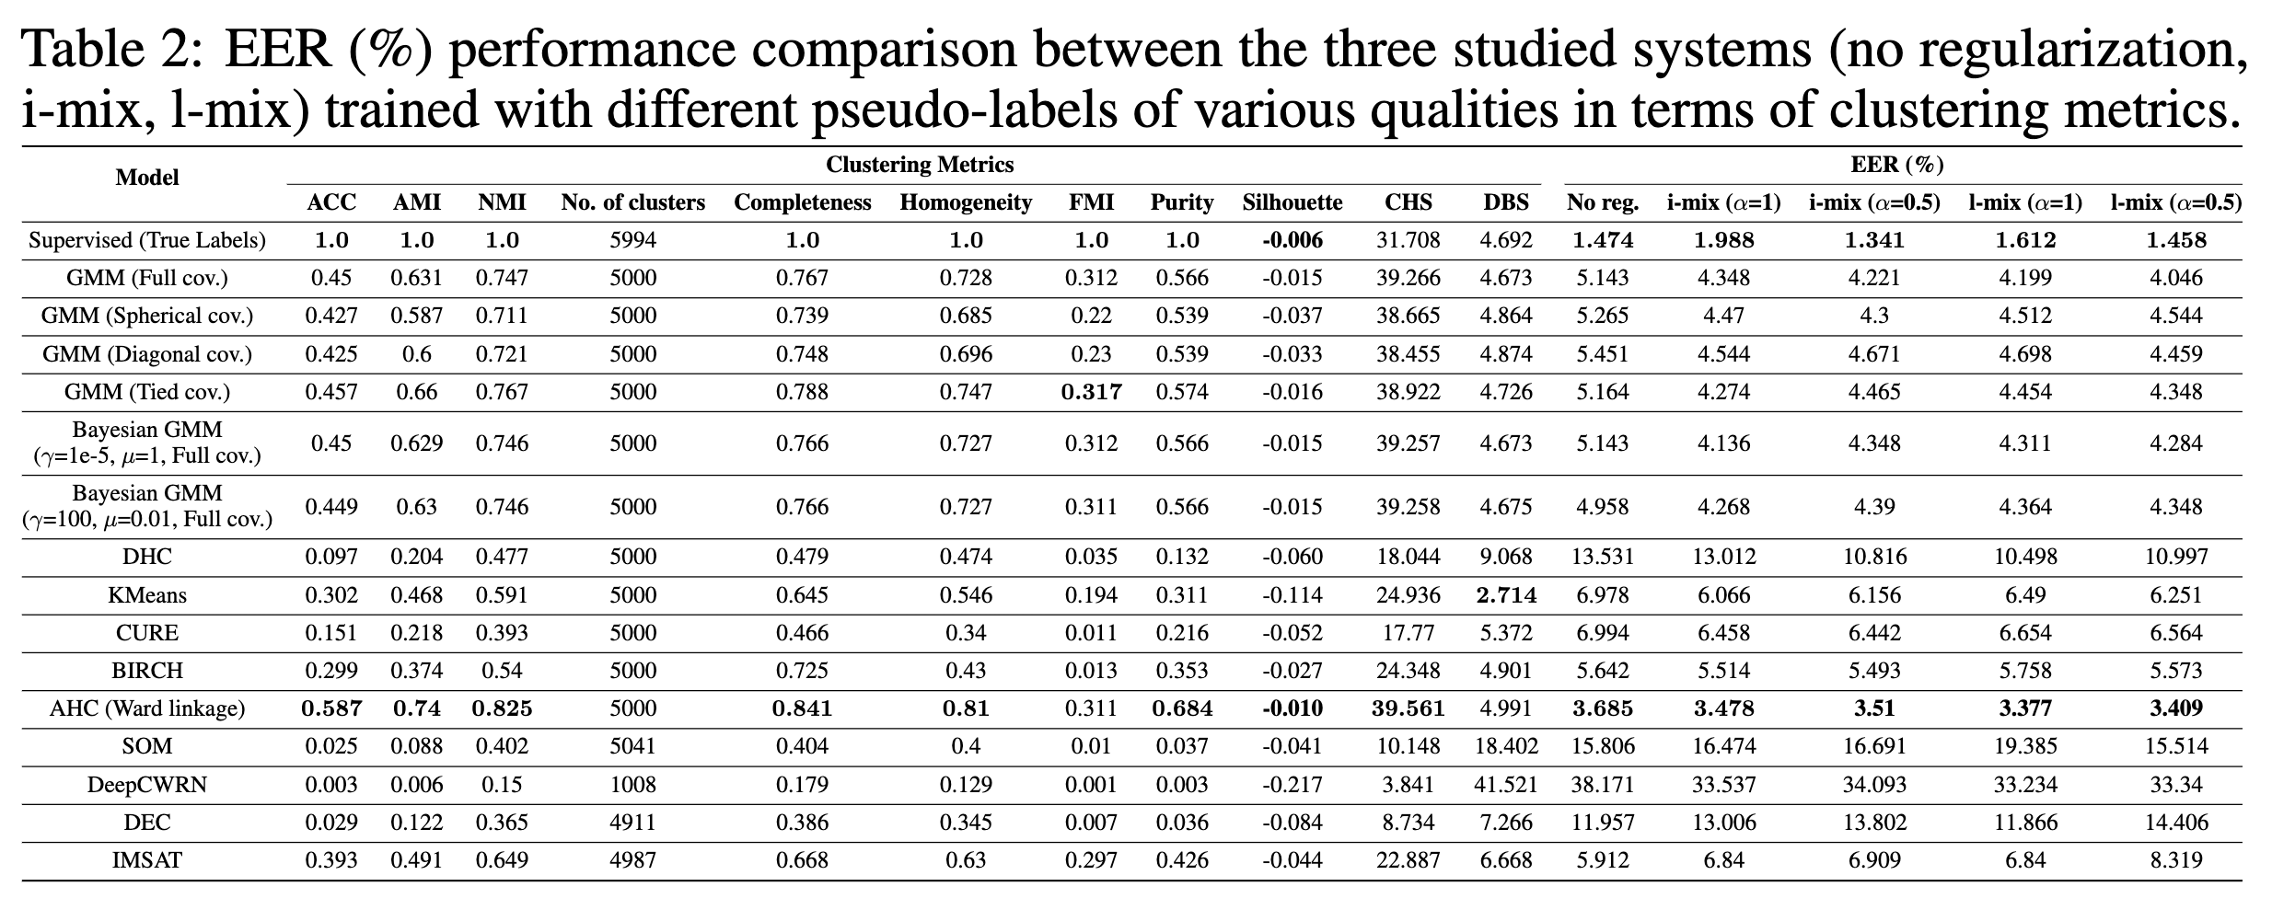
ReSULTS | Clustering & speaker verif. performances

Slide 7
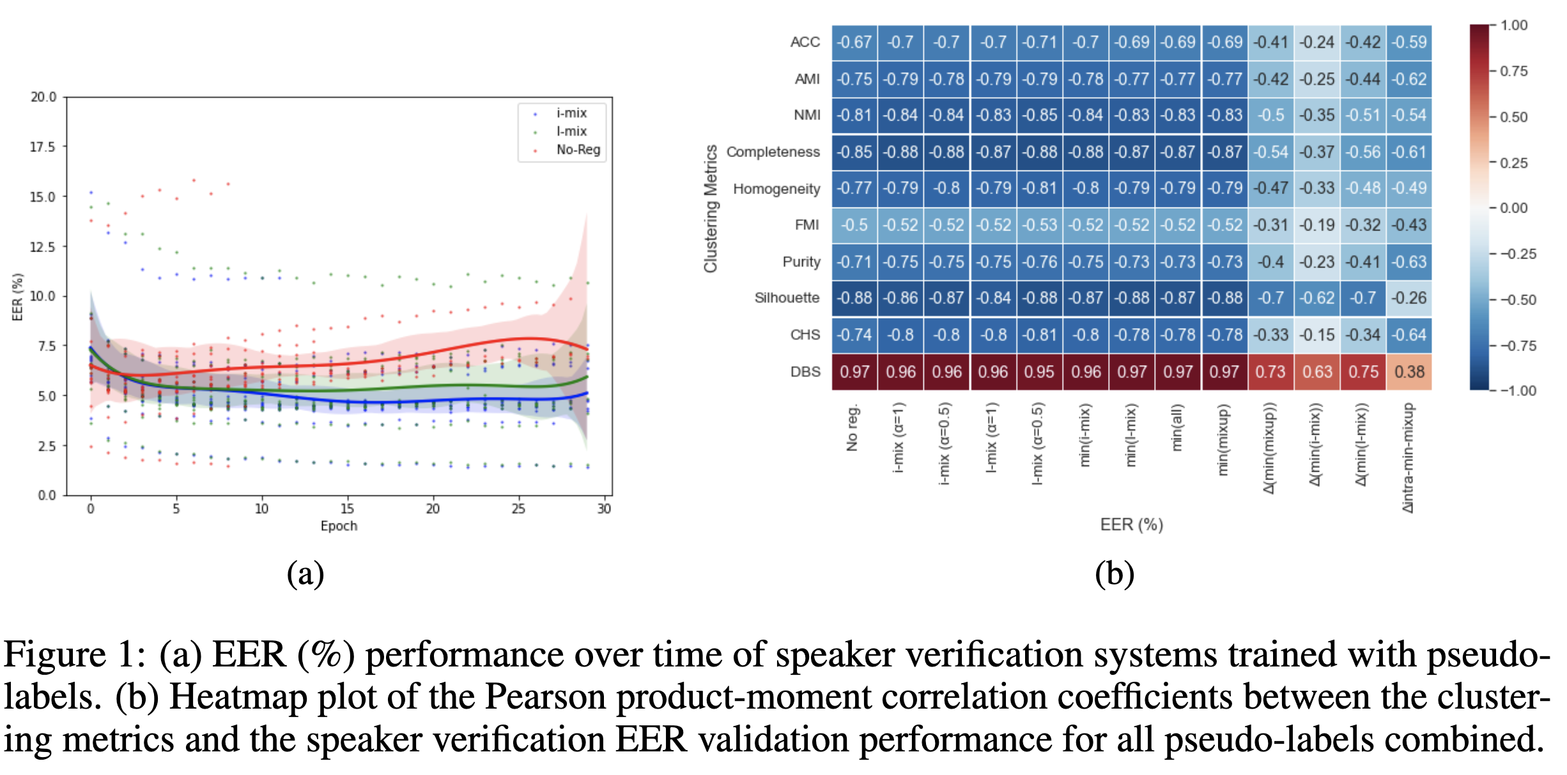
ReSULTS |noise overfit & Correlation Analysis

Slide 8
Key Findings
In general, mixup tends to become more helpful when the generated clusters are less compact or not well distanced.
Interestingly, our ECAPA-TDNN-based embedding systems trained with AAMSoftmax objective can perform well at very low accuracies, high degrees of label noise, overlapping clusters, and high discrepancies between the pseudo-labels and the speaker-identity ground truths.
We observe a complementarity between all the clustering metrics.
The AHC pseudo-labels outperformed all other labels.

Slide 9
Conclusion
We analyzed the impact of the quality of pseudo-labels on the self-supervised speaker verification task.
In particular, we investigated the performance of several clustering algorithms and configurations.
Speaker verification performance can be severely degraded from overfitting to the noisy pseudo-labels.
We found very high correlation between the various clustering metrics and the downstream task, where, in particular, beyond accuracy or mutual information, metrics such as completeness, separation and cohesion of clusters were found to be very helpful monitoring unsupervised metrics.
Clustering metrics are highly predictive of the final downstream speaker-verification performance.
Metrics such as DBS, Silhoutte, and completeness are highly correlated with the final downstream speaker-verification performance.
Unsupervised Silhoutte, CHS, and DBS scores which do not need access to any ground-truth, can be very effective and practical to constantly ensure good downstream performance.
Our results showed that the pseudo-labels-based self-supervised speaker embedding systems can yield comparable performance to the supervised embedding systems.
The mixup strategy can effectively mitigate the memorization effects of label noise.

Slide 10
Q & A

