Slide 1
An Analytic Study on Clustering-based
Pseudo-Labels for Self-Supervised Deep Speaker Verification
Woo Hyun KANG , Jahangir ALAM, Abderrahim Fathan
PresenteD BY: Abderrahim Fathan
14 – 16 November, 2022, SPECOM 2022
ASVSpoof2019

Slide 2
Introduction & Motivation
Although the pseudo-label-based self-supervised speaker embedding extraction scheme has shown impressive performance, not much exploration was done regarding the pseudo-label generation process.
Most common approach for speaker verification: extract utterance-level embeddings from the enrollment and test speech samples and fed them into a scoring algorithm (e.g., cosine distance, PLDA) to measure their similarity (e.g., i-vector, x-vector).
Supervised learning approaches require large amounts of annotated datasets which is expensive and time-consuming.
How to leverage abundant unlabeled datasets?
Create pseudo-labels using clustering algorithms to train the embedding network.
Highly dependent on the clustering algorithms’ performance.
Can show unstable performance issues.
We analyze the impact of different clustering configurations for the pseudo-label-based self-supervised speaker verification system training strategy: We conduct a set of experiments using several clustering algorithms.
Notes:
-MFCC are generally considered unusable for speech synthesis
-2D-CNN layers to capture the spatial correla- tions within the input images and construct informative features by fusing both spatial and channel-wise information within lo- cal receptive fields, multiple attention heads for attending dif- ferently to parts of the images, and fully connected MLPs as universal function approximators. Therefore, we expect at least some of these architectures to extract relevant information for spoof detection taking, for instance, into account both time- and frequency-correlations when considering the mel-spectrogram feature as a 2D-image, by learning to focus on the small but im- portant anomalous parts of the spectrogram via attention mech- anisms depending on the context, and/or through adaptive re- calibration of channel-wise feature responses via Squeeze-and- Excitation blocks that explicitly model interdependencies be- tween our HPSS-based channels.

Slide 3
OUR Contributions
We explore the effect of different configurations in the pseudo-label-based self-supervised speaker verification system.
We experimented with pseudo-labels created using GMMs with different configurations (e.g., number of clusters).
We compared the performance of pseudo-labels created using different clustering algorithms (e.g., K-means, BIRCH, CURE, AHC).
We analyzed the training behavior with pseudo-labels generated from different configurations and its limitation.
We compared the pseudo-label-based training strategy on different embedding network architectures (e.g., ECAPA-TDNN, Hybrid).
Notes:
-MFCC are generally considered unusable for speech synthesis
-2D-CNN layers to capture the spatial correla- tions within the input images and construct informative features by fusing both spatial and channel-wise information within lo- cal receptive fields, multiple attention heads for attending dif- ferently to parts of the images, and fully connected MLPs as universal function approximators. Therefore, we expect at least some of these architectures to extract relevant information for spoof detection taking, for instance, into account both time- and frequency-correlations when considering the mel-spectrogram feature as a 2D-image, by learning to focus on the small but im- portant anomalous parts of the spectrogram via attention mech- anisms depending on the context, and/or through adaptive re- calibration of channel-wise feature responses via Squeeze-and- Excitation blocks that explicitly model interdependencies be- tween our HPSS-based channels.

Slide 4
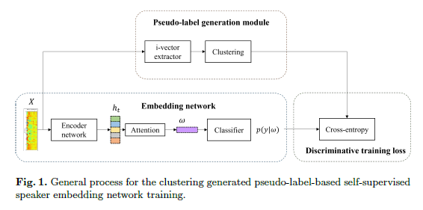
Self-Supervised Speaker Embedding Extraction System
After training the encoder and classifier networks, the classifier is discarded, and the encoder is used for extracting the embedding vectors.
we have experimented with 2 types of encoder architectures:
ECAPA-TDNN.
Hybrid: a CNN-LSTM-TDNN hybrid architecture with multi-level global-local statistics pooling.
Notes:
-MFCC are generally considered unusable for speech synthesis
-2D-CNN layers to capture the spatial correla- tions within the input images and construct informative features by fusing both spatial and channel-wise information within lo- cal receptive fields, multiple attention heads for attending dif- ferently to parts of the images, and fully connected MLPs as universal function approximators. Therefore, we expect at least some of these architectures to extract relevant information for spoof detection taking, for instance, into account both time- and frequency-correlations when considering the mel-spectrogram feature as a 2D-image, by learning to focus on the small but im- portant anomalous parts of the spectrogram via attention mech- anisms depending on the context, and/or through adaptive re- calibration of channel-wise feature responses via Squeeze-and- Excitation blocks that explicitly model interdependencies be- tween our HPSS-based channels.

Slide 5
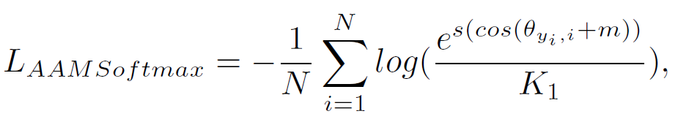
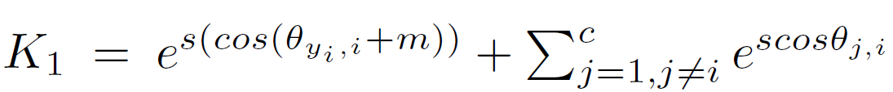


Self-Supervised Angular Additive Margin Softmax
(AAMSoftmax) Objective
To improve out-of-sample generalization, the AAMSoftmax objective is formulated as follows:
N is the batch size, c is the number of classes, and s is the scale factor.
: label index (made possible by using clustering algorithms).
: the angle between the column vector of weight matrix Wj and the i-th embedding ωi.
M : a margin to encourage the similarity of correct classes to be greater than that of incorrect classes.
where
Notes:
-MFCC are generally considered unusable for speech synthesis
-2D-CNN layers to capture the spatial correla- tions within the input images and construct informative features by fusing both spatial and channel-wise information within lo- cal receptive fields, multiple attention heads for attending dif- ferently to parts of the images, and fully connected MLPs as universal function approximators. Therefore, we expect at least some of these architectures to extract relevant information for spoof detection taking, for instance, into account both time- and frequency-correlations when considering the mel-spectrogram feature as a 2D-image, by learning to focus on the small but im- portant anomalous parts of the spectrogram via attention mech- anisms depending on the context, and/or through adaptive re- calibration of channel-wise feature responses via Squeeze-and- Excitation blocks that explicitly model interdependencies be- tween our HPSS-based channels.

Slide 6
Experiments
We conducted a set of experiments based on the VoxCeleb2 dataset.
For training the embedding networks, we used the development subset of the VoxCeleb2 dataset: 1,092,009 utterances collected from 5,994 speakers.
The evaluation was performed according to the original VoxCeleb1 trial list: 4,874 utterances spoken by 40 speakers.
For more challenging trials: we have also conducted experiments on the VoxCeleb Speaker Recognition Challenge (VoxSRC) 2021 validation set.
Acoustic features: we use 40-dimensional Mel-frequency cepstral coefficients (MFCCs) extracted at every 10 ms, using a 25 ms Hamming window.
Data augmentation: we have used waveform-level additive noise and room impulse response (RIR) simulation.
For the ECAPA-TDNN systems: we have also applied specaugment augmentation over the extracted MFCCs.
For the Hybrid systems: we have applied specaugment to the spectrogram of the input speech.
Verification scoring:
For the ECAPA-TDNN systems: we use Cosine similarity.
For the hybrid networks: we use PLDA, trained on VoxCeleb2 development set with pseudo labels.
Notes:
-MFCC are generally considered unusable for speech synthesis
-2D-CNN layers to capture the spatial correla- tions within the input images and construct informative features by fusing both spatial and channel-wise information within lo- cal receptive fields, multiple attention heads for attending dif- ferently to parts of the images, and fully connected MLPs as universal function approximators. Therefore, we expect at least some of these architectures to extract relevant information for spoof detection taking, for instance, into account both time- and frequency-correlations when considering the mel-spectrogram feature as a 2D-image, by learning to focus on the small but im- portant anomalous parts of the spectrogram via attention mech- anisms depending on the context, and/or through adaptive re- calibration of channel-wise feature responses via Squeeze-and- Excitation blocks that explicitly model interdependencies be- tween our HPSS-based channels.

Slide 7
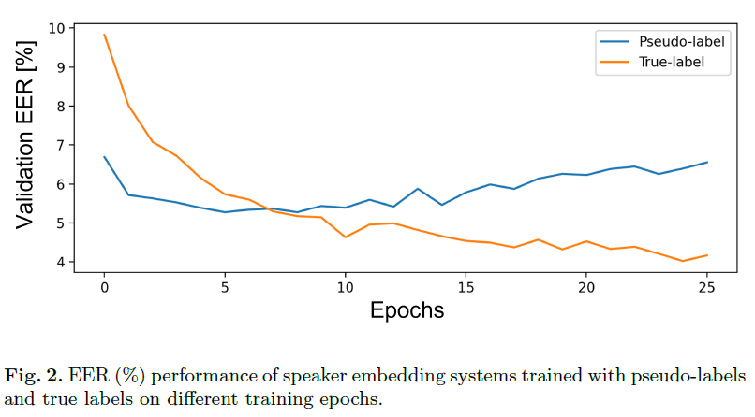
RESULTS | training behaviour
Notes:
Figure 2 shows the VoxCeleb1-O equal error rate (EER) performance of the ECAPA-TDNN systems trained with true
speaker labels and GMM pseudo labels on different training epochs

Slide 8
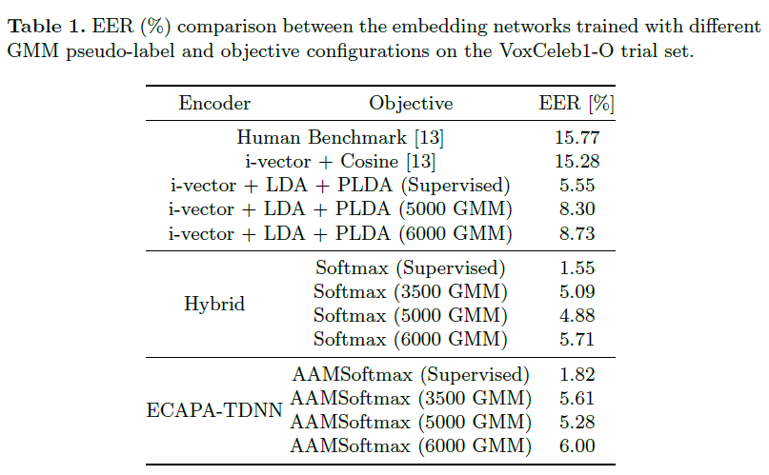
RESULTS | Different GMM pseudo-labels configurations
Notes:
Figure 2 shows the VoxCeleb1-O equal error rate (EER) performance of the ECAPA-TDNN systems trained with true
speaker labels and GMM pseudo labels on different training epochs

Slide 9
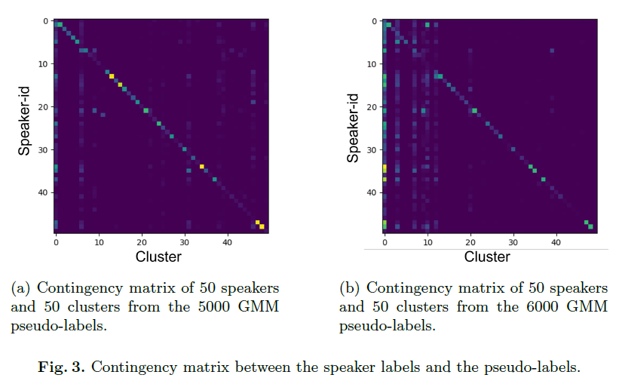
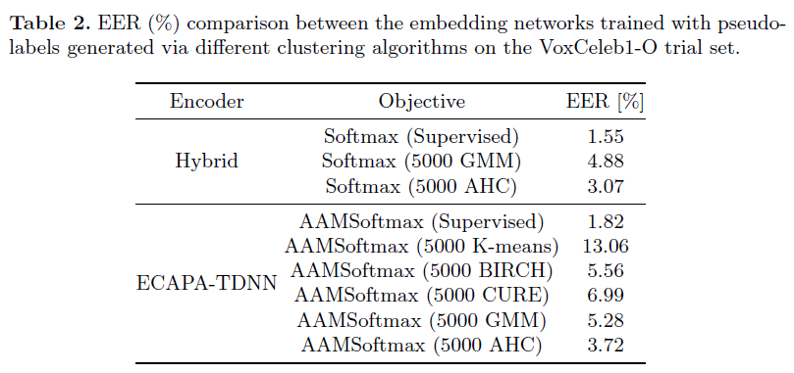
RESULTS | CONTINGENCY MATRIX & clustering algorithms
Notes:
Figure 2 shows the VoxCeleb1-O equal error rate (EER) performance of the ECAPA-TDNN systems trained with true
speaker labels and GMM pseudo labels on different training epochs

Slide 10
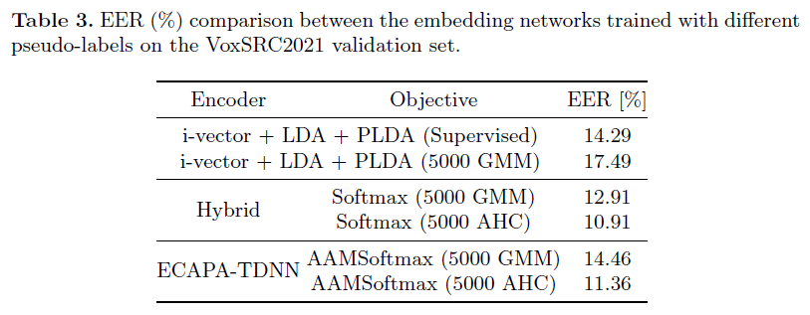
RESULTS | VoxSRC2021
Notes:
Figure 2 shows the VoxCeleb1-O equal error rate (EER) performance of the ECAPA-TDNN systems trained with true
speaker labels and GMM pseudo labels on different training epochs

Slide 11
conclusion
The performance of the pseudo-label-based self-supervised speaker verification system is crucially dependent on the quality of the clustering model.
The best performance was observed from the Hybrid system trained with the AHC pseudo-labels, which yielded 3.07% EER.
We investigated the effect of different configurations for generating the pseudo-labels on the self-supervised speaker verification task.
Our results showed that the pseudo-label-based self-supervised speaker embedding systems can show comparable performance to the supervised embedding systems and even outperform the human benchmark performance and the conventional i-vector framework.
We could see that the performance of the pseudo-label-based self-supervised speaker embedding systems heavily depends on the accuracy of the pseudo-labels.
We observed that the speaker verification performance can be severely degraded when overfitting to the inaccurately generated pseudo-labels.
Notes:
-MFCC are generally considered unusable for speech synthesis
-2D-CNN layers to capture the spatial correla- tions within the input images and construct informative features by fusing both spatial and channel-wise information within lo- cal receptive fields, multiple attention heads for attending dif- ferently to parts of the images, and fully connected MLPs as universal function approximators. Therefore, we expect at least some of these architectures to extract relevant information for spoof detection taking, for instance, into account both time- and frequency-correlations when considering the mel-spectrogram feature as a 2D-image, by learning to focus on the small but im- portant anomalous parts of the spectrogram via attention mech- anisms depending on the context, and/or through adaptive re- calibration of channel-wise feature responses via Squeeze-and- Excitation blocks that explicitly model interdependencies be- tween our HPSS-based channels.

Slide 12
Q & A

