Slide 1
Weekly Report
2026/09/14
Amir Fathi

Slide 2
Highlights
Highlights of this week:
  Measured new SLBs with 50% BMP and TAT at 0.5 µM 500 FPS
  FFT filtering Pipeline
Next:
  Process the new GNPs SPT data with the new pipline
  Follow up withe fs-laser chiller problem
  Do SPT with iSCAT for BMP 50% + TAT with higher concentration
  Experiment with the idea of fringe suppression with z Stacking
  As in domains show more confinement, find a way to quantify the confinement using gyration tensor, ergodicity analysis, transient confinement analysis, and other metrics
  Do more experiments for phase separation
  Find a way to calibrate confocal image with the iSCAT image
  More simulation for the random phase mask to find the optimal parameters for the diffuser

Slide 3
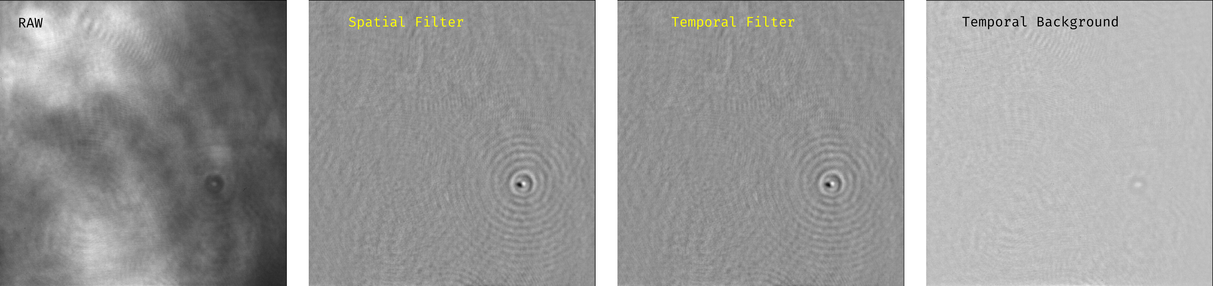
Background Correction Pipeline
I have developed a pipeline to correct the background in iSCAT images. This will be the first steps in preparing the images for SPT. The pipeline includes: 1. Spatial filtering to remove the background by a large Gaussian kernel. 2. Temporal filtering to remove the slow variation of the background frame to frame.

Slide 4
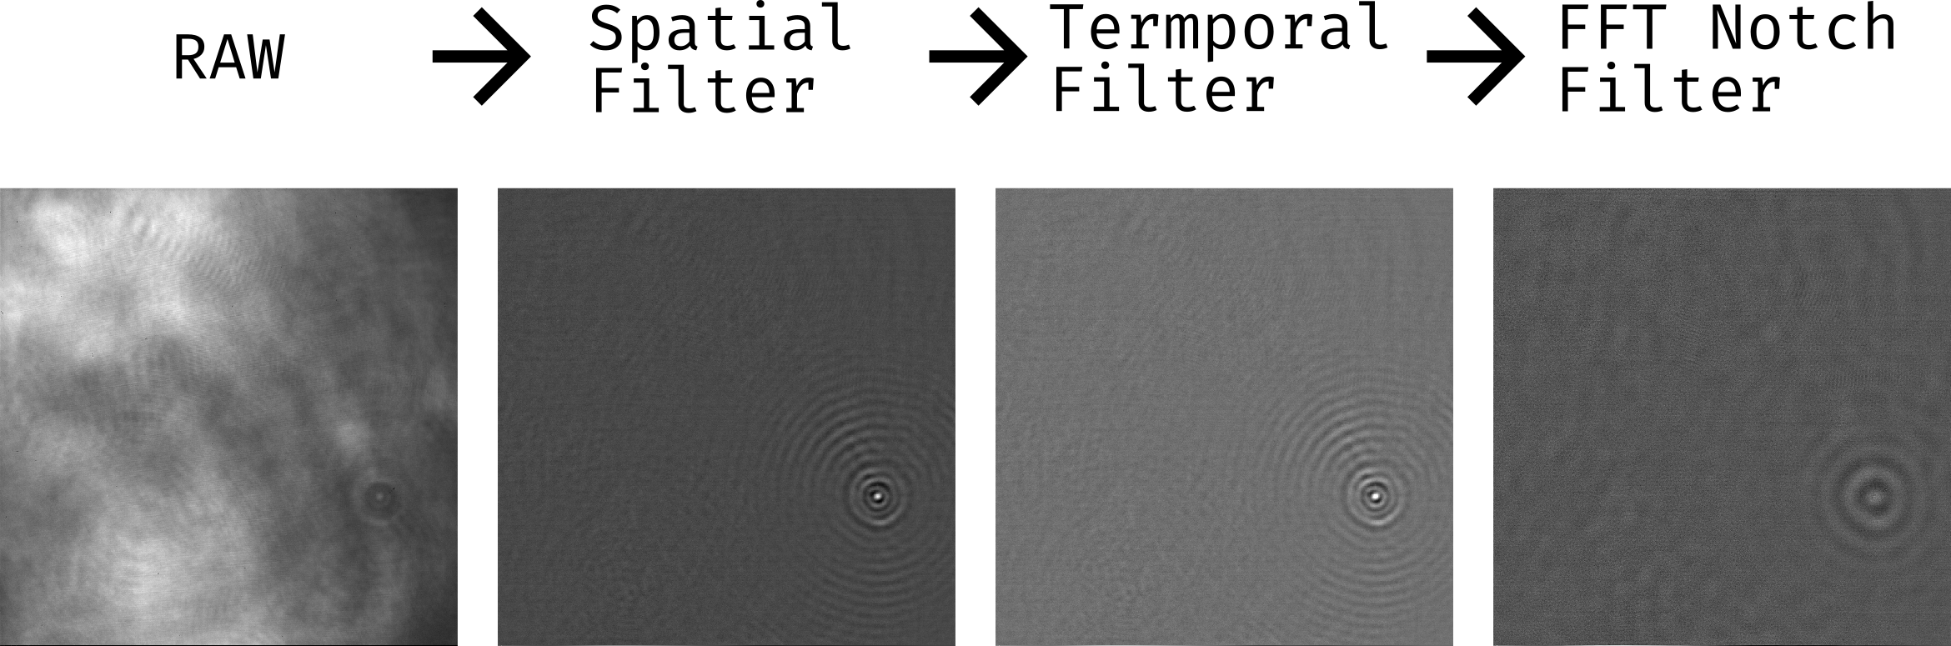
iSCAT image prepration for SPT
To track the GNPs in iSCAT without synchronized beam scanning, it is crucial to prepare the images before tracking. Three different filtering methods are used to prepare the images for tracking: 1. Spatial filtering to remove by a large Gaussian kernel to remove the background. 2. Temporal filtering to remove the slow variation of the background frame to frame. 3. FFT filtering to remove the fringes and other artifacts in the image at certain spatial frequencies.

Slide 5
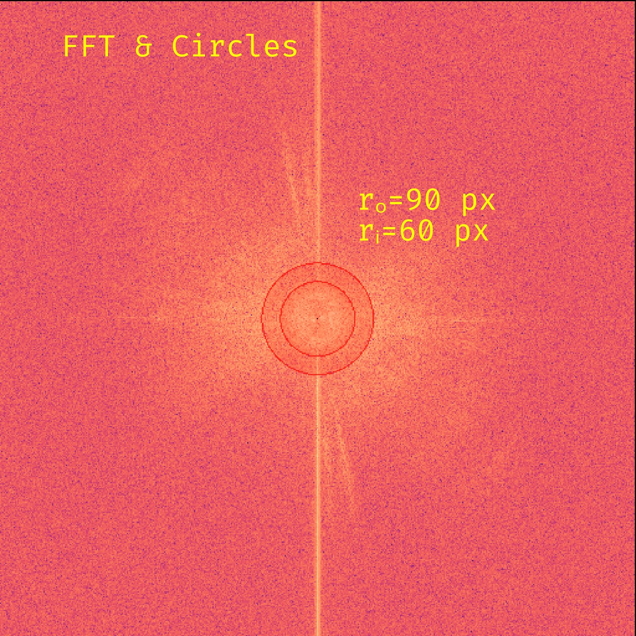
FFT Frequency Selection
I have developed several filters for toroidal notch or toroidal pass-band, radial low-pass, and radial high-pass filters. I first visualize the FFT of the image and draw the desired frequency range to select the frequencies to be filtered. The radius can be used in the toroidal or radial filters in the image processing pipeline. I am still tweaking and tuning the parameters to find a good set of parameters for the filters. The FFT filtering should be consistent over the frames and ease the tracking of the GNPs in the iSCAT images.

Slide 6
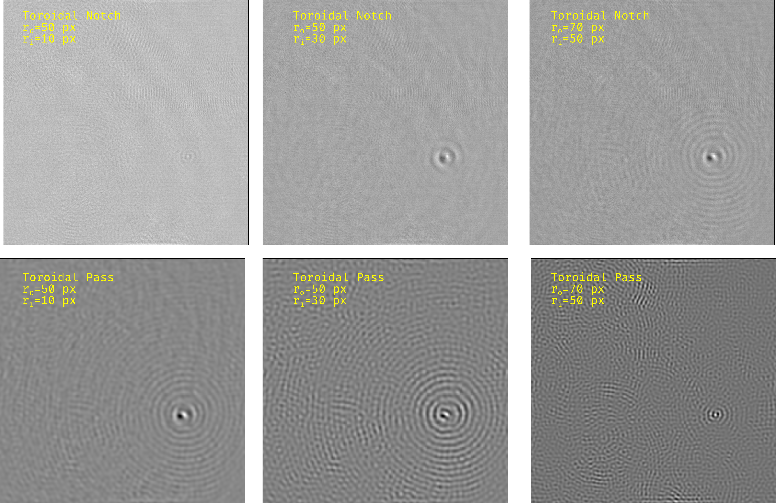
Toroidal Filter
I have shown here some results for different radius sets for the toroidal filter.

Slide 7
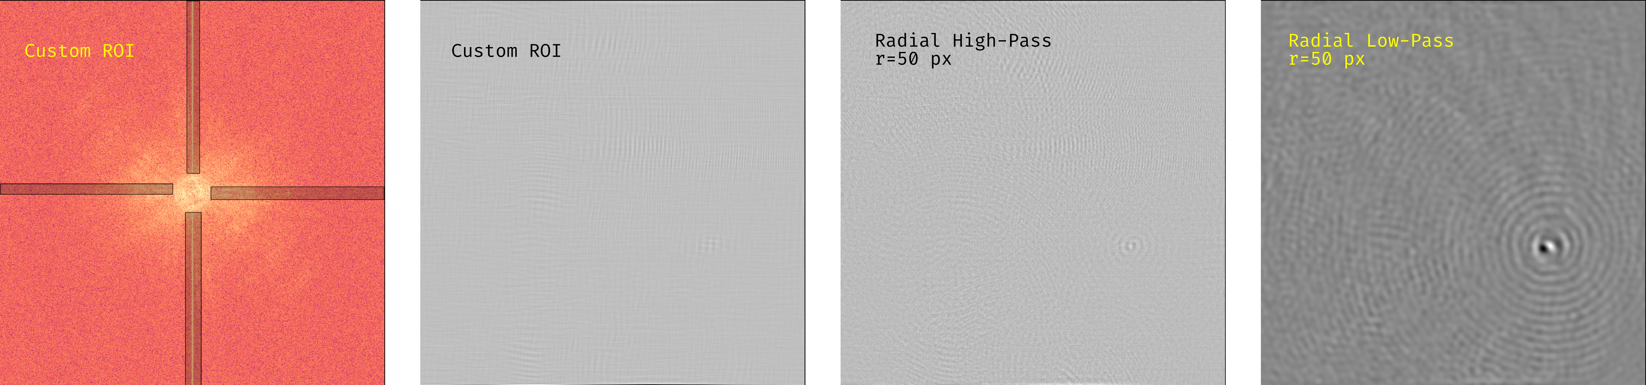
Radial and Custom ROI Filter
I have also developed radial and custom ROI filters for the image processing pipeline. The custom ROI filter is useful for patterns that are not circular or toroidal. I have shown a typical use case where the custom ROI filter is used to remove horizontal and vertical fringes

Slide 8
Meeting Summary
Paul
Paul repeated the TAT affinity experiment and the data analysis is ongoing.
He is also working on to improve his python script to address the large population of trajectories with α very close to zero.
Additionally, he found an issue where the fitting results did not consider the missed frames during tracking. He is working on a solution to address this issue.
We also discussed the short-lived τ values (20-50 ms) being very close to the frame duration (20 ms) and how to address this issue. One solution is to fit the data in two steps for the two time constants.
Tony
Tony finished measuring and analysis of TAT-B and TAT-R with domain coverage around 1%.
He also measures domains dynamics over time (for two hours) and will be reported after analyzing the data.
Peggy
Peggy developed the assay to mark the LNPs and the proteins and quantify the coronation with flow cytometry. There is a cross-talk between the two fluorophore markers due to energy transfer. Maybe this can be addressed by some experimental calibration for low to high coronation strategy before comparing the two LNP groups.
Andrew
Andrew repeated the experiment with TAT-6+ with Atto488-DOPE and Bodipy-DOPC markers. In both cases, in contrast to earlier experiments from Paul and Tony, the TAT-6+ shows domain formation.

