Slide 1


Slide 2
PHP Introduction
PHP is a recursive acronym for “PHP: Hypertext Preprocessor” -- It is a widely-used open source general-purpose scripting language that is especially suited for web development and can be embedded into HTML.

Slide 3
PHP Introduction
PHP is a server-side scripting language
PHP scripts are executed on the server
PHP supports many databases (MySQL, Informix, Oracle, Sybase, Solid, PostgreSQL, Generic ODBC, etc.)‏
PHP is open source software
PHP is free to download and use

Slide 4
PHP Introduction
PHP runs on different platforms (Windows, Linux, Unix, etc.)‏
PHP is compatible with almost all servers used today (Apache, IIS, etc.)‏
PHP is FREE to download from the official PHP resource: www.php.net
PHP is easy to learn and runs efficiently on the server side

Slide 5
PHP Introduction
Instead of lots of commands to output HTML (as seen in C or Perl), PHP pages contain HTML with embedded code that does "something" (like in the next slide, it outputs "Hi, I'm a PHP script!").
The PHP code is enclosed in special start and end processing instructions <?php and ?> that allow you to jump into and out of "PHP mode."

Slide 6
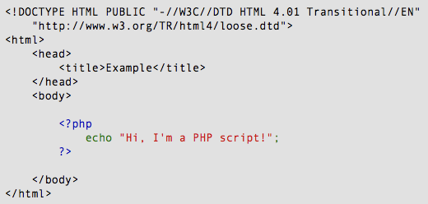
PHP Introduction

Slide 7
PHP Introduction
PHP code is executed on the server, generating HTML which is then sent to the client. The client would receive the results of running that script, but would not know what the underlying code was.
A visual, if you please...

Slide 8
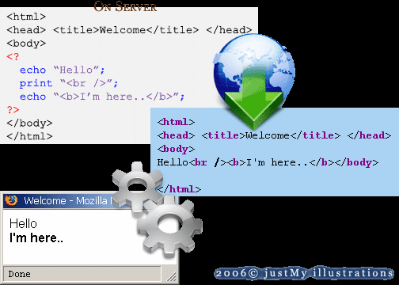
PHP Introduction

Slide 9
PHP Getting Started
On windows, you can download and install WAMP. With one installation and you get an Apache webserver, database server and php.
http://www.wampserver.com
On mac, you can download and install MAMP.
http://www.mamp.info/en/index.html

Slide 10
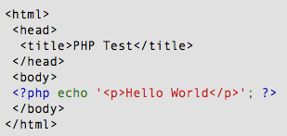
PHP Hello World
Above is the PHP source code.

Slide 11
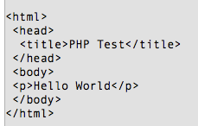
PHP Hello World
It renders as HTML that looks like this:

Slide 12
PHP Hello World
This program is extremely simple and you really did not need to use PHP to create a page like this. All it does is display: Hello World using the PHP echo() statement.
Think of this as a normal HTML file which happens to have a set of special tags available to you that do a lot of interesting things.

Slide 13
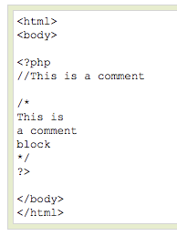
PHP Comments
In PHP, we use // to make a single-line comment or /* and */ to make a large comment block.

Slide 14
TEXT BOOK
1. Steven Holzner, “The Complete Reference PHP”, Tata McGraw Hill Pvt.Ltd., 2008.
BOOK FOR REFERENCE
1. Leon Atkinson, “Core PHP Programming”, Pearson Education, 2004.

Slide 15
THANK YOU

