Slide 1
SIEMENS DATA SCIENCE CONTEST · IEDC SUMMIT 2026
Kerala Landslide Risk Estimation
Using Rainfall, Terrain Susceptibility and Land-Use Factors
A data-driven prototype analyzing how rainfall exposure, geological susceptibility, and
land-use characteristics relate to observed landslide locations in Kerala during the 2018 monsoon.
Fathima M J | B.Tech Artificial Intelligence & Data Science | Ilahia College of Engineering and Technology

Slide 2
The Problem
Kerala's monsoon landslide crisis
4,728
3
60
Landslides mapped across
Kerala in the 2018 monsoon
Distinct landslide types recorded— Debris Flow, Shallow Slide, Rockfall
Rainfall stations available
to characterize the entire state
Existing susceptibility maps (e.g. GSI) rate terrain risk, but they are static, expert-derived classifications — they do not directly incorporate the dynamic rainfall conditions or land-use context present at the time of an event. 65.9% of the 2018 landslides — nearly two-thirds — occurred in areas GSI classified as only Moderate or Low susceptibility, not High — suggesting these existing maps alone don't fully explain where and how landslides happen.
The question: can rainfall and land-use data add meaningful insight beyond what existing susceptibility maps already tell us?
Kerala Landslide Risk Estimation
2

Slide 3
Motivation
1
Human & economic cost
2
Rainfall is the trigger, but rarely modeled directly
Landslides in Kerala regularly damage homes, roads, agriculture and claim lives — most severely during intense monsoon rainfall spells.
Most susceptibility mapping is terrain-only. Actual rainfall exposure at the time and place of each landslide is often left out of the picture.
3
Landslides are not all the same
4
A genuine, honest data science opportunity
Debris flows, shallow slides, and rockfalls have different mechanisms and different mitigation needs — treating them as one category hides useful structure.
Kerala's 2018 inventory, rainfall records, and susceptibility layers already exist — they simply haven't been integrated and analyzed together at this scale.
Kerala Landslide Risk Estimation
3

Slide 4
Research Gap & Framing
Why I did NOT build an occurrence prediction model
The 2018 inventory contains only confirmed landslide locations — no reliable "landslide did not happen here" (negative) samples. Building a landslide-vs-non-landslide classifier without proper background sampling would be scientifically indefensible, so I deliberately avoided it.
Instead, my research question:
“Can rainfall and land-use information provide additional predictive insight beyond existing GSI susceptibility — in distinguishing the type of landslide mechanism observed?”
This is answered through a legitimate supervised multiclass classification task: predicting landslide type (Debris Flow / Shallow Slide / Rockfall) from environmental, pre-event characteristics — a task fully supported by the ground-truth labels already present in the inventory.
Kerala Landslide Risk Estimation
4

Slide 5
Proposed Approach
1
2
3
4
→
→
→
Integrate
Engineer
Model
Interpret
Spatial data fusion in QGIS — rainfall, GSI susceptibility, land use joined to every landslide point
Select honest, pre-event environmental predictors; remove any post-event / outcome fields
Multiclass ML in Altair AI Studio (RapidMiner) — Decision Tree, Random Forest, Gradient Boosted Trees
5-fold cross-validation, per-class metrics, feature importance — honest reporting of strengths & limits
End-to-end pipeline
Raw data → QGIS spatial integration → Integrated dataset → Altair AI Studio (ML) → Landslide-type classification → Feature importance → Risk characterization
Kerala Landslide Risk Estimation
5

Slide 6
Datasets Used
Dataset | Source / Content | Size
Landslide inventory | 2018 Kerala monsoon landslide points, incl. type (Debris Flow / Shallow Slide / Rockfall) | 4,728 points
Rainfall station data | 60 stations — total, mean daily, and max 1/3/7-day rainfall, coverage ratio | 60 stations
GSI susceptibility | Geological Survey of India landslide susceptibility polygons (High / Moderate / Low) | Statewide
Land use | Land-use classification for 2010 and 2018 (24–25 categories) | Statewide
Dataset
Source / Content
Size
Final analysis-ready dataset
4,606 of 4,728 landslides (97.42%) retained — records with valid GSI susceptibility, complete rainfall data (0 missing, every landslide matched to a nearest station), and confirmed land-use labels.
The remaining 122 records (2.58%) lacked GSI susceptibility and were excluded from modelling, not deleted.
Kerala Landslide Risk Estimation
6

Slide 7
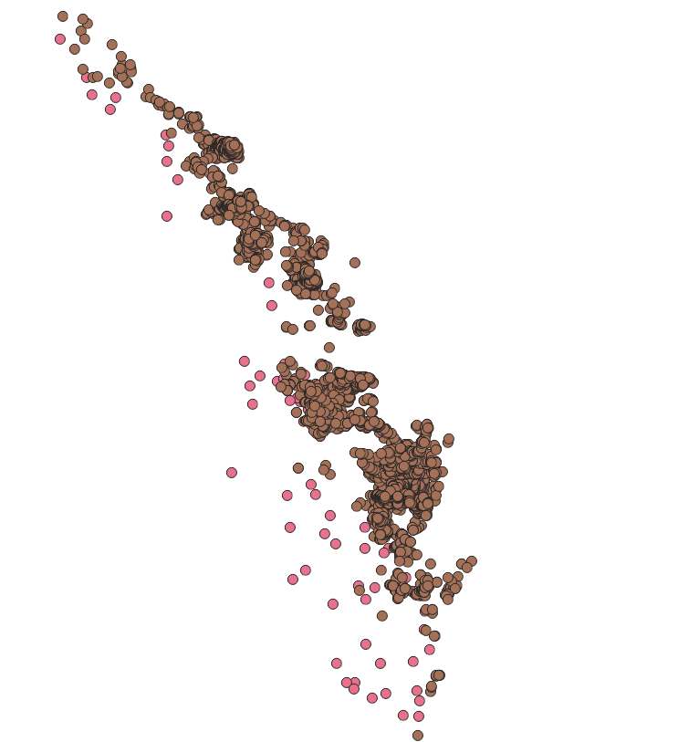
Data Preprocessing & Spatial Integration — QGIS
1
Loaded 60 rainfall stations (CSV, lat/long) as a point layer in WGS84
2
Reprojected rainfall stations to EPSG:32643 (UTM 43N, metres) to match landslide/GSI layers
3
“Join Attributes by Nearest” — matched each of 4,728 landslides to its nearest rainfall station
4
Verified 0 unmatched landslides; distance ranged ~1 km to ~78 km (recorded as a data-confidence field)
IMAGE PLACEHOLDER
QGIS workflow diagram / spatial
join screenshot
(rainfall → landslide nearest-join)
5
Filtered to 4,606 records with valid GSI susceptibility for the modelling dataset
6
Exported final integrated layer to CSV for machine learning in Altair AI Studio
Spatial join: nearest rainfall station matched to each landslide location
Kerala Landslide Risk Estimation
7

Slide 8
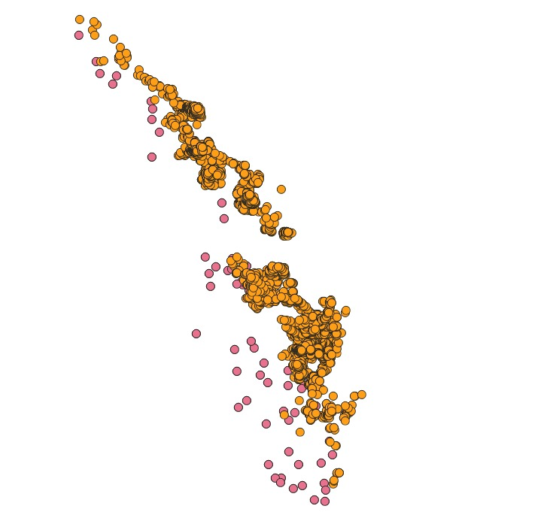
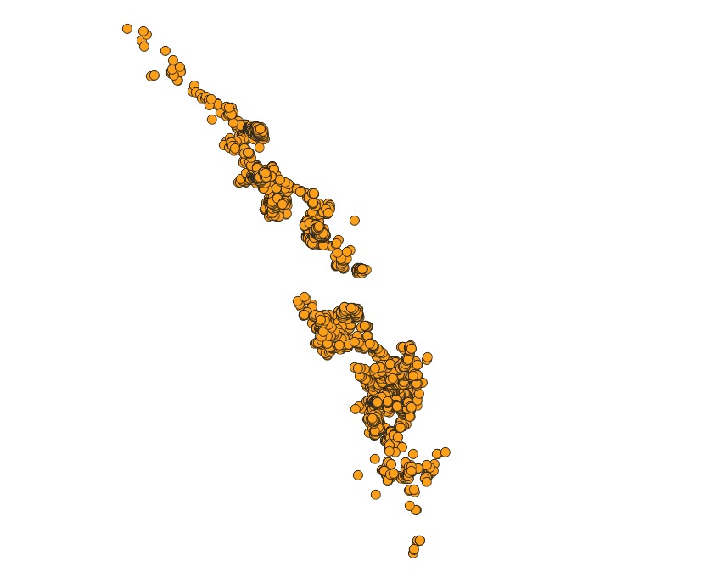
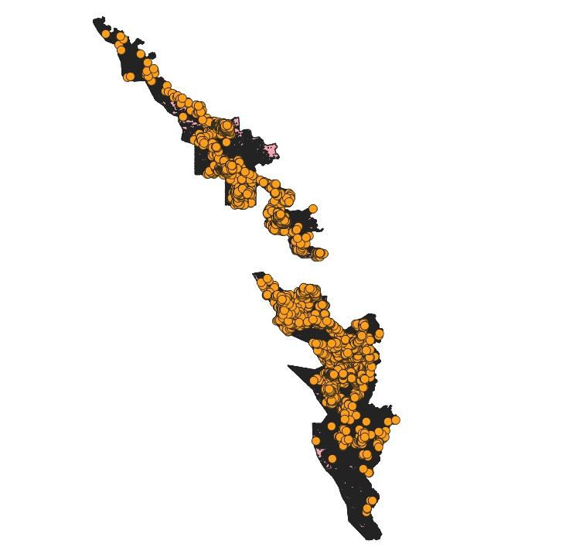
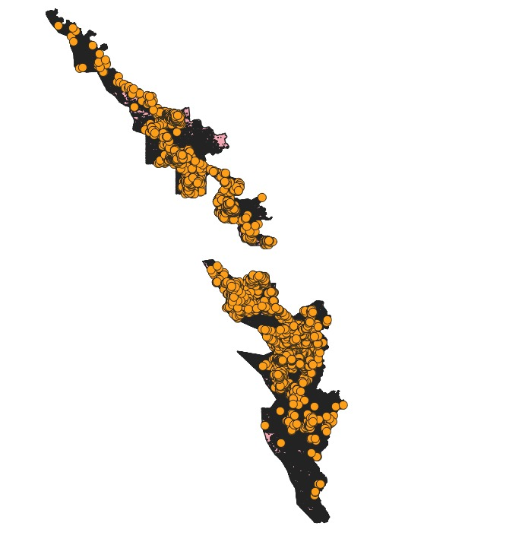
Spatial Integration — QGIS Maps
Kerala 2018 landslide
distribution
GSI susceptibility + landslides
Rainfall + landslide map
Final integrated QGIS map
Kerala Landslide Risk Estimation
8

Slide 9
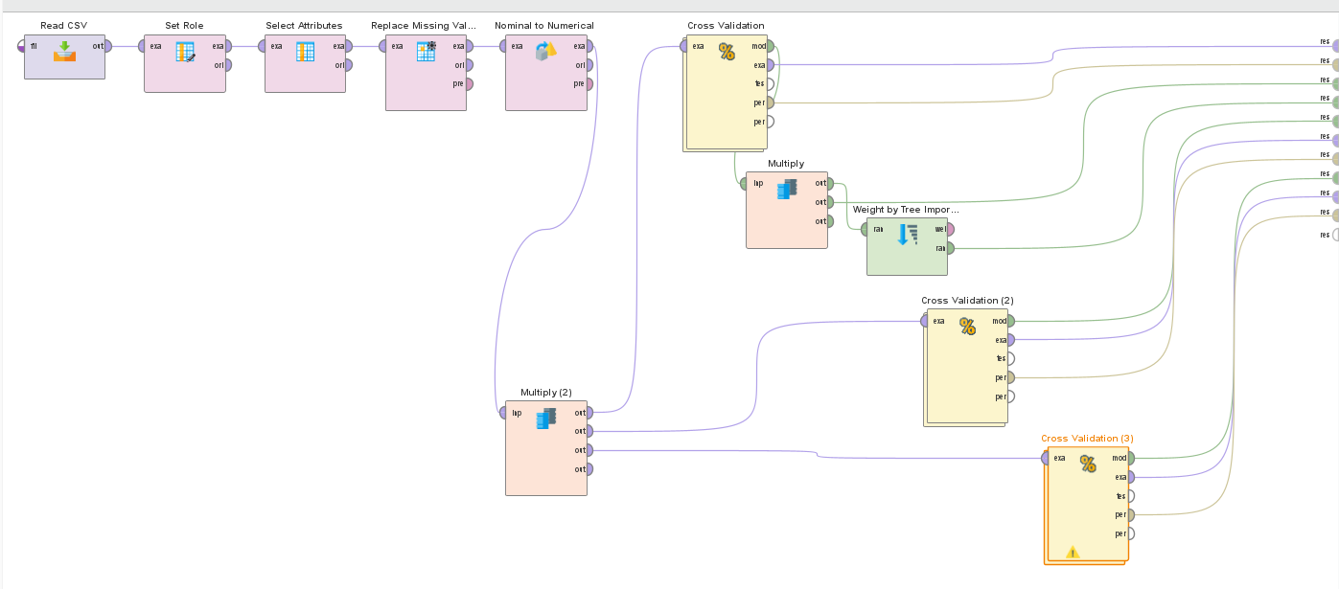
Machine Learning Workflow — Altair AI Studio
Read CSV → Set Role → Select Attributes → Replace Missing Values → Nominal to Numerical → Cross Validation ( Model → Apply Model → Performance )
IMAGE PLACEHOLDER
Full RapidMiner / AI Studio process canvas
(Read CSV → preprocessing → Cross Validation)
Kerala Landslide Risk Estimation
9

Slide 10
Machine Learning Workflow — Altair AI Studio
Target & predictors
Target (label): Type_of_sl
→ Debris Flow · Shallow/Surficial Slide · Rockfall
Excluded (leakage risk): Area, Length, Width, Damage, Remarks, coordinates, source-confirmation flags, distance-to-station
Predictor set (9 features → 34 after encoding)
GSI_Susceptibi · LU_2010 · RASTERVALU (slope) · Total_Rainfall · Mean_Daily_Rainfall · Max_1Day_Rainfall · Max_3Day_Rainfall · Max_7Day_Rainfall · Coverage_Ratio
Kerala Landslide Risk Estimation
10

Slide 11
Results — Model Comparison
5-fold cross-validation · 4,606 records · 3-class target (Debris Flow / Shallow Slide / Rockfall)
Metric | Decision Tree | Random Forest | Gradient Boosted Trees
Overall Accuracy | 72.12% | 73.88% | 73.93%
Debris Flow — Recall | 68.00% | 72.57% | 76.40%
Shallow Slide — Recall | 83.08% | 81.36% | 74.22%
Rockfall — Recall | 20.39% | 11.84% | 22.37%
Rockfall — Precision | 50.82% | 60.00% | 60.71%
Metric
Decision Tree
Random Forest
Gradient Boosted Trees
Gradient Boosted Trees achieved the best overall accuracy while also giving the best recall and precision on the minority Rockfall class — a genuine, non-trivial finding, not just “highest accuracy wins.”
Kerala Landslide Risk Estimation
11

Slide 12
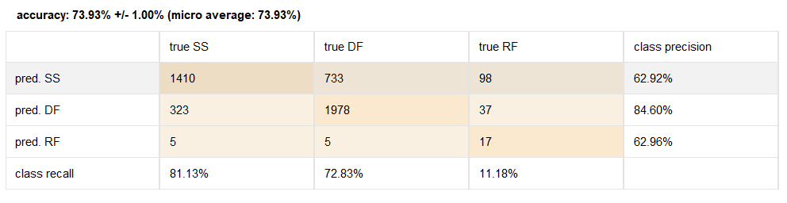
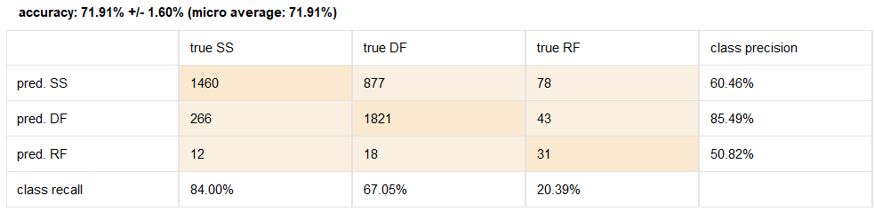
Results — Confusion Matrices
Random Forest
Decision Tree
Decision Tree
Kerala Landslide Risk Estimation
12

Slide 13
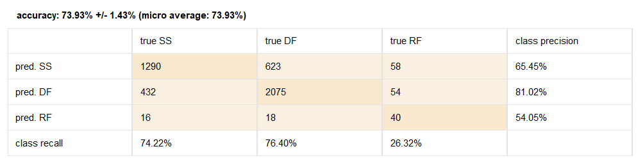
Results — Confusion Matrices
Gradient Boosted Trees
Kerala Landslide Risk Estimation
13

Slide 14
Feature Importance & Key Findings
Rank | Feature | Importance
1 | Slope (RASTERVALU) | 2.942
2 | Coverage_Ratio * | 0.775
3 | Total_Rainfall | 0.559
4 | Mean_Daily_Rainfall | 0.558
5 | Max_1Day_Rainfall | 0.464
6 | Max_3Day_Rainfall | 0.365
7 | GSI_Susceptibi (High) | 0.338
Rank
Feature
Importance
What this tells us
✓
Slope is by far the dominant predictor of landslide type — roughly 4× the next-highest feature.
Rainfall intensity measures (total, mean daily, 1/3-day max) form a strong second tier.
✓
GSI susceptibility contributes meaningfully — confirming it still carries real signal.
✓
Individual land-use categories (LU_2010) were the weakest group of predictors overall
✓
* Coverage_Ratio reflects rainfall-data reliability rather than a true physical driver — noted as a caveat, not treated as a causal factor.
Kerala Landslide Risk Estimation
14

Slide 15
Honest Limitations
What this project does NOT claim
✗
Does not predict whether a landslide will occur — no reliable negative samples exist in this inventory
✗
Does not provide real-time early warning — event-level rainfall timing is not available per landslide
✗
Does not establish causation between land-use and landslides — only association is examined
Genuine limitations in the data & results
•
Rockfall is a small minority class (n=152, ~3%) — all three models show limited recall on it
•
Only 60 rainfall stations statewide; some landslides are matched to a station up to ~78 km away
•
Coverage_Ratio ranked highly in importance — may partly reflect data quality, not physical cause
•
122 landslides (2.58%) lacked GSI data and were excluded from modelling, not deleted
Kerala Landslide Risk Estimation
15

Slide 16
Conclusion
An integrated QGIS and machine learning pipeline was built to analyze 4,606 confirmed landslide locations from Kerala's 2018 monsoon inventory. Rainfall characteristics — particularly total, mean daily, and short-duration maximum rainfall — along with slope, emerged as the strongest predictors of landslide type, while individual land-use categories contributed comparatively less. Among the three models compared (Decision Tree, Random Forest, and Gradient Boosted Trees), Gradient Boosted Trees delivered the most balanced performance, achieving the highest overall accuracy (73.93%) while also providing the best recall and precision for the minority Rockfall class. All results were evaluated using 5-fold cross-validation to ensure they reflect genuine predictive performance rather than training artifacts, and findings — including the model's limitations on the underrepresented Rockfall class — are reported honestly rather than overstated.
Kerala Landslide Risk Estimation
16

Slide 17
Future Scope
Address class imbalance directly through stratified weighting or targeted data collection to improve Rockfall detection, which remained the weakest-performing class across all three models due to its limited sample size (n=152)
Build a validated, spatially-aware negative/background sample set to enable true landslide-occurrence risk modelling, going beyond the current type-classification approach
Incorporate land-use change between 2010 and 2018 as an explicit predictor, to examine whether shifts in land use (e.g., deforestation, urbanization) are associated with landslide type or severity
Expand the rainfall monitoring network, or apply spatial interpolation techniques, to reduce the distance-based uncertainty in rainfall estimates for landslides located far from existing stations
Map model outputs and feature importance back into QGIS to produce a spatial risk-characterization visualization that could support disaster-preparedness planning in high-susceptibility districts
Kerala Landslide Risk Estimation
17

Slide 18
Thank You
Kerala Landslide Risk Estimation Using Rainfall, Terrain Susceptibility and Land-Use Factors
Questions welcome.

