Slide 1
Analysis and Identification of Malicious Mobile Applications
CSE7101- Capstone Project
Review-2
Batch Number: CCS33
Roll Number | Student Name
20221CCS0155 | FATHIMA HIJAAB IRFAN
20221CCS0120 | AAMINA SULTAN
20221CCS0111 | TANISHA N
Under the Supervision of
Dr. Syed Siraj Ahmed
Associate Professor
School of Computer Science and Engineering
Presidency University
Name of the Program: Computer Science & Engineering (Cyber Security)
Name of the HoD: Dr. Anandaraj S.P
Name of the Program Project Coordinator: Dr. Sharmasth Vali
Name of the School Project Coordinators: Dr. Sampath A K , Dr. Geetha A

Slide 2
Content
Problem Statement
Abstract
Literature Survey
Objectives
Existing Methods and Drawbacks
Proposed Method & Feasibility Study
System Architecture Diagram
Modules
Hardware and Software Details
Project Timeline
References

Slide 3
Problem Statement Number: 68
Analysis and Identification of Malicious Mobile Applications
Organization: Ministry of Power
Technology Bucket: Blockchain and Cybersecurity
Category: Software
Problem Description:
The rapid growth of mobile applications has significantly increased the risk of cyber threats, as malicious applications can easily disguise themselves and remain undetected on smartphones
Users often accumulate unused applications without realizing the potential security vulnerabilities they pose.
Current detection methods are insufficient in identifying hidden malicious activities such as suspicious network communications, unauthorized data transfers, and abnormal background processes.
Therefore, there is a need to develop a robust mobile application that leverages open-source intelligence and threat feeds to analyze, identify, and mitigate malicious mobile applications, ensuring enhanced security and user protection.

Slide 4
Abstract
The increasing usage of mobile applications across diverse platforms has amplified the risk of malicious software compromising user security and privacy. This project presents a hybrid mobile application designed to detect and analyze malicious behaviors by integrating multiple open-source tools and real-time threat intelligence. Utilizing MobSF for static code analysis, Scapy for dynamic network traffic monitoring, and MISP for continuous threat feed updates, the system offers comprehensive detection that is both explainable and actionable for end users. This solution emphasizes transparency, multi-layered analysis, and practical deployment, providing users with clear alerts and insights into suspicious app activities across mobile platforms. By leveraging existing robust technologies in an innovative, combined framework, the app enhances mobile device security against a wide spectrum of evolving threats.

Slide 5
Literature Survey (sources in references)
Integration and Interpretability in Hybrid Detection
Hybrid malware detection combines static analysis (permissions, API and system call graphs) with dynamic analysis (runtime behaviors, network activity, system calls) to address limitations of single approaches and improve detection comprehensiveness.
Explainability is enhanced using visualization techniques like Grad-CAM heatmaps on CNN classifiers to highlight critical API calls, helping reduce black-box issues in ML-based detection.
Feature engineering focusing on selecting top-ranked permissions and system calls improves classification accuracy and robustness, as demonstrated in recent studies.

Slide 6
Literature Survey (cont.)
Efficient Detection Workflows and Model Performance
Two-stage workflows use lightweight static classifiers to filter clear benign or malicious samples early, reserving resource-intensive hybrid analysis for ambiguous apps, thus optimizing detection efficiency without compromising accuracy.
Ensemble methods like Random Forest often outperform other ML algorithms when combining static and dynamic features, providing reliable malware detection with balanced data.
Dataset quality impacts detection; continuously updated datasets reflecting current malware variability are critical to maintain model effectiveness and adapt to new threats.

Slide 7
Literature Survey (cont.)
Challenges and Future Directions in Mobile Malware Detection
Reliance on emulator environments limits the realism of malware detection; moving towards real device testing and on-device detection is essential but challenged by resource and security constraints.
Balancing cloud-based processing with on-device analysis provides a scalable protection framework, where cloud can handle heavy computation while devices perform real-time detection, demanding hybrid deployment strategies.
Improving malware behavior triggering through advanced input generation methods enhances dynamic analysis coverage and malware activation, critical for uncovering sophisticated threats.

Slide 8
Objectives
Develop a hybrid detection system that combines static analysis (app permissions, code structure), dynamic analysis (runtime behaviors, system calls), and network traffic monitoring to identify malicious mobile applications.
Integrate open-source tools and threat intelligence feeds (MobSF, Scapy, MISP) to ensure real-time detection of new and evolving malware variants.
Provide explainable and transparent alerts to end users, clearly showing why an app is flagged as malicious (permissions, suspicious traffic, abnormal background processes).
Ensure practical deployment by building a cross-platform mobile app (React Native frontend, FastAPI backend, MongoDB Atlas database).
Enhance user security and privacy by detecting hidden malicious activities such as:
Unauthorized data transfers
Suspicious network communications
Abnormal background processes
Improve over existing methods by creating a lightweight, scalable, and deployment-ready system instead of only academic or emulator-based solutions.

Slide 9
Existing Methods and Drawbacks
Current Scenario:
Mobile devices, particularly Android, dominate the market with a vast app ecosystem that cybercriminals exploit via third-party stores and platform fragmentation.
60% of security flaws are found on the client (mobile device) side
Android accounts for 43% of client-side vulnerabilities, compared to iOS with 38%.
Common malware types: Trojans, ransomware, spyware, adware, keyloggers, and botnets that threaten user privacy, data, and finances.
Major security risks: Improper permissions, insecure storage, insecure communication, weak authentication, code tampering
Analysis Methods:
TAN-Based Hybrid Model for Android Malware Detection
Static and Dynamic Analysis of Android Malware
Anomaly Detection Using One-Class K-Nearest Neighbors (OC-KNN)
SCANDAL: Static Analyzer for Privacy Leaks
DroidData: Static and Dynamic Data Transfer Monitoring
Drawbacks:
Static analysis is limited by obfuscation, polymorphism, and zero-day threats.
Dynamic analysis is resource-heavy and may miss some malware.
Machine learning needs large data, is vulnerable to attacks, and is resource-intensive.
Hybrid methods add complexity and resource use.

Slide 10
Existing Methods and Drawbacks (cont.)
Goal:
Detect Android malware using a lightweight approach.
Combine permissions requested by apps (static analysis) with network traffic features (dynamic analysis).
Use machine learning models (SVM, Decision Tree) for classification.
Methodology:
Collected Android apps (both malware and benign).
Extracted permissions from the app manifest → converted to binary vectors (1/0).
Monitored basic network activity (packet counts, flow stats).
Combined static and network features.
Trained ML classifiers to predict if an app is malicious or safe.
Drawbacks:
Relies too much on permissions → not reliable (benign apps may also request sensitive permissions).
Network analysis was very shallow, only basic stats (no malicious domain or flow inspection).
Small, outdated dataset → lacks robustness against modern malware.
No dynamic/runtime analysis → misses behavior triggered during execution.
No real-world deployment → purely academic, lab-level experiment.

Slide 11
Proposed Method & Feasibility Study
How Our Project Improves:
  Hybrid approach: Static (MobSF) + Dynamic (runtime monitoring) + Network (Scapy).
  Uses threat intelligence feeds (MISP) to detect new malware variants.
  Single-family focus
  (e.g., BankBot trojan) → more precise and explainable detection.
  Deployment-ready system: React Native (frontend) + FastAPI (backend) + Supabase.
  Provides user alerts and transparency, showing why an app is flagged.
Proposed Solution:
Our mobile app analyzes app behavior and monitors network traffic while referencing threat intelligence feeds to identify potentially malicious applications.
It aims to detect suspicious activities like unauthorized data transfers and unusual background processes.
By providing insights and alerts, the app helps users stay informed about the security status of their device.

Slide 12
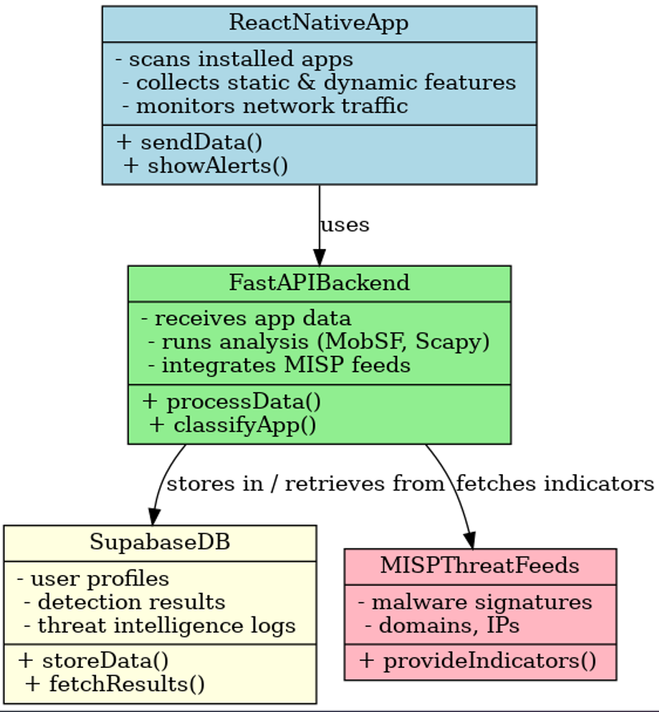
System Architecture Diagram

Slide 13
Modules
Module | What it Does
Static Analysis | Checks app code & permissions
Dynamic Analysis | Monitors app behavior
Network Monitoring | Tracks suspicious traffic
Threat Intelligence | Uses malware threat feeds
Backend (FastAPI) | Handles data & processing
Database (Supabase) | Stores user data & results
Frontend (React Native) | Shows alerts to the user

Slide 14
Software Details:
Software Requirements:
OS: Windows / Linux / macOS
React Native (Frontend)
FastAPI – Python (Backend)
Supabase (Database)
GitHub (Version Control & Deployment)
Cybersecurity Tools: MobSF, Scapy, MISP

Slide 15
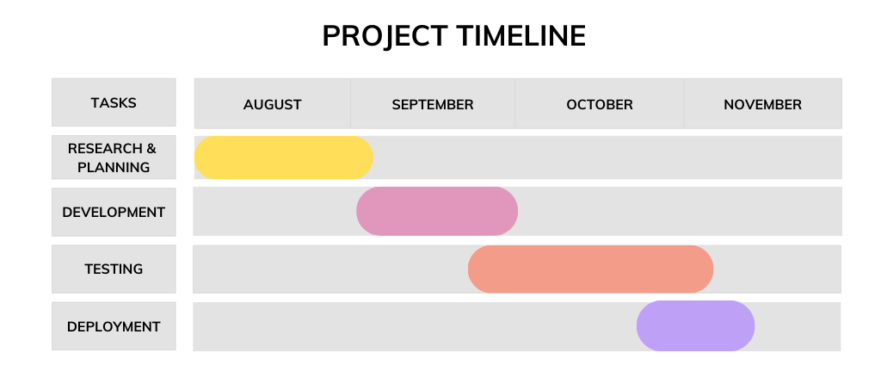
Timeline of the Project (Gantt Chart)

Slide 16
References (IEEE Paper format)
J. Keteku, G. O. Dameh, S. A. Mante, T. K. Mensah, S. L. Amartey, and J.-B. Diekuu, "Detection and Prevention of Malware in Android Mobile Devices: A Literature Review," International Journal of Intelligence Science, vol. 14, no. 4, Oct. 2024, doi: 10.4236/ijis.2024.144005.
S. Kandukuru and R. M. Sharma, "Android Malicious Application Using Permission Vector and Network Traffic Analysis," in 2017 2nd International Conference for Convergence in Technology (I2CT), Pune, India, 2017, pp. 221–226, doi: 10.1109/I2CT.2017.822603.
A. M. S. Abhijith, K. R. Druva, H. K., G. D., and G. S. Rapate, "Detection of Mobile Malware (ANDROID) using ML and Hybrid Analysis," in Proceedings of the 7th Asia Pacific Information Technology Conference (APIT 2025), Hong Kong, China, Jan. 2025, pp. 1–6, doi: 10.1145/3726101.3726103.
A. Kapratwar, "Static and Dynamic Analysis for Android Malware Detection," M.S. thesis, Dept. Computer Science, San Jose State University, San Jose, CA, USA, 2016. [Online]. Available: https://scholarworks.sjsu.edu/etd_projects/488
R. A. Yunmar, S. S. Kusumwardani, Widyawan, and F. Mohsen, "Hybrid Android Malware Detection: A Review of Heuristic-Based Approach," IEEE Access, vol. 12, pp. 41254–41287, 2024, doi: 10.1109/ACCESS.2024.3377658.
A. Mohanraj and K. Sivasankari, "Android traffic malware analysis and detection using ensemble classifier," Ain Shams Engineering Journal, vol. 15, 2024, Art. no. 103134, doi: 10.1016/j.asej.2024.103134.
Kazım Kılıç, ˙Ismail Atacak, and ˙Ibrahim Alper Do˘gru, "FABLDroid: Malware detection based on hybrid analysis with factor analysis and broad learning methods for android applications," Engineering Science and Technology, an International Journal, vol. 62, 2025, Art. no. 101945, doi: 10.1016/j.jestch.2024.101945.
Ashawa, M. A., & Morris, S. (2019). Analysis of Android malware detection techniques: A systematic review. International Journal of Cyber-Security and Digital Forensics, 8(3), 177-194. https://doi.org/10.17781/p002605
Kulkarni, K., & Javaid, A. (Year Unknown). Open Source Android Vulnerability Detection Tools: A Survey. IEEE.
Shakya, S., & Dave, M. (Year Unknown). Analysis, Detection, and Classification of Android Malware using System Calls.

Slide 17


