Slide 1
Analysis and Identification of Malicious Mobile Applications
CSE7101- Capstone Project
Review-1
Batch Number: CCS33
Roll Number | Student Name
20221CCS0155 | FATHIMA HIJAAB IRFAN
20221CCS0120 | AAMINA SULTAN
20221CCS0111 | TANISHA N
Under the Supervision of
Dr. Syed Siraj Ahmed
Associate Professor
School of Computer Science and Engineering
Presidency University
Name of the Program: Computer Science & Engineering (Cyber Security)
Name of the HoD: Dr. Anandaraj S.P
Name of the Program Project Coordinator: Dr. Sharmasth Vali
Name of the School Project Coordinators: Dr. Sampath A K , Dr. Geetha A

Slide 2
Problem Statement Number: 68
Organization: Ministry of Power
Technology Bucket: Blockchain and Cybersecurity
Category: Software
Problem Description:
The rapid growth of mobile applications has significantly increased the risk of cyber threats, as malicious applications can easily disguise themselves and remain undetected on smartphones
Users often accumulate unused applications without realizing the potential security vulnerabilities they pose.
Current detection methods are insufficient in identifying hidden malicious activities such as suspicious network communications, unauthorized data transfers, and abnormal background processes.
Therefore, there is a need to develop a robust mobile application that leverages open-source intelligence and threat feeds to analyze, identify, and mitigate malicious mobile applications, ensuring enhanced security and user protection.

Slide 3
Content
Problem Statement
Objectives
Background and Related work for title Selection
Analysis of Problem Statement
Innovation or Novel Contributions
Git-hub Link
Timeline of the Project
References

Slide 4
Analysis of Problem Statement
Technology Stack Components:
Frontend: React Native
Backend: Python
Database: MongoDB Atlas
Cybersecurity Tools: MobSF, Scapy, MISP
Deployment: GitHub Actions

Slide 5
Detection and Prevention of Malware in Android Mobile Devices: A Literature Review
Related work [1]
Current Scenario:
Mobile devices, particularly Android, dominate the market with a vast app ecosystem that cybercriminals exploit via third-party stores and platform fragmentation.
60% of security flaws are found on the client (mobile device) side
Android accounts for 43% of client-side vulnerabilities, compared to iOS with 38%.
Common malware types: Trojans, ransomware, spyware, adware, keyloggers, and botnets that threaten user privacy, data, and finances.
Major security risks: Improper permissions, insecure storage, insecure communication, weak authentication, code tampering
Analysis Methods:
TAN-Based Hybrid Model for Android Malware Detection
Static and Dynamic Analysis of Android Malware
Anomaly Detection Using One-Class K-Nearest Neighbors (OC-KNN)
SCANDAL: Static Analyzer for Privacy Leaks
DroidData: Static and Dynamic Data Transfer Monitoring
Drawbacks:
Static analysis is limited by obfuscation, polymorphism, and zero-day threats.
Dynamic analysis is resource-heavy and may miss some malware.
Machine learning needs large data, is vulnerable to attacks, and is resource-intensive.
Hybrid methods add complexity and resource use.

Slide 6
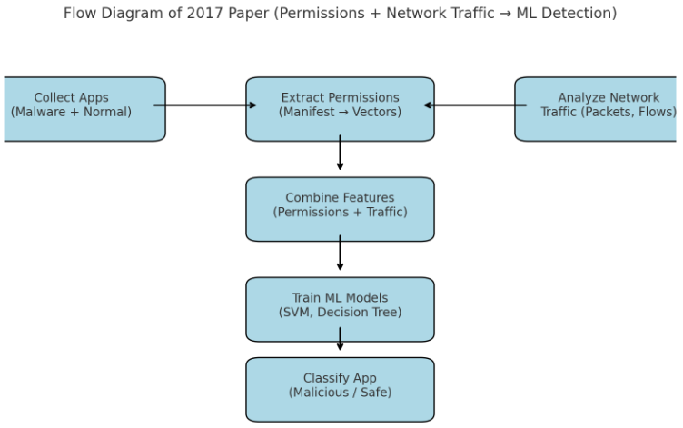
Android Malicious Application Detection Using Permission Vector and Network Traffic Analysis
Related work [2]
Goal:
  Detect Android malware using a lightweight approach.
  Combine permissions requested by apps (static analysis) with network traffic features (dynamic analysis).
  Use machine learning models (SVM, Decision Tree) for classification.
Methodology:
  Collected Android apps (both malware and benign).
  Extracted permissions from the app manifest → converted to binary vectors (1/0).
  Monitored basic network activity (packet counts, flow stats).
  Combined static and network features.
  Trained ML classifiers to predict if an app is malicious or safe.
Pros:
  Simple and lightweight design.
  Easy to implement for research purposes.
  One of the early works to mix static (permissions) with network features.

Slide 7
Android Malicious Application Detection Using Permission Vector and Network Traffic Analysis
Cons:
Relies too much on permissions → not reliable (benign apps may also request sensitive permissions).
Network analysis was very shallow, only basic stats (no malicious domain or flow inspection).
Small, outdated dataset → lacks robustness against modern malware.
No dynamic/runtime analysis → misses behavior triggered during execution.
No real-world deployment → purely academic, lab-level experiment.
How Our Project Improves:
  Hybrid approach: Static (MobSF) + Dynamic (runtime monitoring) + Network (Scapy).
  Uses threat intelligence feeds (MISP) to detect new malware variants.
  Single-family focus
  (e.g., BankBot trojan) → more precise and explainable detection.
  Deployment-ready system: React Native (frontend) + FastAPI (backend) + MongoDB Atlas.
  Provides user alerts and transparency, showing why an app is flagged.

Slide 8
Github Link
The Github link provided should have public access permission.
Github Link : https://github.com/fathima524/MaliciousApp-Detector

Slide 9
Analysis of Problem Statement (contd...)
Software Requirements:
OS: Windows / Linux / macOS
React Native (Frontend)
FastAPI – Python (Backend)
MongoDB Atlas (Database)
GitHub (Version Control & Deployment)
Hardware Requirements:
Processor: Intel i5 or higher
RAM: 8 GB (min)
Storage: 256 GB SSD
Smartphone (Android/iOS) for testing

Slide 10
Analysis of Problem Statement (contd...)
Smartphone users often keep unused apps, which may hide malicious activities.
Malicious apps can bypass store checks and remain undetected.
Manual detection is difficult as threats run in background processes and network traffic.
Users need an automated tool to identify suspicious apps and connections.
A security solution can enhance data protection, privacy, and device safety.

Slide 11
Analysis of Problem Statement (contd...)
Proposed Solution:
Our mobile app analyzes app behavior and monitors network traffic while referencing threat intelligence feeds to identify potentially malicious applications.
It aims to detect suspicious activities like unauthorized data transfers and unusual background processes.
By providing insights and alerts, the app helps users stay informed about the security status of their device.

Slide 12
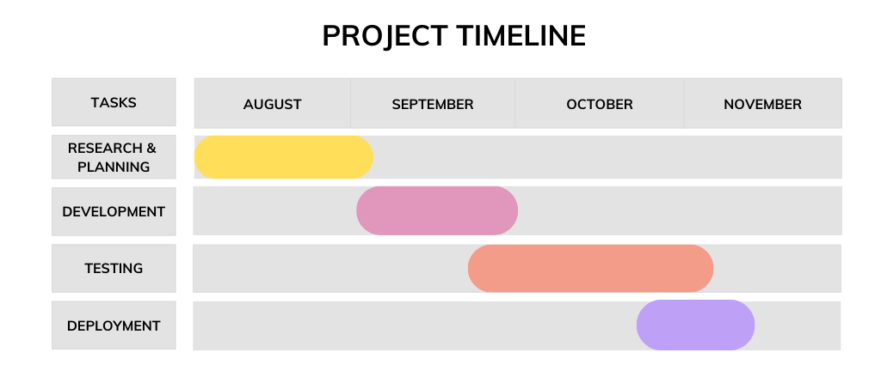
Timeline of the Project (Gantt Chart)

Slide 13
References (IEEE Paper format)
  J. Keteku, G. O. Dameh, S. A. Mante, T. K. Mensah, S. L. Amartey, and J.-B. Diekuu, "Detection and Prevention of Malware in Android Mobile Devices: A Literature Review," International Journal of Intelligence Science, vol. 14, no. 4, Oct. 2024, doi: 10.4236/ijis.2024.144005.
  S. Kandukuru and R. M. Sharma, "Android Malicious Application Detection Using Permission Vector and Network Traffic Analysis," 2017 2nd International Conference for Convergence in Technology (I2CT), Pune, India, 2017, pp. 221-226, doi: 10.1109/I2CT.2017.8226303.

Slide 14


