Slide 1
Health Harvest
Your Path to Wellness Starts Here

Slide 2
Points to cover
Why Health Harvest
Features
Testing
Streamlit UI Interface
Text to Multilanguage conversion
Multilanguage Audio conversion

Slide 3
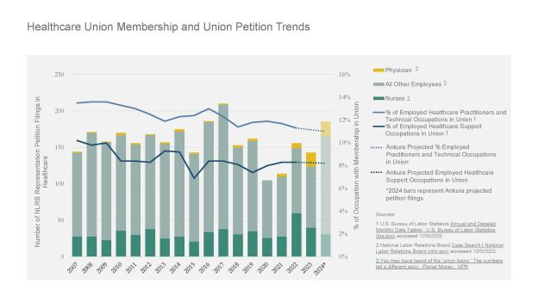
Why Health Harvest

Slide 4
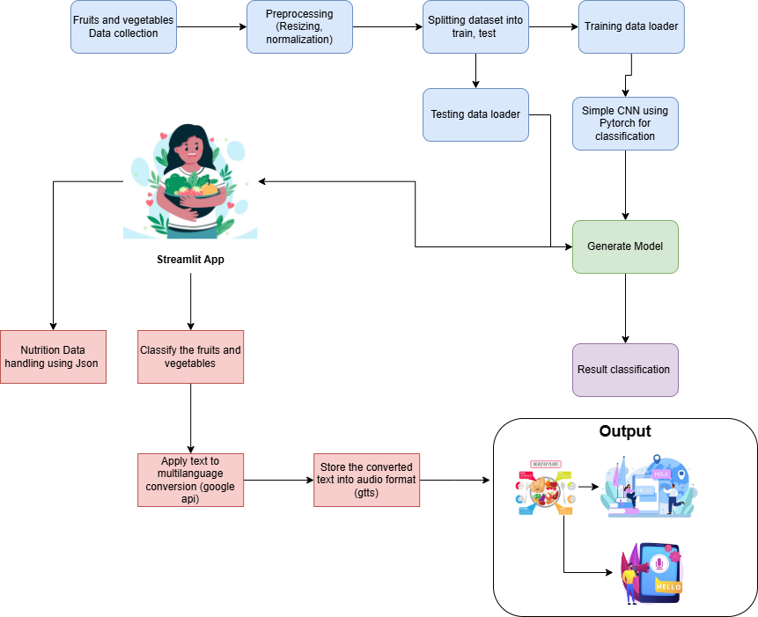
Block Diagram

Slide 5
Features
Detailed nutritional and dietary information about various fruits and vegetables
The multilingual translation and text-to-speech features make the information accessible to a wider audience, including those with visual impairments or language barriers.
User-Friendly Interface
Health Awarness

Slide 6
Loading and Preprocessing
The image is first loaded and converted to the RGB color mode to ensure consistency.
A series of transformations are applied to the image, such as resizing, normalization, and converting it to a tensor suitable for model input.
The transformed image is then prepared with an additional batch dimension to match the model's expected input format.

Slide 7
Training & Model Generation
The training transform loader is splitted and subjected to CNN layer. Before making predictions, the model is switched to evaluation mode. This step disables certain layers like dropout and batch normalization that are only active during training
The image tensor is transferred to the same device (CPU or GPU) where the model is located to ensure efficient computation.
Using 10epoch the model is generated and save as torch model

Slide 8
Testing
The class names corresponding to the output labels are loaded. These are typically defined during the training phase and saved for use during inference.
The predicted class index is used to retrieve the corresponding class label from the list of class names.
The predicted class label is then printed or displayed as the final output.

Slide 9
Streamlit App Features
Image Upload and Classification:
Allows users to upload an image of a fruit or vegetable in various formats (PNG, JPG, JPEG).
Displays details about the uploaded file, including its name, type, and size.
Uses a pre-trained convolutional neural network (CNN) model to classify the uploaded image into one of 36 classes.
Information Retrieval:
Once an image is classified, users can retrieve detailed information about the identified fruit or vegetable.
Information includes name, scientific name, benefits, drawbacks, how to eat, who shouldn't eat it, vitamins, minerals, and daily effects.

Slide 10
Cont..
Multilingual Translation and Audio Conversion:
Translates the information into various languages using the Google Translator API.
Converts translated text to speech using the Google Text-to-Speech (gTTS) API.
Plays the audio file directly within the app, providing a more accessible way to consume the information.
Navigation:
Users can navigate between different sections (Home, Testing, More Info) using a custom navigation bar.

Slide 11
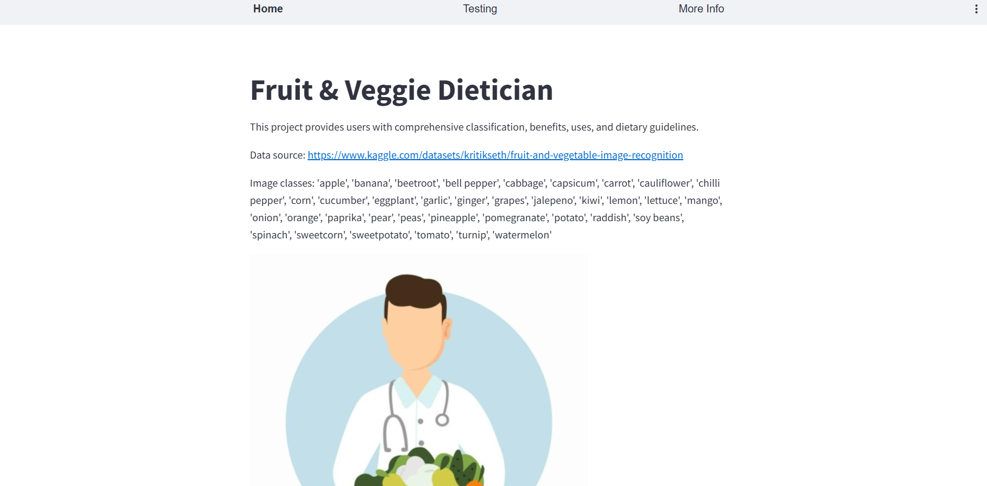
Home Page

Slide 12
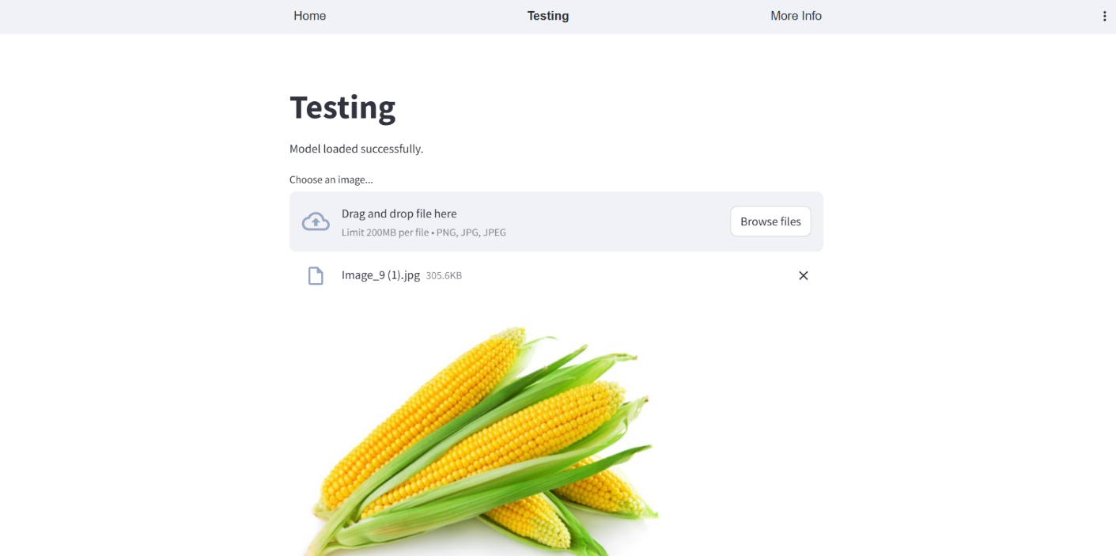
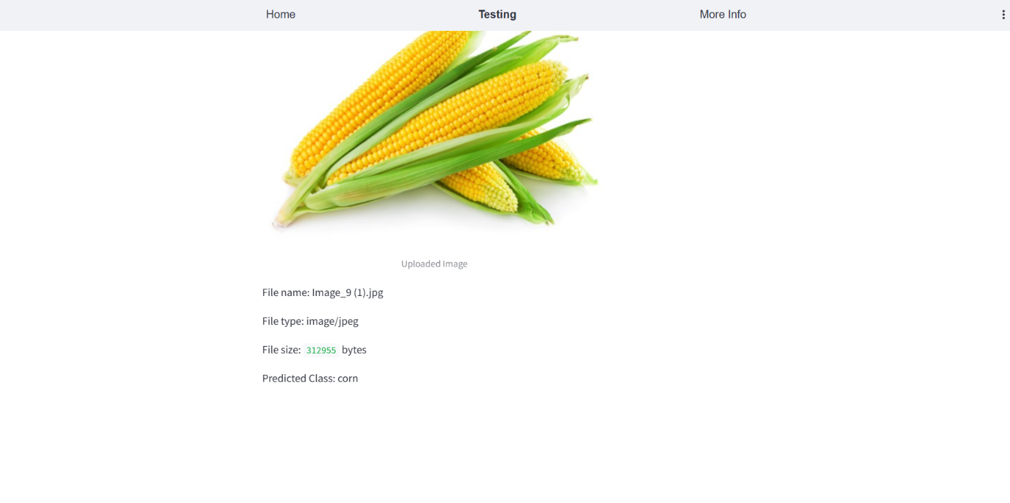
Testing Or Evaluation

Slide 13
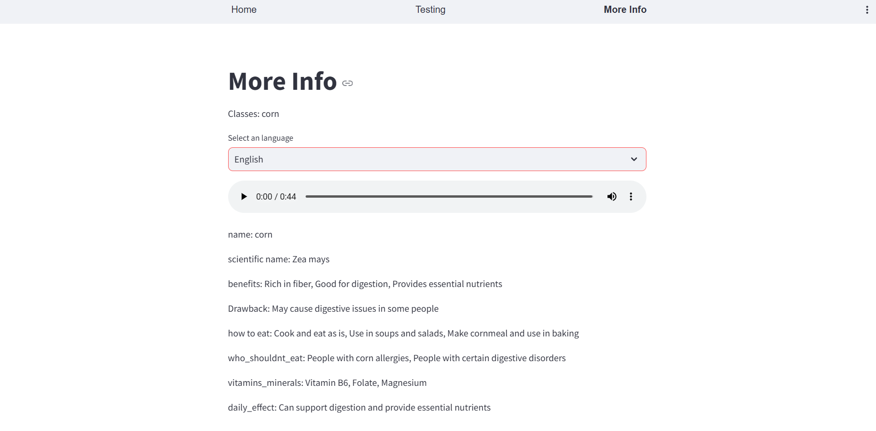
English Language Conversion with audio

Slide 14
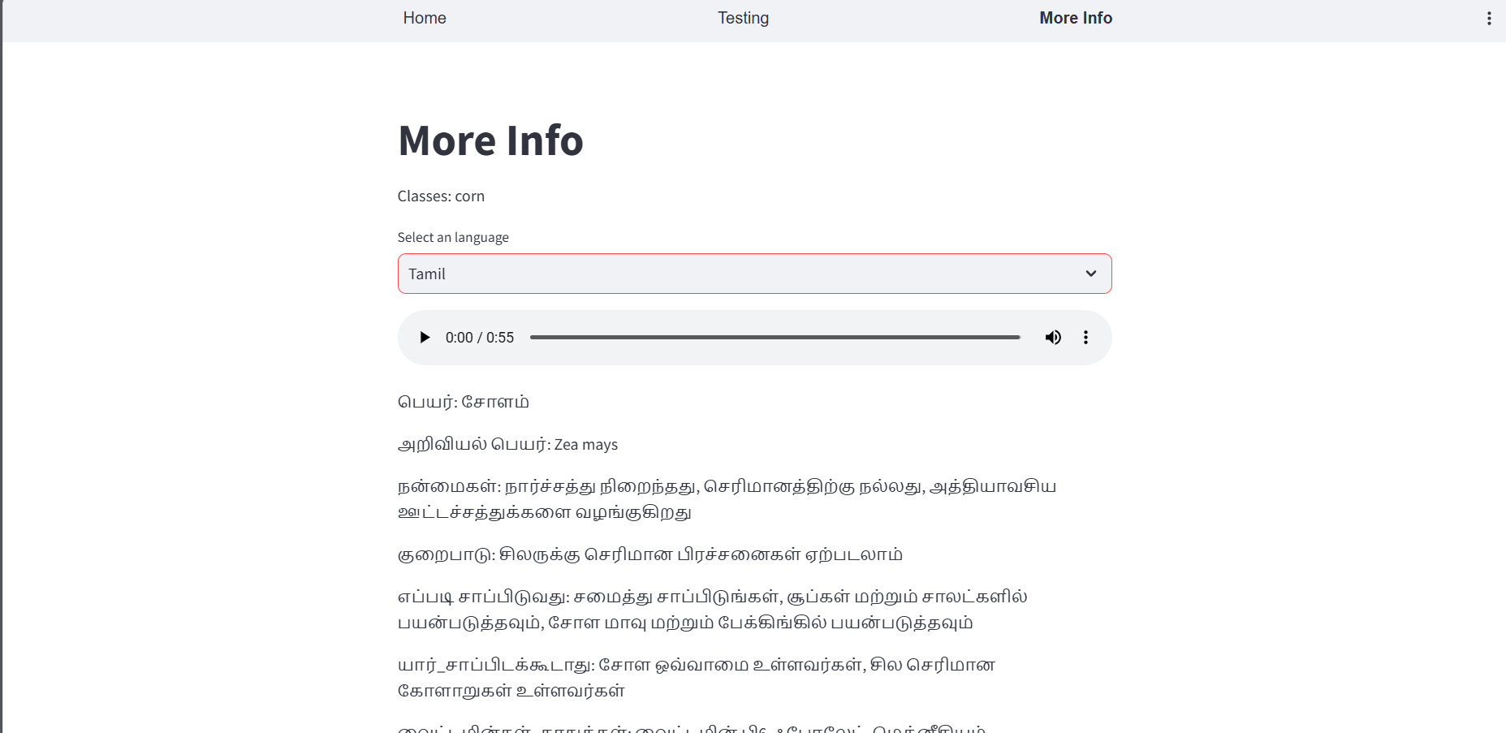
Tamil Language Conversion

Slide 15
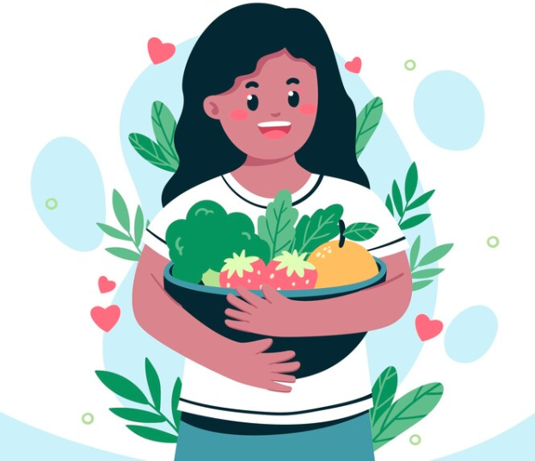
Thank You

