Slide 1
DATABASE MANAGEMENT SYSTEMS
Object Relational
Database Systems
How relational databases were enhanced with object-oriented concepts — complex types, inheritance, arrays, references — with SQL examples throughout.

Slide 2
ROADMAP
What We'll Cover
01
Why plain RDBMS falls short
02
What is an ORDBMS?
03
Advantages & disadvantages
04
Complex data types & type constructors
05
Inheritance in SQL (type & table)
06
Arrays, multisets & object references
07
Implementation issues
08
ORDBMS vs OODBMS
Object Relational Database Systems (ORDBMS)
2

Slide 3
THE MOTIVATION
Why Plain RDBMS Falls Short
Relational databases represent everything as simple two-dimensional tables. This works beautifully for text/business data, but struggles with complex applications:
✕
Complex applications
✕
Multi-valued attributes
CAD, CAM, CIM and CASE systems need rich interrelationships among objects — hard to model as flat tables.
Composite/multi-valued attributes force a table to be split into several tables just to stay normalized.
✕
No custom data types
✕
Inheritance is unnatural
SQL only offers standard built-in types — users cannot define their own domain-specific types.
Hierarchies (e.g. Student is-a Person) need multiple linked tables with referential constraints instead of one clean structure.
Yet RDBMS remains commercially successful — proven security, reliability, and easy access. So instead of replacing it, the industry extended it.
Object Relational Database Systems (ORDBMS)
3

Slide 4
DEFINITION
What is an ORDBMS?
ORDBMS = “Relational Database + Object-Oriented Features”
A relational database system enhanced with a richer type system and object-orientation, with SQL extended to handle these new types. Relational users can migrate to it easily.
Two ways to build an object database system:
Path A — OODBMS
Path B — ORDBMS ✓ (our focus)
Start from Object-Oriented Programming and extend it to include database features (persistence, transactions).
Start from the proven Relational model and extend it with object-oriented features — new types, inheritance, references.
Object Relational Database Systems (ORDBMS)
4

Slide 5
IN THE REAL WORLD
ORDBMS Products You'll Recognise
Oracle 8 (Oracle Data Cartridge)
IBM DB2 Universal Database (Extenders)
Informix Dynamic Server (Data Blades)
DB
DB
DB
Ingres II
Sybase Adaptive Server
UniSQL / OSMOS
DB
DB
DB
These vendors extended their existing relational engines with support for multimedia, spatial/geographic data, ADTs (Abstract Data Types) and collection-valued attributes.
Object Relational Database Systems (ORDBMS)
5

Slide 6
BACKGROUND
Why Did ORDBMS Emerge?
🧩
🎞
🔗
Complex new applications
New kinds of data
Best of both worlds
As technology developed, New applications became complex & sophisticated, needing diverse data — far beyond simple
numbers and text.
Applications needed to store text, images, audio, streamed data and BLOBs directly inside the database.
Eg: medical info system stores – patient details along with medical images
Eg: Digital Library
A rising trend to merge the best features of object databases into the proven, reliable relational model.
In short: ORDBMS evolved to meet the challenges of new, complex applications that plain RDBMS could not handle efficiently.
Object Relational Database Systems (ORDBMS)
6

Slide 7
BENEFITS
Advantages of ORDBMS
✓
Reuse
✓
Sharing
The programmer can extend the DBMS server centrally to add standard functionality — instead of re-coding it in every application.
If an app needs a particular database functionality, it can be embedded once into the server, and every application shares it.
✓
Easy migration
✓
SQL's own strength
Enterprises can migrate from their existing relational systems to ORDBMS without making major structural changes.
SQL is a mature 4GL — it gives strong protection against programming errors and a rich foundation for query optimisation.
Object Relational Database Systems (ORDBMS)
7

Slide 8
LIMITATIONS
Disadvantages of ORDBMS
1
Complex in nature and comes with increased development & maintenance costs.
2
Relational purists feel the extensions dilute the simplicity that made the relational model successful.
3
Some experts believe it suits only a limited set of applications, not general relational use.
4
The strength of ORDBMS (SQL) is also its weakness for memory-resident, high-performance applications — SQL overhead can hurt in-memory workloads.
Object Relational Database Systems (ORDBMS)
8

Slide 9
CORE TRAITS
Characteristics of ORDBMS
🗂
Nested Relations
🧬
Complex Types & Object-Orientation
Attributes of a table can themselves contain whole relations (tables within tables).
Supports classes, objects, inheritance — not just atomic values.
🔍
Querying with Complex Types
🏗
Creation of Complex Values & Objects
It is not enough to store complex data. We must be able to search and retrieve it. SQL is extended so queries can search and filter inside complex/nested structures.
Lets developers build new structured values/objects, not just simple rows.
Object Relational Database Systems (ORDBMS)
9

Slide 10
Representing a Complex Type: Address
The same example — how it is represented in a traditional RDBMS vs. in an ORDBMS
In Traditional RDBMS
In an ORDBMS
The address components are stored as separate columns in the STUDENT table.
We define a user-defined type (Address) grouping the related attributes; STUDENT has one attribute of type Address.
CREATE TABLE STUDENT (
name Char(25),
house Char(20),
locality Char(20),
city Char(12),
state Char(15),
pincode Char(6),
phone Char(12),
program Char(5)
);
CREATE TYPE Address AS (House Char(20),
Locality Char(20), City Char(12),
State Char(15), Pincode Char(6));
CREATE TABLE STUDENT (name Char(25),
address Address, phone Char(12),
programme Char(5));
name | house | locality | city | state | pincode | phone | programme
Anu | Rose Villa | Edappally | Kochi | Kerala | 682024 | 9876543210 | MCA
name | address | phone | programme
Anu | Rose Villa, Edappally, Kochi, Kerala, 682024 | 9876543210 | MCA
STUDENT
STUDENT
name
house
locality
city
state
pincode
phone
programme
name
address
phone
programme
House
Locality
City
State
Pincode
Object Relational Database Systems (ORDBMS)
10

Slide 11
COMPLEX DATA TYPES
Querying a Composite Attribute
Because Address is now one attribute of type Address, you can use it as a whole — or reach into its components with dot notation.
① Use the whole composite attribute
② Reach a single component with “ . ”
Find name & address of MCA students:
Find name & address of MCA students in Mumbai:
SELECT name, address
FROM student
WHERE programme = 'MCA';
SELECT name, address
FROM student
WHERE programme = 'MCA'
AND address.city = 'Mumbai';
👉 The address stays intact as one field, yet each part is still individually queryable.
Object Relational Database Systems (ORDBMS)
11

Slide 12
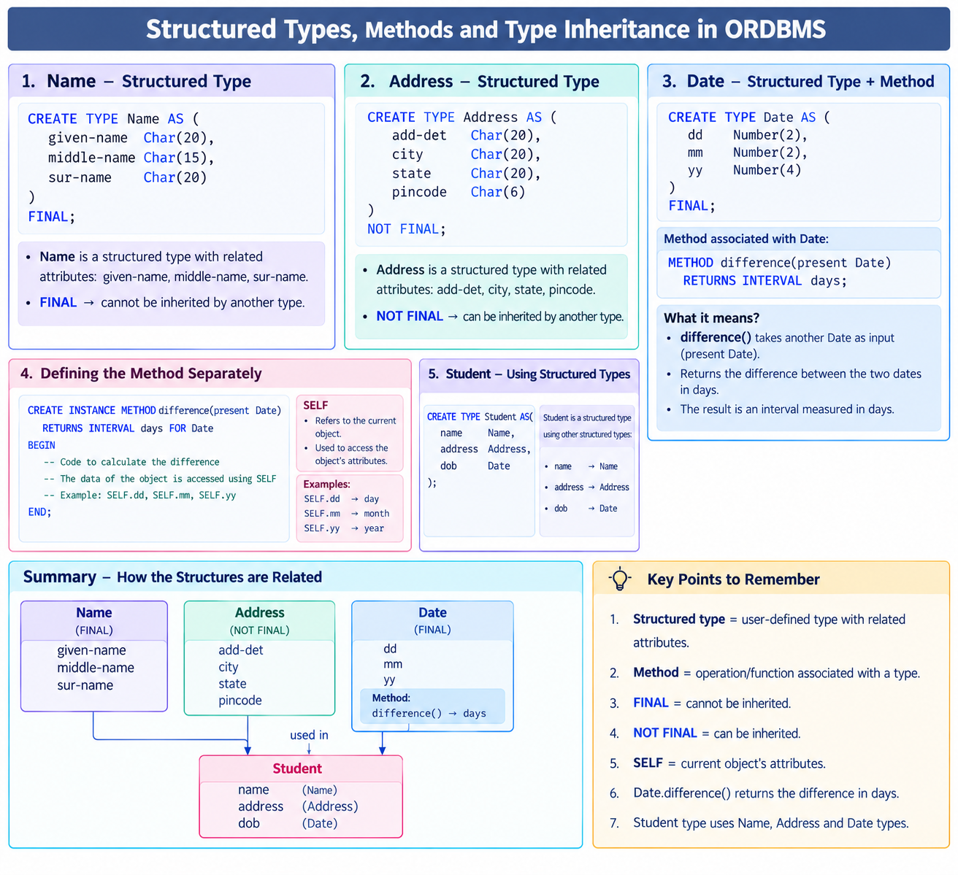
TYPES, METHODS & INHERITANCE
Structured Types in ORDBMS
A type isn't just data — it can define methods (operations), and be marked FINAL or NOT FINAL (exactly like Java) to control whether it can be inherited further.
Date 1 → 20/09/2026
Date 2 → 27/09/2026
difference() → 7 days
FINAL → this type cannot be inherited further. NOT FINAL → other types can extend it. METHOD → A method is an operation or function associated with a structured type that performs a specific task.
Object Relational Database Systems (ORDBMS)
12

Slide 13
TYPES, METHODS & INHERITANCE
Type Inheritance & Table Inheritance
Type Inheritance (UNDER)
Table Inheritance (OF ... UNDER)
Student and Staff both share name & address — so both inherit from University-person instead of repeating fields.
CREATE TABLE University_members
OF University_person;
CREATE TABLE student_list OF Student
UNDER University_members;
CREATE TYPE University_person AS (
name Name,
address Address
);
CREATE TYPE Student
UNDER University_person (
programme Char(10)
);
CREATE TYPE Staff
UNDER University-person (
designation Char(10),
basic-salary Number(7)
);
A record inserted into student_list is automatically present in university_members too. Use ONLY to query just the parent table:
SELECT NAME FROM university_members ONLY;
Object Relational Database Systems (ORDBMS)
13

Slide 14
COLLECTION DATA TYPES
Handling Multi-Valued Attributes: Array & Multiset
ARRAY — stores values in a fixed, ordered sequence. MULTISET — stores values in an unordered set (duplicates allowed).
CREATE TYPE Book AS (
ISBNNO Char(14),
TITLE Char(25),
AUTHORS Char(25) ARRAY [5], -- ordered list, e.g. first author = AUTHORS[1]
PUBLISHER Char(20),
KEYWORDS Char(10) MULTISET -- unordered set of keywords
);
CREATE TABLE library OF Book;
Find books tagged “Object Oriented”:
The query checks: “Is the object oriented present among the keywords?”….if yes, the book is selected
Find the first author of each book:
SELECT ISBNNO, TITLE
FROM library
WHERE 'Object Oriented' IN
(UNNEST(KEYWORDS));
SELECT ISBNNO, TITLE, AUTHORS[1]
FROM library;
Object Relational Database Systems (ORDBMS)
14

Slide 15
OBJECT IDENTITY
Referencing Objects with REF
When one row needs to point to another (e.g. a purchase record pointing to a library book), SQL uses REF ... SCOPE to link them — like an object pointer.
CREATE TABLE book_purchase_table (
ACCESSION_NO CHAR(10),
ISBNNO REF(Book) SCOPE (library)
);
ACCESSION_NO : column that stores the accession number
ISBNNO: column that stores ISBN
REF: Creates a reference/pointer to an object
SCOPE: specifies where the referenced object is stored
SYSTEM GENERATED reference
USER GENERATED reference (simpler)
Insert a NULL reference first, then UPDATE it by sub-querying the system-generated object ID for the matching ISBN.
If ISBNNO is already the library table's key, declare the REF as USER GENERATED — then insert the ISBN value directly:
INSERT INTO book_purchase_table
VALUES ('912345678','83-7758-476-6');
Object Relational Database Systems (ORDBMS)
15

Slide 16
POSITIONING ORDBMS
ORDBMS vs OODBMS — Quick Comparison
Aspect
ORDBMS
OODBMS
Built by
Extending the relational model
Extending object-oriented programming
Query power
Strong — mature SQL-based querying
Weaker; not as powerful as SQL
Protection from errors
Good — SQL is a disciplined 4GL
An error in one data type can affect many users
Programming integration
Moderate
Very high integration with OOP languages
Best fit
Transaction processing, business apps
CAD, e-commerce, highly complex apps
Performance profile
Reliable for typical query workloads
Very good for memory-resident, complex objects
Takeaway: they don't compete — they target different application profiles. Both extend the relational foundation with objects, from opposite directions.
Object Relational Database Systems (ORDBMS)
18

Slide 17
WRAPPING UP
Summary & Key Terms
Key Takeaways
Quick Glossary
• ORDBMS = Relational + Object features; extends the mature relational model rather than replacing it.
• Born from RDBMS's struggle with complex apps, multi-valued attributes and inheritance.
• CREATE TYPE lets you build user-defined composite types (e.g. Address, Date).
• Type inheritance (UNDER) and table inheritance (OF ... UNDER) avoid repeating shared fields.
• ARRAY (ordered) and MULTISET (unordered) handle multi-valued attributes cleanly.
• REF ... SCOPE gives object-style references between rows/tables.
• ORDBMS and OODBMS solve overlapping problems from opposite starting points.
ADT: Abstract Data Type — atomic type + its methods.
UDT: User-Defined Type, created via CREATE TYPE.
BLOB / CLOB: Binary / Character Large Object.
REF: An object reference / pointer to another row.
SCOPE: Names which table a REF points into.
Object Relational Database Systems (ORDBMS)
19

Slide 18
THANK YOU

