Slide 1
High Cloud Analysis Dashboard
Airline Operations Visualization | May 2025
By: Fathimath Shamrin Moosa Aboobacker

Slide 2
Project Overview
This Power BI project visualizes global airline operations with a focus on:
- Route frequency
- Passenger volume
- Load efficiency
- Carrier distance
Dataset covers 208 airlines, 18.3K cities, 104 countries, 82M km, and 11.5K passengers.

Slide 3
Key Performance Indicators (KPIs)
- Total Airlines: 208
- Total Cities: 18.367K
- Total Countries: 104
- Total Distance: 82M
- Total Passengers: 11.504K

Slide 4
Interactive Filters
- Month Selector
- Year Selector (2008–2013)
- Weekday vs Weekend Toggle
- Carrier and City Drill-through

Slide 5
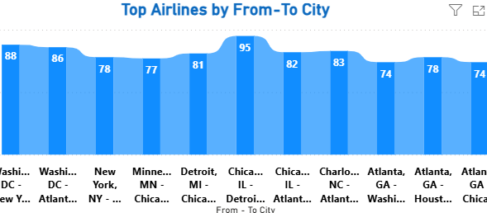
Top Airlines by From–To City
- Chicago–Detroit: Highest frequency (95 routes)
- Other top city pairs include Washington DC, Atlanta, and New York
- Highlights key operational hubs

Slide 6
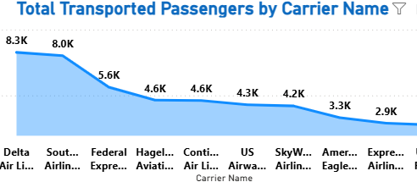
Total Transported Passengers by Carrier
- Delta: 8.3K passengers
- Southwest: 8.0K passengers
- Over 20 carriers transport more than 2,000 passengers
- Helps benchmark carrier scale

Slide 7
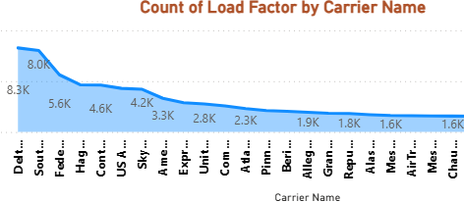
Count of Load Factor by Carrier
- Delta Airlines, Southwest Airlines and Federal Express Airlines lead in load factor counts
- Indicates efficient seat utilization
- Useful for capacity planning

Slide 8
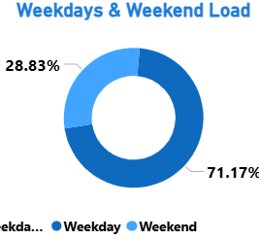
Weekday vs Weekend Load Distribution
- 71.17% of flights occur on weekdays
- 28.83% on weekends
- Helps inform scheduling and demand-based planning

Slide 9
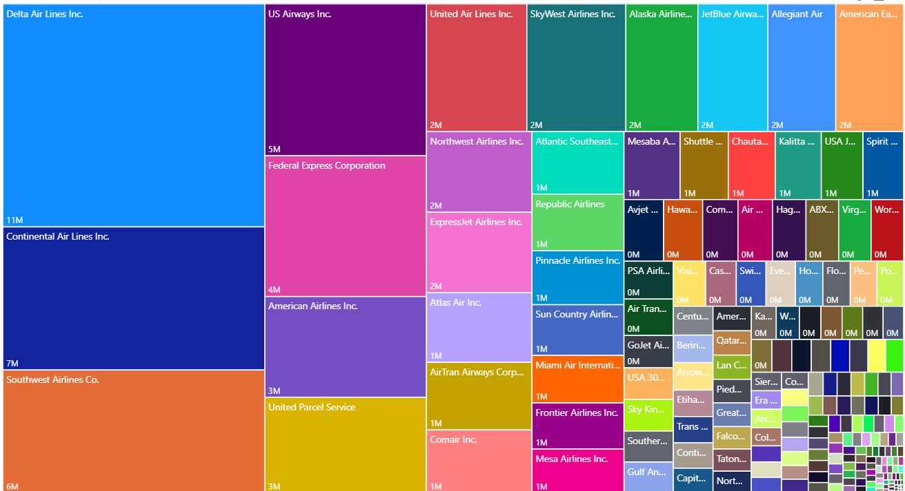
Distance Travelled by Carrier (Tree map)
- Delta: Highest total distance
- Continental, Southwest also cover large distances
- Visualizes carrier network scale and reach

Slide 10
Tools Used
Power BI – For data modeling and interactive visualization
DAX – Custom measures and calculated columns
Excel/CSV – For data preprocessing
Design Principles – Clean layout, minimal clutter, user-friendly slicers

Slide 11
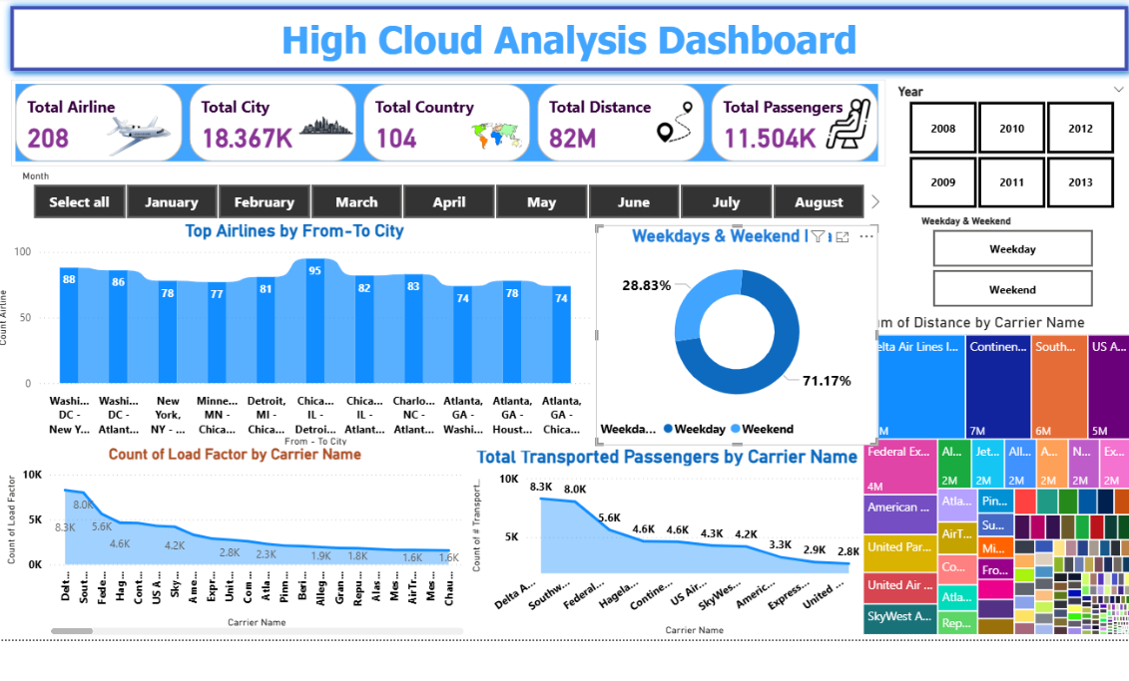

Slide 12
Business Value of Dashboard
- Route optimization & cost control
- Passenger flow prediction
- Carrier benchmarking
- Improved scheduling strategy

Slide 13

Thank You!

