Slide 1
E-business 2009
Turid Hedlund
Lecture 3
E-business strategy
E-business models chapters 2 and 14 from textbook
Hanken Svenska handelshögskolan / Hanken School of Economics www.hanken.fi

Slide 2
The strategic planning process
Strategy - the fundamental questions
  How is the company going to accomplish its mission?
  What is the position and direction of the company?
  What goals are going to be established?
  What plans and policies are needed to reach the goals?
  Wat resources are needed?
T.Hedund 2009
Hanken Svenska handelshögskolan / Hanken School of Economics www.hanken.fi

Slide 3
The strategy planning process stages:
Strategy initation
Strategy formulation
Strategy implementation
Strategy assessment
T.Hedund 2009
Hanken Svenska handelshögskolan / Hanken School of Economics www.hanken.fi

Slide 4
Business plan – business model
A business plan is a document that describes the goals of a company and how the goals are to be achieved
A business model is a set of planned activities designed to result in a profit in a marketplace
  E-commerce business models use the unique qualities of the Internet
T.Hedund 2009
Hanken Svenska handelshögskolan / Hanken School of Economics www.hanken.fi

Slide 5
Key ingredients in a business model
Value proposition
  An analysis of the benefits of using the model
  why should the customer buy from you?
  What can you provide that your competitors don’t?
  Your customer might value personalization, time saving, convenience etc.
T.Hedund 2009
Hanken Svenska handelshögskolan / Hanken School of Economics www.hanken.fi

Slide 6
Market strategy
  A plan that describes how you intend to enter a new market and attract new customers
  How do you plan to promote your products and services?
T.Hedund 2009
Hanken Svenska handelshögskolan / Hanken School of Economics www.hanken.fi

Slide 7
Competitive environment
  Which are your competitors?
  What special advantages does your firm bring to the market?
  Does your firm have favorable agreements with the suppliers?
  Does your firm have unique products that cannot be obtained from others?
T.Hedund 2009
Hanken Svenska handelshögskolan / Hanken School of Economics www.hanken.fi

Slide 8
Elements of Competitive advantage: Influence of Internet
Porter’s competitive forces model
Potential New
Entrants
+ Internet can expand the markets
- Internet also creates new
substitution threaths
- Reduces differences among
competitors
- Migrates competition to price
Supplier’s
bargaining power
Rivalry from
competitors
Buyer’s
bargaining power
- Shifts bargaining power
to end consumers
- Reduces switching costs
-Internet provides channels
to reach end users dirctly
Suppliers get access to more
companies
Barriers
To entry
Reduces barriers
Internet applications
are difficult to keep proprietary
T.Hedund 2009

Slide 9
Organizational development
  What types of organizational structures within the firm are necessary to carry out the business plan?
T.Hedund 2009
Hanken Svenska handelshögskolan / Hanken School of Economics www.hanken.fi

Slide 10
Revenue model
  A revenue model outlines how the organisation or company will earn revenue from their EC project
  How will your business earn money?
T.Hedund 2009
Hanken Svenska handelshögskolan / Hanken School of Economics www.hanken.fi

Slide 11
Revenue Models (Turban)
Sales
  revenue generated from selling products or services
Transaction fees
  commissions based on transactions (tickets)
Subscription fees
  monthly or annual fee for a product or service (journal subscription)
T.Hedund 2009
Hanken Svenska handelshögskolan / Hanken School of Economics www.hanken.fi

Slide 12
Revenue Models (Turban) cont.
Advertising fees
  companies charge for allowing another company to place a banner on their site
Affiliate fees
  companies receive commission for referring customers to other web sites
Other revenue sources
  companies charge for allowing visitors to play games
T.Hedund 2009
Hanken Svenska handelshögskolan / Hanken School of Economics www.hanken.fi

Slide 13
Categorization of typical
Business Models
Online direct marketing
  Manufacturer selling directly to customers
  E-tailing
Online auctions (e-Bay)
Tendering = reverse auction
  sellers submit bids and the lowest bidder wins)
Service provider (seller of services)
Community provider
  site where people of common interests can come together
Subscription
Portal
  Integrated services
  Search services, contents, news, e-mail, chat etc.
T.Hedund 2009
Hanken Svenska handelshögskolan / Hanken School of Economics www.hanken.fi

Slide 14
Taxonomy of Internet Commerce (Bambury)
Transplanted real-world business models
  mail order model
  advertising mode
  free trial model
  real estate model
  etc.
Native Internet Business models
  The library model
  The freeware model
  access provision model
  web hosting model
  etc.
T.Hedund 2009
Hanken Svenska handelshögskolan / Hanken School of Economics www.hanken.fi

Slide 15
Transplanted models
The mail-order model for example Amazon.com
  a Web site shop front end sells physical goods which are then posted or delivered. While goods are advertised and payment is made via the Internet these enterprises are very much based in the real-world and are really traditional retail operations with a Web-based shop front. Probably the most common Internet business model.
T.Hedund 2009
Hanken Svenska handelshögskolan / Hanken School of Economics www.hanken.fi

Slide 16
Transplanted models
The advertising based model
used particularly by search engine companies such as Yahoo and also supports many other free Web sites. Compare to commercial television and free print publications, where advertising revenues support the operation of a free service.
The use of banner hyperlinked ads is frequent. Clicking on an ad banner takes a Web surfer to a product home site and also records a click on the original site.
T.Hedund 2009
Hanken Svenska handelshögskolan / Hanken School of Economics www.hanken.fi

Slide 17
Transplanted models
The subscription model
Particularly suited for combination with digital delivery. Typically a user will subscribe for access to a database of digital products for a specified period of time. Newspaper sites, music etc.
T.Hedund 2009
Hanken Svenska handelshögskolan / Hanken School of Economics www.hanken.fi

Slide 18
Transplanted models
The free trial model
  is similar to the "30 days free trial" retail model. Mostly used for software .
T.Hedund 2009
Hanken Svenska handelshögskolan / Hanken School of Economics www.hanken.fi

Slide 19
Transplanted models
The real estate model.
Some enterprises apply this model by selling Web space, domain names and e-mail addresses.
T.Hedund 2009
Hanken Svenska handelshögskolan / Hanken School of Economics www.hanken.fi

Slide 20
Native business models
The library model.
Community service model. Used particularly for free information sources. Librarians, academics and scientists were among the first professional groups to use the network for disseminating and making available free information. Now we have Wikipedia, blogs, learning resources, etc.
Individuals and organisations on the Internet share resources for free
T.Hedund 2009
Hanken Svenska handelshögskolan / Hanken School of Economics www.hanken.fi

Slide 21
Native business models
The freeware model is used extensively by the Internet software community. Much software, including popular Web browsers such as Mozilla Firefox are available for free download. Popular freeware or shareware are Apache Web server and Linux (Unix-based operating system);
T.Hedund 2009
Hanken Svenska handelshögskolan / Hanken School of Economics www.hanken.fi

Slide 22
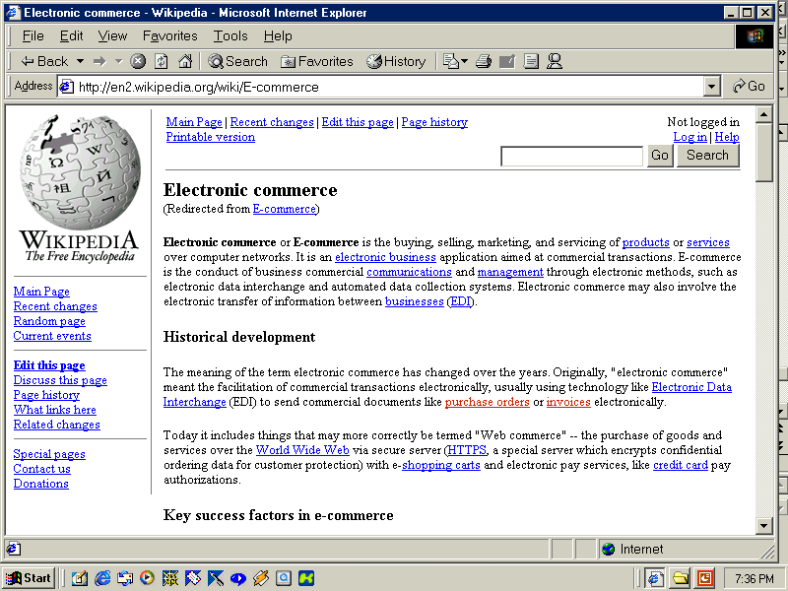
T.Hedund 2009

Slide 23
Native business models
The access provision model
  This business model provides access to the Internet by Internet Service Providers (ISPs).
Web site hosting and other Internet services
  ISPs and other Web-based enterprises provide services such as hosting Web servers, electronic mail and URL and e-mail re-direction services. Some enterprises provide free Web hosting and e-mail, financed by advertisements.
T.Hedund 2009
Hanken Svenska handelshögskolan / Hanken School of Economics www.hanken.fi

Slide 24
References:
Turban et al (2008): Electronic commerce a managerial perspective 2008
Laudon and Traver (2004): E-commerce: Business. Technology. Society.
Rappa Michael: Business models on the web
http://digitalenterprise.org/models/models.html
Bambury, Paul: A Taxonomy of Internet Commerce, First Monday, Volume 3 Number 10 — October 5th 1998
http://www.firstmonday.dk/issues/issue3_10/bambury/index.html
T.Hedund 2009
Hanken Svenska handelshögskolan / Hanken School of Economics www.hanken.fi

Slide 25
Question for discussion
Discuss which are the major differences
between Born-on-the-net companies and
Move-to-the-net companies when they are developing an e-strategy?
Discuss in the terms of for example: type of
company, age, size, customer base,
suppliers.
T.Hedund 2009
Hanken Svenska handelshögskolan / Hanken School of Economics www.hanken.fi

