Slide 1
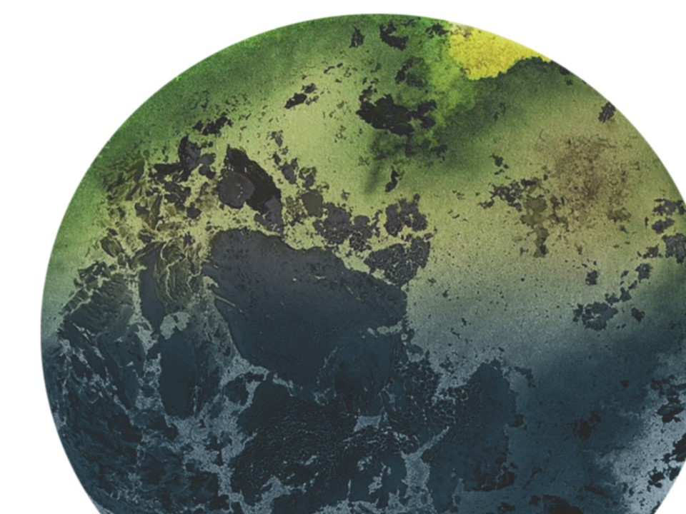

KEGS 2023 SYMPOSIUM
Fatiando a Terra: Open-source tools for geophysics
Santiago soler*, lindsey heagy
Earth, Ocean and Atmospheric Sciences, University of British Columbia

Slide 2
THANK YOU

