Slide 1
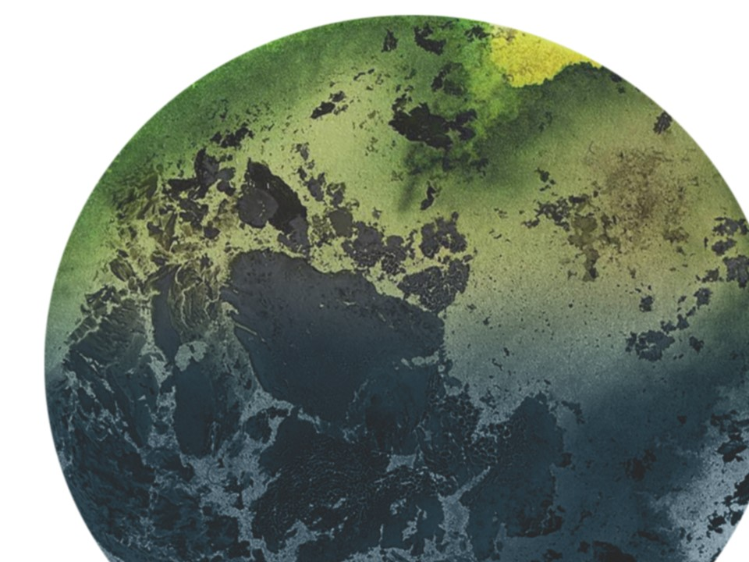

KEGS 2023 SYMPOSIUM
Fatiando a Terra: Open-source tools for geophysics
Santiago soler*, lindsey heagy
Earth, Ocean and Atmospheric Sciences, University of British Columbia

Slide 2
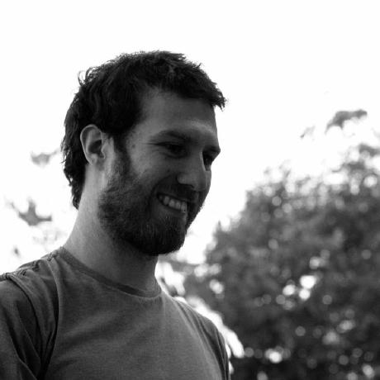


About the speaker
Physicist and PhD in Geophysics (Argentina)
Currently Postdoc Researcher (GIF, UBC)
  Supervisor: Lindsey Heagy
Research topics:
  Methodologies for processing and inverting potential field data
  Carbon capture potential with grav+mag inversions
Core developer of Fatiando a Terra

Slide 3


Slide 4



A bit of history
Started in 2010
Part of PhD Thesis of Leonardo Uieda in Brazil
Single Python library: fatiando
Tools for:
  Processing spatial data
  Forward modelling gravity and magnetic fields
  Geometry inversions
  Toy problems for teaching

Slide 5

https://legacy.fatiando.org

Slide 6


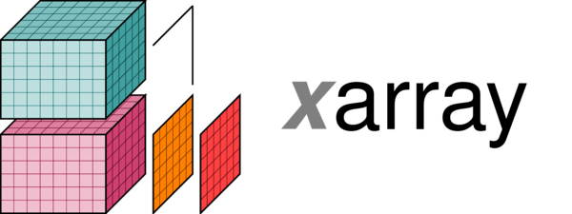





Modernizing our tools
Growing scientific Python ecosystem
+

Slide 7
The Fatiando libraries

Slide 8






Verde
Harmonica
Spatial data processing and interpolation with a Machine Learning flavour
Processing and modelling potential field data
fatiando.org/harmonica
fatiando.org/verde
Boule
Pooch
Ensaio
Reference ellipsoids and normal gravity
A friend to download and cache your data
Curated open-licensed geophysical datasets
fatiando.org/boule
fatiando.org/pooch
fatiando.org/ensaio

Slide 9
Example:
Processing gravity data

Slide 10
Download ground gravity data over Southern Africa
Fetch the data from the web
import ensaio
fname = ensaio.fetch_southern_africa_gravity(version=1)
Load the data with Pandas
import pandas as pd
data = pd.read_csv(fname)
Ensaio
(manage tabular data)

Slide 11
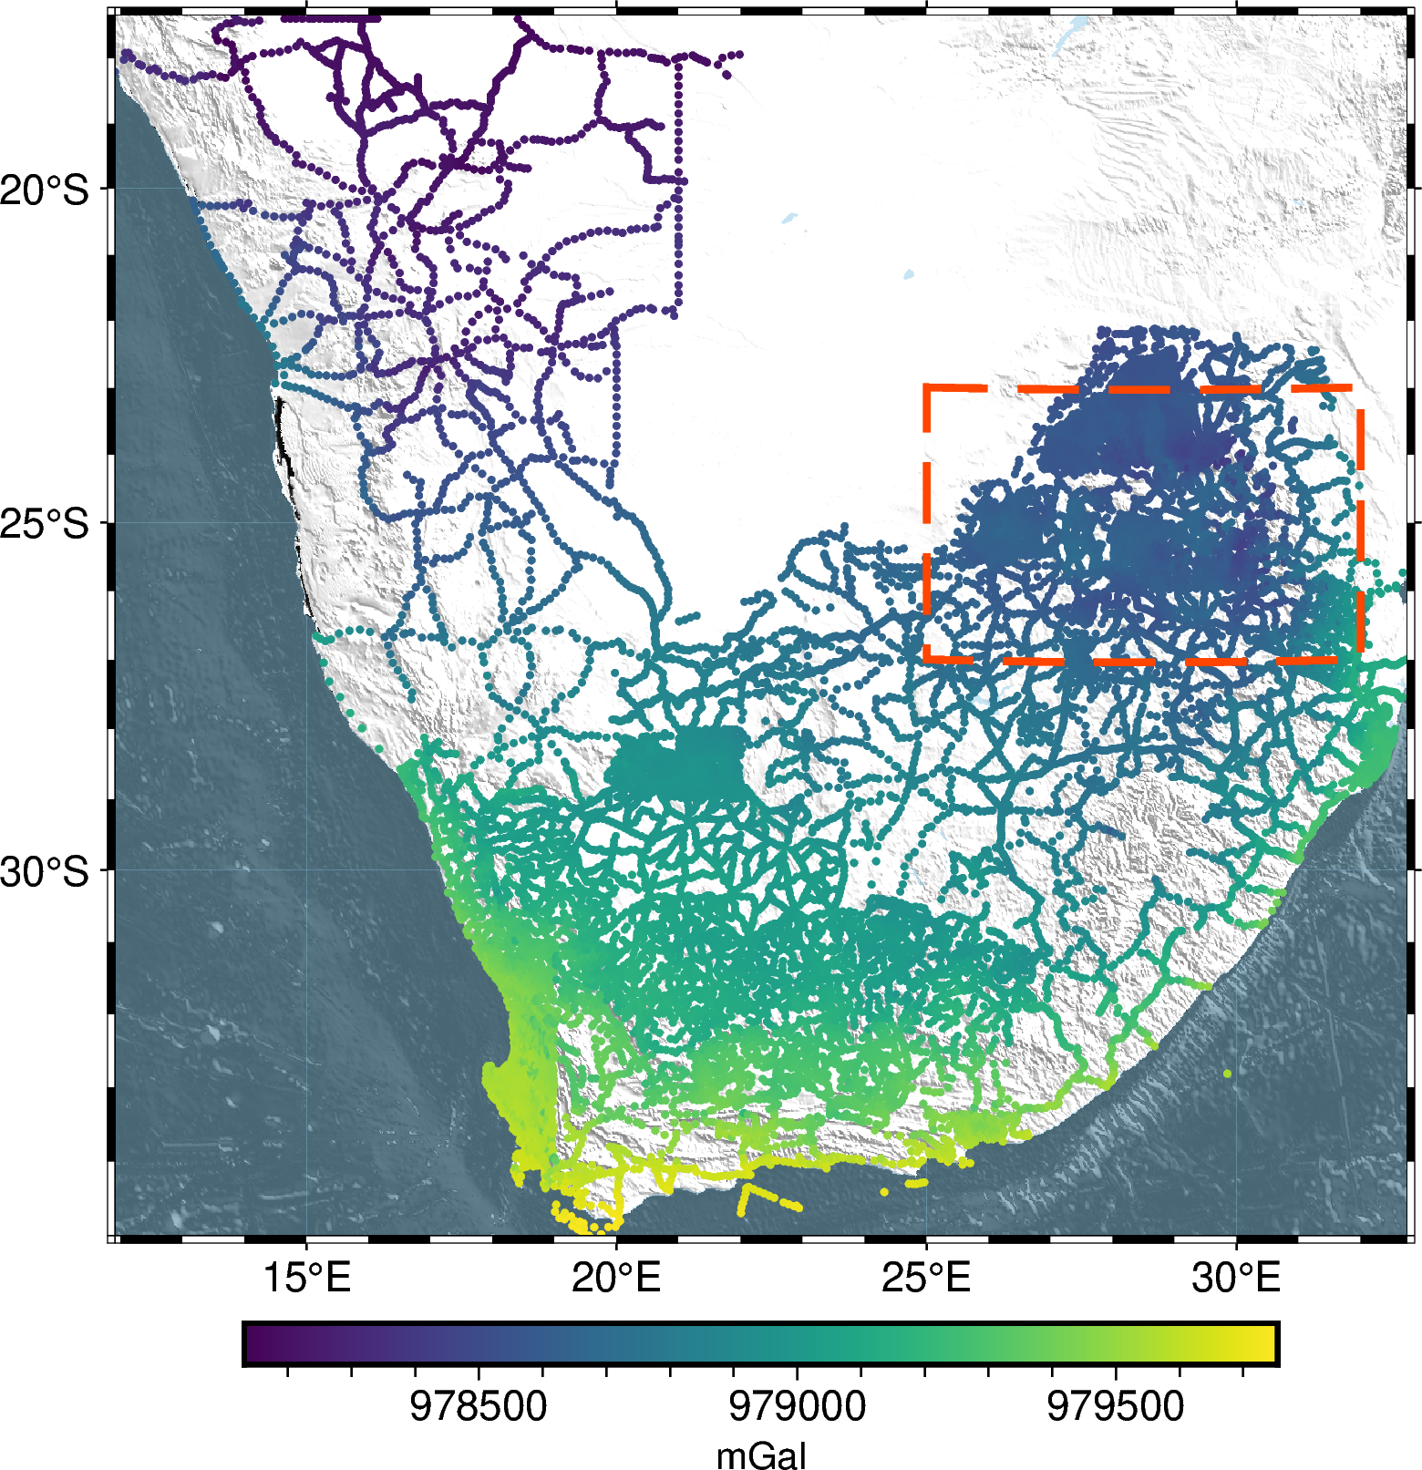
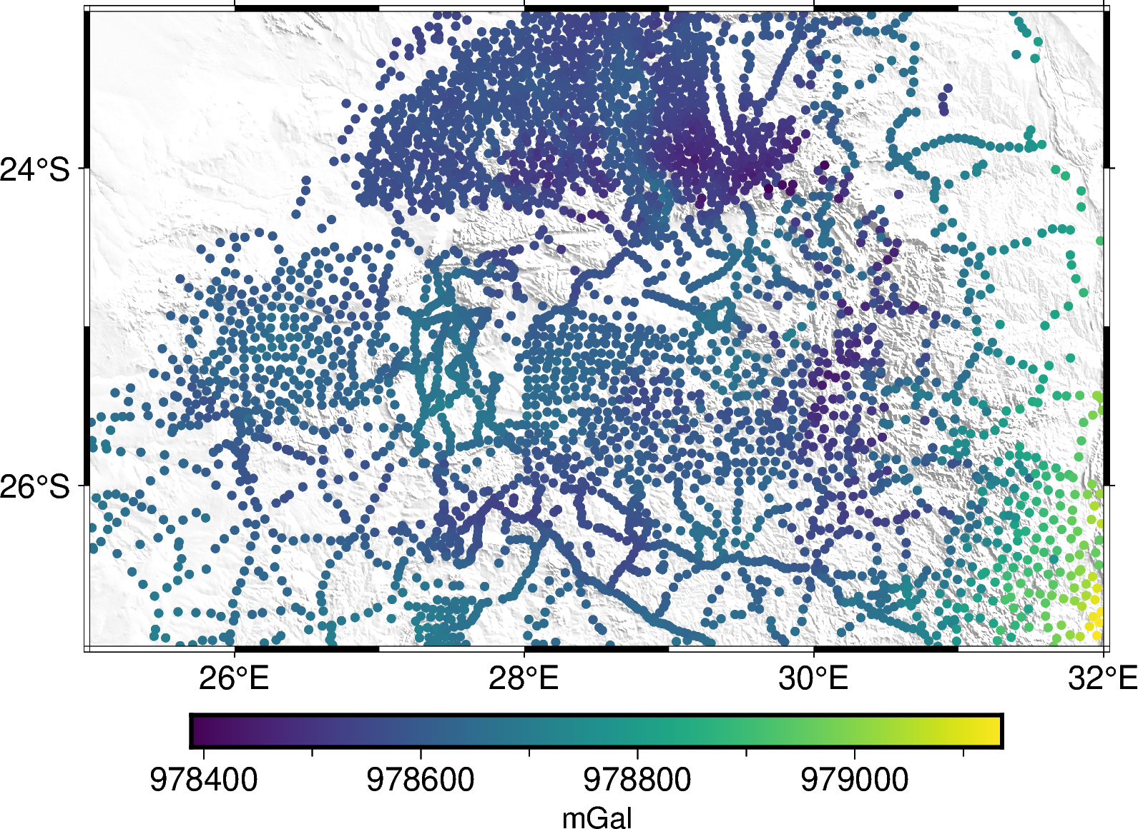
Download ground gravity data over Southern Africa
Observed gravity over the Bushveld Igneous Complex

Slide 12

Gravity disturbance
Normal gravity
import boule as bl
ellipsoid = bl.WGS84
normal_gravity = ellipsoid.normal_gravity(
data.latitude, data.height
)
Gravity disturbance
gravity_disturbance = data.gravity - normal_gravity
Boule

Slide 13
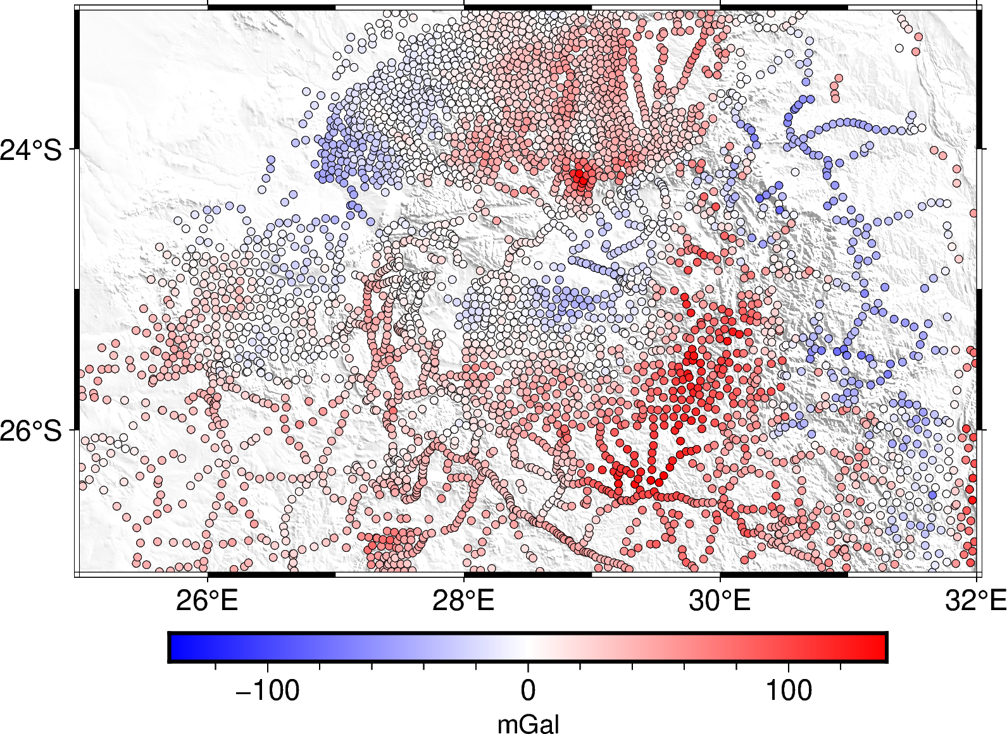
Gravity disturbance

Slide 14
Terrain effect
Model the topography with prisms
import harmonica as hm
density = np.where(topography > 0, 2670, 1040 – 2670)
terrain_model = hm.prism_layer(
coordinates=(topography.easting, topography.northing),
surface=topography,
reference=0,
properties={"density": density},
)
Harmonica

Slide 15
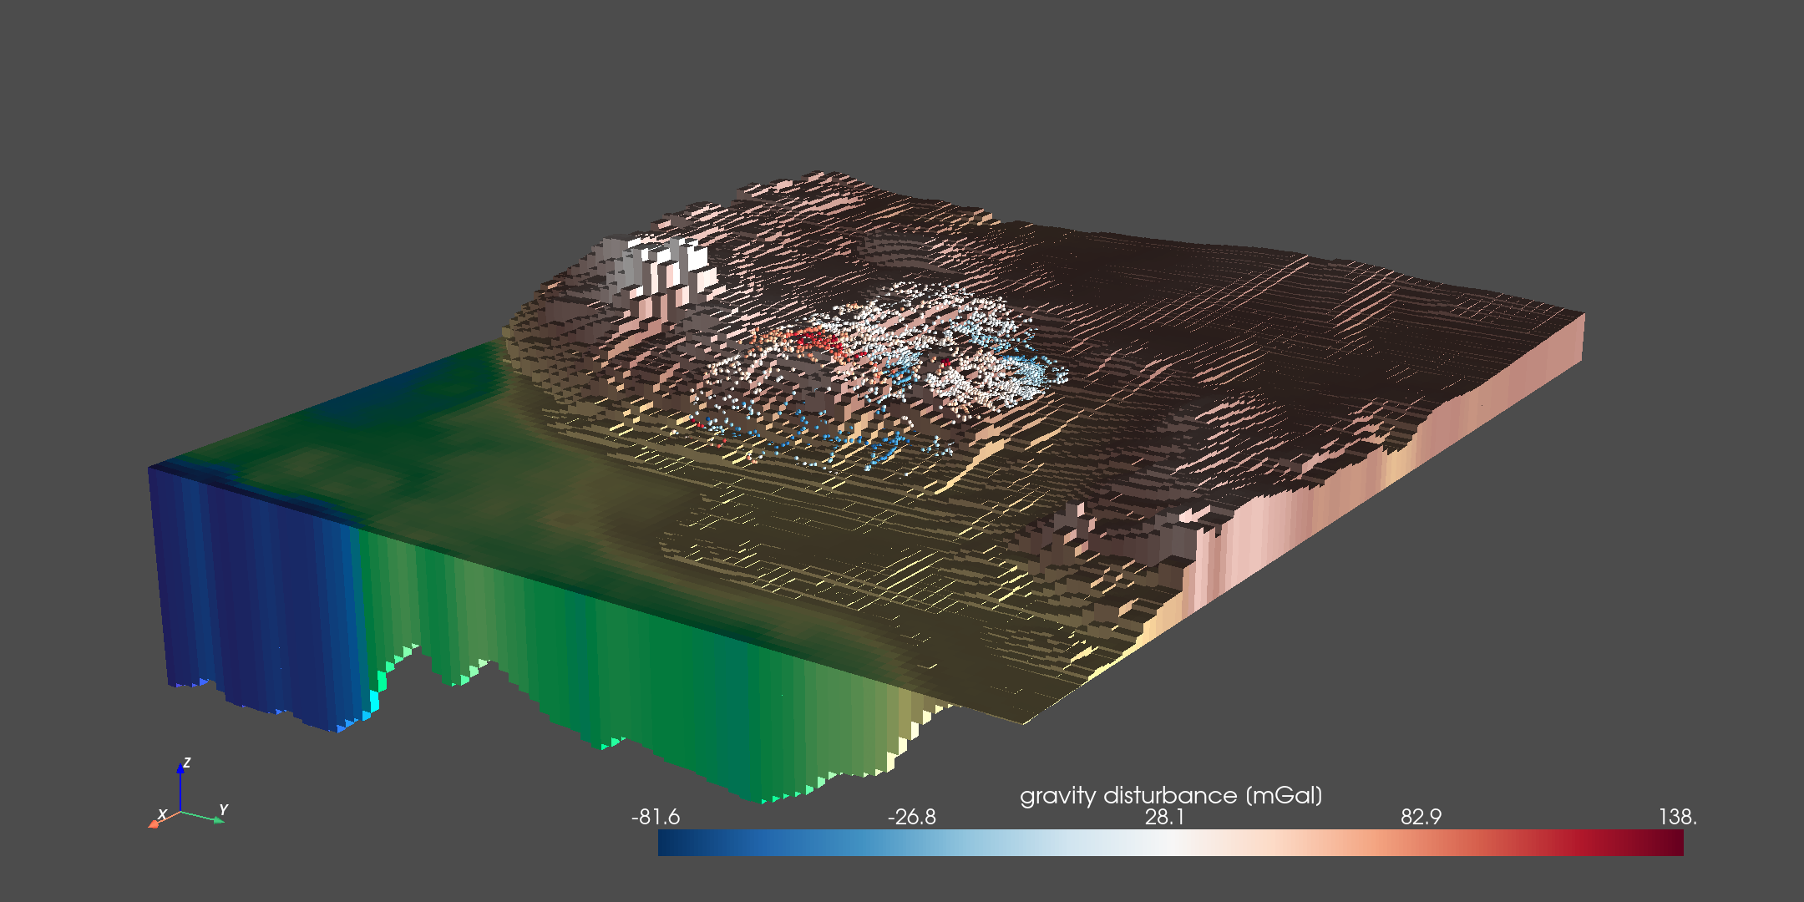
Terrain effect

Slide 16
Terrain effect
Forward model the terrain effect
terrain_effect = terrain_model.prism_layer.gravity(
coordinates, field="g_z"
)
Compute Bouguer disturbance
bouguer = gravity_disturbance - terrain_effect
Harmonica

Slide 17
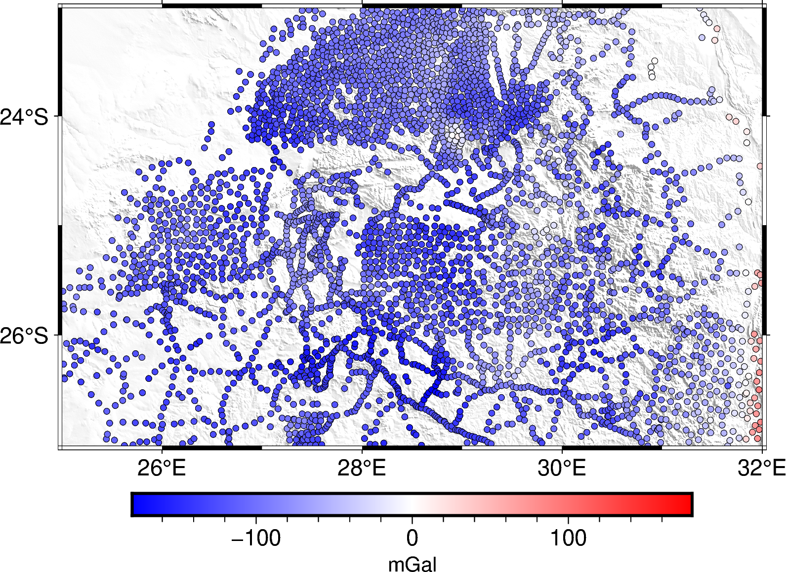
Terrain effect
Bouguer disturbance

Slide 18
Residual and regional field separation
Deep equivalent sources that reproduce the regional field
deep_sources = hm.EquivalentSources(damping=1000, depth=500e3)
deep_sources.fit(coordinates, gravity_bouguer)
gravity_regional = deep_sources.predict(coordinates)
Separate the residual field
gravity_residual = gravity_bouguer - gravity_regional
Harmonica

Slide 19
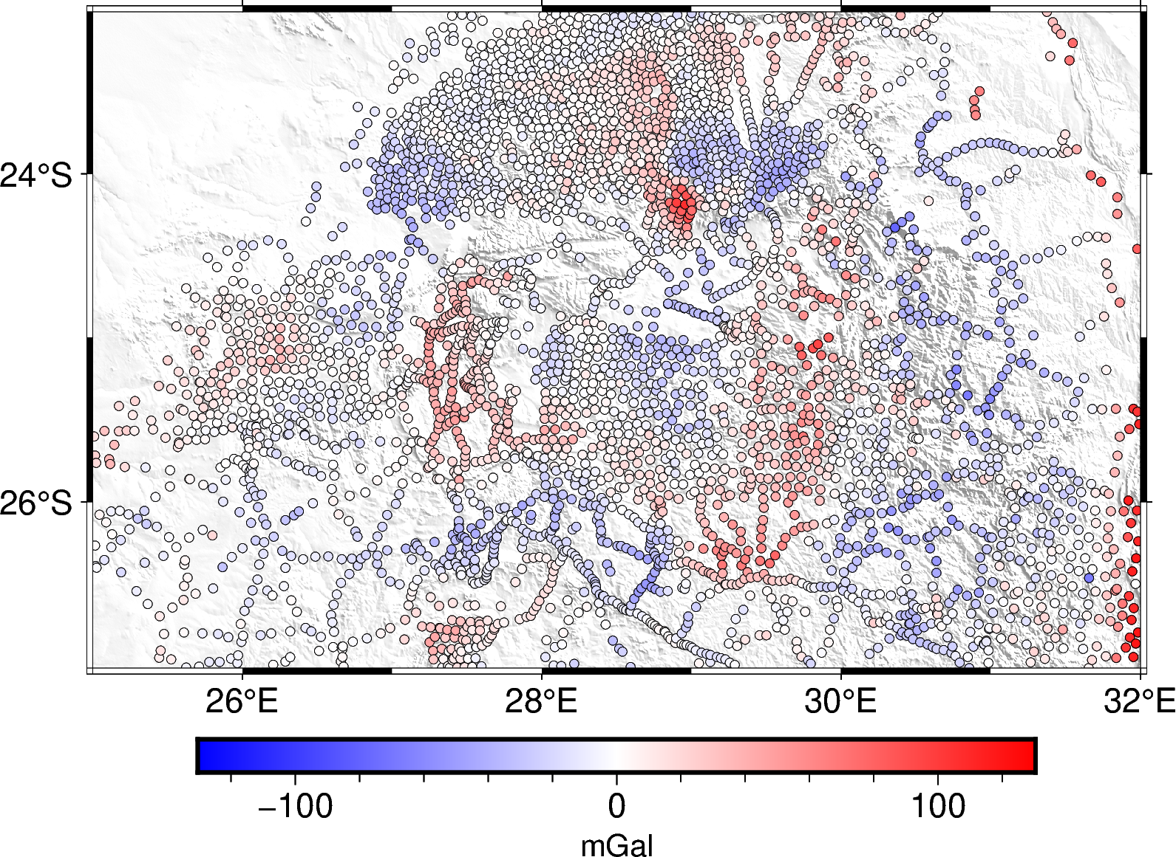
Residual and regional field separation
Residual gravity

Slide 20
Grid with equivalent sources
Fit some equivalent sources
eq_sources = hm.EquivalentSources(damping=10, depth=10e3)
eq_sources.fit(coordinates, gravity_residual)
Grid residual field at a constant height
grid = eq_sources.grid(
upward=2200, # height in meters
spacing=4000, # grid spacing in meters
)
Harmonica

Slide 21
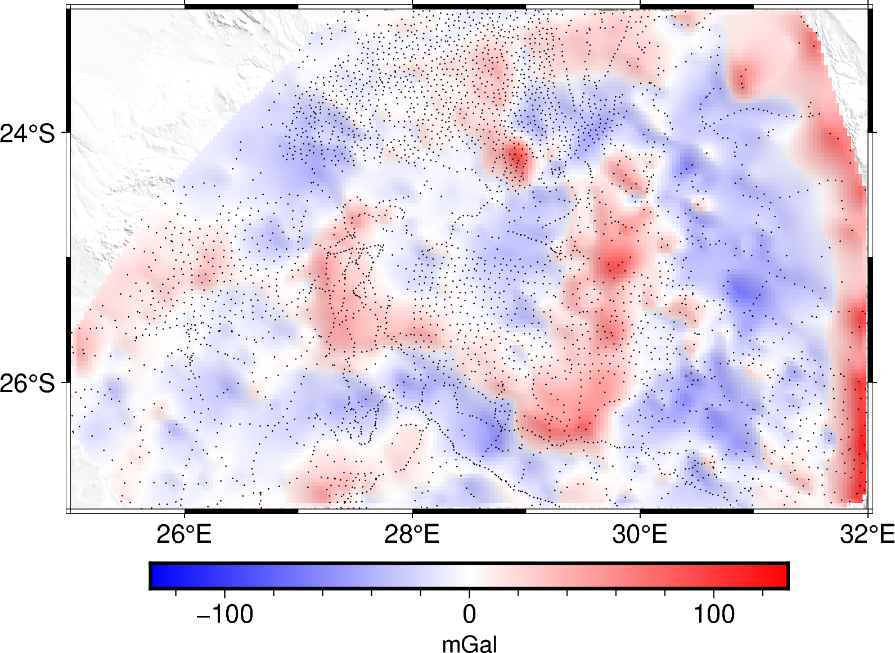
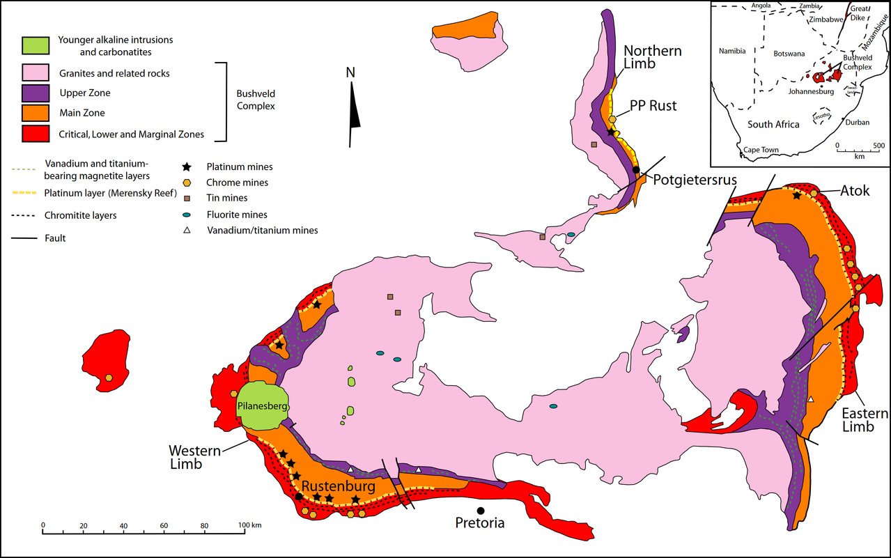
Grid with equivalent sources
Grid of residual gravity field
Geology of Bushveld Igneous Complex

Slide 22
Example:
Grid transformations

Slide 23
Download a magnetic data grid
Fetch the data from the web
import ensaio
fname = ensaio.fetch_lightning_creek_magnetic(version=1)
Load the grid with Xarray
import xarray as xr
magnetic_grid = xr.load_dataarray(fname)
Ensaio
(multidimensional arrays)

Slide 24
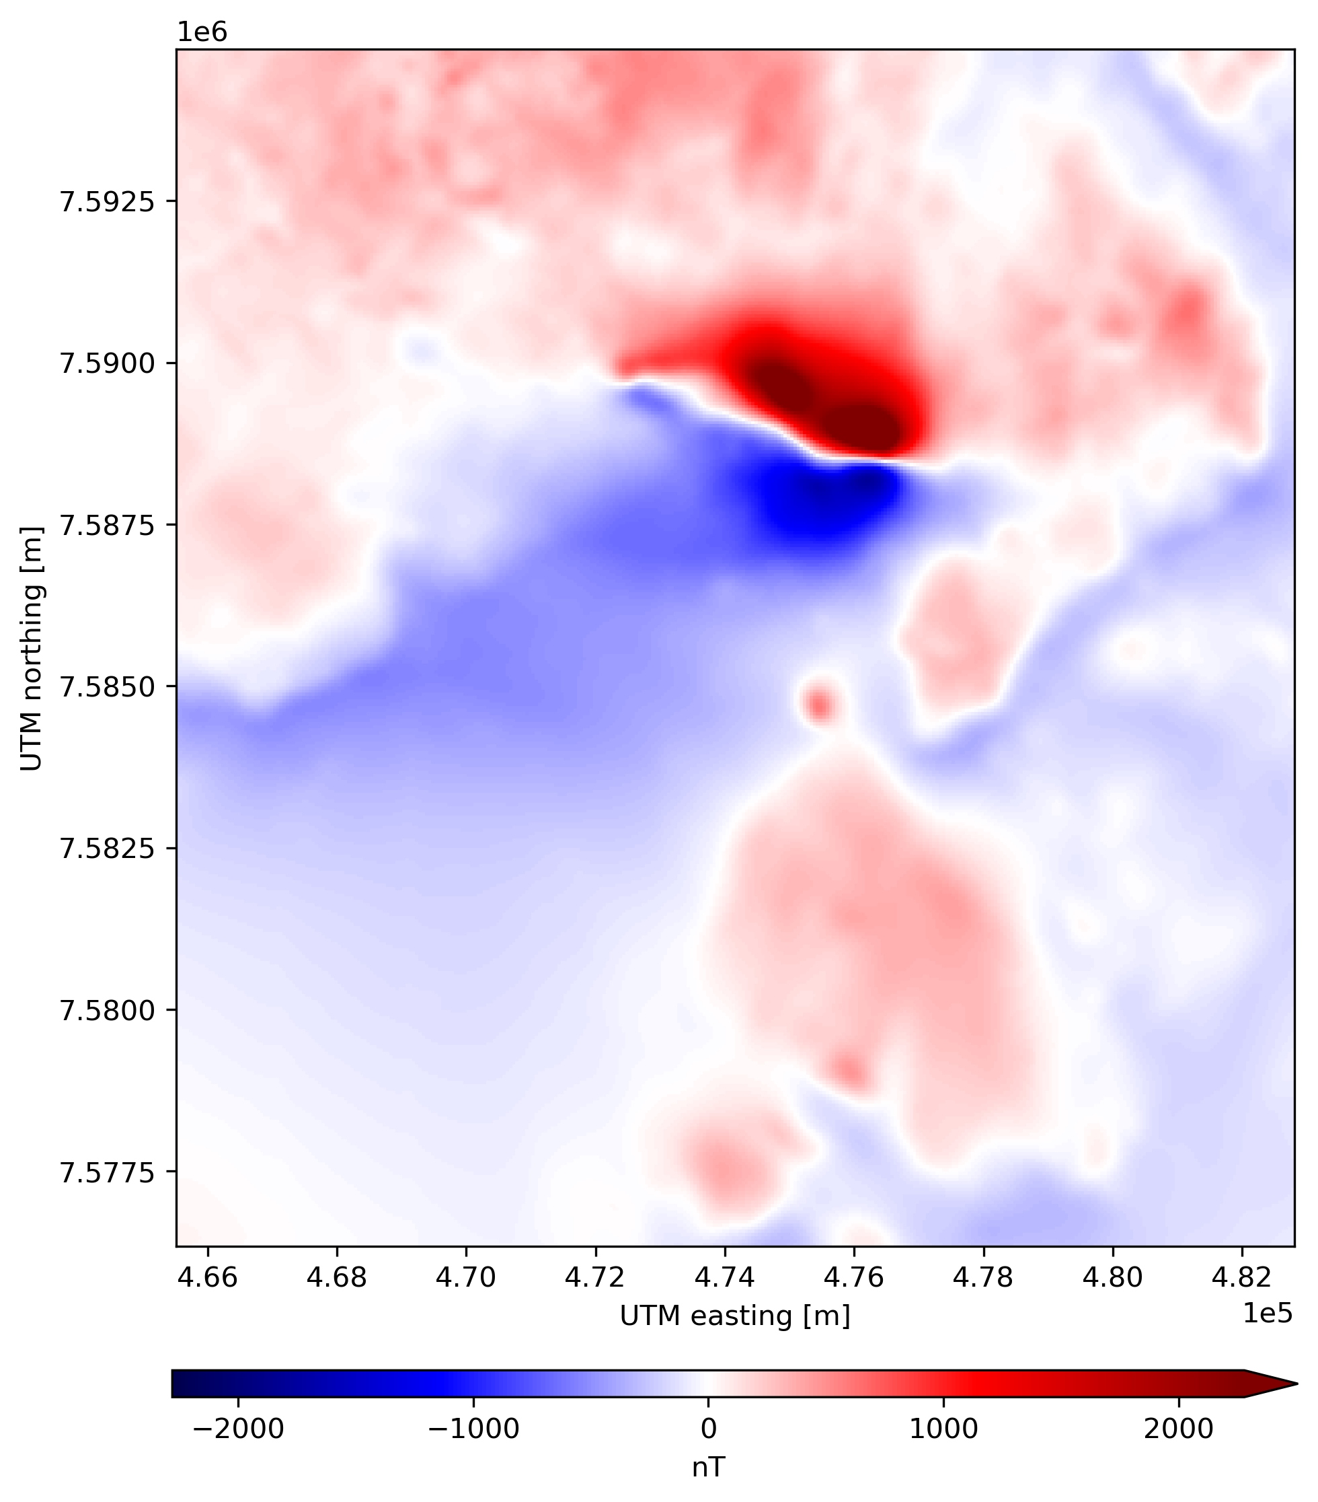
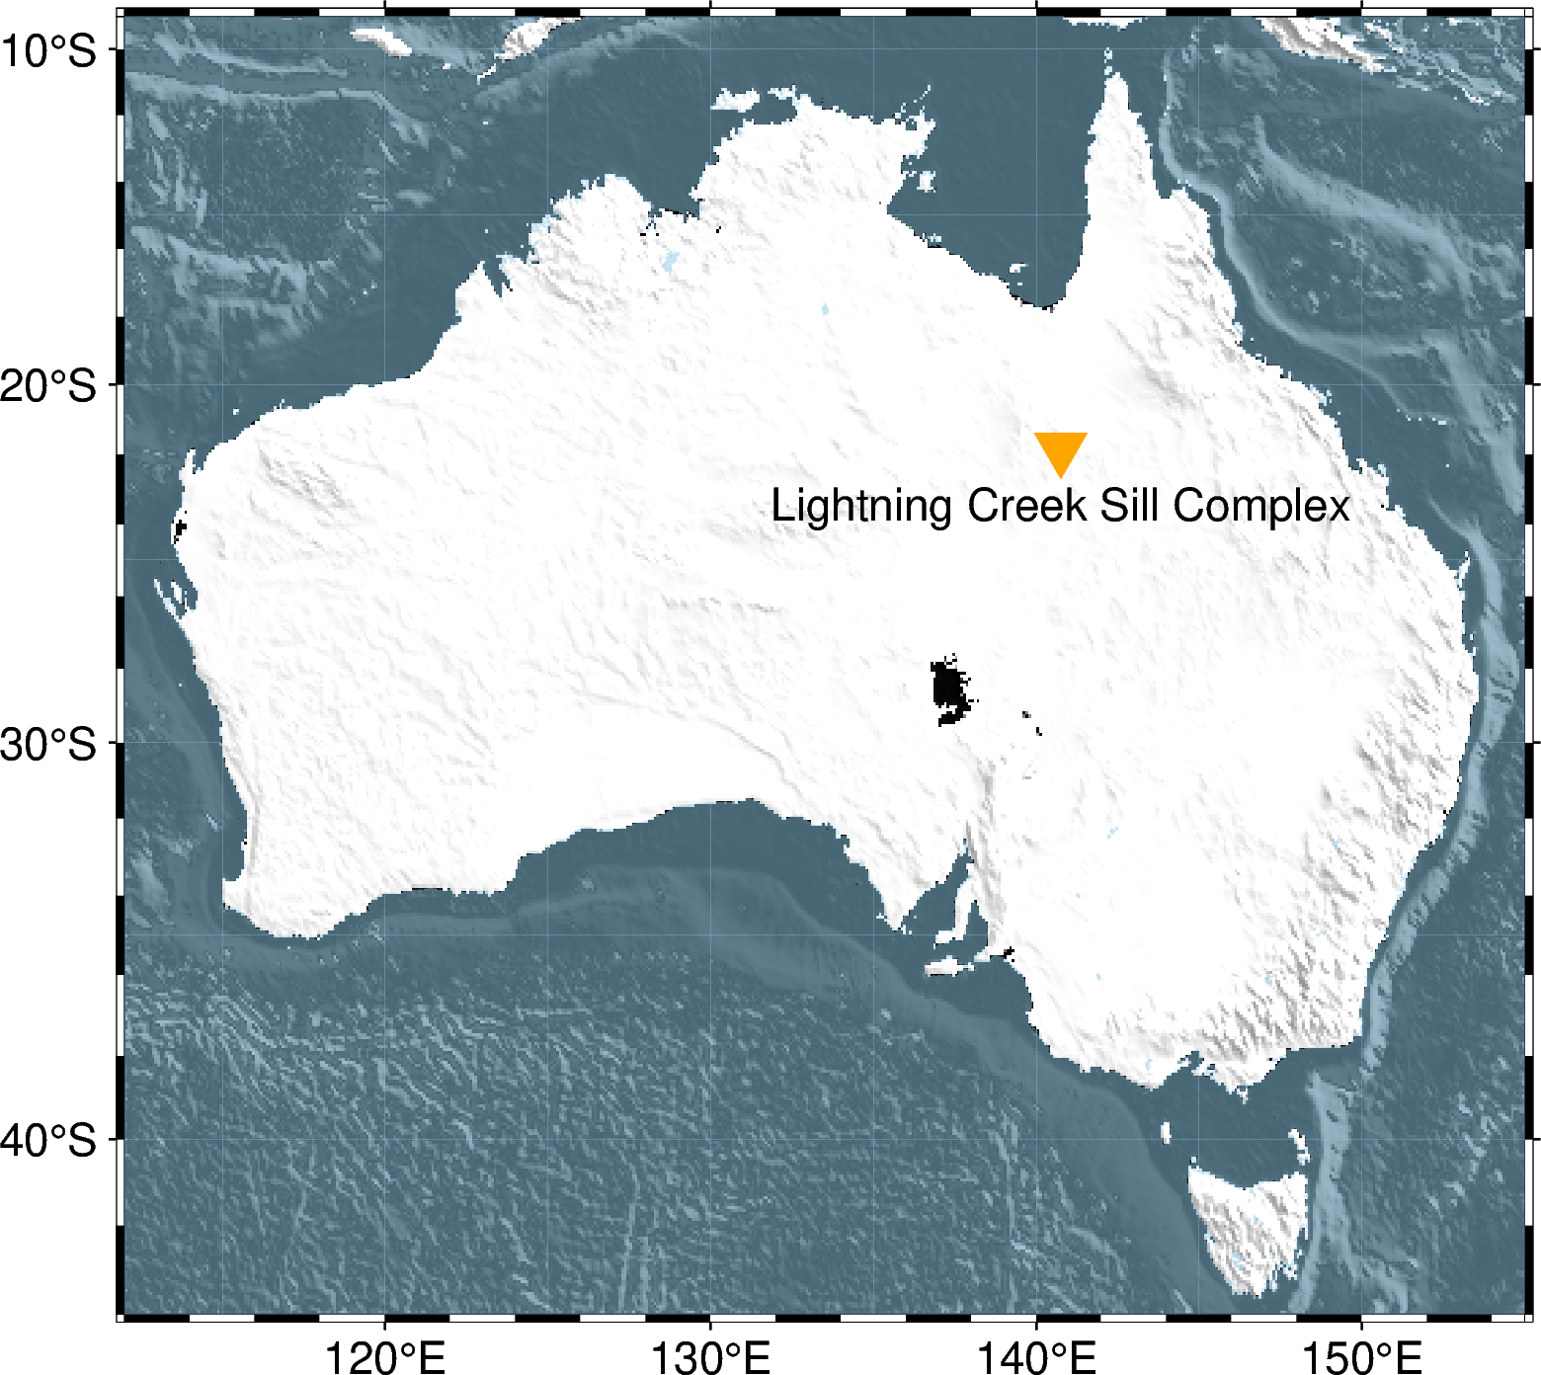
Download a magnetic data grid
Total field magnetic anomaly

Slide 25
Reduction to the pole
import harmonica as hm
reduced_to_pole = hm.reduction_to_pole(
magnetic_grid,
inclination=-53.0,
declination=6.5,
)
Harmonica

Slide 26
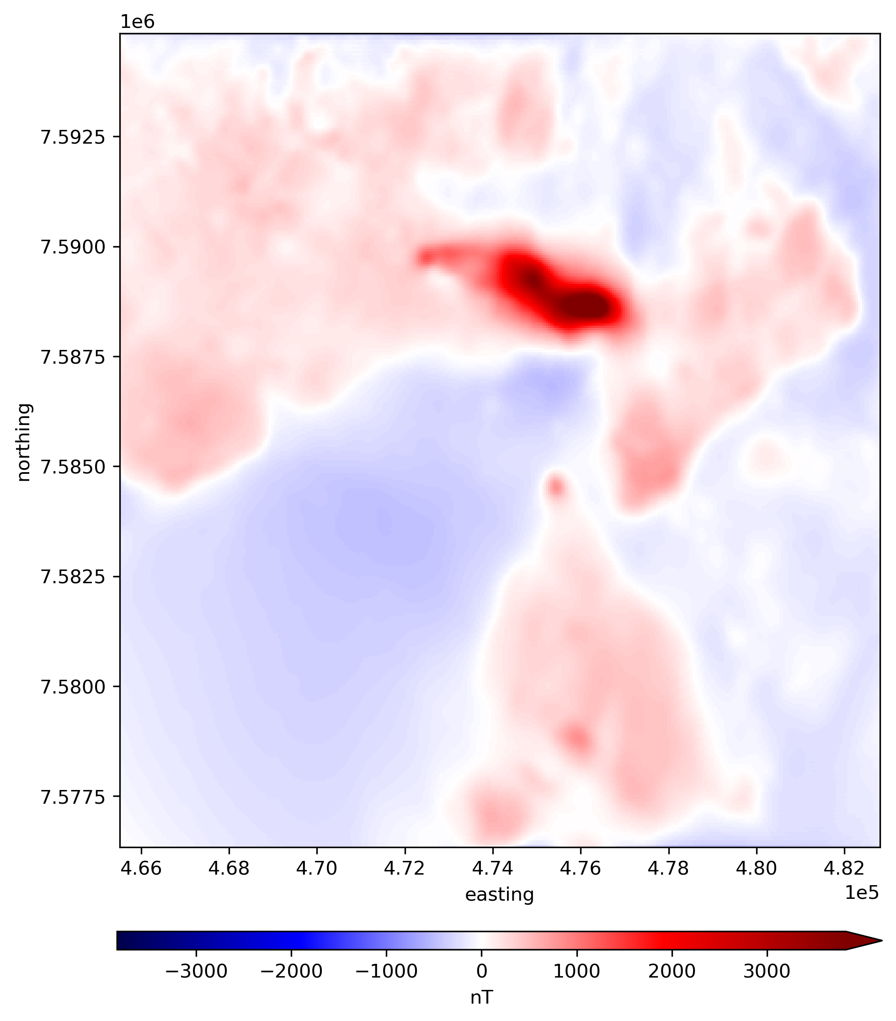
Reduction to the pole
Total field anomaly
Reduced to the pole

Slide 27
Upward derivative
import harmonica as hm
deriv_upward = hm.derivative_upward(reduced_to_pole)
Harmonica

Slide 28
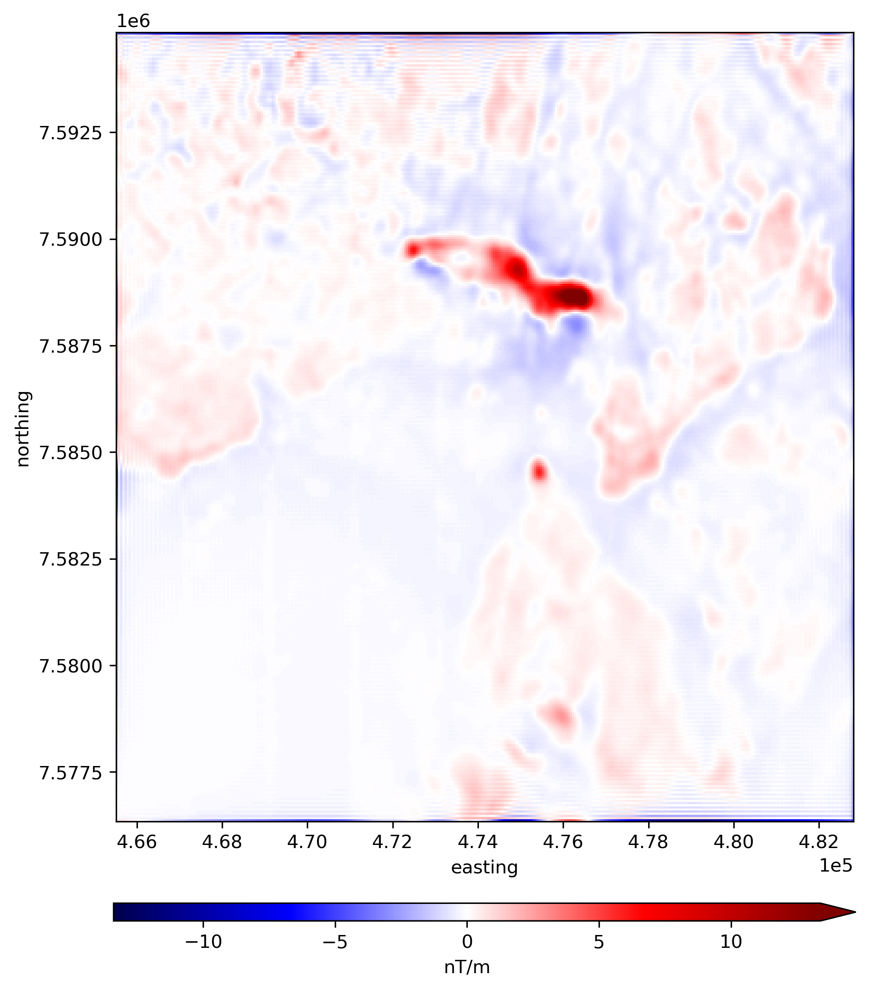
Upward derivative
Reduced to the pole
Upward derivative

Slide 29
Upward continuation
import harmonica as hm
upward_cont = hm.upward_continuation(
reduced_to_pole,
height_displacement=500,
)
Harmonica

Slide 30
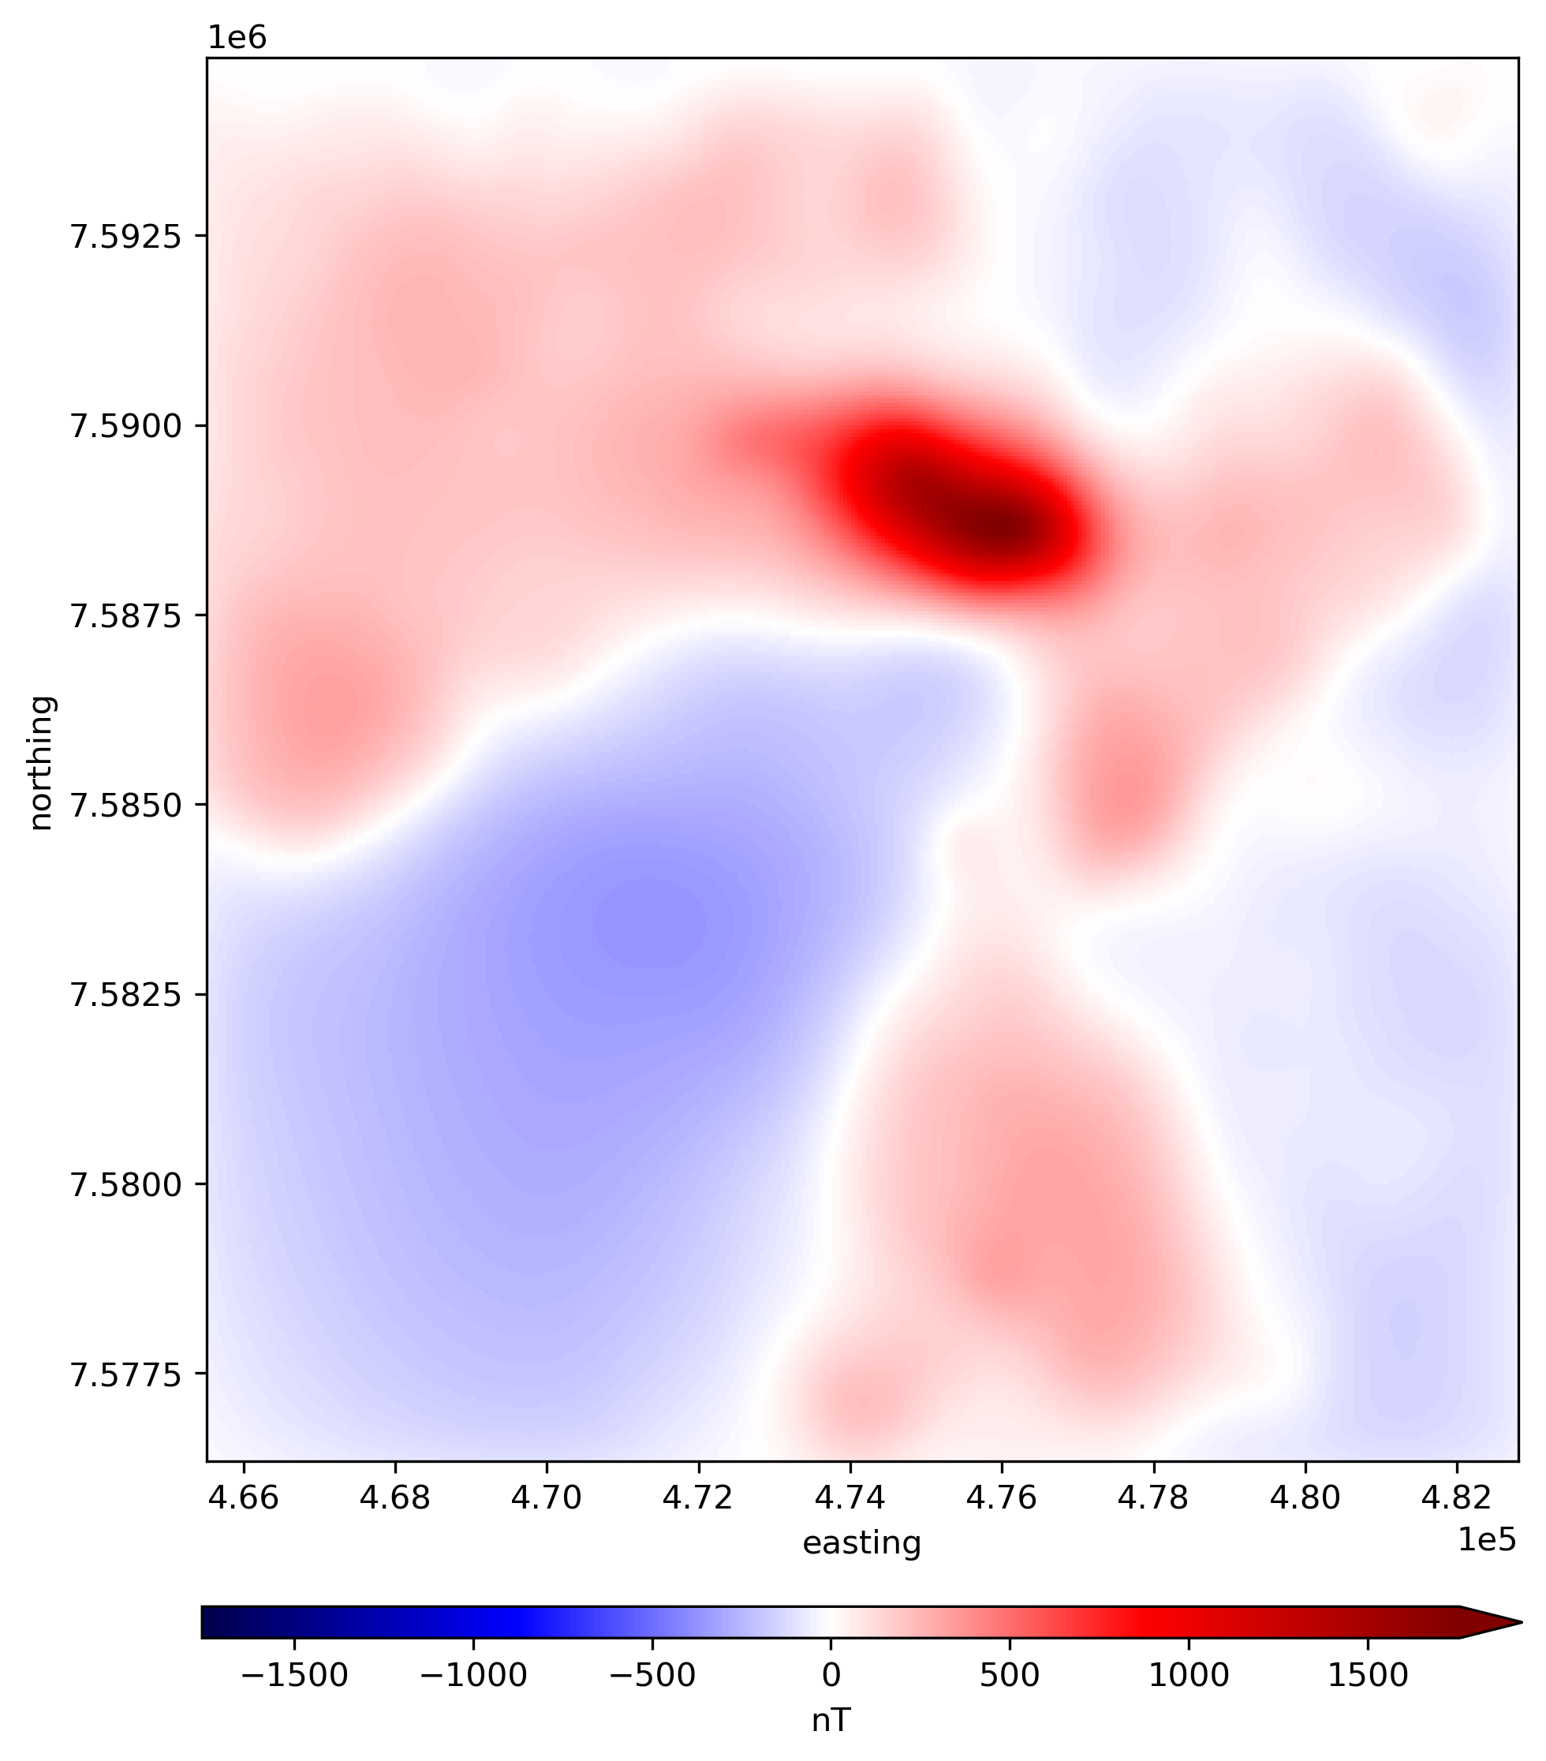
Upward continuation
Reduced to the pole
Upward continued (500m)

Slide 31
Example:
Oasis Montaj® GRD files in Python

Slide 32
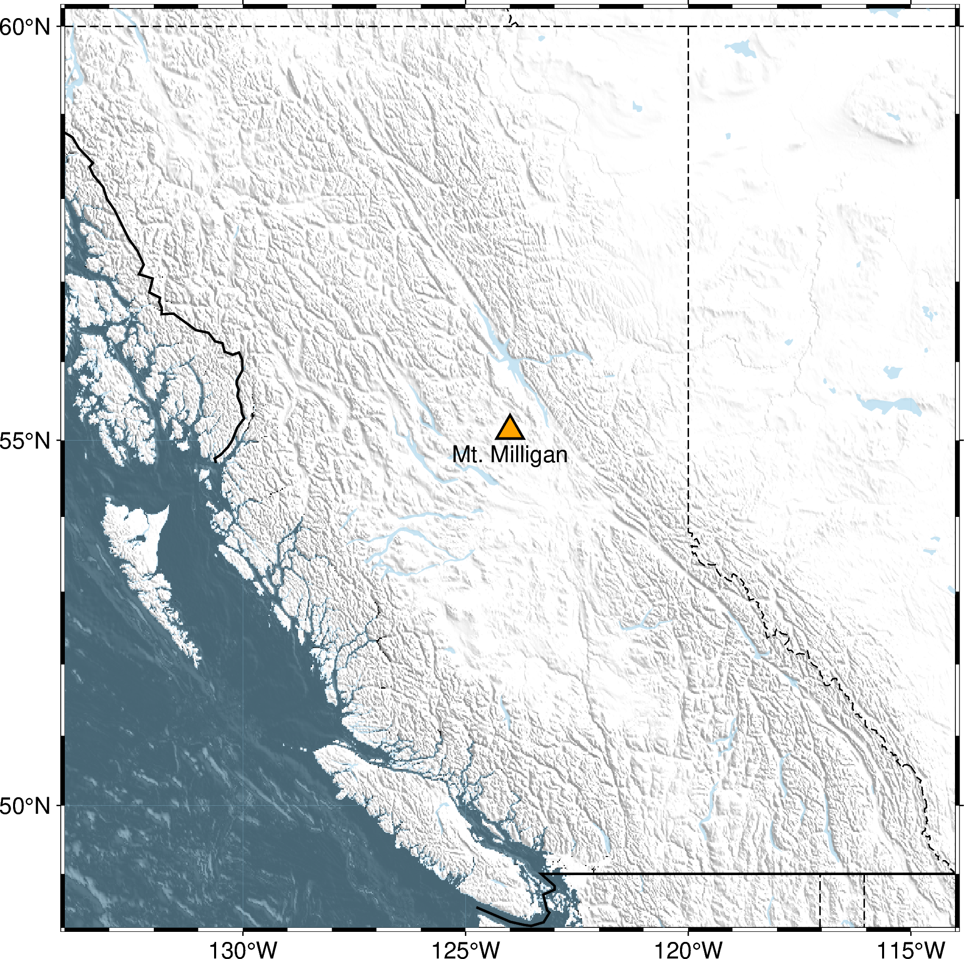
Mt. Milligan, British Columbia

Slide 33
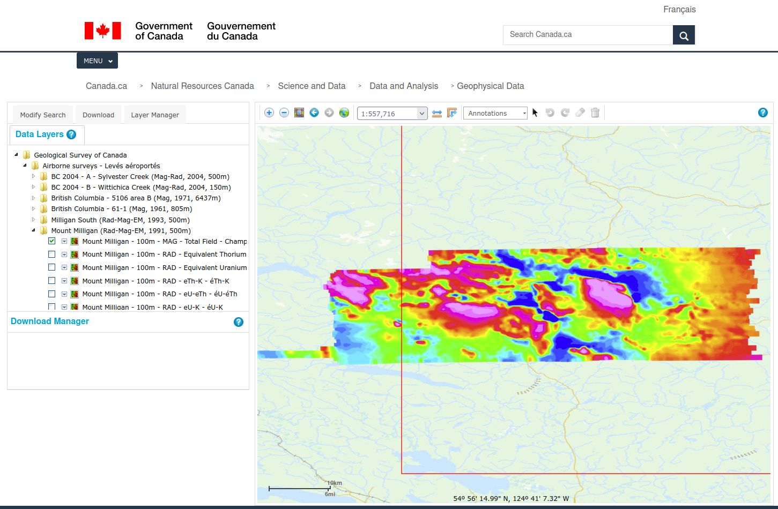
Open-licensed data from NRCAN

Slide 34
Gridded data:
Oasis Montaj® GRD files
Open-licensed data from NRCAN

Slide 35
Reading GRD files in Python
import harmonica as hm
grid = hm.load_oasis_montaj_grid("Mount_Milligan_MTF.GRD")
Harmonica

Slide 36
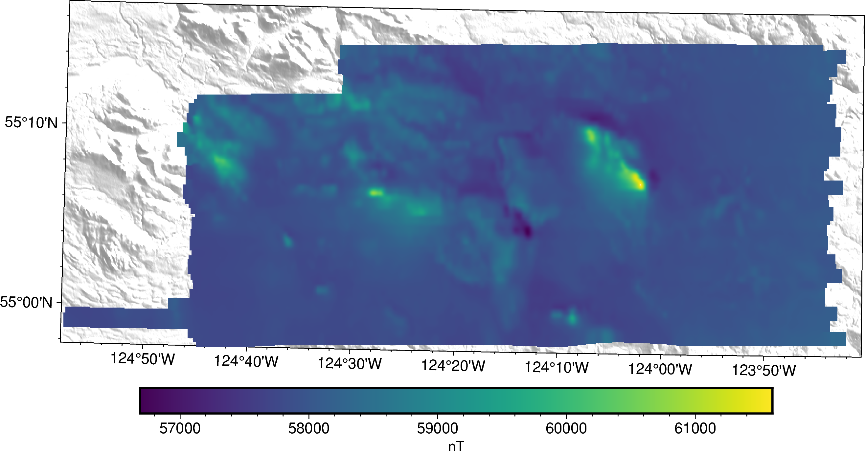
Reading GRD files in Python
Total magnetic field data

Slide 37

Total field anomaly
import ppigrf
from datetime import datetime
date = datetime(year=1991, month=9, day=14)
height_km = 0.120
igrf = ppigrf.igrf(
longitude, latitude, height_km, date
)
igrf = np.sqrt(igrf[0]**2 + igrf[1]**2 + igrf[2]**2)
tf_anomaly = grid - igrf
klaundal/ppigrf
(compute International Geomagnetic Reference Field)

Slide 38
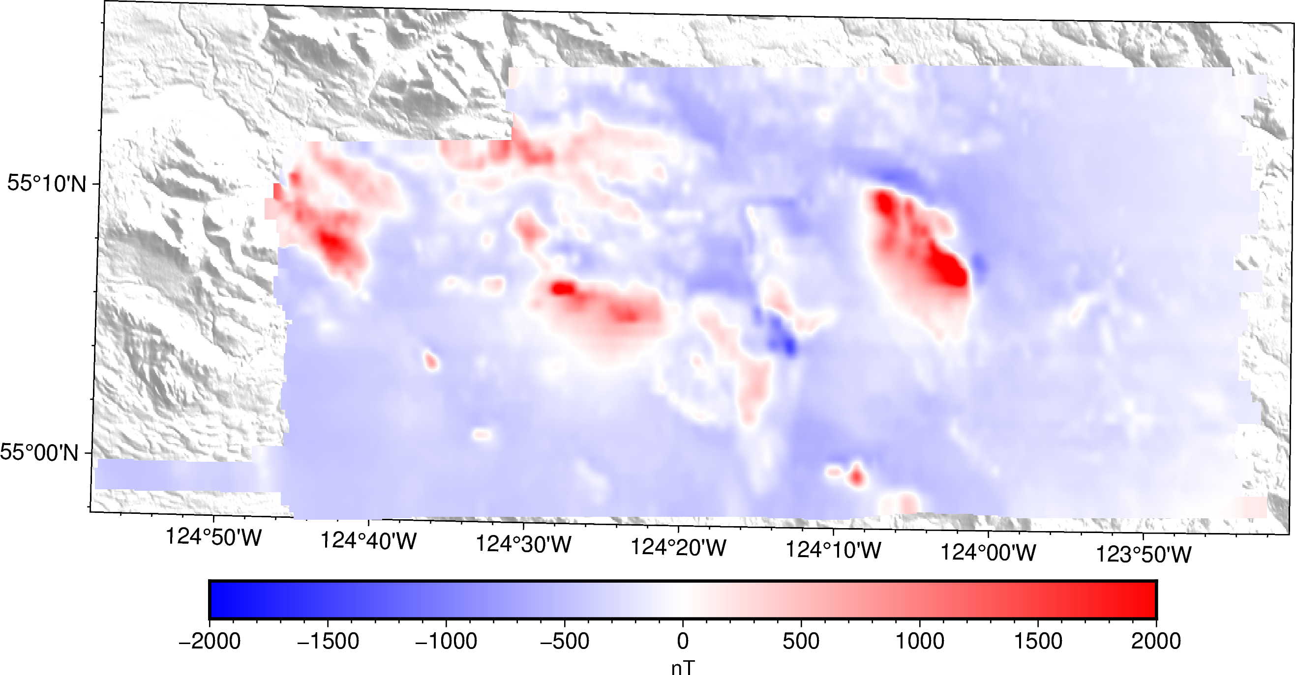
Total field anomaly
Total field anomaly

Slide 39
Who makes Fatiando possible?

Slide 40
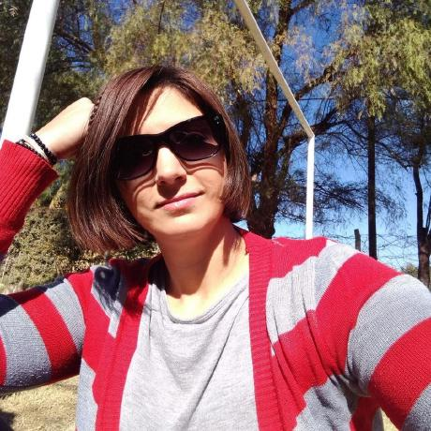


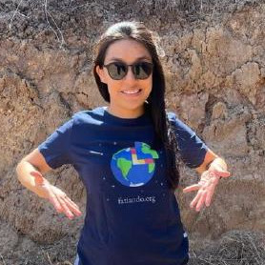
Steering Council
aguspesce
leouieda
LL-Geo
MGomezN
santisoler

Slide 41



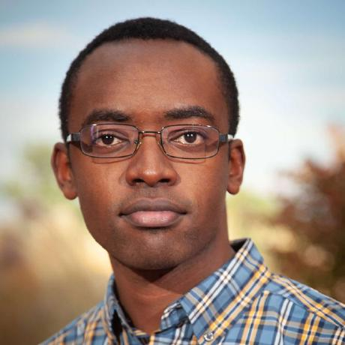


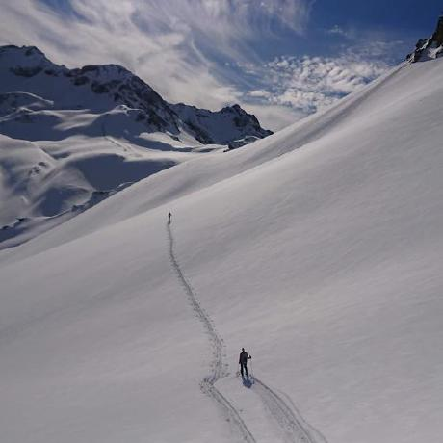



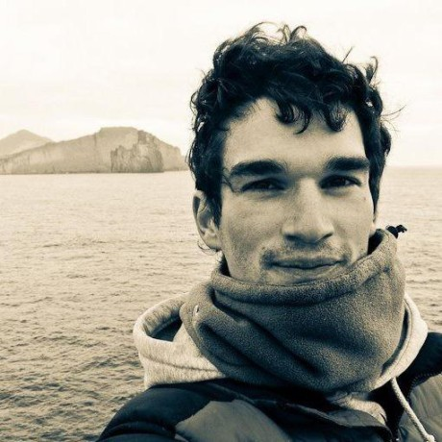
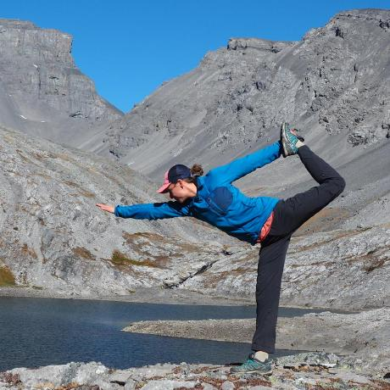




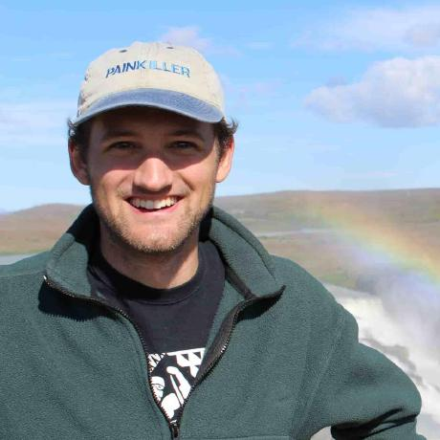

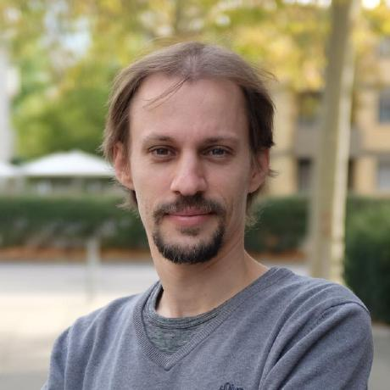

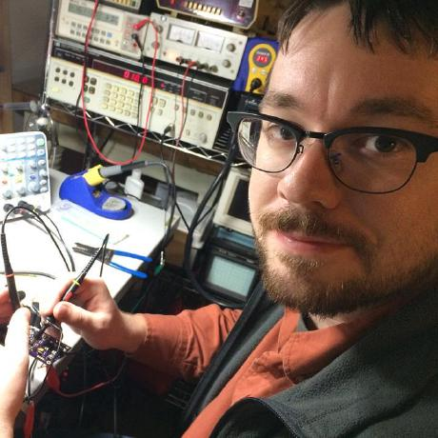


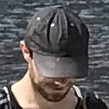
Contributors

Slide 42

Get started!
www.fatiando.org/learn
Join the conversation
www.fatiando.org/contact
www.fatiando.org

Slide 43
THANK YOU

Slide 44


Get the slides
https://doi.org/10.6084/m9.figshare.22151357
Slides available under Creative Commons Attribution International 4.0 License

