Slide 1
Transport Management System Project

Slide 2
Introduction

Slide 3
01
Introduction
02
L’interface web du TMS.
03
Développement des algorithmes:
Clarke and Wright Algorithm
Branch and Bound Algorithm
Variable Neighbourhood Search
04
Conclusion.

Slide 4
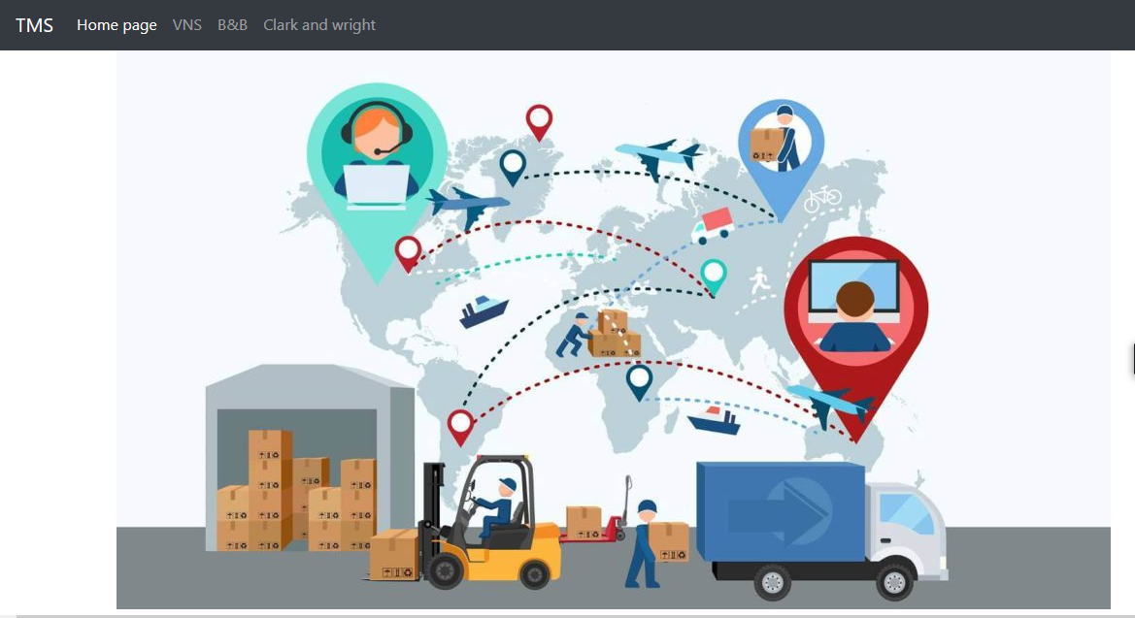
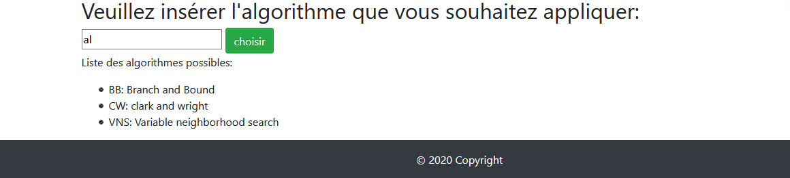
L’interface web du TMS.

Slide 5
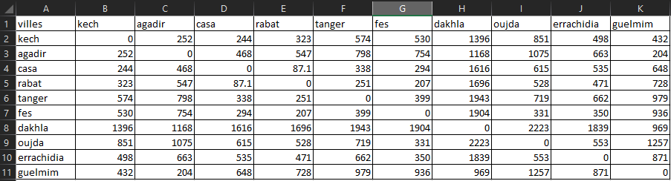
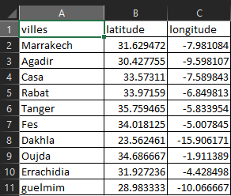
Les matrices
des distances
Les matrices des longitudes et latitudes

Slide 6
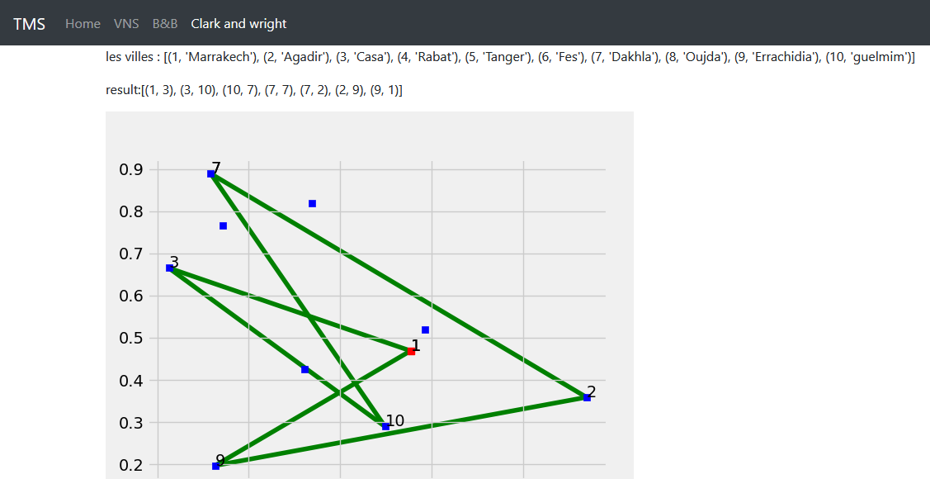
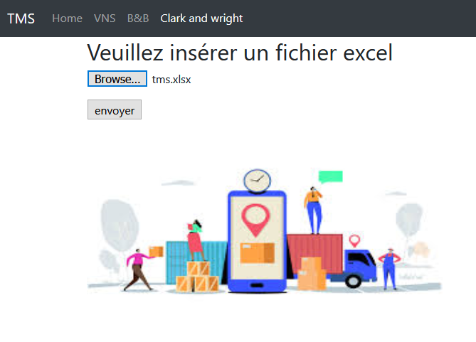
Clarke and Wright Algorithm
Add Text
Get a modern PowerPoint Presentation that is beautifully designed.

Slide 7
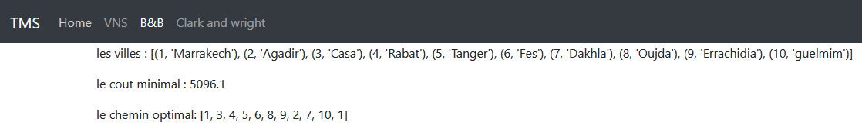
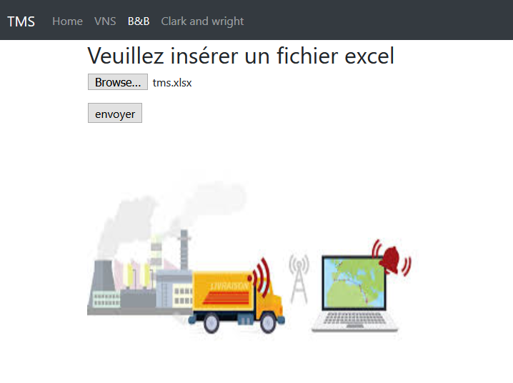
Branch and Bound Algorithm
Add Text
Get a modern PowerPoint Presentation that is beautifully designed.

Slide 8
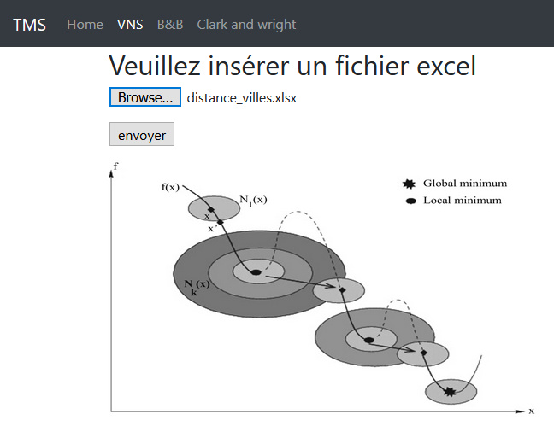
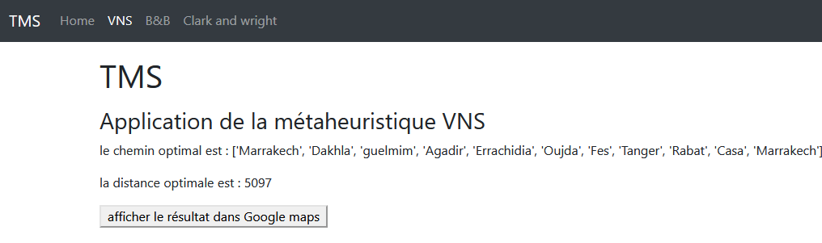
Variable Neighbourhood Search
Add Text
Get a modern PowerPoint Presentation that is beautifully designed.

Slide 9
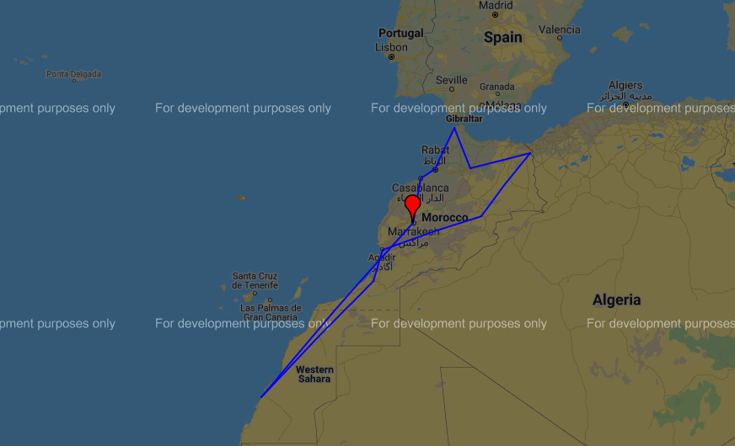
Variable Neighbourhood Search
La visualisation sur MAPS
Add Text
Get a modern PowerPoint Presentation that is beautifully designed.

Slide 10
Conclusion

