Slide 1
Chapter 3 - Transmission Media
Page Number Title
1 Basic Idea
2 Transmission media
3 Copper wires
4 Glass fibers
5 Radio
6 Wireless Example
7 Wireless Exmaple
8 Microwave
9 Infrared
10 Laser
11 Choosing a medium
12 Media in use at Bucknell

Slide 2
Basic Idea
Encode data as energy and transmit energy
Decode energy at destination back into data
Energy can be electrical, light, radio, sound, ...
Each form of energy has different properties and requirements for transmission

Slide 3
Transmission media
Transmitted energy is carried through some sort of medium
Transmitter encodes data as energy and transmits energy through medium
  Requires special hardware for data encoding
  Requires hardware connection to transmission medium
  (Figure)
Media can be copper, glass, air, ...

Slide 4
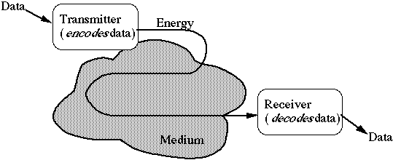

Slide 5

Copper wires
Twisted pair uses two wires

Slide 6
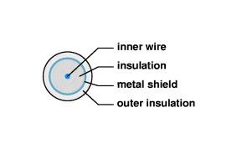
Coaxial cable includes shield for improved performance

Slide 7

Glass fibers
Thin glass fiber carries light with encoded data
Plastic jacket allows fiber to bend (some!) without breaking
Fiber is very clear and designed to reflect light internally for efficient transmission
Light emitting diode (LED) or laser injects light into fiber
Light sensitive receiver at other end translates light back into data

Slide 8
Radio
Data transmitted using radio waves
Energy travels through the air rather than copper or glass
Conceptually similar to radio, TV, cellular phones
Can travel through walls and through an entire building
Can be long distance or short distance
  Long distance with satellite relay
Short distance - wireless computer network

Slide 9
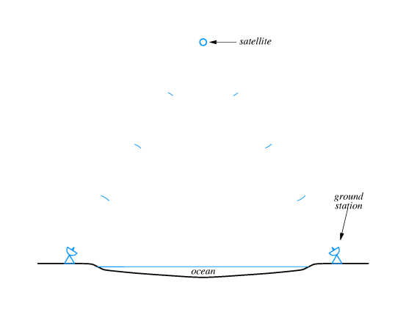

Slide 10
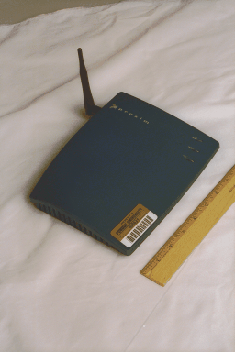
Wireless Example
Wireless bridge and antenna

Slide 11
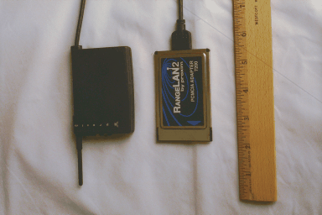
Wireless Exmaple
Remote station (laptop) interface

Slide 12
Microwave
High frequency radio waves
Unidirectional, for point-to-point communication
Antennas mounted on towers relay transmitted data

Slide 13
Infrared
Infrared light transmits data through the air
Similar to technology used in TV remote control
Can propagate throughout a room (bouncing off surfaces), but will not penetrate walls
Becoming common in personal digital assistants

Slide 14
Laser
Unidirectional, like microwave
Higher speed than microwave
Uses laser transmitter and photo-sensitive receiver at each end
Point-to-point, typically between buildings
Can be adversely affected by weather

Slide 15
Choosing a medium
Copper wire is mature technology, rugged and inexpensive; maximum transmission speed is limited
Glass fiber:
  Higher speed
  More resistant to electro-magnetic interference
  Spans longer distances
  Requires only single fiber
  More expensive; less rugged

Slide 16
Radio and microwave don't require physical connection
Radio and infrared can be used for mobile connections
Laser also does not need physical connection and supports higher speeds

Slide 17
Media in use at Bucknell (KTU)
Copper/fiber for long-distance connection to Internet
Fiber between buildings
Copper within buildings

