Slide 1
Chapter 7 - LAN Technologies and Network Topology
Page Number Title
1 Introduction
2 Direct point-to-point communication
3 Connections in a point-to-point network
4 Connections in a point-to-point network
5 Reducing the number of communication channels
6 Growth of LAN technologies
7 Locality of reference
8 LAN topologies
9 Star topology

Slide 2
10 Star topology in practice
11 Ring topology
12 Bus topology
13 Why multiple topologies?
14 Ethernet
15 Ethernet speeds
16 Ethernet operation
17 Ethernet example
18 CSMA
19 CSMA example
20 Collision detection - CD
21 Collision example
22 Ethernet CD
23 Recovery from collision

Slide 3
24 Exponential backoff
25 Wireless LAN
26 Limited connectivity with wireless
27 CSMA/CA
28 Collisions
29 LocalTalk
30 Token ring
31 Transmission around a token ring
32 Using the token
33 Token and synchronization
34 IBM token ring
35 FDDI

Slide 4
36 FDDI and reliability
37 ATM - Star network
38 ATM details
39 ATM switches
40 Summary

Slide 5
Direct point-to-point communication
Computers connected by communication channels that each connect exactly two computers
Forms mesh or point-to-point network
Allows flexibility in communication hardware, packet formats, etc.
Provides security and privacy because communication channel is not shared

Slide 6
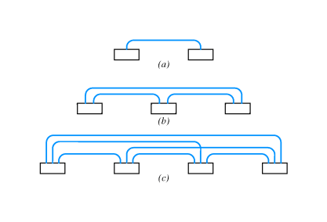
Connections in a point-to-point network
Number of wires grows as square of number of computers

Slide 7
For N computers:
Connections = (n² - n)/2

Slide 8
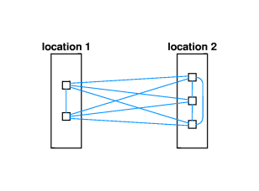
Connections in a point-to-point network
Connections between buildings can be prohibitive:

Slide 9
Adding a new computer requires N - 1 new connections

Slide 10
Reducing the number of communication channels
LANs developed in late 1960s and early 1970s
Key idea - reduce number of connections by sharing connections among many computers
  Computers take turns - TDM
  Must include techniques for synchronizing use

Slide 11
Growth of LAN technologies
LAN technologies reduce cost by reducing number of connections
But ... attached computers compete for use of shared connection
Local communication almost exclusively LAN
Long distance almost exclusively point-to-point
  SMDS
  ATM

Slide 12
Locality of reference
Principle of locality of reference helps predict computer communication patterns:
  Spatial (or physical) locality of reference - computers likely to communicate with other computers that are located nearby
  Temporal locality of reference - computers are likely to communicate with the same computers repeatedly
Thus - LANs are effective because of spatial locality of reference, and temporal locality of reference may give insight into which computers should be on a LAN

Slide 13
LAN topologies
Networks may be classified by shape
Three most popular:
  Star
  Ring
  Bus

Slide 14
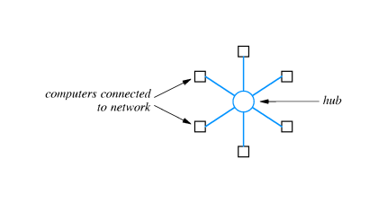
Star topology
All computers attach to a central point:
Center of star is sometimes called a hub

Slide 15
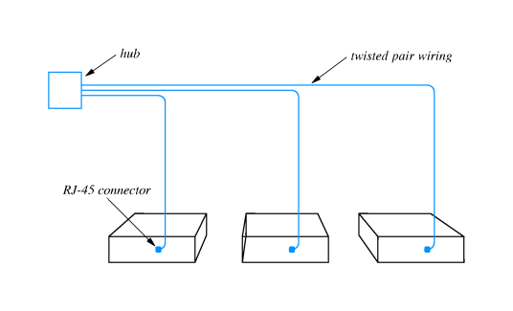
Star topology in practice
Previous diagram is idealized; usually, connecting cables run in parallel to computers:

Slide 16
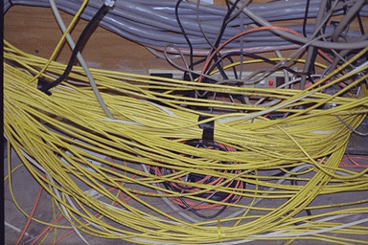
Result is:

Slide 17
Ring topology
Computers connected in a closed loop
First passes data to second, second passes data to third, and so on
In practice, there is a short connector cable from the computer to the ring
Ring connections may run past offices with connector cable to socket in the office:

Slide 18
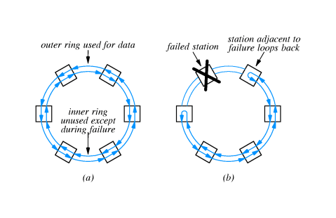

Slide 19
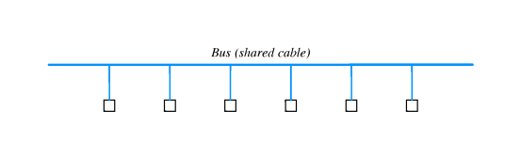
Bus topology
Single cable connects all computers
Each computer has connector to shared cable
Computers must synchronize and allow only one computer to transmit at a time

Slide 20
Why multiple topologies?
Each has advantages and disadvantages:
  Ring ease synchronization; may be disabled if any cable is cut
  Star easier to manage and more robust; requires more cables
Bus requires fewer cables; may be disable if cable is cut
Bucknell has used all three; now almost entirely star topology
Industry is settling on star topology as most widely used

Slide 21
Ethernet
Widely used LAN technology
  Invented at Xerox PARC (Palo Alto Research Center) in 1970s
  Defined in a standard by Xerox, Intel and Digital - DIX standard
  Standard now managed by IEEE - defines formats, voltages, cable lengths, ...
Uses bus topology
  Single coax cable - the ether
  Multiple computers connect
One Ethernet cable is sometimes called a segment
  Limited to 500 meters in length
  Minimum separation between connections is 3 meters

Slide 22
Ethernet speeds
Originally 3Mbps
Current standard is 10Mbps
Fast Ethernet operates at 100Mbps

Slide 23
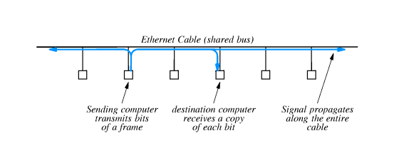
Ethernet operation
One computer transmits at a time
Signal is a modulated carrier which propagates from transmitter in both directions along length of segment

Slide 24
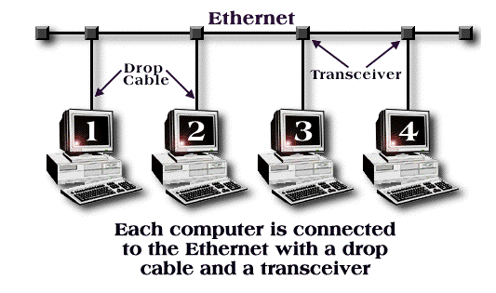
Ethernet example

Slide 25
CSMA
No central control managing when computers transmit on ether
Ethernet employs CSMA to coordinate transmission among multiple attached computers
Carrier Sense with Multiple Access
  Multiple access - multiple computers are attached and any can be transmitter
  Carrier sense - computer wanting to transmit tests ether for carrier before transmitting

Slide 26
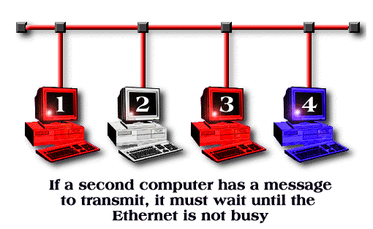
CSMA example

Slide 27
Collision detection - CD
Even with CSMA, two computers may transmit simultaneously
  Both check ether at same time, find it idle, and begin transmitting
  Window for transmission depends on speed of propagation in ether
Signals from two computers will interfere with each other
Overlapping frames is called a collision
  No harm to hardware
Data from both frames is garbled

Slide 28
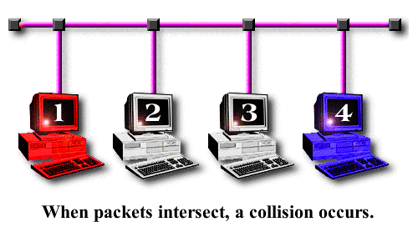
Collision example

Slide 29
Ethernet CD
Ethernet interfaces include hardware to detect transmission
  Monitor outgoing signal
  Garbled signal is interpreted as a collision
After collision is detected, computer stops transmitting
So, Ethernet uses CSMA/CD to coordinate transmissions

Slide 30
Recovery from collision
Computer that detects a collision sends special signal to force all other interfaces to detect collision
Computer then waits for ether to be idle before transmitting
  If both computers wait same length of time, frames will collide again
  Standard specifies maximum delay, and both computers choose random delay less than maximum
After waiting, computers use carrier sense to avoid subsequent collision
  Computer with shorter delay will go first
  Other computers may transmit first

Slide 31
Exponential backoff
Even with random delays, collisions may occur
Especially likely with busy segments
Computers double delay with each subsequent collision
Reduces likelihood of sequence of collisions

Slide 32
Wireless LAN
Use radio signals at 900MHz
Data rate of 2Mbps
Shared medium - radio instead of coax

Slide 33
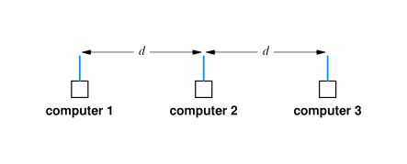
Limited connectivity with wireless
In contrast with wired LAN, not all participants may be able to reach each other
  Low signal strength
  Propagation blocked by walls, etc.
Can't depend on CD; not all participants may hear

Slide 34
CSMA/CA
Wireless uses collision avoidance rather than collision detection
  Transmitting computer sends very short message to receiver
  Receiver responds with short message reserving slot for transmitter
Response from receiver is broadcast so all potential transmitters receive reservation

Slide 35
Collisions
Receiver may receive simultaneous requests
  Results in collision at receiver
  Both requests are lost
  Neither transmitter receives reservation; both use backoff and retry
Receiver may receive closely spaced requests
  Selects one
  Selected transmitter sends message
  Transmitter not selected uses backoff and retries

Slide 36
LocalTalk
LAN technology that uses bus topology
Interface included with all Macintosh computers
Relatively low speed - 230.4Kbps
Low cost (``free'' with a Macintosh); easy to install and connect
Uses CSMA/CD

Slide 37
Token ring
Many LAN technologies that use ring topology use token passing for synchronized access to the ring
Ring itself is treated as a single, shared communication medium
Bits pass from transmitter, past other computers and are copied by destination
Hardware must be designed to pass token even if attached computer is powered down

Slide 38
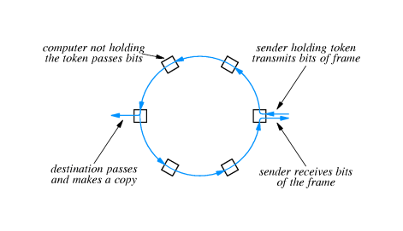

Slide 39
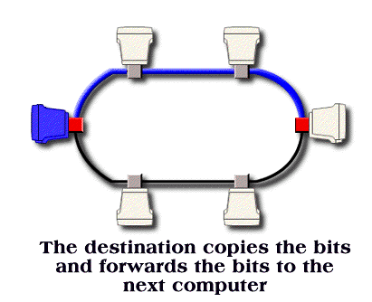
Transmission around a token ring

Slide 40
Using the token
When a computer wants to transmit, it waits for the token
After transmission, computer transmits token on ring
Next computer ready to transmit receives token and then transmits

Slide 41
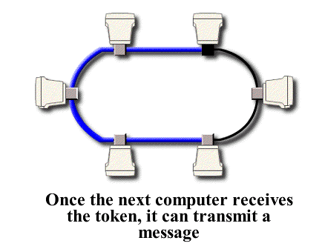

Slide 42
Token and synchronization
Because there is only one token, only one computer will transmit at a time
  Token is short, reserved frame that cannot appear in data
  Hardware must regenerate token if lost
Token gives computer permission to send one frame
  If all ready to transmit, enforces ``round-robin'' access
  If none ready to transmit, token circulates around ring

Slide 43
IBM token ring
Very widely used
Originally 4mbps, now 16Mbps
Uses special connector cable between computer and ring interface

Slide 44
FDDI
Fiber Distributed Data Interconnect (FDDI) is another ring technology
  Uses fiber optics between stations
  Transmits data at 100Mbps
Uses pairs of fibers to form two concentric rings

Slide 45
FDDI and reliability
FDDI uses counter-rotating rings in which data flows in opposite directions
In case of fiber or station failure, remaining stations loop back and reroute data through spare ring
All stations automatically configure loop back by monitoring data ring

Slide 47
ATM - Star network
Asynchronous Transfer Mode technology consists of electronic packet switches to which computers can connect
ATM switches form hub into which computers connect in a star topology
Computers get point-to-point connections - data from transmitter is routed directly through hub switches to destination

Slide 48
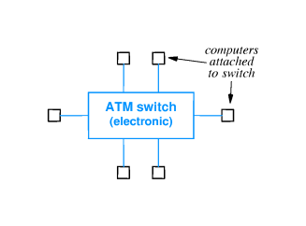

Slide 49
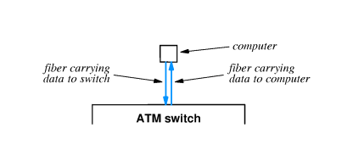
ATM details
Transmits data at over 100Mbps
Uses fiber optics to connect computer to switch
Each connection includes two fibers

Slide 50
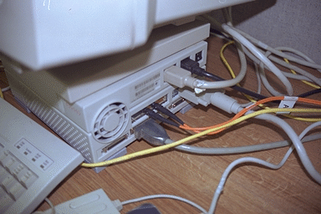

Slide 51
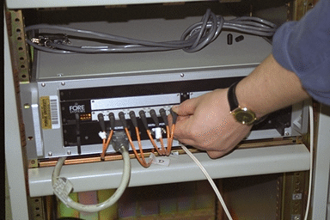
ATM switches

Slide 52
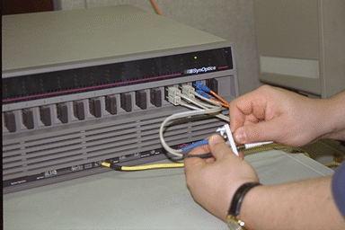

Slide 53
Summary
LAN technologies use shared communication media to interconnect multiple computers over short distances
Transmitting computer has exclusive use of communication medium; computers must synchronize transmission and share available capacity
LAN topologies:
  Star
  Ring
  Bus
LAN technologies
  Ethernet
  Wireless
  LocalTalk
  IBM Token Ring
  FDDI
  ATM

