Slide 1
Chapter 4 - Local Asynchronous Communication
Page Number Title
1 Bit-wise data transmission
2 Asynchronous communication
3 Using electric current to send bits
4 Sending bits - example
5 Transmission timing
6 RS-232
7 Details of RS-232
8 RS-232 wiring and connectors
9 Identifying asynchronous characters
10 Timing

Slide 2
11 Measures of transmission rates
12 Framing
13 Full-duplex communication
14 RS-232 connection standards
15 2-3 swap
16 RS-232 cable breakout-box
17 Limitations of real hardware
18 Hardware bandwidth
19 Bandwidth and data transmission
20 Summary

Slide 3
Bit-wise data transmission
Data transmission requires:
  Encoding bits as energy
  Transmitting energy through medium
  Decoding energy back into bits
Energy can be electric current, radio, infrared, light
Transmitter and receiver must agree on encoding scheme and transmission timing

Slide 4
Asynchronous communication
One definition of asynchronous: transmitter and receiver do not explicitly coordinate each data transmission
  Transmitter can wait arbitrarily long between transmissions
  Used, for example, when transmitter such as a keyboard may not always have data ready to send
Asynchronous may also mean no explicit information about where data bits begin and end

Slide 5
Using electric current to send bits
Simple idea - use varying voltages to represent 1s and 0s
One common encoding use negative voltage for 1 and positive voltage for 0
In following figure, transmitter puts positive voltage on line for 0 and negative voltage on line for 1

Slide 6
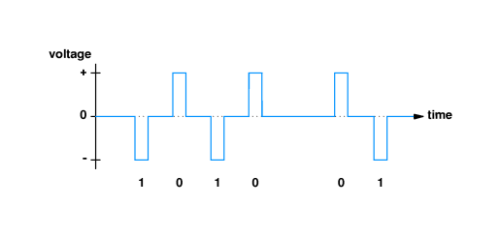

Slide 7
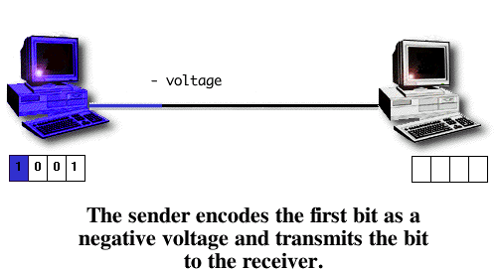
Sending bits - example

Slide 8
Transmission timing
Encoding scheme leaves several questions unanswered:
  How long will voltage last for each bit?
  How soon will next bit start?
  How will the transmitter and receiver agree on timing?
Standards specify operation of communication systems
  Devices from different vendors that adhere to the standard can interoperate
  Example organizations:
  International Telecommunications Union (ITU)
  Electronic Industries Association (EIA)
Institute for Electrical and Electronics Engineers (IEEE)

Slide 9
RS-232
Standard for transfer of characters across copper wire
Produced by EIA
Full name is RS-232-C
RS-232 defines serial, asynchronous communication
Serial - bits are encoded and transmitted one at a time (as opposed to parallel transmission)
Asynchronous - characters can be sent at any time and bits are not individually synchronized.

Slide 10
Details of RS-232
Components of standard:
  Connection must be less than 50 feet
  Data represented by voltages between +15v and -15v
  25-pin connector, with specific signals such as data, ground and control assigned to designated pins
  Specifies transmission of characters between, e.g., a terminal and a modem
Transmitter never leaves wire at 0v; when idle, transmitter puts negative voltage (a 1) on the wire

Slide 11
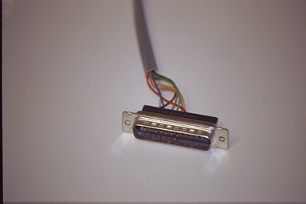
RS-232 wiring and connectors

Slide 12
Identifying asynchronous characters
Transmitter indiciates start of next character by transmitting a zero
  Receiver can detect transition as start of character
  Extra zero called the start bit
Transmitter must leave wire idle so receiver can detect transition marking beginning of next character
  Transmitter sends a one after each character
  Extra one call the stop bit
Thus, character represented by 7 data bits requires transmission of 9 bits across the wire

Slide 13
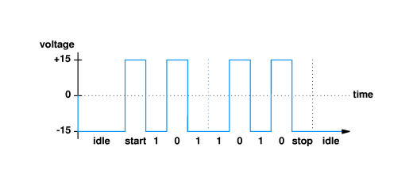
RS-232 terminology:
  MARK is a negative voltage (== 1)
  SPACE is a positive voltage (== 0)

Slide 14
Timing
Transmitter and receiver must agree on timing of each bit
Agreement accomplished by choosing transmission rate
  Measured in bits per second
  Detection of start bit indicates to receiever when subsequent bits will arrive
Hardware can usually be configured to select matching bit rates
  Switch settings
  Software
Autodetection

Slide 15
Measures of transmission rates
Baud rate measures number of signal changes per second
Bits per second measures number of bits transmitted per second
In RS-232, each signal change represents one bit, so baud rate and bits per second are equal
If each signal change represents more than one bit, bits per second may be greater than baud rate

Slide 16
Framing
Start and stop bits represent framing of each character
If transmitter and reciver are using different speeds, stop bit will not be received at the expected time
Problem is called a framing error
RS-232 devices may send an intentional framing error called a BREAK

Slide 17
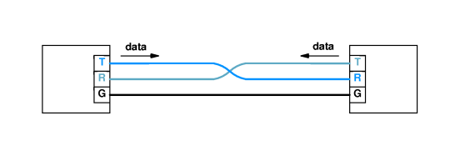
Full-duplex communication
Two endpoints may send data simultaneously - full-duplex communication
Requires an electrical path in each direction

Slide 18
RS-232 connection standards
RS-232 specifies use of 25 pin connector (DB-25)
Pins are assigned for use as data, ground and control:
  Pin 2 - Receive (RxD)
  Pin 3 - Transmit (TxD)
  Pin 4 - Ready to send (RTS)
  Pin 5 - Clear to send (CTS)
  Pin 7 - Ground

Slide 19
2-3 swap
Cable must cross-over wires to connect pins 2 and 3 on receiver and transmitter

Slide 20
To avoid 2-3 swap, RS-232 specifies that modems transmit on pin 2 and receive on pin 3, while computers transmit on pin 3 and receive on pin 2
However, RS-232 cables between two computers must have 2-3 swap

Slide 21
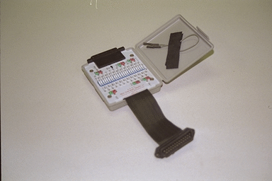
RS-232 cable breakout-box
May need to test RS-232 connections
Breakout-box gives access to signals

Slide 22
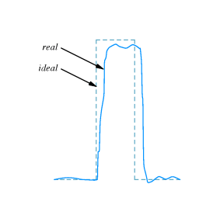
Limitations of real hardware
Effects of wire mean waveforms look like:

Slide 23
Longer wire, external interference may make signal look even worse
RS-232 standard specifies how precise a waveform the transmitter must generate, and how tolerant the receiever must be of imprecise waveform

Slide 24
Hardware bandwidth
Limitations on time to change voltages imposes upper limit on number of changes per second
Theoretical upper limit is called the bandwidth
Measured in cycles per second or Hertz

Slide 25
Bandwidth and data transmission
Nyquist sampling theorem expresses relationship between bandwidth and maximum data transmission speed
For RS-232, using two voltages, maximum speed over medium with bandwidth B is 2B
In general, for system using K different states, maximum is 2Blog₂K
In practice, noise limits maximum data transmission rate to less than maximum allowed by Nyquist sampling theorem; Claude Shannon

Slide 26
Summary
Asynchronous communication - data can start at any time; individual bits not delineated
RS-232 - EIA standard for asynchronous character transmission
Characters per second and baud rate
Bandwidth limits maximum data transmission rate

