Slide 1
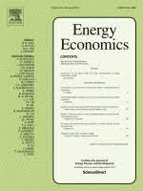
Fiscal Policy in Oil and Gas-Exporting Economies: Good Times, Bad Times and Ugly Times Olivier Durand-Lasserve and Fatih Karanfil
The material presented is based on Durand-Lasserve and Karanfil (Energy Economics, Oct. 2023):
“Fiscal policy in oil and gas-exporting economies: Good times, bad times and ugly times”

Slide 2
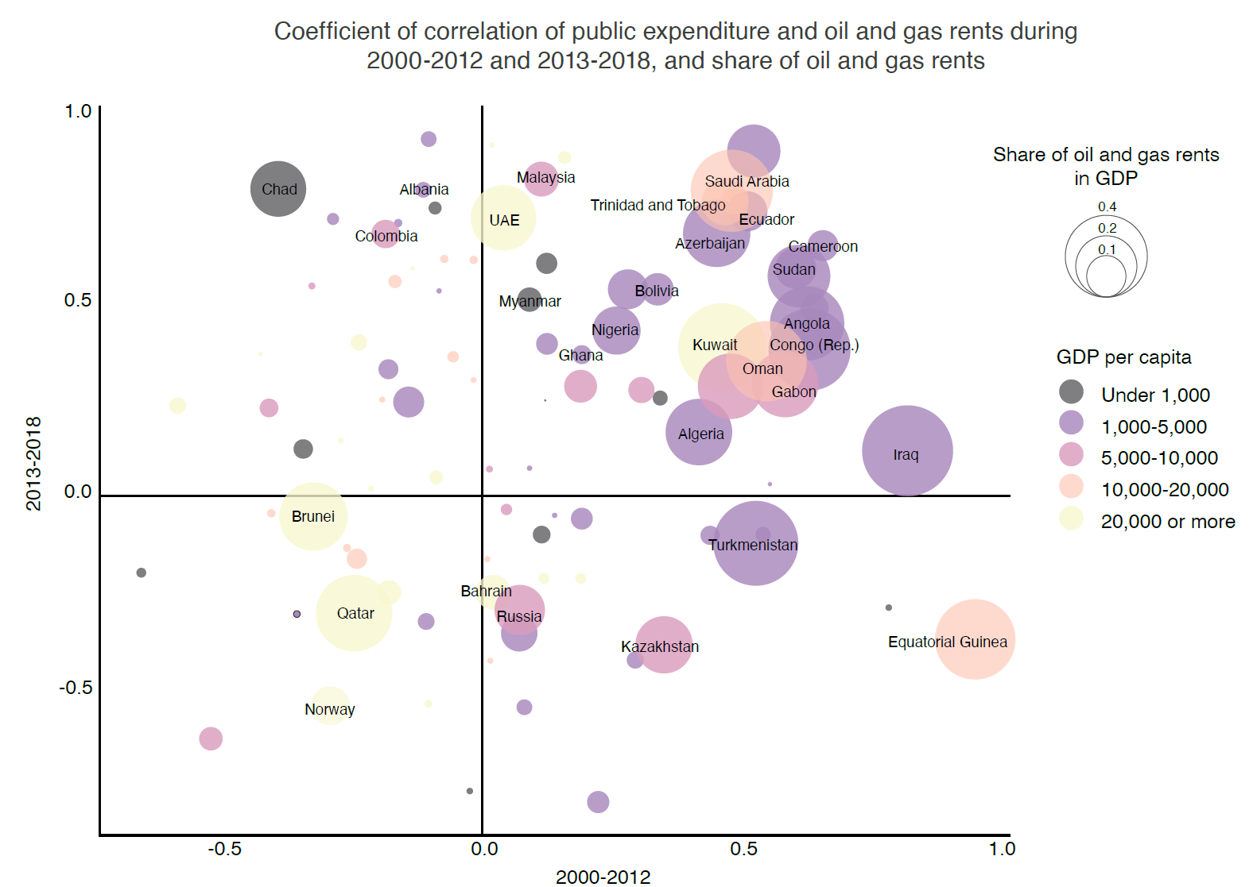
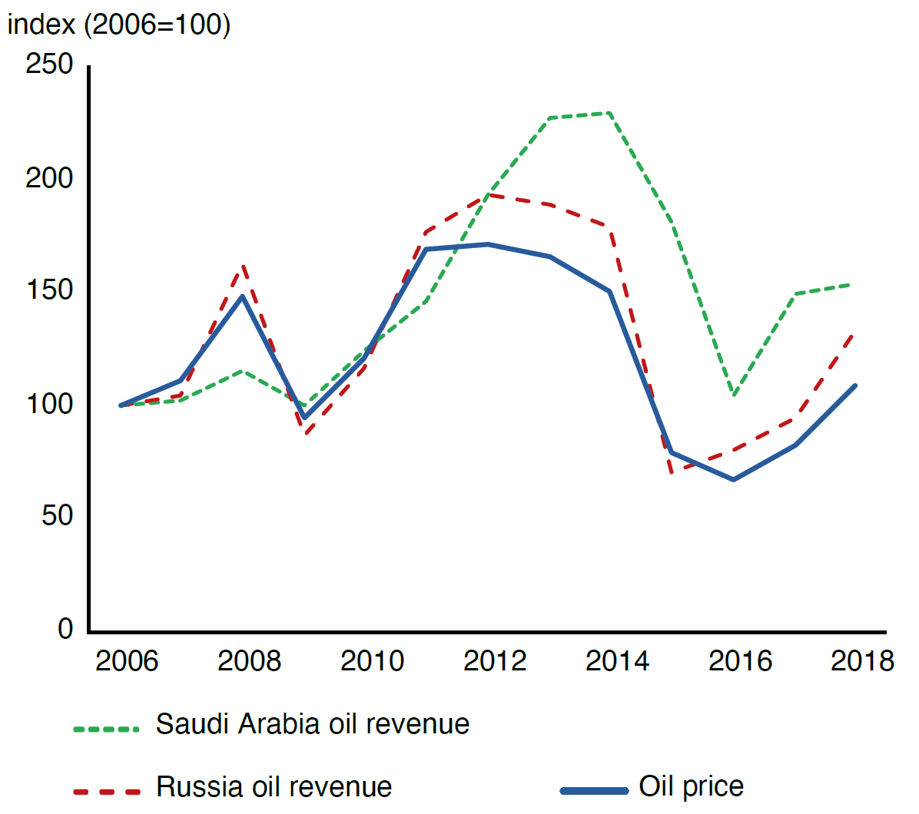
Cyclical fiscal policies transmit oil price volatility to the economy
Public expenditure and oil and gas revenues are correlated
Variations of oil price and oil revenue in the two largest oil exporters
Are emerging and developing oil-exporting economies procyclical?
What factors influence procyclicality?
What factors influence the fiscal response in specific parts of the cycle?
2

Slide 3
Baseline model: panel data with interaction terms
30 ED oil and gas-exporting countries, from 2000 to 2020
$$Δ{EXP}_{i,t}=α_{1,i}+βΔRENT_{i,t}+{γX}_{i,t}+ {λΔRENT_{i,t}×X}_{i,t}+ε_{i,t}$$
$ΔEXP$ is the variation of the cyclical component of total expenditure, investment expenditure or current consumption expenditure
$ΔRENT$ is the variation of the cyclical component of the oil and gas rent
Positive (negative) $β$ denotes procyclicality (countercyclicality)
$X$ is vector of variables that we interact with $ΔRENT$
Positive (negative) coefficient $λ$means that variable $X$ amplifies (reduces) procyclicality
3

Slide 4
Insights from the model without asymmetries
Procyclicality: The pass-through of oil and gas rents to government expenditure is close to 1
Financial openness increases procyclicality, in line with the financial constraint hypothesis
Institutional quality and fiscal rules reduce procyclicality
4

Slide 5







We consider four configurations of oil and gas revenue shocks
Deterioration Improvement
Position of oil and gas revenue (w.r.t. baseline revenue)
Low High
$$Δ^{−}RENT_{H}$$
$$Δ^{+}RENT_{H}$$
Ugly times
Good times
Variation of oil and gas revenue
$$Δ^{−}RENT_{L}$$
$$Δ^{+}RENT_{L}$$
Bad times
Ugly times
5

Slide 6
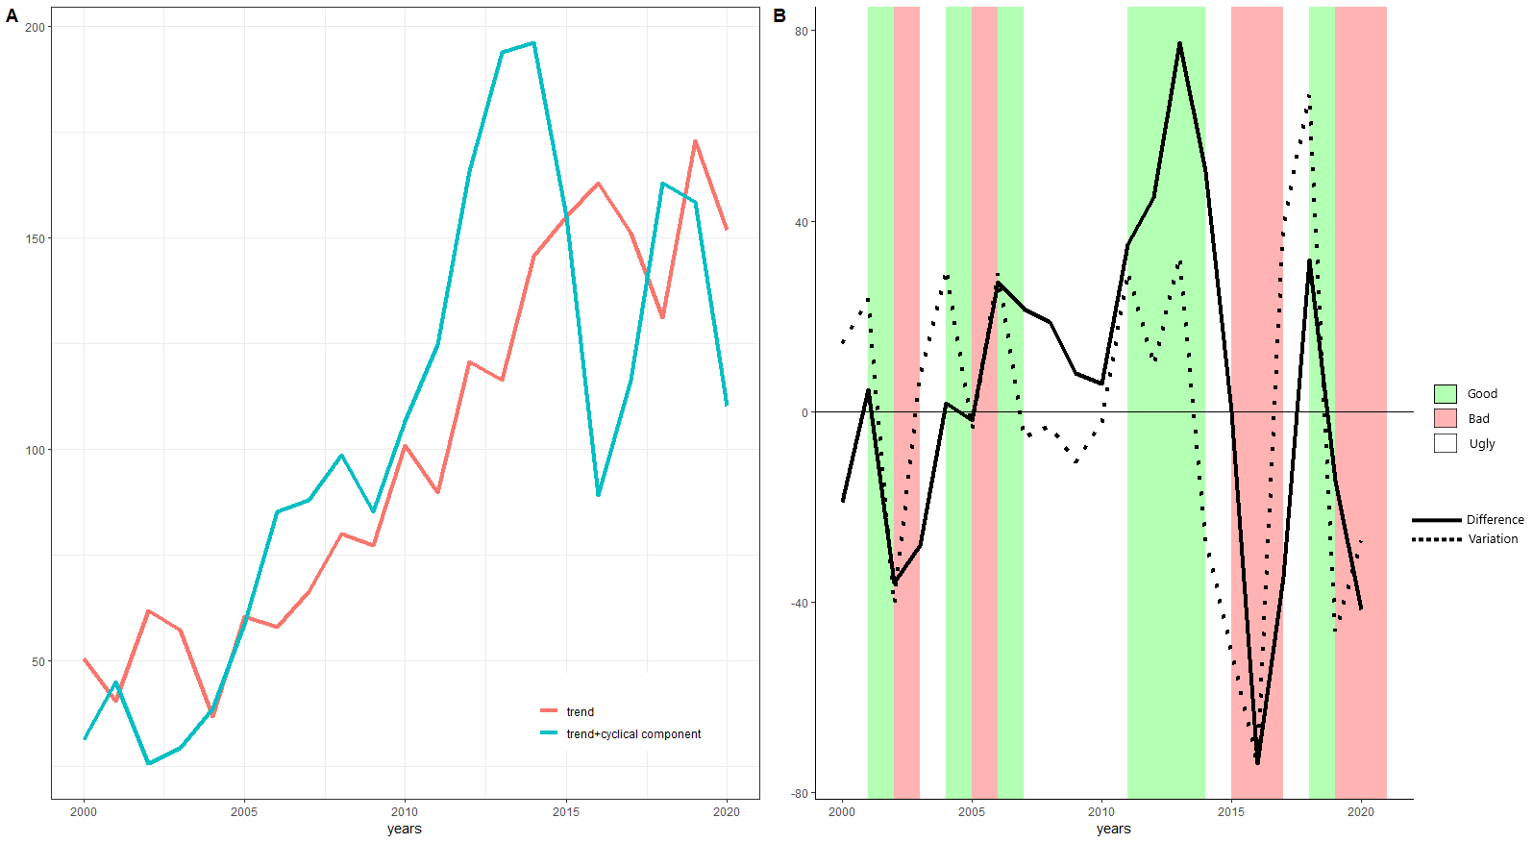
Asymmetries of variation and position: illustration with Saudi Arabia
6

Slide 7
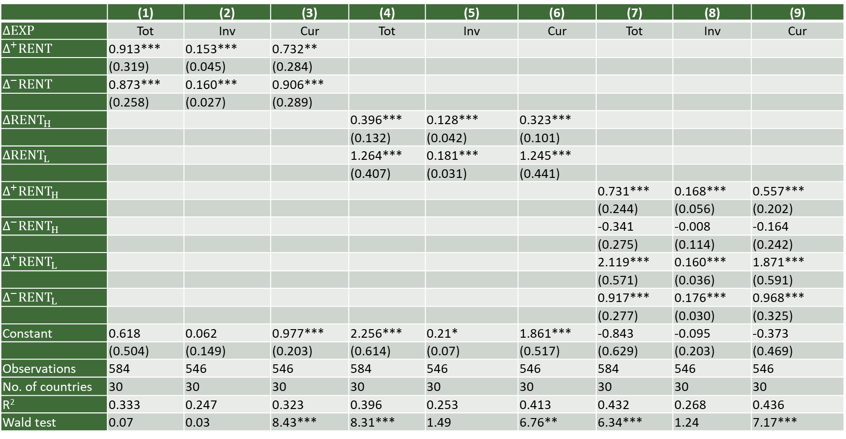
Results with asymmetry
 | (1) | (2) | (3) | (4) | (5) | (6) | (7) | (8) | (9)
$$ΔEXP$$ | Tot | Inv | Cur | Tot | Inv | Cur | Tot | Inv | Cur
$$Δ^{+}RENT$$ | 0.913*** | 0.153*** | 0.732**
 | (0.319) | (0.045) | (0.284)
$$Δ^{−}RENT$$ | 0.873*** | 0.160*** | 0.906***
 | (0.258) | (0.027) | (0.289)
$ΔRENT_{H}$ |  |  |  | 0.396*** | 0.128*** | 0.323***
 |  |  |  | (0.132) | (0.042) | (0.101)
$$ΔRENT_{L}$$ |  |  |  | 1.264*** | 0.181*** | 1.245***
 |  |  |  | (0.407) | (0.031) | (0.441)
$Δ^{+}RENT_{H}$ |  |  |  |  |  |  | 0.731*** | 0.168*** | 0.557***
 |  |  |  |  |  |  | (0.244) | (0.056) | (0.202)
$$Δ^{−}RENT_{H}$$ |  |  |  |  |  |  | -0.341 | -0.008 | -0.164
 |  |  |  |  |  |  | (0.275) | (0.114) | (0.242)
$$Δ^{+}RENT_{L}$$ |  |  |  |  |  |  | 2.119*** | 0.160*** | 1.871***
 |  |  |  |  |  |  | (0.571) | (0.036) | (0.591)
$$Δ^{−}RENT_{L}$$ |  |  |  |  |  |  | 0.917*** | 0.176*** | 0.968***
 |  |  |  |  |  |  | (0.277) | (0.030) | (0.325)
Constant | 0.618 | 0.062 | 0.977*** | 2.256*** | 0.21* | 1.861*** | -0.843 | -0.095 | -0.373
 | (0.504) | (0.149) | (0.203) | (0.614) | (0.07) | (0.517) | (0.629) | (0.203) | (0.469)
Observations | 584 | 546 | 546 | 584 | 546 | 546 | 584 | 546 | 546
No. of countries | 30 | 30 | 30 | 30 | 30 | 30 | 30 | 30 | 30
R² | 0.333 | 0.247 | 0.323 | 0.396 | 0.253 | 0.413 | 0.432 | 0.268 | 0.436
Wald test | 0.07 | 0.03 | 8.43*** | 8.31*** | 1.49 | 6.76** | 6.34*** | 1.24 | 7.17***
7

Slide 8
Insights from the model asymmetries
Significant asymmetries in expenditure response
Position asymmetry is more pronounced than variation asymmetry
In low revenue regimes, the pass-through to total and current expenditure is about three times higher than during high revenue regimes
When revenues are above the trend but go down (ugly times), the fiscal policy is neutral
Suggesting that there is a belief that the revenue will recover
Inertia in spending, fiscal buffer
High procyclicality during bad times
Fiscal balance in a bad position, leaving less room to buffer further price drops
8

Slide 9

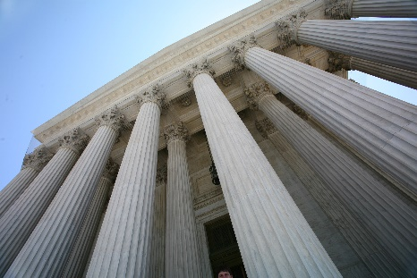


Takeaways from interacting asymmetries and explanatory variables
Financial openness
Financial integration leads to more investment during good times
But mitigates the drop in investment during bad times
Institutional quality
Limits the increase in expenditure (in ugly times with low but increasing prices)
Reduces expenditure (in ugly times with high but decreasing prices)
Fiscal rules
Reduce procyclicality during good times and bad times
IMF programs
Countercyclical in ugly times during low revenue regimes and procyclical during bad times
9

Slide 10
Policy implications
Avoid expenditure cuts during bad times because it is when the social cost is higher
But financial openness and IMF programs, instead of helping smooth fiscal policies, accentuate the procyclicality
Limiting procyclicality in good times would be the optimal solution
Fiscal rules can support such a policy
Rapid growth in capital inflows are challenging if not invested in the right direction
During good times, need for investments that drive economic diversification and long-term economic growth
10

Slide 11
Thank you

Slide 12
Covariates
Financial constraints
Chinn and Ito (2006) index of capital account openness. The more open the country is to cross-border capital transactions the higher the index values are
Institutional quality
Sum of the 6 Worldwide Governance Indicators of Kaufmann et al (2010)
Fiscal rules
Dummy calculated based on the IMF’s fiscal rule database of Davoodi et al. (2022)
Exchange rate flexibility
Index rising from 1 to 6 as flexibility increases, with 1 representing a pegged currency Ilzetzki et al. (2021)
IMF programs
Dummy if a country is under IMF arrangement (Dreher 2006)
12

Slide 13
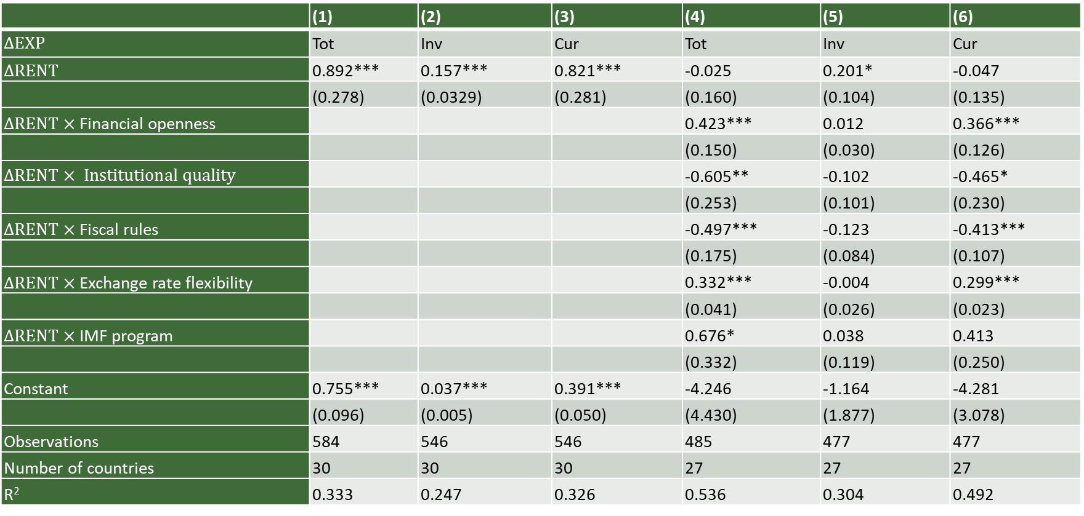
Procyclicality of expenditure to oil revenue: preliminary findings
 | (1) | (2) | (3) | (4) | (5) | (6)
$$ΔEXP$$ | Tot | Inv | Cur | Tot | Inv | Cur
$ΔRENT$ | 0.892*** | 0.157*** | 0.821*** | -0.025 | 0.201* | -0.047
 | (0.278) | (0.0329) | (0.281) | (0.160) | (0.104) | (0.135)
$ΔRENT×$Financial openness |  |  |  | 0.423*** | 0.012 | 0.366***
 |  |  |  | (0.150) | (0.030) | (0.126)
$$ΔRENT× Institutional quality$$ |  |  |  | -0.605** | -0.102 | -0.465*
 |  |  |  | (0.253) | (0.101) | (0.230)
$ΔRENT×$Fiscal rules |  |  |  | -0.497*** | -0.123 | -0.413***
 |  |  |  | (0.175) | (0.084) | (0.107)
$ΔRENT×$Exchange rate flexibility |  |  |  | 0.332*** | -0.004 | 0.299***
 |  |  |  | (0.041) | (0.026) | (0.023)
$ΔRENT×$IMF program |  |  |  | 0.676* | 0.038 | 0.413
 |  |  |  | (0.332) | (0.119) | (0.250)
Constant | 0.755*** | 0.037*** | 0.391*** | -4.246 | -1.164 | -4.281
 | (0.096) | (0.005) | (0.050) | (4.430) | (1.877) | (3.078)
Observations | 584 | 546 | 546 | 485 | 477 | 477
Number of countries | 30 | 30 | 30 | 27 | 27 | 27
R² | 0.333 | 0.247 | 0.326 | 0.536 | 0.304 | 0.492
13

Slide 14
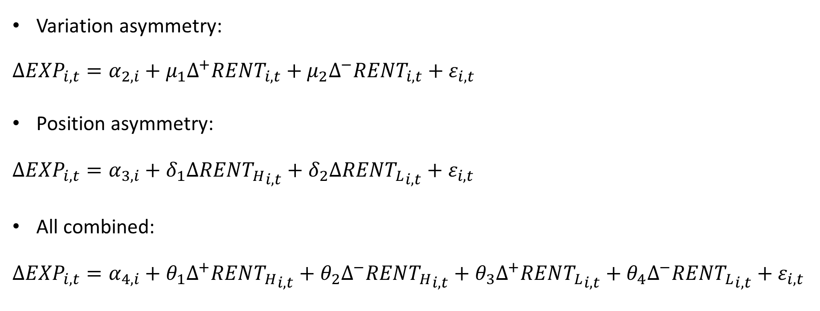
Models with asymmetries
Variation asymmetry:
$$Δ{EXP}_{i,t}=α_{2,i}+μ_{1}{Δ^{+}RENT}_{i,t}+μ_{2}{Δ^{−}RENT}_{i,t}+ε_{i,t}$$
Position asymmetry:
$$Δ{EXP}_{i,t}=α_{3,i}+δ_{1}{ΔRENT_{H}}_{i,t}+δ_{2}{ΔRENT_{L}}_{i,t}+ε_{i,t}$$
All combined:
$$Δ{EXP}_{i,t}=α_{4,i}+θ_{1}{Δ^{+}RENT_{H}}_{i,t}+θ_{2}{Δ^{−}RENT_{H}}_{i,t}+θ_{3}{Δ^{+}RENT_{L}}_{i,t}+θ_{4}{Δ^{−}RENT_{L}}_{i,t}+ε_{i,t}$$
14

