Slide 1



Oil dependence in transition: The role of immigration in maintaining a resilient economy
Dramane Coulibalyª, Fatih Karanfil^{b}, Luc Désiré Omgba^{c}
ª GATE, University Lumière Lyon 2, France
^{b} KAPSARC, Saudi Arabia
^{c} BETA, University of Lorraine, France
IAEE MENA 2024, December 8-9

Slide 2
MOTIVATION
The Dutch Disease lives on
▶ A resource boom leads to currency appreciation and labor shifts toward the booming sector, reducing competitiveness and output in other tradable sectors
▶ Substantial economic reliance on fossil fuels poses hurdles during a period in which these economies have embarked on broad and
ambitious national plans to diversify their economies as part of their domestic energy transitions
For an oil exporter, these plans impact the economy in two ways
Exposure
Diversification increases the share of GDP from sectors other than oil and gas, reducing the economy’s exposure to volatility in the global energy market
Domestic energy transitions provide environmental benefits and compliance with future international regulations
Increased oil exports result in a larger share of GDP dependent on oil, making revenue streams and overall economic performance more exposed to volatility in the global energy market
Less stable financial resources available to support economic and energy transitions domestically
Exposure

Slide 3
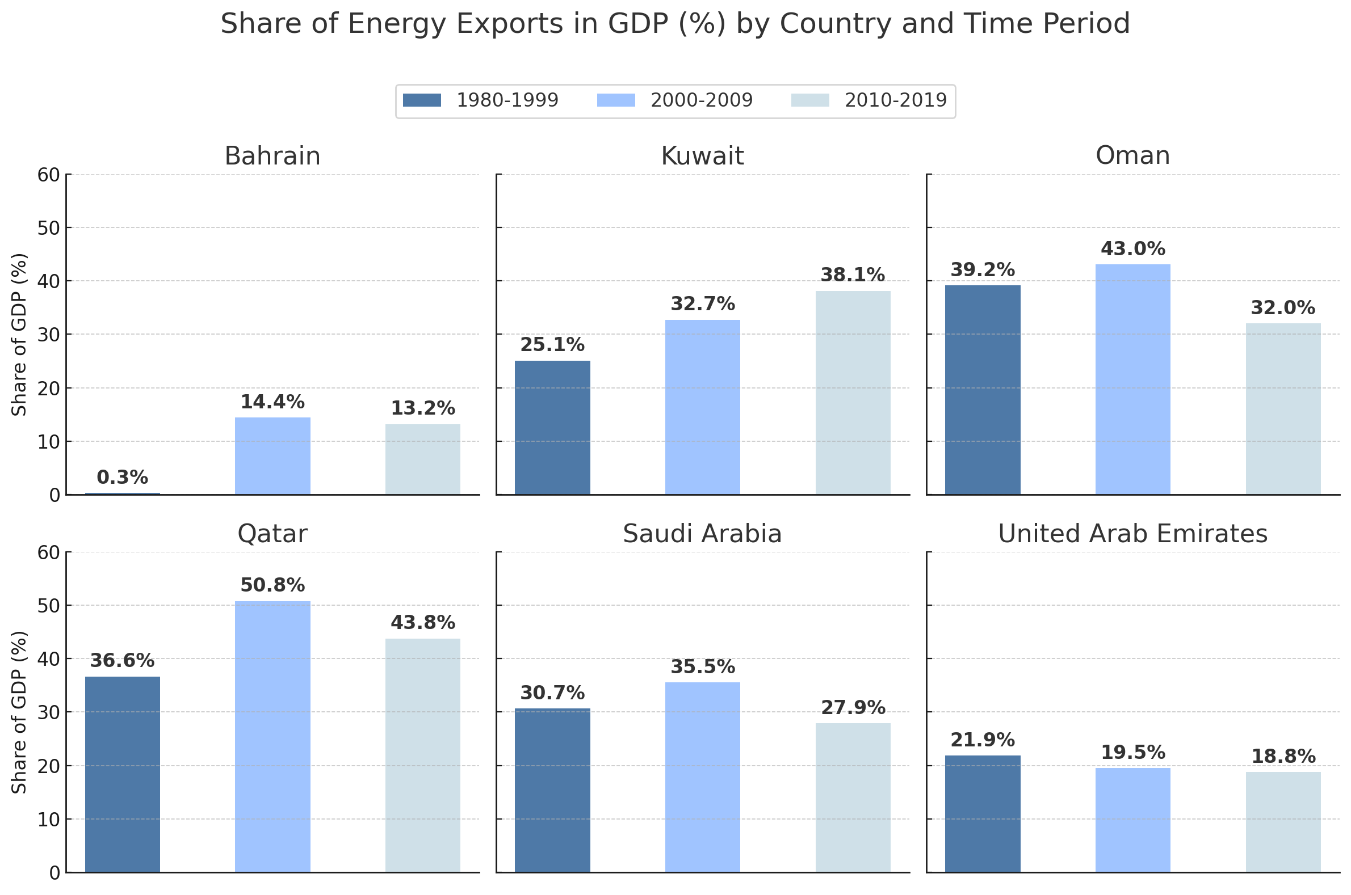
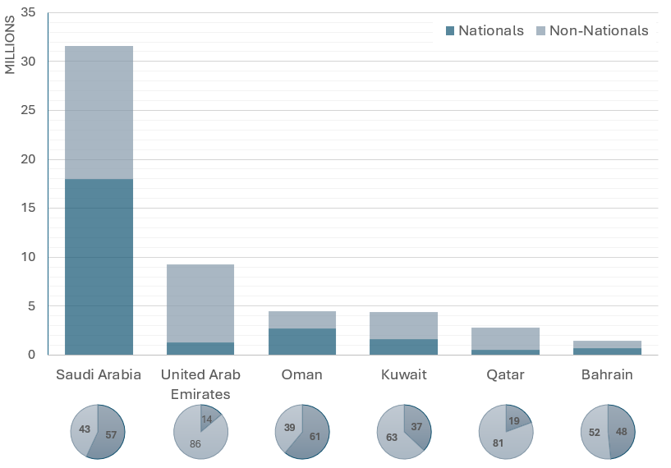
MOTIVATION
The Gulf at the crossroads of energy transition and international migration
Dependence on energy exports
▶ A substantial share of world reserves: 1/4 of world oil production and 11% of natural gas production
Presence of foreign residents
▶ Foreign-born individuals make up the largest portion of the population in most Gulf states (data for 2020)

Slide 4
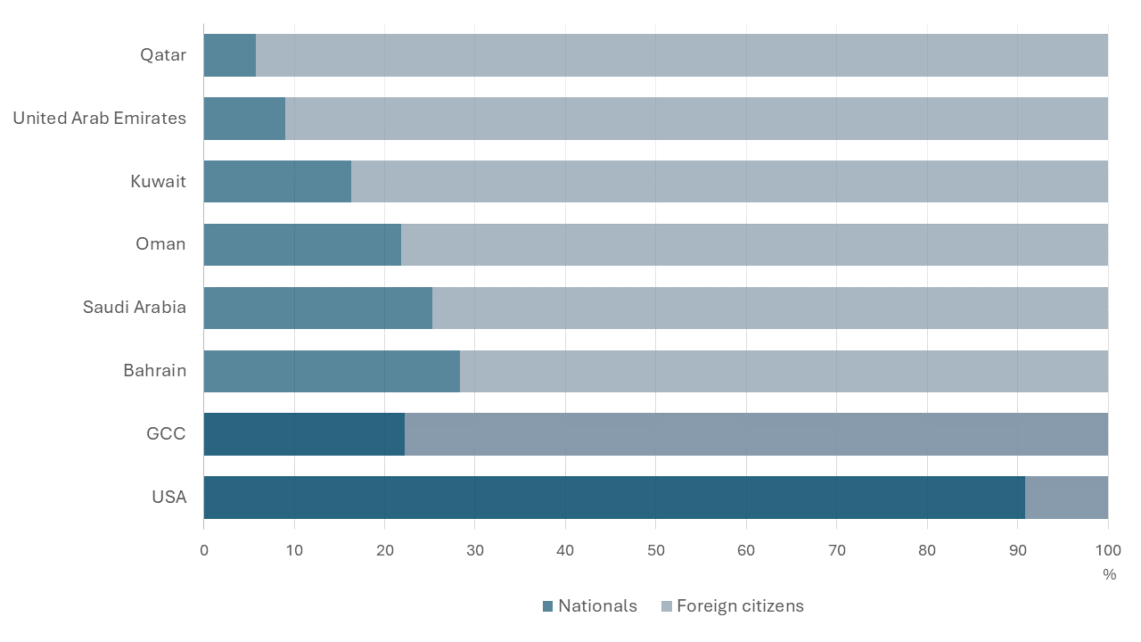
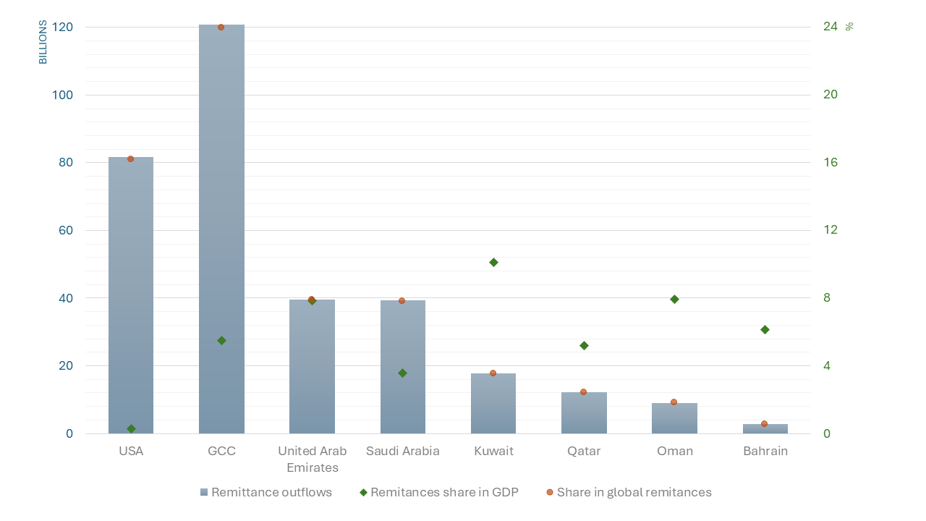
MOTIVATION
The Gulf at the crossroads of energy transition and international migration
The Gulf countries are among the top destinations of foreign workers
▶ With a population of only 58 million, the Gulf states are the second
destination of international migrants (share of 16%, after the United
States at 18%; data for 2020)
International migration as a crucial aspect of the economic policy
▶ GCC is the largest source of migrant remittances worldwide
(KNOMAD/World Bank, 2023; data for 2022)
Employment by nationality (%)
Remittance outflows (left: $, right: %)

Slide 5


MOTIVATION
What we do
Explore the role of international migration in mitigating the Dutch Disease effect in the Gulf countries within the context of energy transition
Introduce a simple model of an energy-exporting economy to theoretically demonstrate the relationship between energy price shocks and international migrant flows
Test theoretical predictions by estimating a structural vector autoregression (VAR) model on a panel of the 6 Gulf countries with annual data over the period 1980-2019

Slide 6
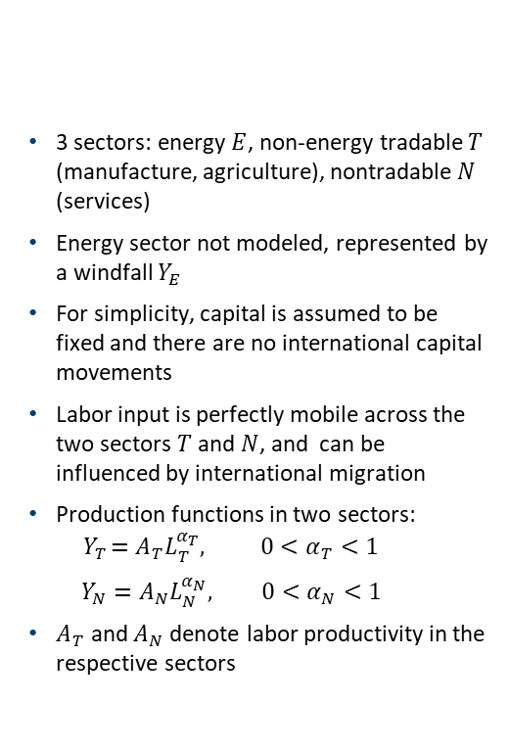
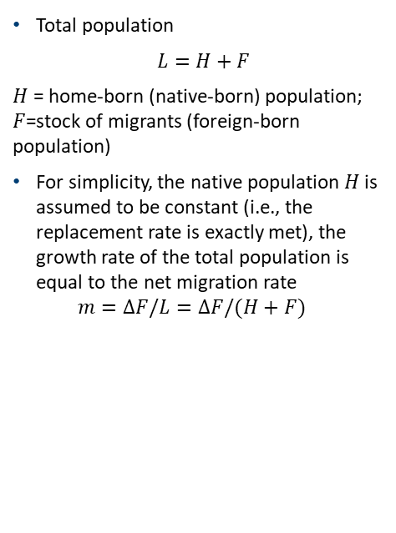


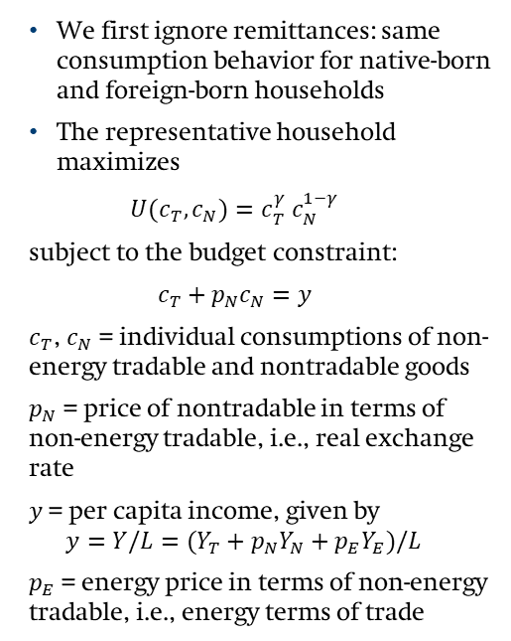
A MODEL FOR AN ENERGY-EXPORTING ECONOMY WITH INTERNATIONAL MIGRATION
Demographics
3 sectors: energy $E$, non-energy tradable $T$ (manufacture, agriculture), nontradable $N$ (services)
Energy sector not modeled, represented by a windfall $Y_{E}$
For simplicity, capital is assumed to be fixed and there are no international capital movements
Labor input is perfectly mobile across the two sectors $T$ and $N$, and can be influenced by international migration
Production functions in two sectors: ${ Y}_{T }=A_{T}L_{T}^{α_{T}}, 0<α_{T}<1$
$$Y_{N}=A_{N}L_{N}^{α_{N}}, 0<α_{N}<1$$
$A_{T}$ and $A_{N}$ denote labor productivity in the respective sectors
Firms and production
Households
Total population
$$L=H+F$$
$H$ = home-born (native-born) population; $F$=stock of migrants (foreign-born population)
For simplicity, the native population $H$ is assumed to be constant (i.e., the replacement rate is exactly met), the growth rate of the total population is equal to the net migration rate $m=ΔF/L=ΔF/(H+F)$
We first ignore remittances: same consumption behavior for native-born and foreign-born households
The representative household maximizes
$$U(c_{T},c_{N})=c_{T}^{γ} c_{N}^{1−γ}$$
subject to the budget constraint:
$$c_{T}+p_{N}c_{N}=y$$
$c_{T}$, $c_{N}$ = individual consumptions of non-energy tradable and nontradable goods
$p_{N}$ = price of nontradable in terms of non-energy tradable, i.e., real exchange rate
$y$ = per capita income, given by $y=Y/L=(Y_{T}+p_{N}Y_{N}+p_{E}Y_{E})/L$
$p_{E}$ = energy price in terms of non-energy tradable, i.e., energy terms of trade
$${}_{}^{f} {}_{}^{f}$$
$$(1−τ)$$

Slide 7
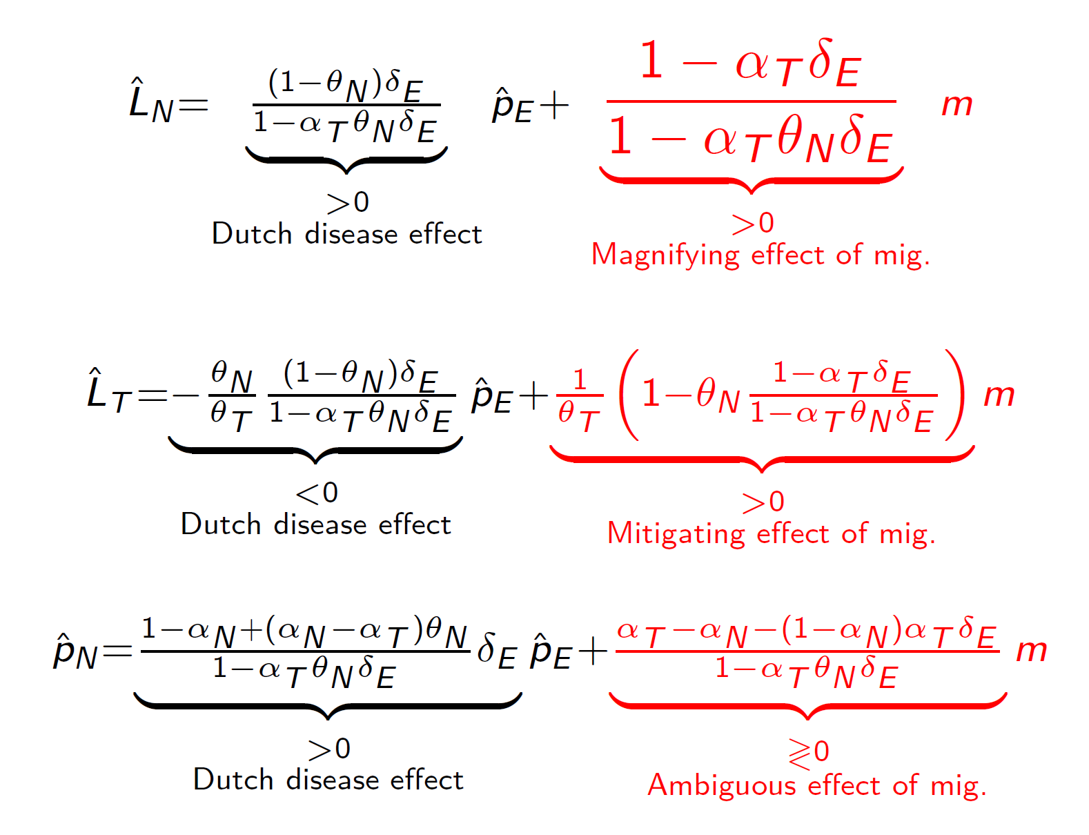
EQUILIBRIUM
Equilibrium values and the impact of immigration

Slide 8
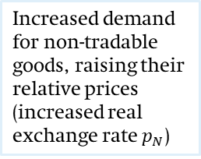
EQUILIBRIUM
NN: Non-Tradables Market Equilibrium
LL: Labor Market Equilibrium
NN
NN'
LL
E1
LL'
Log relative price of nontradable goods
E0
E2
Log labor in nontradable sector
Energy windfall (higher energy prices) – Spending effect
International migration
Higher national income
Increased demand for non-tradable goods, raising their relative prices (increased real exchange rate $p_{N}$)
- Shift of labor toward to nontradable sector to meet the demand
- Upward pressure on wages across the economy
- Contraction of the non-energy tradable sector
Hire more labor, limit the contraction of the non-energy tradable sector
Reduced wage pressures, which mitigates cost-push inflation and limits real exchange rate appreciation
Net effect on the real exchange rate depends on whether the non-tradable sector is more labor-intensive
Impact of remittances
- Reduced spending effect, less pressure on non-tradable prices - Current account surplus is partially offset by remittance outflows

Slide 9

EMPIRICAL ANALYSIS – APPROACH
Empirical evidence from the Gulf economies
Taking stock of the theoretical predictions:
▶ Improvement in the energy terms of trade induces a Dutch disease effect
▶ This effect is mitigated by international immigration, even if we consider remittances
We check these theoretical predictions with an “average” estimation on panel of the 6 Gulf economies
Panel VAR over the period 1980-2019
Identification based on sign restrictions
$Y_{it}=Φ_{1}Y_{it−1}+…+Φ_{p}Y_{it−p}+u_{i}+κ_{i}.t+D_{it}+e_{it}$, \ $i=1,…,N$
$Y_{it}=\left(entot_{it},m_{it}, wap_{it}, tgdp_{it},ntgdp_{it}, rer_{it}\right)′$ is a vector of variables in in logarithm
$entot$ = energy terms of trade
$m$ = net migration rate
$wap$= working-age population ratio
$tgdp$ = non-energy tradable output per capita in real terms
$ntgdp$= nontradable output per capita in real terms
$rer$ = real exchange rate
The model includes country-fixed effects $u_{i}$, country specific time trends $κ_{i}.t$ and country-specific dummy variables for years 1990 and 1991 $D_{it}$ (to account for the invasion of Kuwait in 1990 and the Gulf War in 1991)
Notes: This table displays the sign restrictions on the impulse responses to the two shocks to be identified. The sign “+” means that the response of the variable in column is restricted to be positive for two years following the shock, including the year of impact. A blank entry notifies an absence of restrictions
 | Energy terms of trade | Net migration rate | Working-age population
Energy terms of trade shock | +
Migration shock |  | + | +

Slide 10
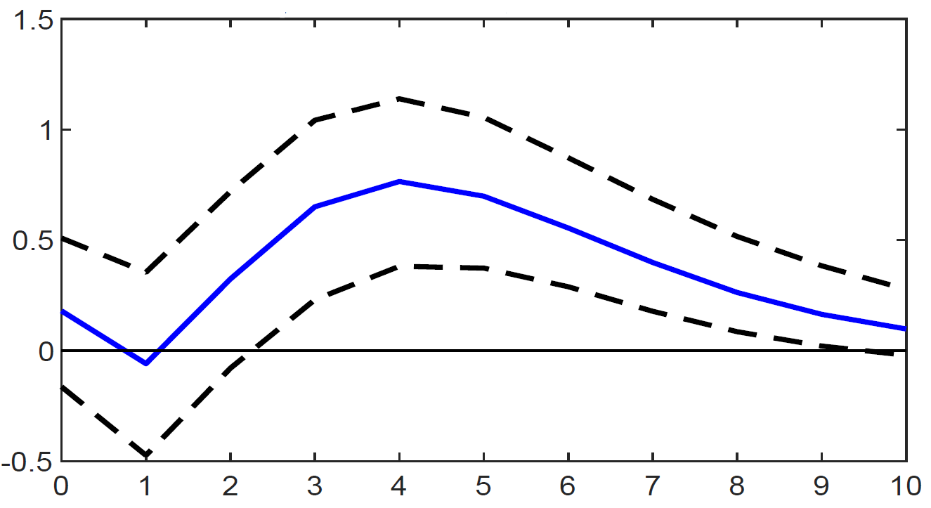
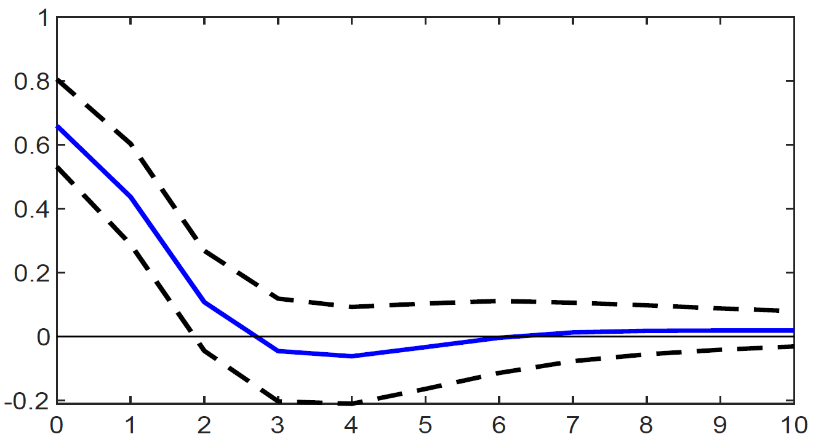
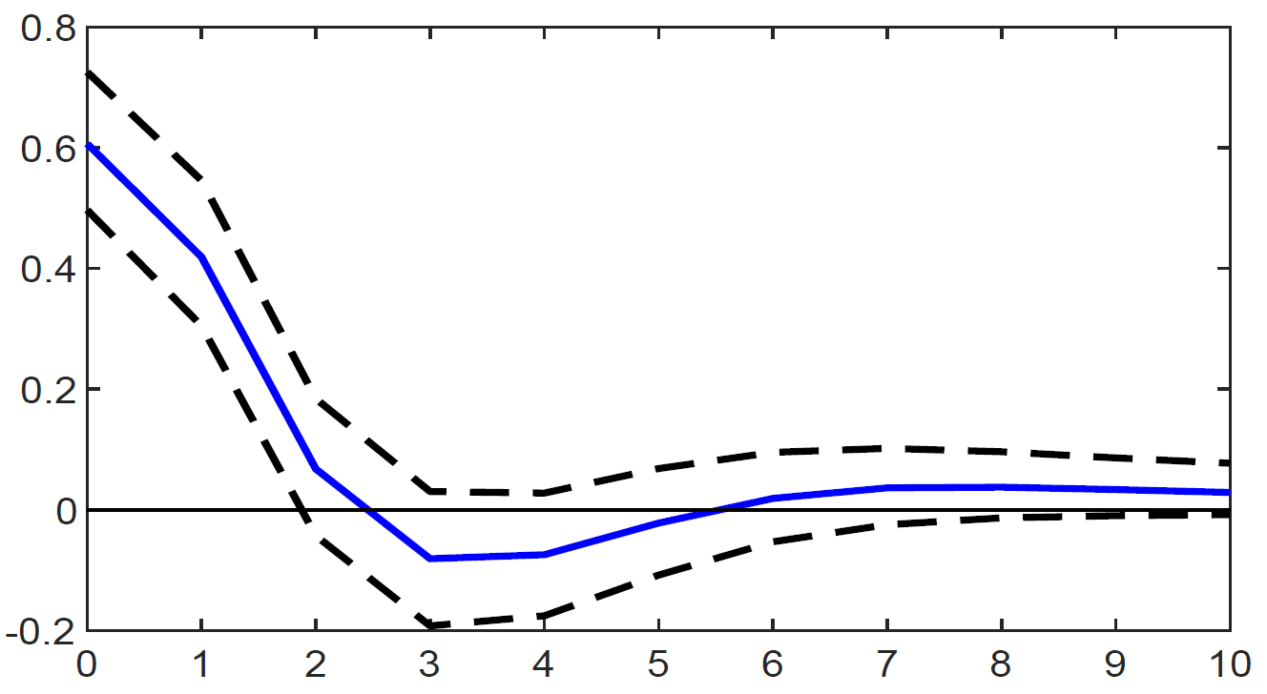
EMPIRICAL ANALYSIS – RESULTS
1% improvement in the energy terms of trade
1 migrant per 1,000 people
Response to energy terms of trade
Response to migration
Response to migration
Tradable output
Nontradable output
Migration
▶ Energy windfalls act as pull factors for international migration
▶ Following a positive shock that improves the energy terms of trade by 10%, migration responds positively, peaking at 7.6 per 1,000 inhabitants (four years later)
▶ Migration helps expand both the tradable and nontradable sectors
▶ Tradable and nontradable outputs by 0.66% and 0.61% on impact (at the peak) and by 0.44% and 0.42% one year after the shock, respectively.

Slide 11
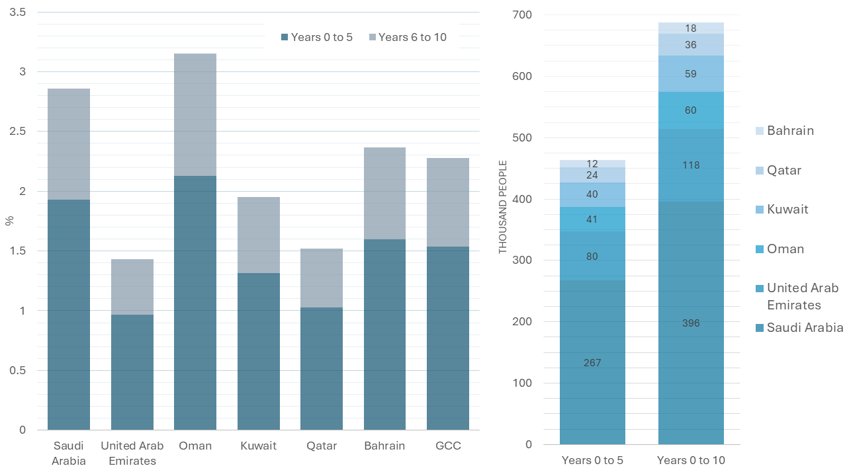

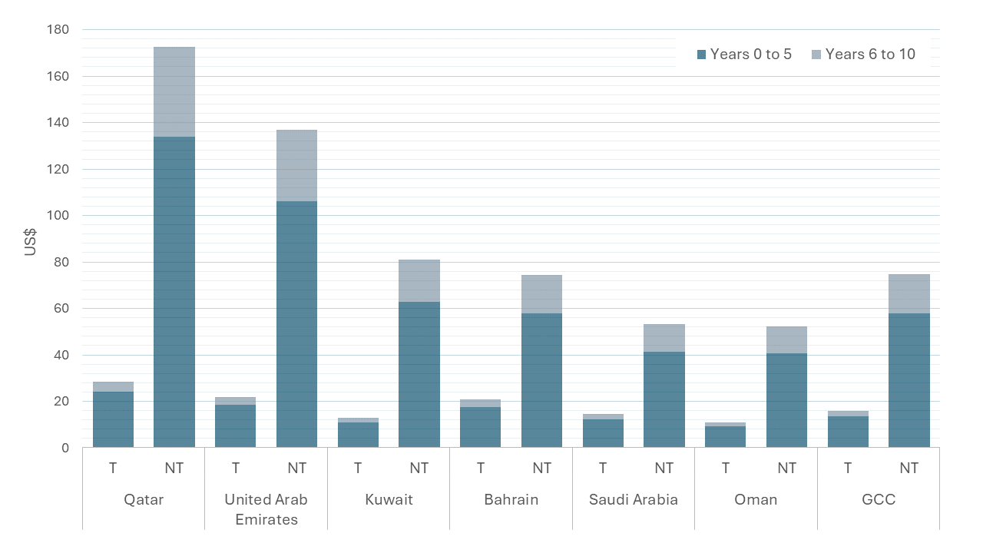

NUMERICAL ILLUSTRATION
\
Impact of energy terms of trade on migration
A 10% increase in energy terms of trade:
A 1.5% rise in the immigrant population of the GCC in the medium run (5 years), reaching 2.3% in the long run (10 years)
The total population in the GCC increases by 460 thousand in the medium term and 690 thousand in the long term
\
Impact of migration on output
A positive migration shock of 1 per 1,000 inhabitants, roughly equivalent to a net increase of 58 thousand immigrants a year into the GCC:
Per capita gains are US$14 and US$16 for tradable output, and US$58 and US$75 for non-tradable output in the medium and long term, respectively
\

Slide 12


Thank You!
King Abdullah Petroleum Studies and Research Center
Airport Road
P.O. Box 88550
Riyadh 11672
Saudi Arabia
/kapsarc
info@kapsarc.org
/kapsarc
kapsarc.org

Slide 13
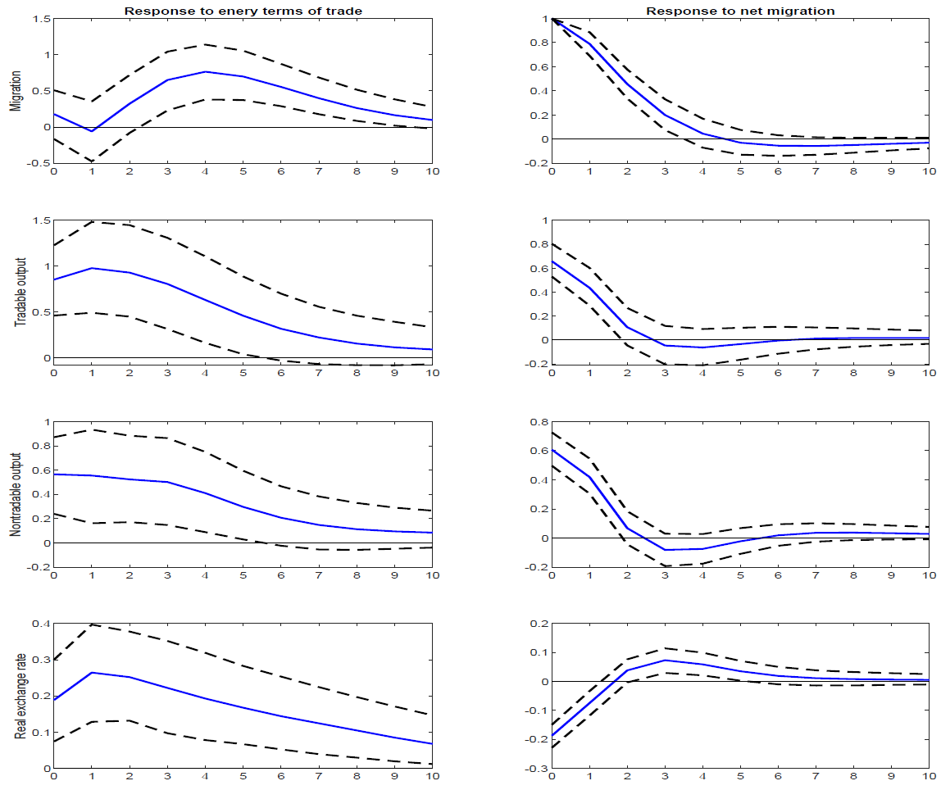
APPENDIX – RESPONSES TO ENERGY TERMS OF TRADE AND MIGRATION SHOCKS

Slide 14
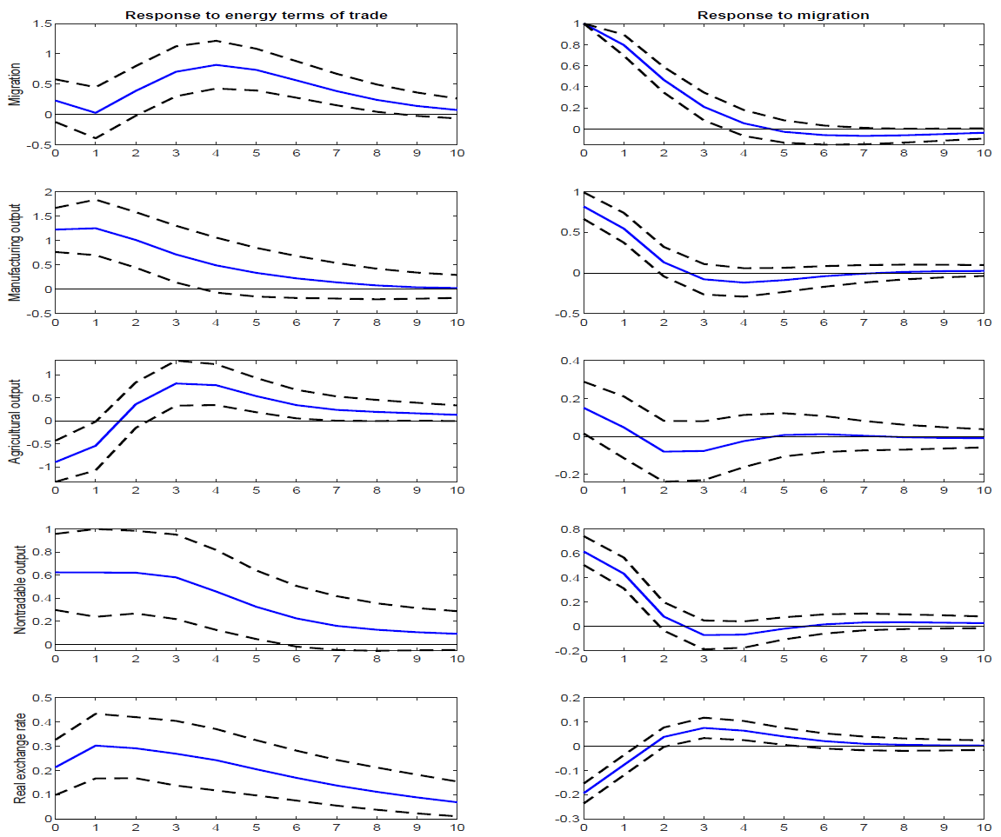
APPENDIX – DECOMPOSING NON-ENERGY TRADABLE OUTPUT

