Slide 1
How Dependence on Oil Revenues Impacts Public Discount Rates Fatih Karanfil and Axel Pierru

Slide 2
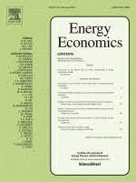
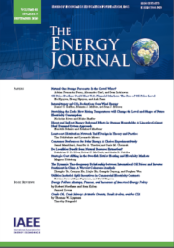
Background
The material presented is based on
Karanfil and Pierru (2021, Energy Economics):
“The opportunity cost of domestic oil consumption for an oil exporter: Illustration for Saudi Arabia”
Karanfil and Pierru (Accepted, The Energy Journal):
“Energy Transition in Oil-Dependent Economies: Public discount rates for investment project evaluation”
Besides being an export earner, oil is a tool for economic development - used as an input in projects that contribute to economic diversification (reducing dependence on oil) - has to be valued at the opportunity cost
The economic benefits of these projects are included in the projects’ net present value (NPV) calculation - compute appropriate public discount rates - dependence on oil impacts the public discount rate for valuing oil-related cash flows
2

Slide 3



How economic dependence on oil impacts the present value of oil-related cash flows from a public policy perspective
The domestic energy transition of an oil-exporting economy often implies investing in projects that displace oil from domestic consumption (enhancing energy efficiency in an oil-consuming sector or developing renewables capacity)
Most oil-exporting economies pursue economic diversification and industrial development policies, which ultimately leads to less dependence on oil revenues
75.9% of Saudi Arabia’s total government revenues (in Q3 2022) (SAMA)
95.1% and 54.7% of total government revenues in Iraq and the UAE (IMF)
Selecting welfare-enhancing projects necessitates understanding the extent to which economic dependence on oil impacts the present value of oil-related cash flows from a public policy perspective
Need for public discount rates that capture both the risk of the cash flows and the characteristics of the oil-exporting economy considered
3

Slide 4
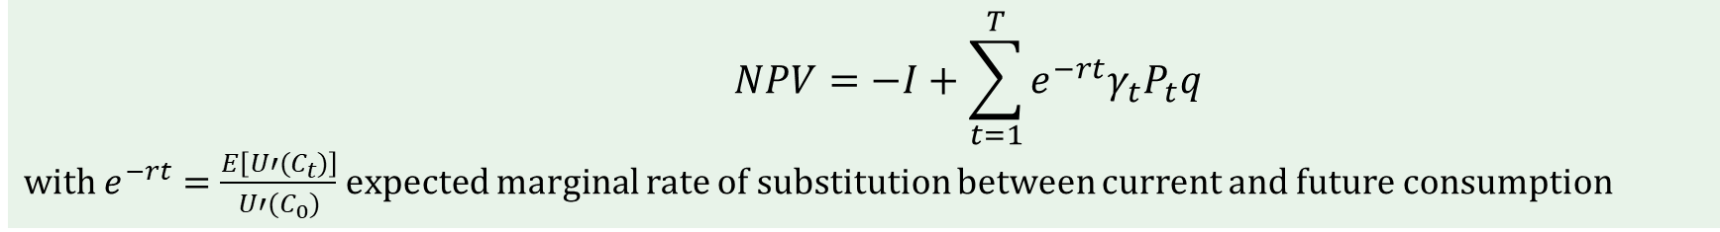
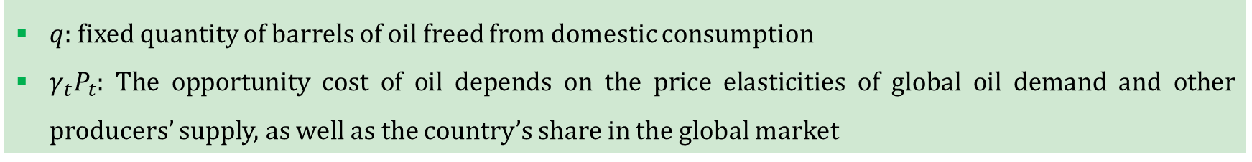
Approach: Valuing cash flows from a public policy perspective
Investment project
$$U\left(C_{0}−I\right)+\sum_{t=1}^{T}{e^{−δt}}E\left[U\left(C_{t}+{γ_{t}P}_{t}q\right)\right]$$
$q$: fixed quantity of barrels of oil freed from domestic consumption
${γ_{t}P}_{t}$: The opportunity cost of oil depends on the price elasticities of global oil demand and other producers’ supply, as well as the country’s share in the global market
The project has a public net present value (NPV):
$$NPV=−I+\sum_{t=1}^{T}{e^{−rt}{γ_{t}P}_{t}q}$$
with $e^{−rt}=\frac{E\left[U′(C_{t})\right]}{U′(C_{0})}$expected marginal rate of substitution between current and future consumption
4

Slide 5

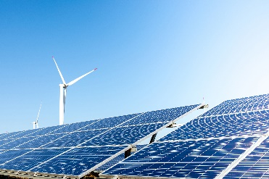




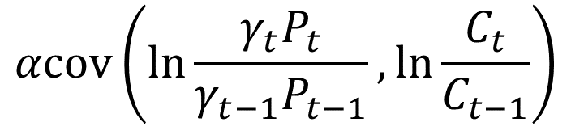
Extended Ramsey rule and the risk premium
$U\left(C_{t}\right)=\frac{C_{t}^{1−α}}{1−α}$, with $α$ constant elasticity of marginal utility of consumption or the relative risk aversion
$=αμ−\frac{α^{2}}{2}σ^{2}$
$$r_{f}$$
$$+αβσ^{2}$$
$$r_{a}$$
$$αcov\left(ln\frac{{γ_{t}P}_{t}}{{γ_{t−1}P}_{t−1}}, ln\frac{C_{t}}{C_{t−1}}\right)$$
Wealth effect
Precautionary effect
Risk Premium
- Risk-free discount rate applied to cash flows that are not correlated with consumption
- Risk-adjusted discount rate applied to oil-related cash flows
5

Slide 6
What connection to the economic dependence on oil?
Economic dependence on oil affects public discount rates in two opposite ways
Oil price fluctuations make the economy more volatile
This leads to higher aggregate uncertainty for the whole economy, lowering the risk-free discount rate and enhancing the present value of future cash flows (for precautionary reasons)
It increases the correlation between oil-related cash flows and aggregate consumption
This yields a higher risk-premium and a lower present value of future cash flows
Which effect holds greater significance?
What is the magnitude of the oil price risk premium?
Do the effects vary significantly?
6

Slide 7
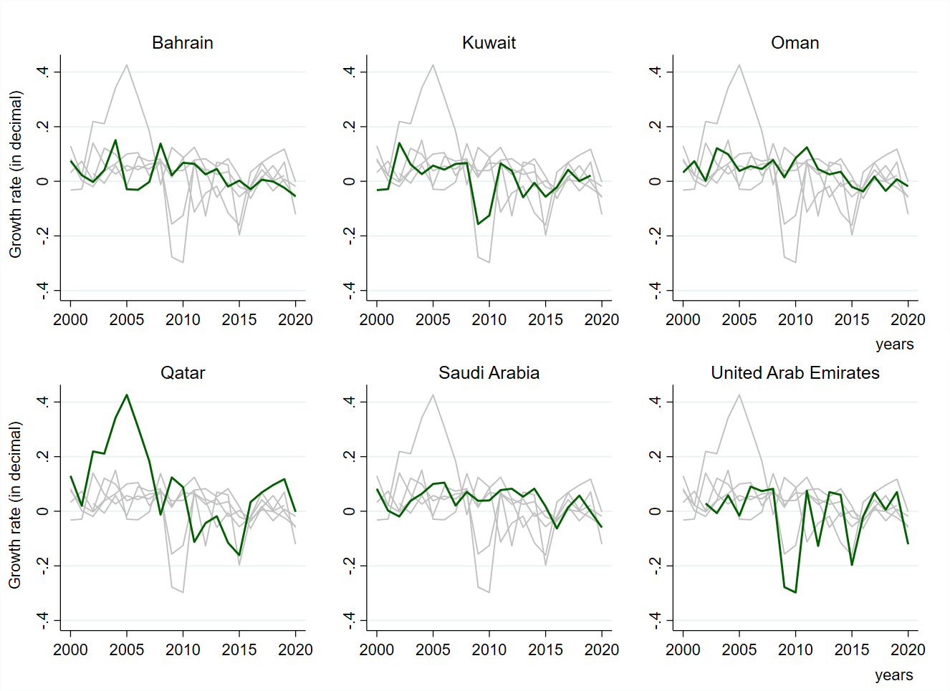
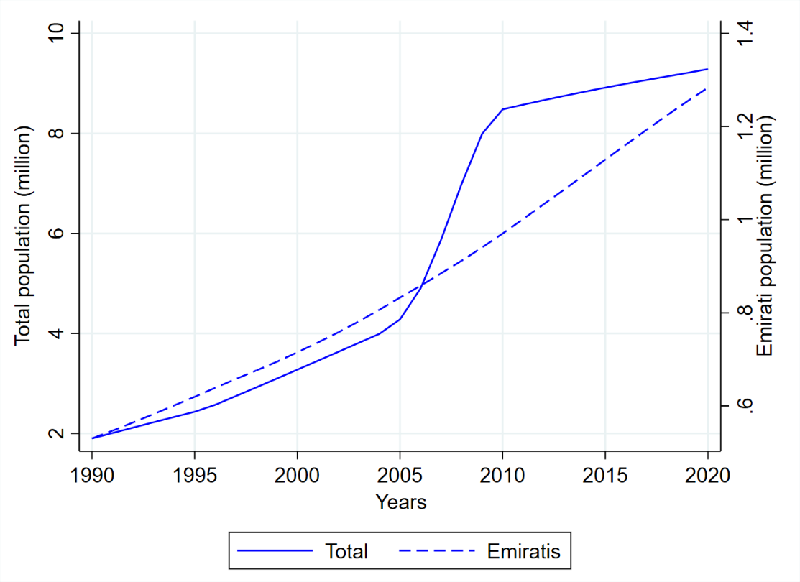
Focus on GCC: The per capita consumption paradox
Mitigating a potential bias:
Growth leads to more expatriate workers
High volatility in GCC countries: Avg. std. dev. of 0.083 six times higher than OECD countries and the USA
Gross consumption data are from WB and include both private and public consumption of all goods and services Population data are from national statistical offices as well as WB and UN Global Migration databases
7

Slide 8
Country-specific and pooled real public discount rates (in percent)
Country | Risk-free discount rate | Risk-adjusted discount rate
Algeria | 3.99 | 4.43
Angola | 0.51 | 1.83
Bahrain | 3.87 | 5.22
Brunei | 2.61 | 3.03
Cameroon | 3.19 | 3.37
Chad | -0.51 | 2.02
Gabon | 0.23 | 0.33
Iraq | 2.32 | 3.81
Iran | 2.37 | 3.11
Kazakhstan | 9.88 | 11.21
Kuwait | 0.43 | 2.09
Oman | 7.06 | 8.39
Qatar | 13.42 | 17.37
Rep. Congo | -1.04 | 0.26
Russia | 7.35 | 9.64
Saudi Arabia | 7.19 | 8.73
Sudan | -0.97 | -1.06
UAE | -7.07 | -3.57
Pooled data | Risk-free discount rate | Risk-adjusted discount rate
All | 3.1 | 4.5
GCC | 2.4 | 5.2
Significant disparities in country-specific discount rates, emphasizing the importance of selecting accurate discount rates
High risk premium for (pooled) GCC panel (2.8%)
8

Slide 9
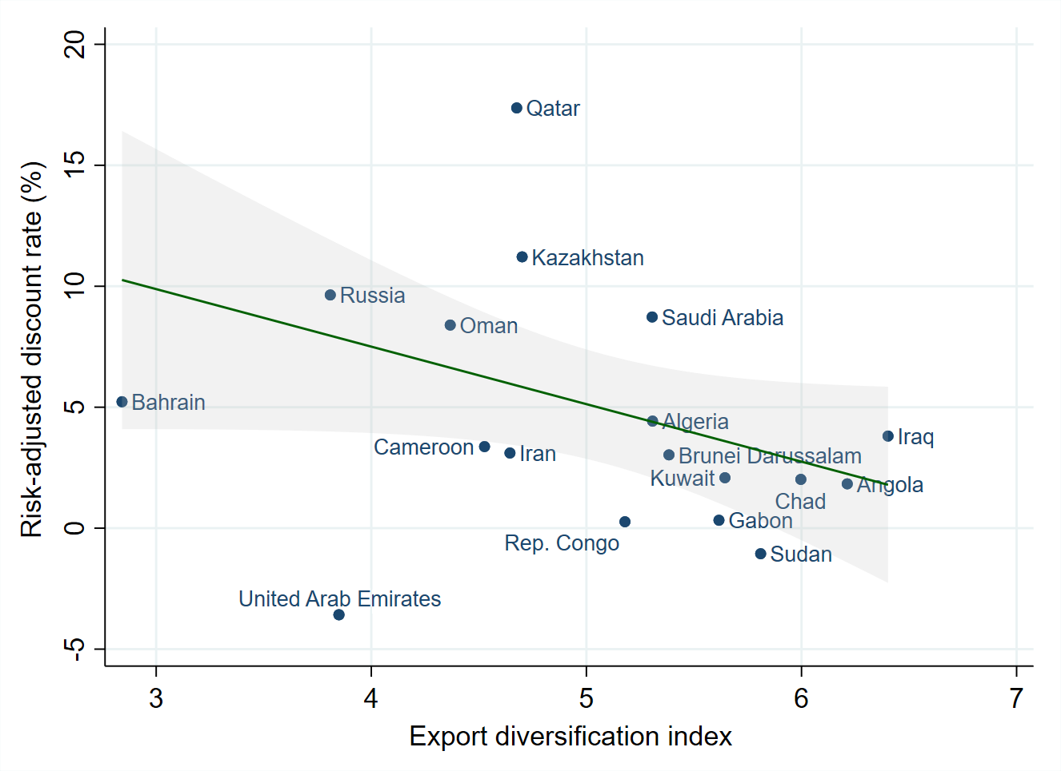
Discount rate and export diversification
Lack of export diversification
increases vulnerability to oil price fluctuations
tends to result in a lower risk-adjusted discount rate
9

Slide 10
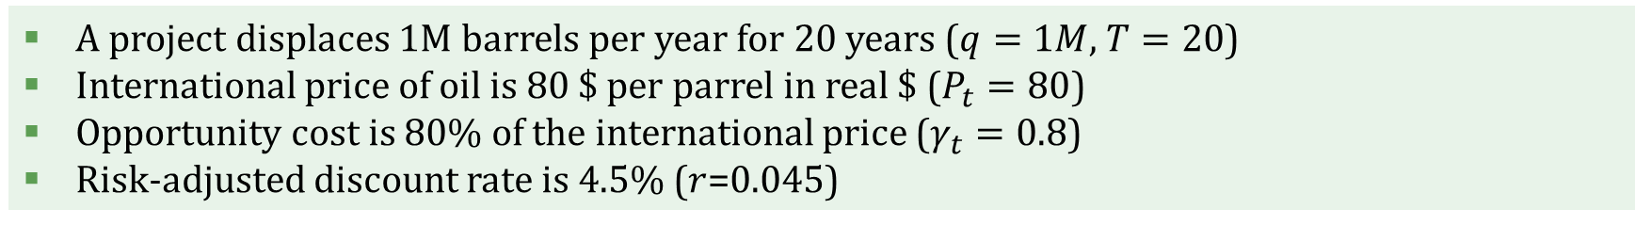
How our results materially impact the public evaluation of future cash flows: A hypothetical example
$$NPV=−I+\sum_{t=1}^{T}{e^{−rt}{γ_{t}P}_{t}q}$$
A project displaces 1M barrels per year for 20 years ($q=1M$, $T=20$)
International price of oil is 80 $ per parrel in real $ ($P_{t}=80$)
Opportunity cost is 80% of the international price ($γ_{t}=0.8$)
Risk-adjusted discount rate is 4.5% ($r$=0.045)
$$\sum_{t=1}^{20}{e^{−0.045t}×0.8×80×1000000≅825M \$}$$
$$I≤825M \$$$
$$NPV≥0$$
10

Slide 11
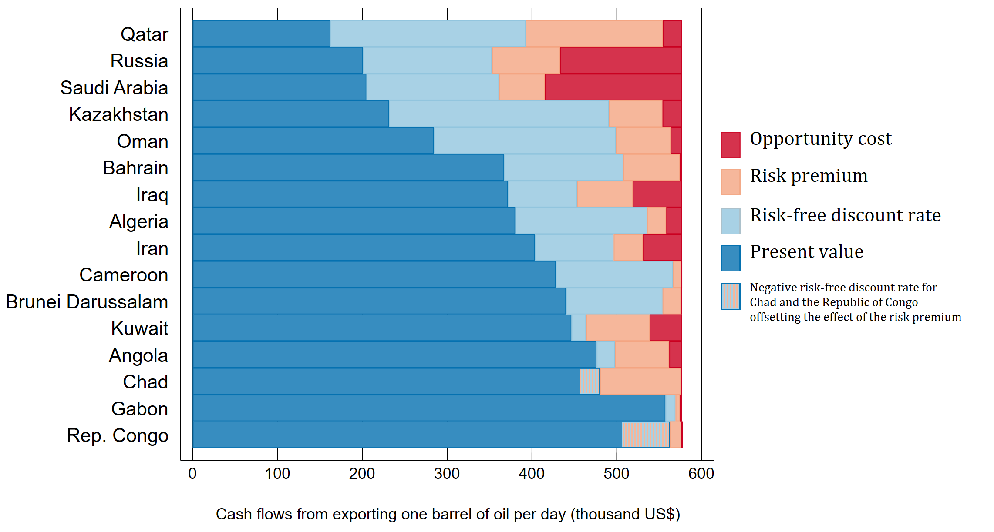
How our results materially impact the public evaluation of future cash flows
2023-2040 period with real oil prices from Stated Policies Scenario (WEO; IEA, 2022)
Average individual impact | Opportunity cost | 6%
 | Risk premium | 10.5%
 | Riskless discount rate | 18.5%
 | Avg. Cumulative impact | 35%
 | Avg. Cumulative impact (GCC) | 49%
11

Slide 12
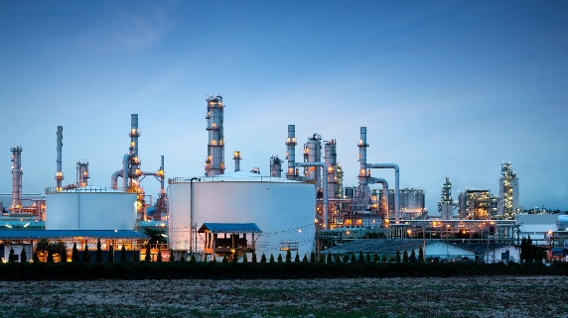


Why it matters?
Our estimates are useful to policymakers in oil-rich countries considering investment projects or policies freeing oil from domestic consumption or using oil as an input
They enable governments to perform more accurate cost-benefit analyses, ensuring that decisions made enhance welfare and economic development
This is especially critical for oil-exporting countries pursuing domestic energy transitions and industrial development
12

Slide 13
Thank you

