Slide 1
Agentic Strategic Oversight of Classical Pathfinding
Cross-episode Episodic Memory + LLM-driven Reflective Reasoning Over A*
Fatih Karatay
EN.705.625.8VL.SP26 Introduction to Agentic AI
April 2026

Slide 2
The Problem
A* and D* Lite are powerful, but limited:
They reset between episodes.
They return a path, not a reason.
Research questions:
RQ1 (Memory): Does cross-episode memory beat D* Lite as episodes accumulate?
RQ2 (Reflection): Does LLM reflection beat raw memory writes?
RQ3 (Cost-Quality): When does LLM oversight justify its latency?

Slide 3
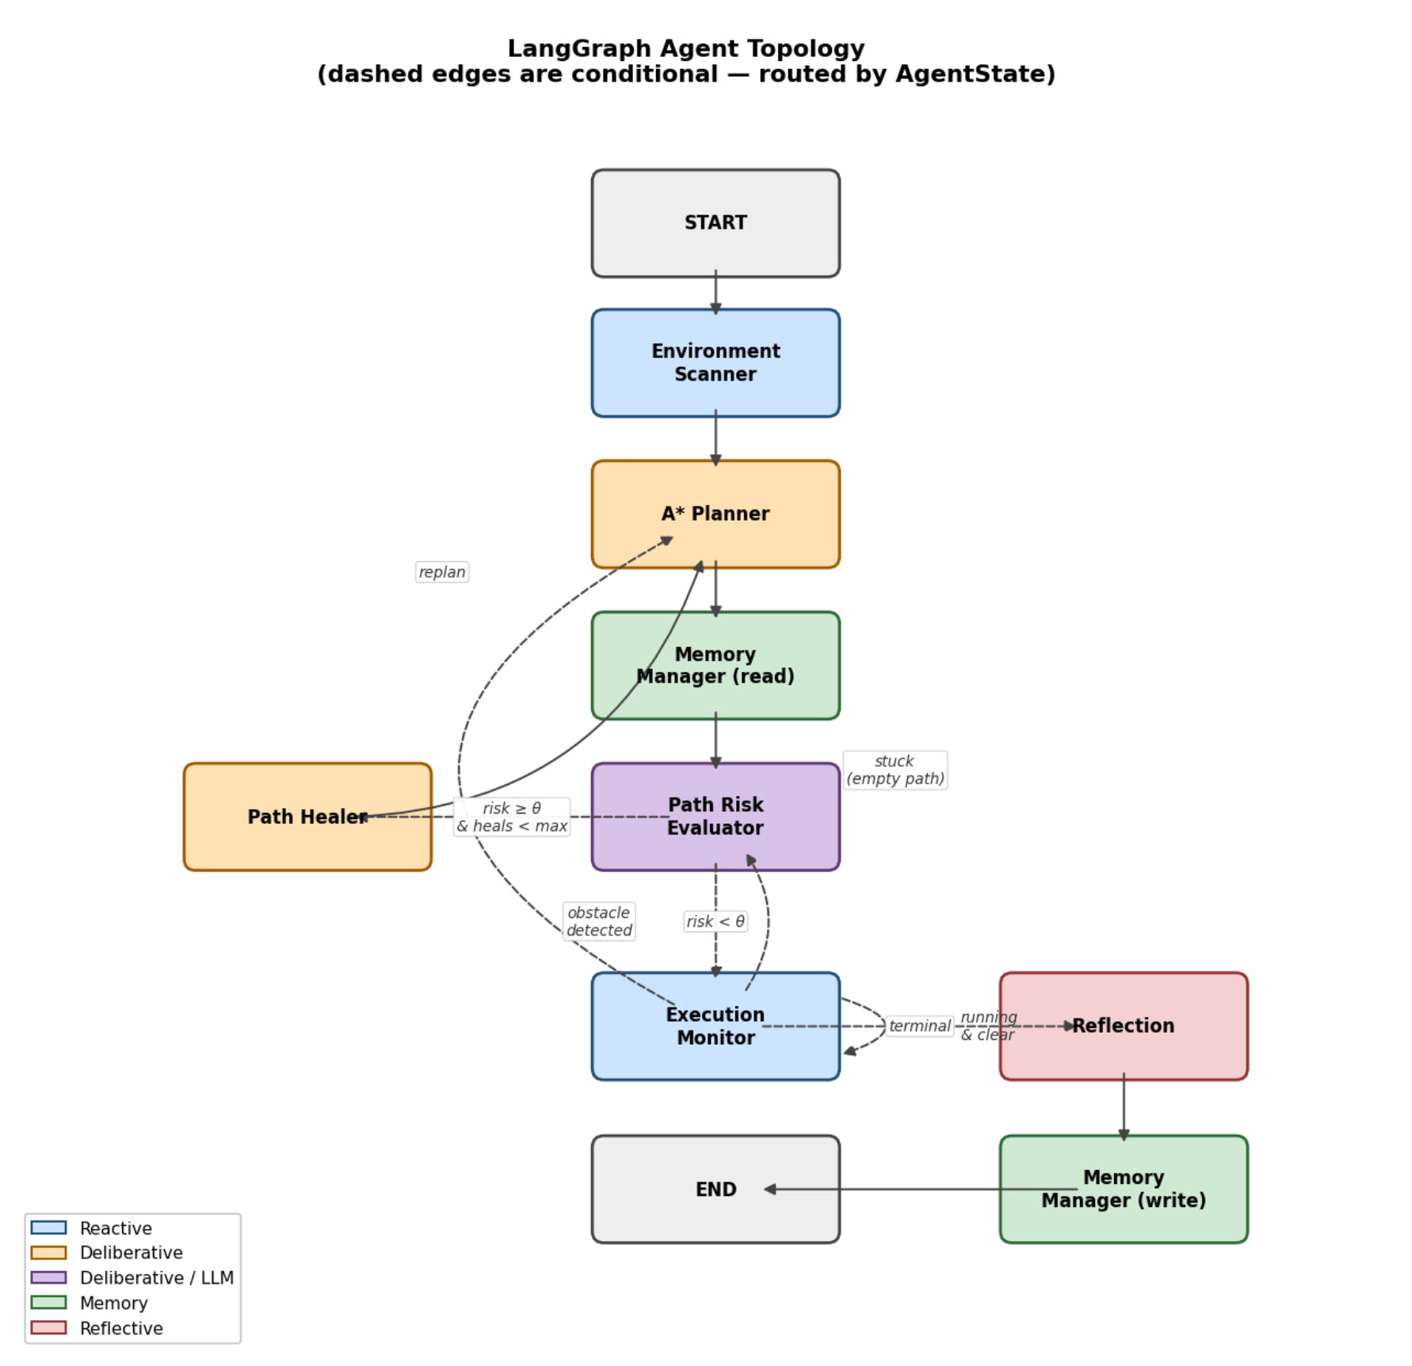
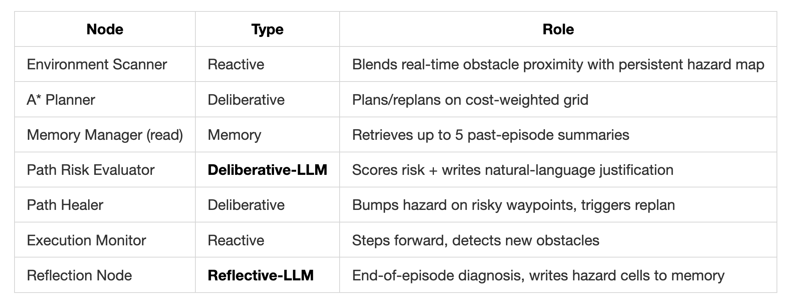
System Architecture
LangGraph Agent: 7 nodes sharing an AgentState TypedDict

Slide 4
How it Learns
Three mechanisms, three timescales:
Per-step uncertainty overlay (reactive) Real-time + persistent hazard map → A* cost weights.
Bump-and-replan (deliberative, within episode) LLM flags risky waypoints → Healer raises their cost → A* replans.
Reflection writes to persistent memory (reflective, between episodes) grid.hazard_map survives grid.reset() — the only cross-episode learning signal.

Slide 5
Experimental Setup
4 variants × 3 conditions × 50 sequential episodes = 600 episodes
Variants: A*, D* Lite, Agent-NoReflection, Full Agent
Conditions: Static (15%), Dynamic-Low (15%, slow), Dynamic-High (20%, every step)
Grid: 20×20, identical seeds across variants
LLM: gpt-4o-mini, ~2,500 calls, ~$1 USD total

Slide 6
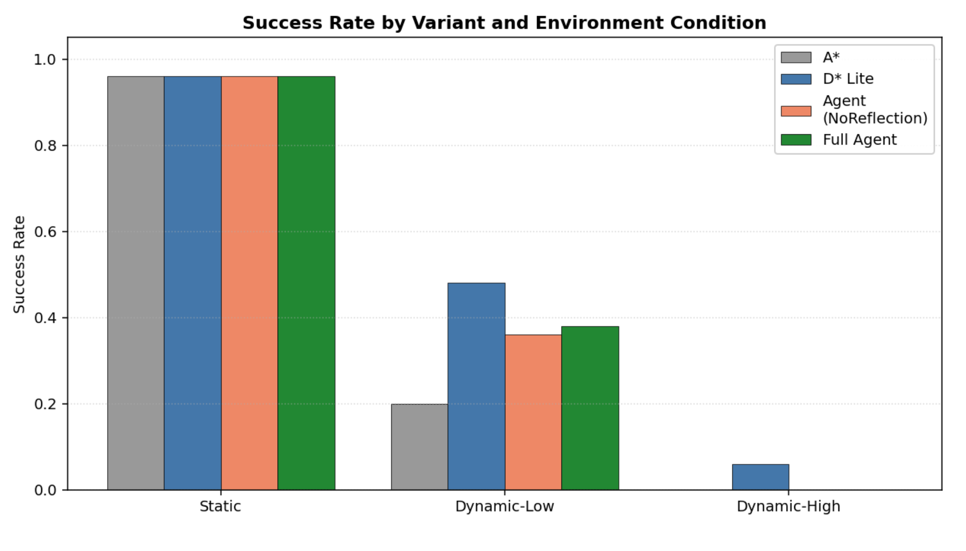
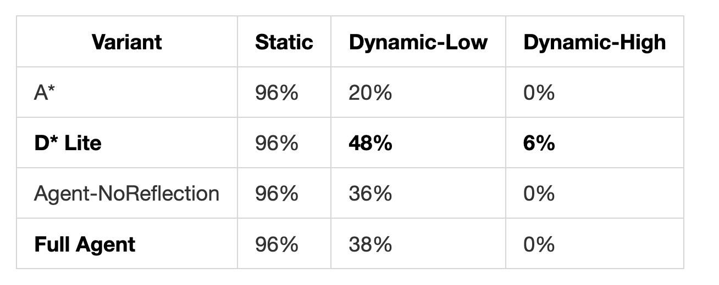
Results
Success rate by variant and condition:
Key findings:
D* Lite wins on raw success rate.
Reflection adds a consistent +2 pp over no-reflection.
Learning curve: Full Agent climbs 0 → ~80% rolling SR over first 15 episodes.
Full Agent is ~1,500× slower than D* Lite per episode (18.9 s vs 13 ms).

Slide 7
The Honest Tradeoff & Takeaways
What I bought for the 1,500× slowdown:
Per-decision natural-language risk justifications
End-of-episode reflective diagnoses stored to JSONL
A complete audit trail for every episode.
No algorithmic baseline produces this
Lessons learned:
Cross-episode memory works mechanically
Visible in the learning curve.
Bump-and-replan over-corrects in mild dynamics: longer paths → more exposure → more collisions.
Interpretability is the agent's defensible contribution, not raw success rate.
Future work: graduated heal magnitudes · 50×50 grids · Agent-NoMemory ablation · semantic memory retrieval.

Slide 8
Copyright The Johns Hopkins University 2022. All rights reserved.

