Slide 1
SoftHier Dequantization Meeting 25.08.25
Integrated Systems Laboratory (ETH Zürich)
Fatih Özdemir Bowen Wang
Yawei Li
Angelo Garofalo

Slide 2
SoftHier Building Block
System Level
Manycore NoC Architecture
Each cluster has
A Vector Processor
L1 Memory (~1 MiB)
Inter-Cluster Broadcast and Communication
To Sync NoC Router
To Data NoC Router
HBM
I $
CTRL
REG
Core 0
RedMule
iDMA
R
R
R
R
Core 0
C
C
C
C
…
Core n
C
C
C
C
Interconnect
R
R
R
R
TCDM (Multi-banked L1)
HBM
HBM
C
C
C
C
R
R
R
R
TE Cluster
C
C
C
C
R
R
R
R
HBM
2

Slide 3
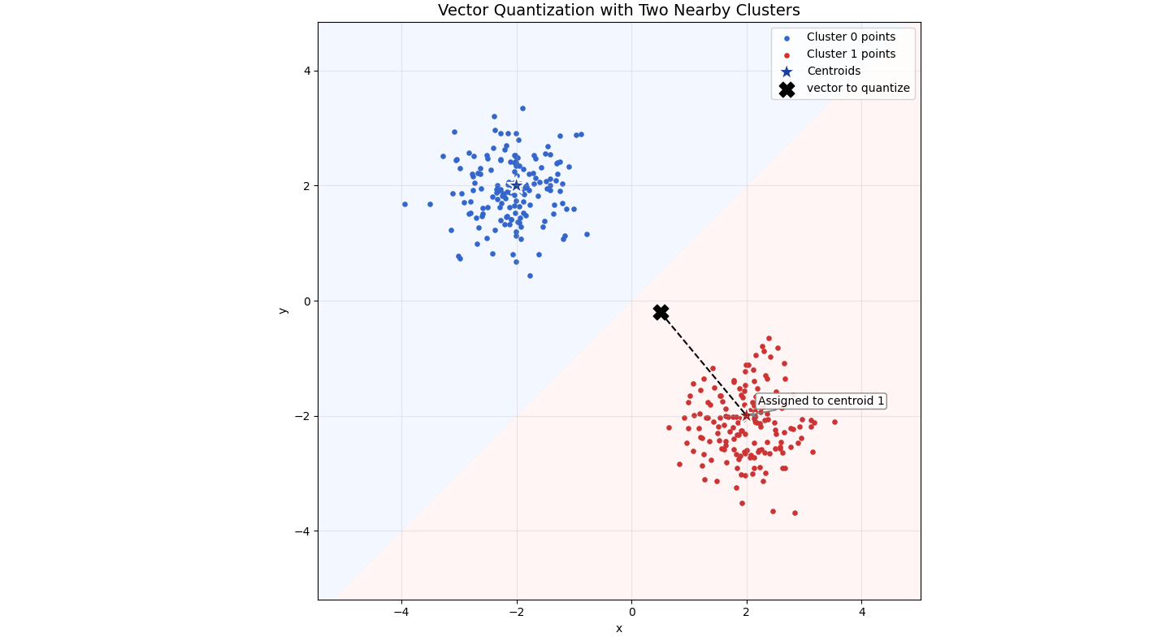
Vector Quantization
Vector v = [-0.5, -0.2]
Centroid1 = [-2 2]
Centroid2 = [2 -2]
Centroids stored in codebook
Codebook=[centroid1
centroid2]
Assign v to centroid 2
Encoded Index to access codebook entry [0-> centroid1
1-> centroid2]
v

Slide 4

Dequantization
Look up the Encoded Index in the Codebook -> Indirect Access needed
$\hat{v}=C[index[i]]$

Slide 5
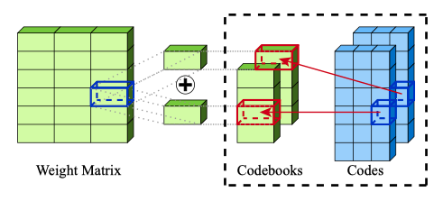

AQLM
Quantize the rows of a Matrix
Additive Quantization: Reconstructed Matrix is sum of M codewords from M codebooks
For B Bits Indices, we can access $2^{B}$ Entries in the Codebook

Slide 6
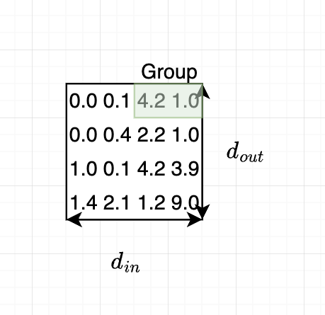
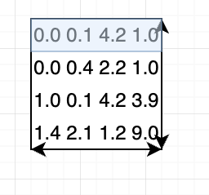
AQLM Quantization
For a Big Matrix, It is also possible to split W by groups vertically along the columns and quantize each group g separately (with the same codebook)
-> Can Dequantize different columns with the same codebook simultaneously In Multicore Setting
-> Each centroid has size (1,g)
We still encode row by row

Slide 7
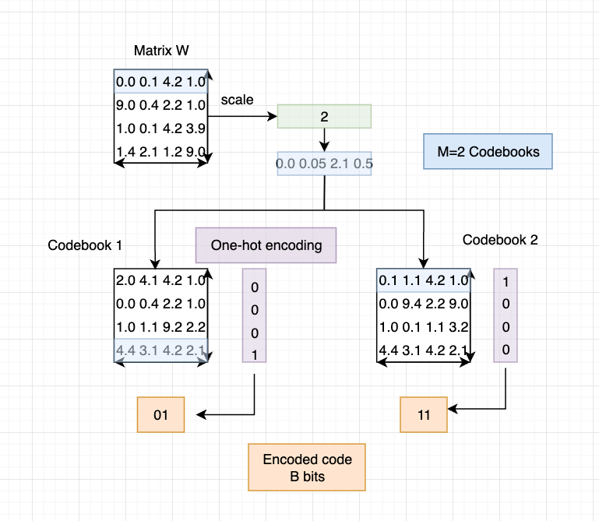
AQLM Quantization
1) scale (divide by the scaled value
2) assign the to-be-encoded row to nearest centroid in both codebooks
3) store the nearest centroid location

Slide 8
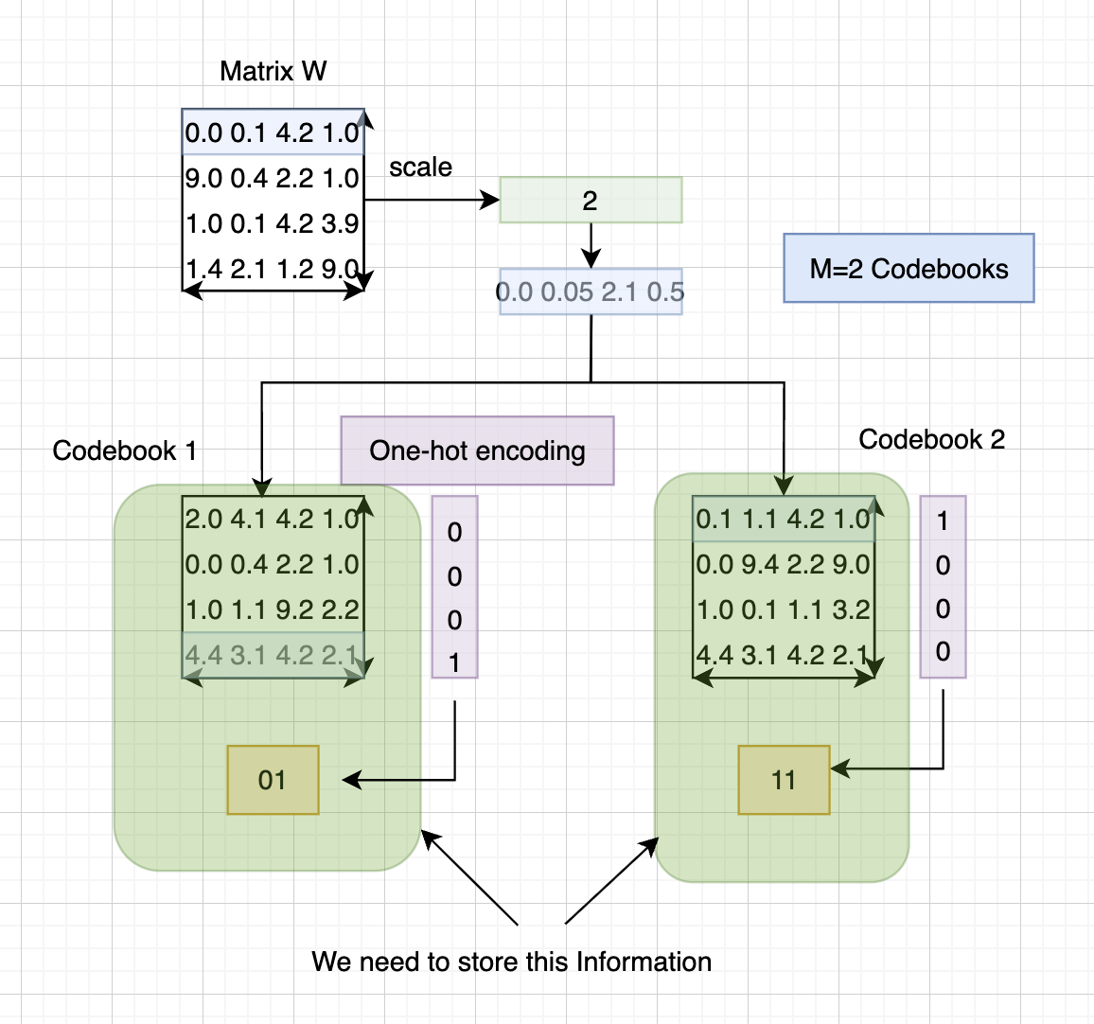
AQLM Quantization

Slide 9
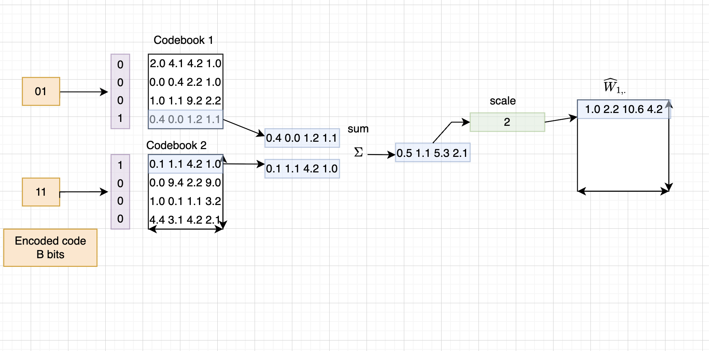
AQLM Dequantization
Each decoding step decodes g elements(size of centroid)
Decompression happens along the rows

Slide 10
AQLM Configs
Parameters to Quantize:
M = Number of Codebooks
g = Group Size
B = Number of Indices Bits
AQLM’s best results use
 | Codebook Size | Indices Shape | Memory Footprint (Codebook Size + Indices Size) | Bits per parameter
M=2,g=8,B=8 | [2,256,8] | [4096, 512] | 8 KiB+ 4 MiB~4 MiB | 2.01
M=1,g=8,B=16 | [1,65536,8] | [4096, 512] | 1 MiB+ 4 MiB=5MiB | 2.38

Slide 11
AQLM Configs
Config 2 requires 1 MiB codebook Size which won’t fit into a single cluster
-> Config 1 with 2 codebooks and smaller codebook size is preferred

Slide 12
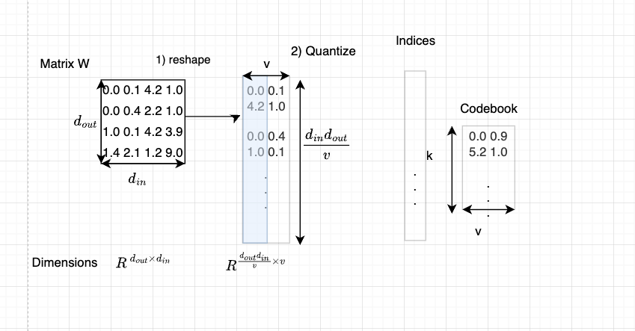
VPTQ
Encode Columns of a Matrix
Reshape Weight Matrix -> many columns, few rows
Quantize each column separately and update weight matrix at each step
Quantize Column by Column (in Contrast, AQLM: row by row)

Slide 13
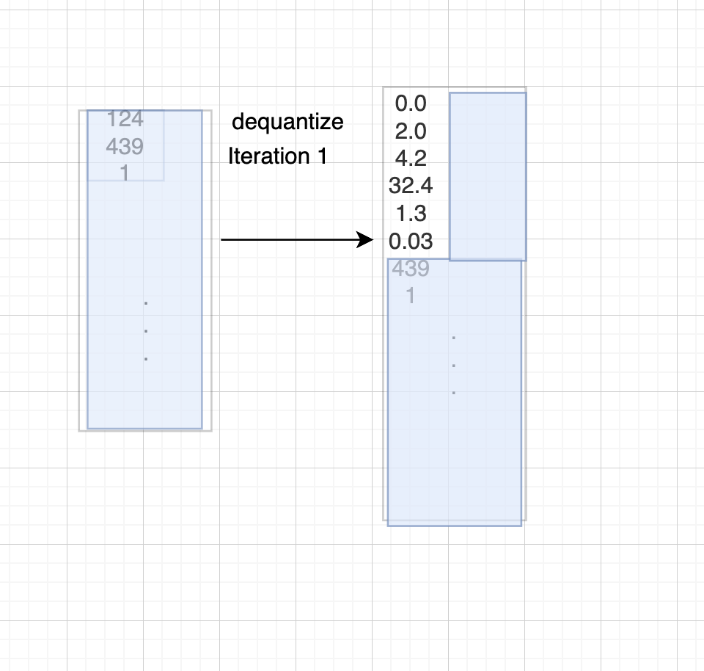
VPTQ Dequantization

Slide 14
VPTQ Configs
Parameters to Quantize:
v = Size of Centroid
K = Number of Centroids
VPTQ’s best results use
 | Codebook Size | Indices Shape | Memory Footprint | Bits per parameter
V=6,K=4096 | [4096,6] | [683, 4096] | 48 KiB+ can4 MiB~4 MiB | ~2
V=6,K=4096 g=8 | [4096,6]*8 | [683, 512] | 48 KiB*8+4 MiB~4.4 MiB | ~2
V=8, K=32768 | [32768,8] | [4096, 512] | 0.5 MiB+ 4 MiB=4.5MiB | ~2

Slide 15
Matrix Multiplication
Main Idea:
Fuse Dequantization and Multiplication to Avoid multiple Memory Accesses

Slide 16
Benchmark VPTQ and AQLM
1) Benchmark Memory Footprint of Indices and Code Shapes(+Scales for AQLM)
2)Benchmark Reconstruction Error
Benchmarked Configs:
AQLM: M=2,g=8,B=8(256 codebook entries)
VPTQ: k=4096, v=6, No Product Quantization
VPTQ: k=4096, v=6, Product Quantization: Split Matrix W by 8 vertically , each having their own codebook entries

Slide 17
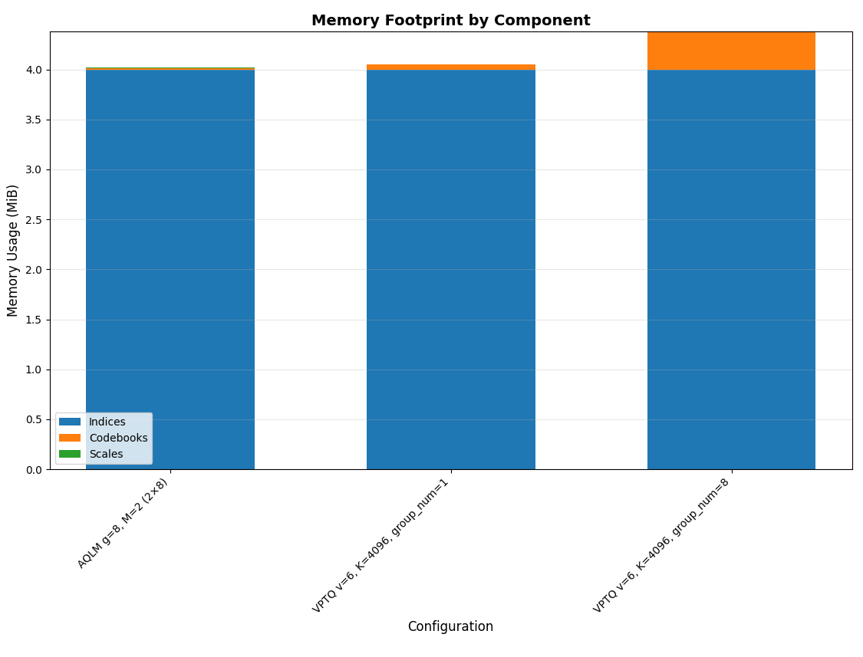
Benchmark Memory Footprint

Slide 18
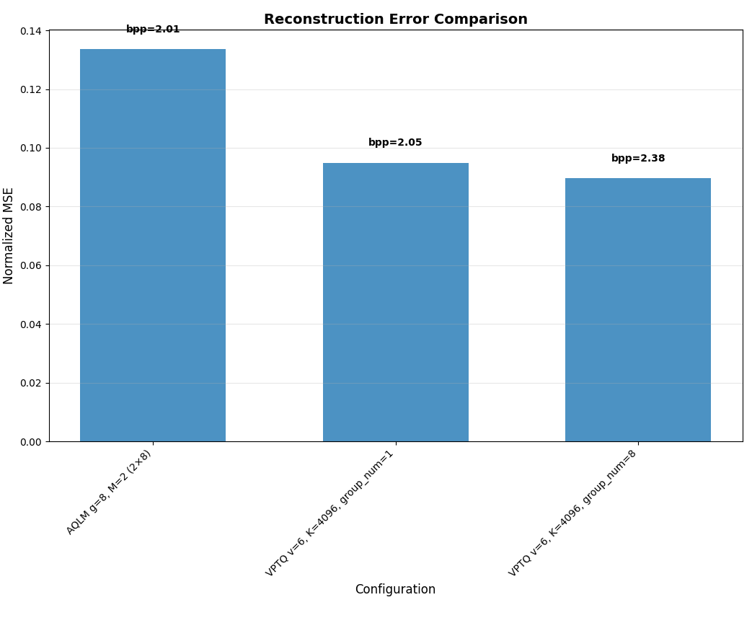

Benchmark1: Reconstruction Error
$\frac{{\left\|W−\hat{W}\right\|}^{2}}{{\left\|W\right\|}^{2}}$

Slide 19
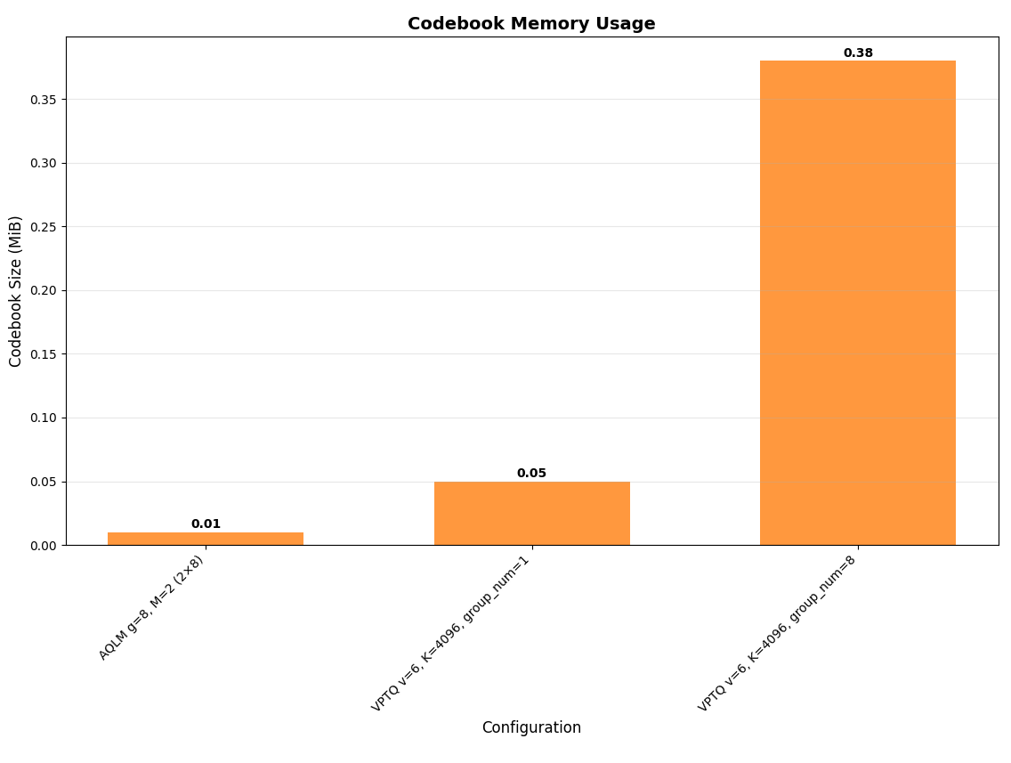
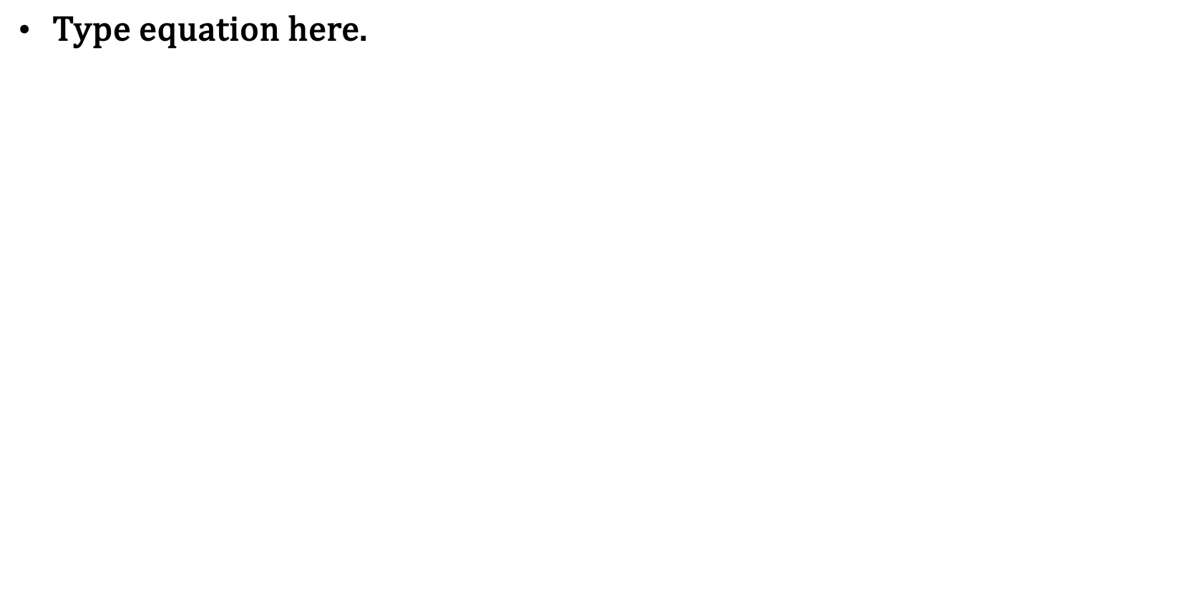

Slide 20

Decisions
Deploy Dequantization with AQLM (M=2 codebooks,256 centroids,g=8 group size)
Implementing Dequantization + Inference on Spatz Vector Processor with existing RISC-V Vector Processor
Implement Basic GEMM Kernel in a single-cluster scenario
Fully Materialized $\hat{W}$ multiplied by a random Matrix to simulate an MLP Layer

