Slide 1

Flutter Kurulum

Slide 2

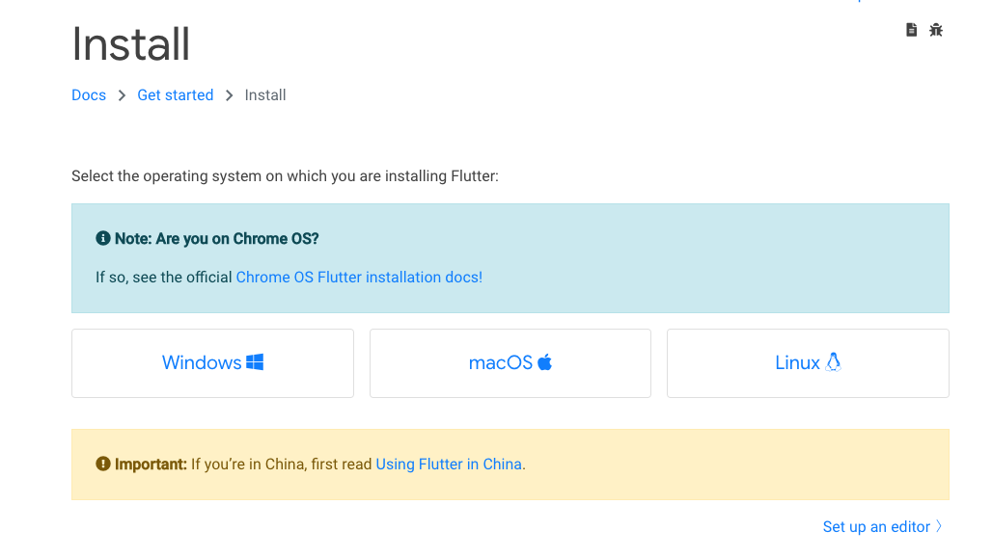
Flutter Kurulum

Slide 3
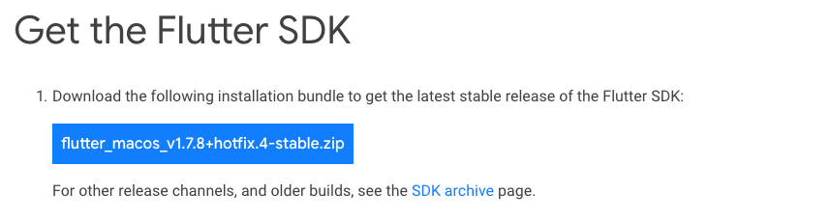
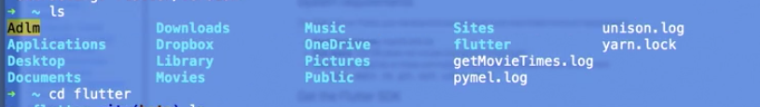
MAC OS X & Linux
cd ~/development $ unzip ~/Downloads/flutter_macos_v1.7.8+hotfix.4-stable.zip
export PATH="$PATH:`pwd`/flutter/bin"
flutter doctor
**ilk adımlarda root path’te olmayı unutmayın

Slide 4
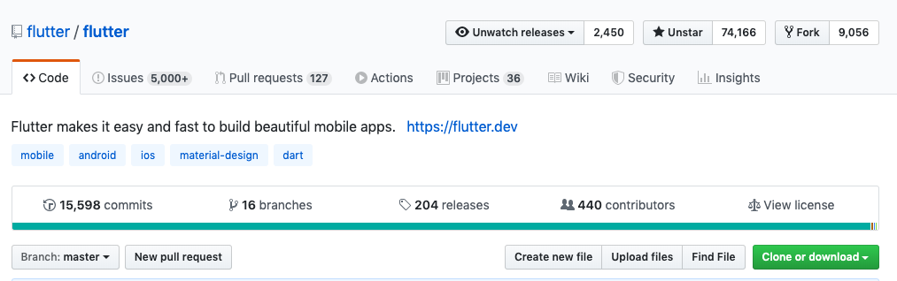
Windows
cd C:/src or C:/development
git clone -b stable https://github.com/flutter/flutter.git
Cd C:/src/flutter
flutter_console.bat file İki defa basılarak kurulum tamamlanır
flutter doctor

