Slide 1
Unit 3. Multi-Path Fading
Ece-gy 6023. Wireless communications
Prof. Sundeep rangan

Slide 2
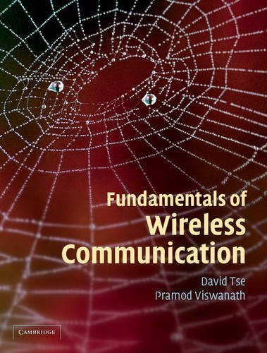
Fading
From the Introduction of a classic text:
There are two fundamental aspects of wireless communication that make the problem challenging and interesting.
…First is the phenomenon of fading … …Second …there is significant interference …

Slide 3
Learning Objectives
Describe up and down-conversion in time- and frequency-domain
Describe the steps in the DAC and ADC including the filtering
Compute a discrete-time and continuous-time base equivalent channels from the passband
Simulate fractional delays and gains in the sampled data
Describe and simulate a deterministic multi-path wireless channel
Compute the time-varying frequency response given the path parameters
Describe a statistical model for multi-path fading
Approximately compute the coherence time and bandwidth given a channel

Slide 4
Outline
Review of Up- and Downconversion
Review of TX and RX Sampling
Doppler and Multi-Path Fading
Statistical Descriptions of Fading

Slide 5




Up- and Downconversion
Complex baseband
upconversion
Real passband
f
f
-$\frac{W}{2}$
$$\frac{W}{2}$$
downconversion
0
$$−f_{c}$$
0
$$f_{c}$$
RF communication systems:
Information occurs and is processed in complex baseband
Transmitted and received in real passband
Up and down-conversion: Shift center frequency of signals
Also called mixing

Slide 6
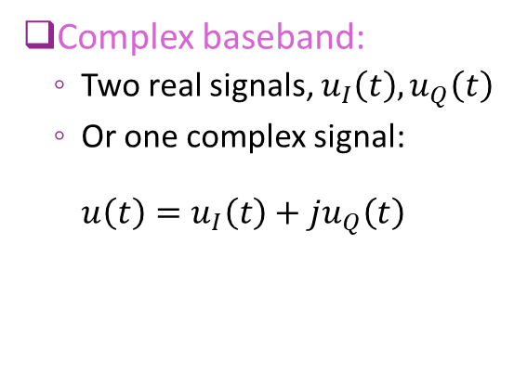

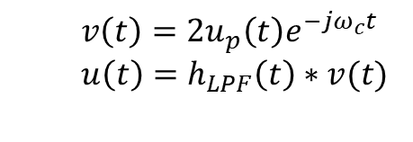

Up and Down-Conversion in Time Domain
upconversion
Complex baseband:
Two real signals, $u_{I}\left(t\right), u_{Q}\left(t\right)$
Or one complex signal: $u\left(t\right)=u_{I}\left(t\right)+ju_{Q}\left(t\right)$
Real passband: $u_{p}\left(t\right)$
$$u_{p}\left(t\right)=Re(u\left(t\right)e^{jω_{c}t})$$
downconversion
Note: downconversion needs:
Multiplication by 2
Low pass filtering
$$v\left(t\right)=2u_{p}\left(t\right)e^{−jω_{c}t} \\ u\left(t\right)=h_{LPF}\left(t\right)∗v(t)$$

Slide 7

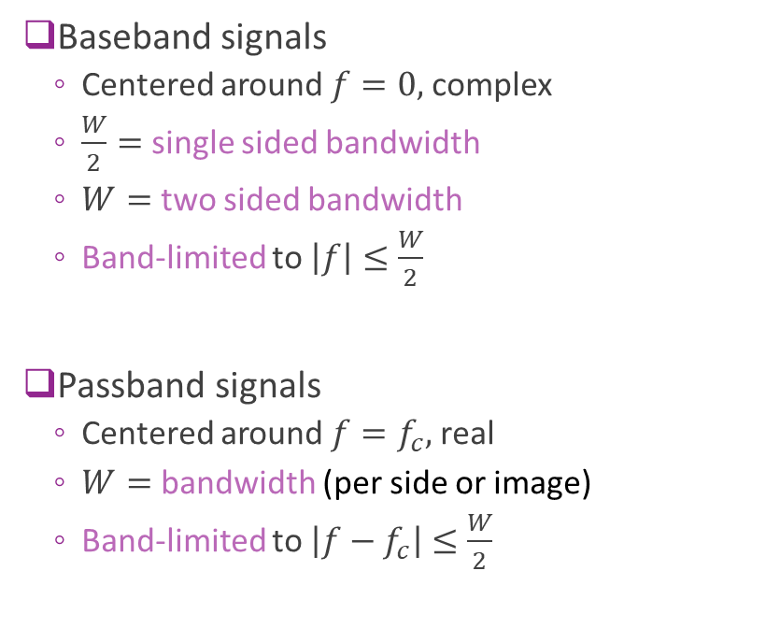






Mixing in Frequency Domain
A
Baseband signals
Centered around $f=0,$ complex
$\frac{W}{2}=$ single sided bandwidth
$W=$ two sided bandwidth
Band-limited to $\left|f\right|≤\frac{W}{2}$
Passband signals
Centered around $f=f_{c},$ real
$W=$ bandwidth (per side or image)
Band-limited to $\left|{f−f}_{c}\right|≤\frac{W}{2}$
$$U(f)$$
$$−\frac{W}{2}$$
0
$$\frac{W}{2}$$
A/2
$$U(f)$$
$${−f}_{c}$$
0
$$f_{c}$$
$$W$$

Slide 8
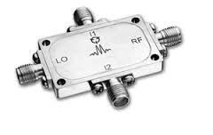
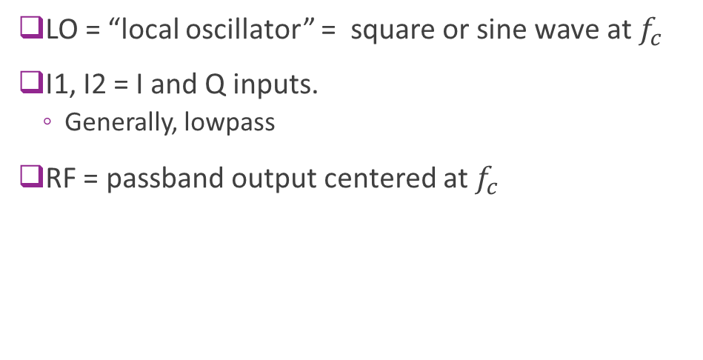
Discrete IQ Mixer
LO = “local oscillator” = square or sine wave at $f_{c}$
I1, I2 = I and Q inputs.
Generally, lowpass
RF = passband output centered at $f_{c}$
http://www.markimicrowave.com/Mixers/IQ_Quadrature-IF_Double-Balanced/IQ-0318.aspx
Datasheet | RF [GHz] | LO [GHz] | IF [MHz] | Conversion Loss [dB] | Image Rejection [dB] | Amplitude Deviation [dB] | Phase Deviation [Degrees] | Isolations L-R [dB] | Isolations L-I [dB]
IQ-0318 | 3 to 18 | 3 to 18 | DC to 500 | 7 | 22 | 0.75 | 10 | 40 | 20

Slide 9


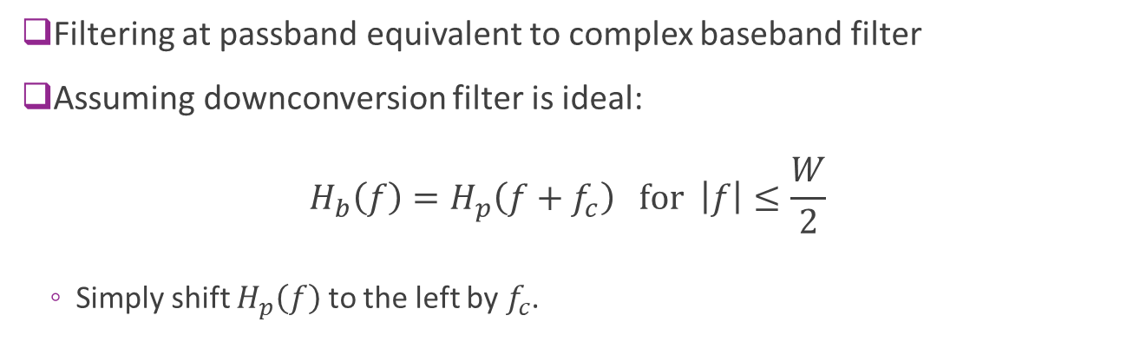








Baseband Equivalent Channel
$$f_{c}$$
$$f_{c}$$
=
$$H_{p}(f)$$
$$H_{b}(f)$$
$$y(t)$$
$$s(t)$$
$$s_{p}(t)$$
$$y_{p}(t)$$
$$y(t)$$
$$s(t)$$
Upconvert
Filter
Downconvert
Filter
Filtering at passband equivalent to complex baseband filter
Assuming downconversion filter is ideal: $H_{b}\left(f\right)=H_{p}\left(f+f_{c}\right) \text{for} \left|f\right|≤\frac{W}{2}$
Simply shift $H_{p}\left(f\right)$ to the left by $f_{c}$.

Slide 10
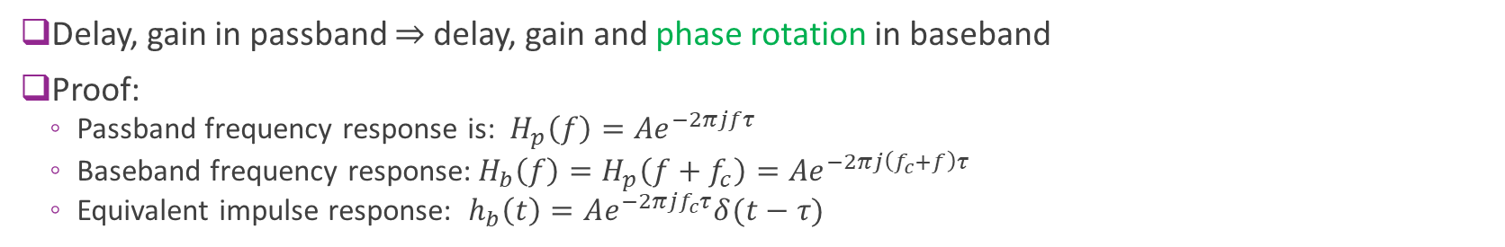
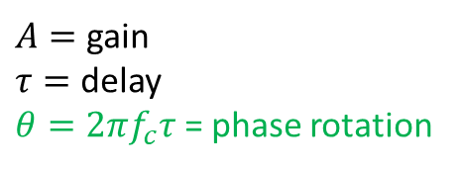

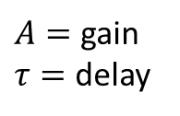

Important Special Case: Delay
Passband channel
Baseband equivalent channel
$$h_{p}\left(t\right)=Aδ\left(t−τ\right)$$
$${ h}_{b}\left(t\right)=Ae^{−2πjf_{c}τ}δ(t−τ)$$
$A=$ gain $τ=$ delay
$A=$ gain $τ=$ delay
$θ=2πf_{c}τ$ = phase rotation
Delay, gain in passband $⇒$ delay, gain and phase rotation in baseband
Proof:
Passband frequency response is: $H_{p}\left(f\right)={Ae}^{−2πjfτ}$
Baseband frequency response:$H_{b}\left(f\right)=H_{p}\left(f+f_{c}\right)={Ae}^{−2πj\left(f_{c}+f\right)τ}$
Equivalent impulse response: $h_{b}\left(t\right)=Ae^{−2πjf_{c}τ}δ(t−τ)$

Slide 11

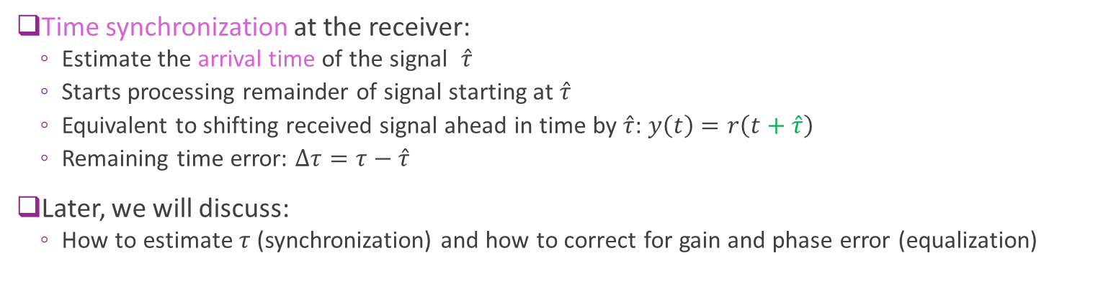

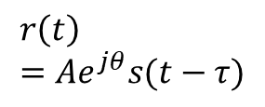



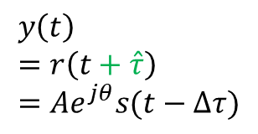
Synchronization and Delay Errors
$$y\left(t\right) \\ =r\left(t+\hat{τ}\right) \\ =Ae^{jθ}s(t−Δτ)$$
$$r\left(t\right) \\ =Ae^{jθ}s(t−τ)$$
Delay & gain
$$s(t)$$
Shift
$$C$$
$$ACe^{jθ}$$
Delay estimate $\hat{τ}$
0
$$τ$$
Sync
Time synchronization at the receiver:
Estimate the arrival time of the signal $\hat{τ}$
Starts processing remainder of signal starting at $\hat{τ}$
Equivalent to shifting received signal ahead in time by $\hat{τ}$: $y\left(t\right)$ $=r\left(t+\hat{τ}\right)$
Remaining time error: $Δτ=τ−\hat{τ}$
Later, we will discuss:
How to estimate $τ$ (synchronization) and how to correct for gain and phase error (equalization)

Slide 12

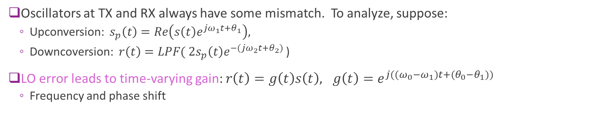





Frequency Errors
$$s(t)$$
$$×$$
$$×$$
$$r(t)=s(t)e^{j{((ω}_{0}−ω_{1})t+(θ_{0}−θ_{1}))}$$
LO 1 $ω_{1},θ_{1}$
LO 2 $ω_{2},θ_{2}$
Oscillators at TX and RX always have some mismatch. To analyze, suppose:
Upconversion: $s_{p}\left(t\right)=Re\left(s\left(t\right)e^{jω_{1}t+θ_{1}}\right),$
Downcoversion: $r\left(t\right)=LPF( 2s_{p}\left(t\right)e^{−(jω_{2}t+θ_{2})}$ )
LO error leads to time-varying gain: $r\left(t\right)=g\left(t\right)s\left(t\right), g\left(t\right)=e^{j{((ω}_{0}−ω_{1})t+(θ_{0}−θ_{1}))}$
Frequency and phase shift

Slide 13
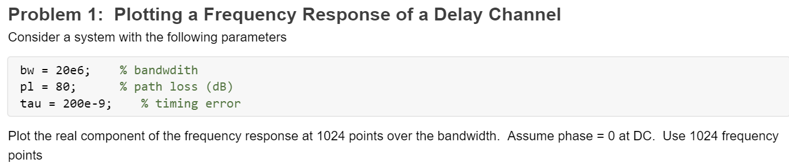
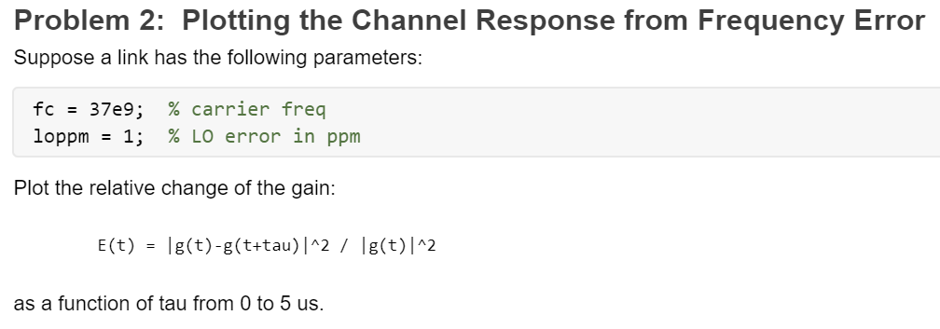
In-Class Problems

Slide 14
Outline
Review of Up- and Downconversion
Review of TX and RX Sampling
Doppler and Multi-Path Fading
Statistical Descriptions of Fading

Slide 15

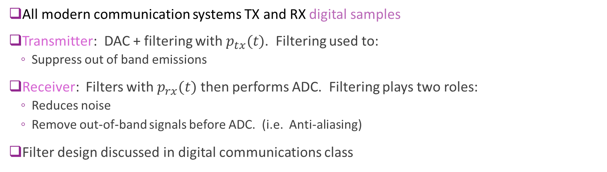








Typical Digital Communication Path
$$u_{δ}(t)$$
$$u(t)$$
$$r(t)$$
$$v(t)$$
$$s[n]$$
$$r[n]$$
TX samples
Ideal D/A
$$p_{tx}(t)$$
$$h_{chan}(t)$$
$$p_{rx}(t)$$
Ideal A/D
RX samples
All modern communication systems TX and RX digital samples
Transmitter: DAC + filtering with $p_{tx}(t)$. Filtering used to:
Suppress out of band emissions
Receiver: Filters with $p_{rx}(t)$ then performs ADC. Filtering plays two roles:
Reduces noise
Remove out-of-band signals before ADC. (i.e. Anti-aliasing)
Filter design discussed in digital communications class

Slide 16
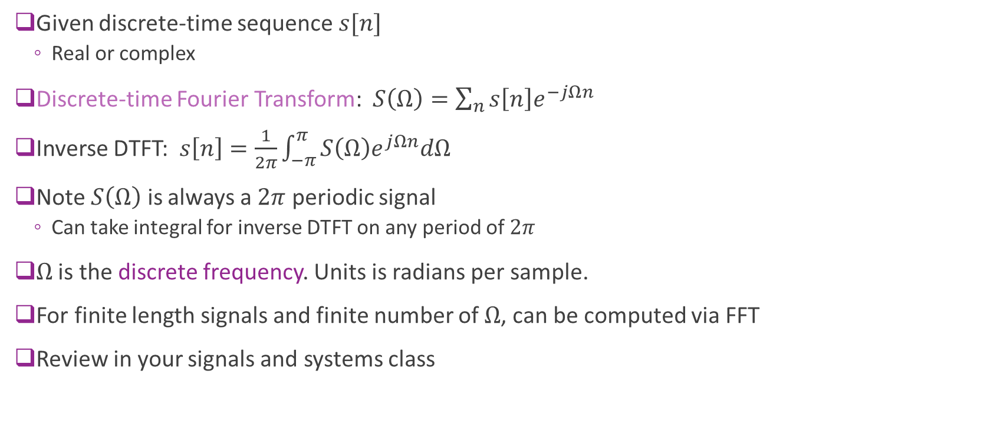
Review of DTFT
Given discrete-time sequence $s[n]$
Real or complex
Discrete-time Fourier Transform: $S\left(Ω\right)=\sum_{n}{s\left[n\right]e^{−jΩn}}$
Inverse DTFT: $s\left[n\right]=\frac{1}{2π}\int_{−π}^{π}{S\left(Ω\right)e^{jΩn}dΩ}$
Note $S\left(Ω\right)$ is always a $2π$ periodic signal
Can take integral for inverse DTFT on any period of $2π$
$Ω$ is the discrete frequency. Units is radians per sample.
For finite length signals and finite number of $Ω$, can be computed via FFT
Review in your signals and systems class

Slide 17
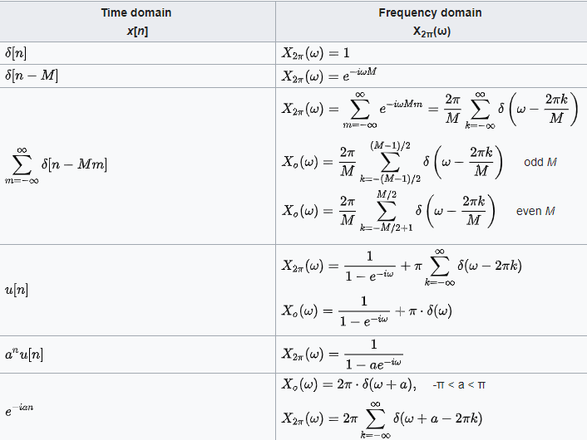
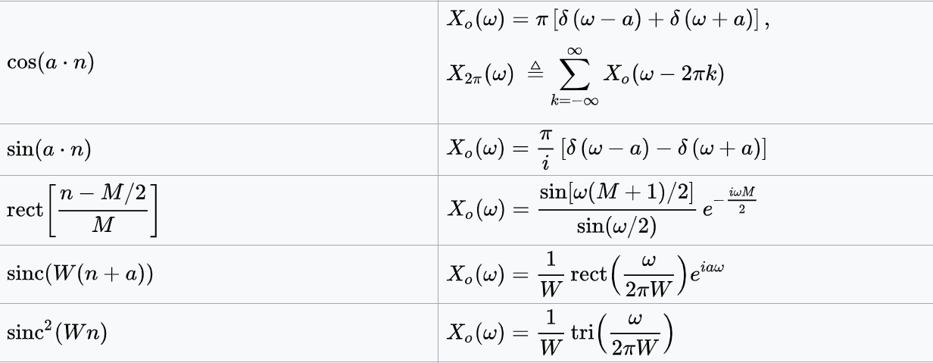
Common DTFT Pairs
See Wikipedia

Slide 18

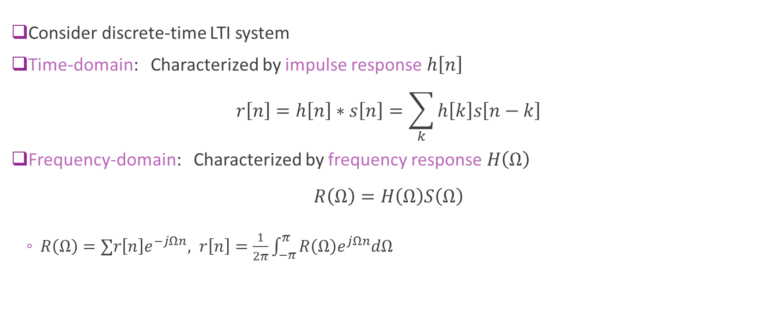


Discrete-Time Systems
$$s[n]$$
$$H(Ω)$$
$$r[n]$$
Consider discrete-time LTI system
Time-domain: Characterized by impulse response $h\left[n\right]$ $r\left[n\right]=h\left[n\right]∗s\left[n\right]=\sum_{k}{h\left[k\right]s\left[n−k\right]}$
Frequency-domain: Characterized by frequency response $H\left(Ω\right)$ $R\left(Ω\right)=H\left(Ω\right)S\left(Ω\right)$
$R\left(Ω\right)=∑r\left[n\right]e^{−jΩn}, r\left[n\right]=\frac{1}{2π}\int_{−π}^{π}{R\left(Ω\right)e^{jΩn}dΩ}$

Slide 19

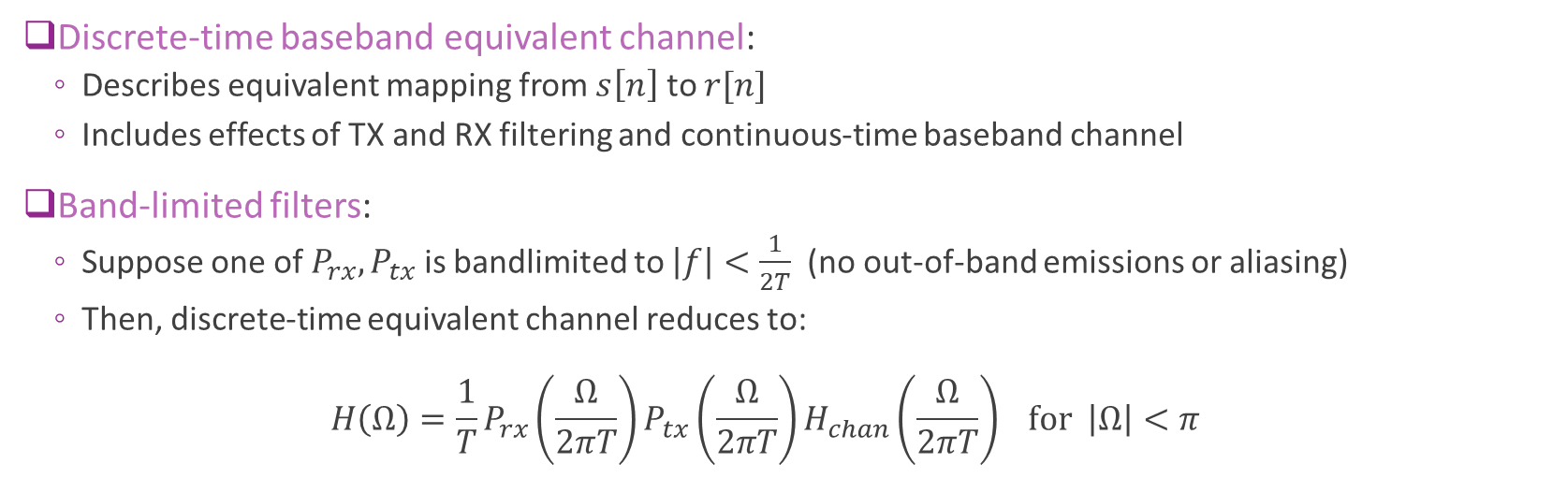







DT Equivalent Channel
$$s[n]$$
$$r[n]$$
=
$$s[n]$$
$$r[n]$$
DAC
$$p_{tx}(t)$$
$$h_{chan}(t)$$
$$p_{rx}(t)$$
ADC
$$H(Ω)$$
Discrete-time baseband equivalent channel:
Describes equivalent mapping from $s\left[n\right]$ to $r[n]$
Includes effects of TX and RX filtering and continuous-time baseband channel
Band-limited filters:
Suppose one of $P_{rx}, P_{tx}$ is bandlimited to $\left|f\right|<\frac{1}{2T}$ (no out-of-band emissions or aliasing)
Then, discrete-time equivalent channel reduces to: $H\left(Ω\right)=\frac{1}{T}P_{rx}\left(\frac{Ω}{2πT}\right)P_{tx}\left(\frac{Ω}{2πT}\right)H_{chan}\left(\frac{Ω}{2πT}\right) for \left|Ω\right|<π$

Slide 20

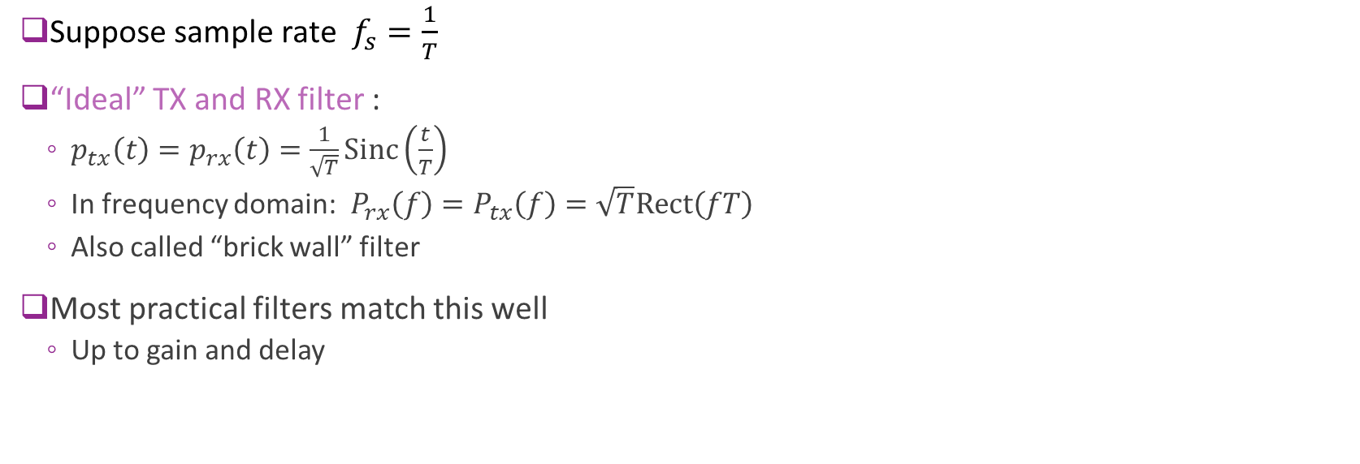




Ideal Filtering
$$s[n]$$
$$r[n]$$
=
$$s[n]$$
$$r[n]$$
DAC
$$p_{tx}(t)$$
$$h_{chan}(t)$$
$$p_{rx}(t)$$
ADC
$$H(Ω)$$
Suppose sample rate $f_{s}=\frac{1}{T}$
“Ideal” TX and RX filter :
$p_{tx}\left(t\right)=p_{rx}\left(t\right)=\frac{1}{\sqrt{T}}Sinc\left(\frac{t}{T}\right)$
In frequency domain: $P_{rx}\left(f\right)=P_{tx}\left(f\right)=\sqrt{T}Rect\left(fT\right)$
Also called “brick wall” filter
Most practical filters match this well
Up to gain and delay
$$P_{tx}\left(f\right)=P_{rx}\left(f\right)$$
$$\sqrt{T}$$
$$f$$
$$−\frac{f_{s}}{2}$$
$$\frac{f_{s}}{2}$$

Slide 21

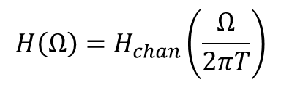
Ideal Filtering
$$s[n]$$
$$r[n]$$
=
$$s[n]$$
$$r[n]$$
DAC
$$p_{tx}(t)$$
$$h_{chan}(t)$$
$$p_{rx}(t)$$
ADC
$$H(Ω)$$
Assume TX and RX filters are ideal
Theorem: DT equivalent channel is the re-scaled continuous-time channel
Frequency $f$ mapped to $Ω=2πTf$
$$H\left(Ω\right)=H_{chan}\left(\frac{Ω}{2πT}\right)$$

Slide 22
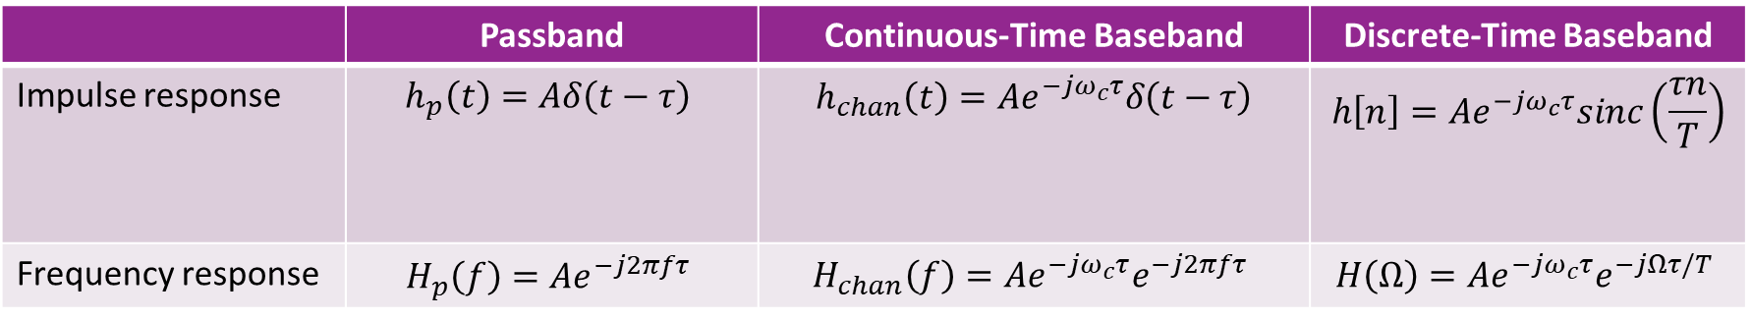
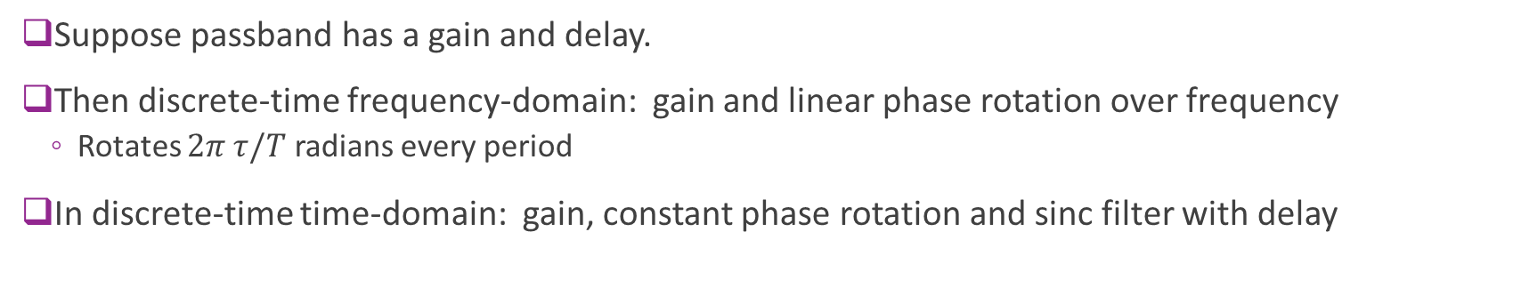
Special Case: Delay
 | Passband | Continuous-Time Baseband | Discrete-Time Baseband
Impulse response | $$h_{p}\left(t\right)=Aδ\left(t−τ\right)$$ | $$h_{chan}\left(t\right)=Ae^{−jω_{c}τ}δ\left(t−τ\right)$$ | $$h\left[n\right]=Ae^{−jω_{c}τ}sinc\left(\frac{τn}{T}\right)$$
Frequency response | $$H_{p}\left(f\right)=Ae^{−j2πfτ}$$ | $$H_{chan}\left(f\right)=Ae^{−jω_{c}τ}e^{−j2πfτ}$$ | $$H\left(Ω\right)=Ae^{−jω_{c}τ}e^{−jΩτ/T}$$
Suppose passband has a gain and delay.
Then discrete-time frequency-domain: gain and linear phase rotation over frequency
Rotates $2π τ/T$ radians every period
In discrete-time time-domain: gain, constant phase rotation and sinc filter with delay

Slide 23

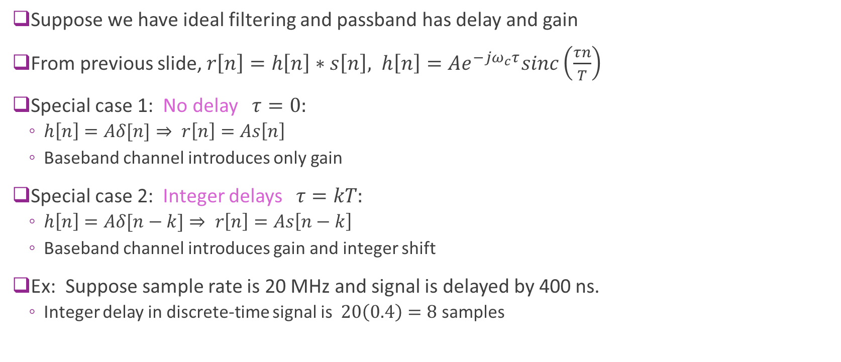





Sinc Filter with Integer Delays
Suppose we have ideal filtering and passband has delay and gain
From previous slide, $r\left[n\right]=h\left[n\right]∗s\left[n\right], h\left[n\right]=Ae^{−jω_{c}τ}sinc\left(\frac{τn}{T}\right)$
Special case 1: No delay $τ=0:$
$h\left[n\right]=Aδ[n]⇒ r\left[n\right]=As\left[n\right]$
Baseband channel introduces only gain
Special case 2: Integer delays $τ=kT:$
$h\left[n\right]=Aδ[n−k]⇒ r\left[n\right]=As\left[n−k\right]$
Baseband channel introduces gain and integer shift
Ex: Suppose sample rate is 20 MHz and signal is delayed by 400 ns.
Integer delay in discrete-time signal is $20\left(0.4\right)=8$ samples
$$A$$
$$h[n]$$
$$0$$
$$A$$
$$h[n]$$
$$k$$

Slide 24
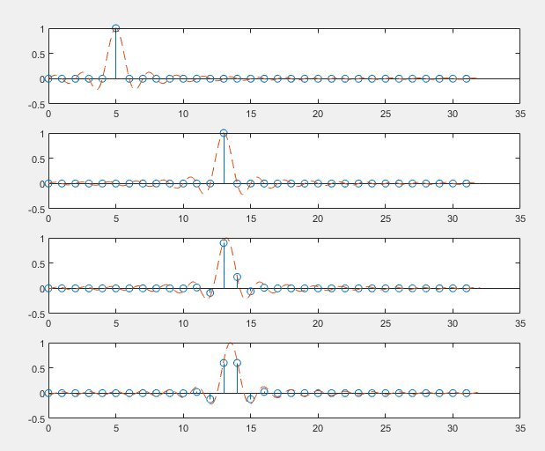





Sinc Pulses with Fractional Delay
$h\left[n\right]=Ae^{−jω_{c}τ}sinc\left(\frac{τn}{T}\right)$
Causes blurring over multiple samples
Inter-symbol interference
Will need equalization to correct
More on this later
$$τ=5$$
$$τ=13$$
$$τ=13.2$$
$$τ=13.5$$

Slide 25
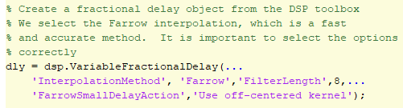

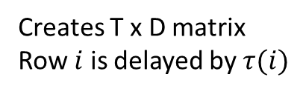
Simulating Fractional Delays in MATLAB
Code on previous slide was create with DSP toolbox
Creates T x D matrix
Row $i$ is delayed by $τ(i)$

Slide 26
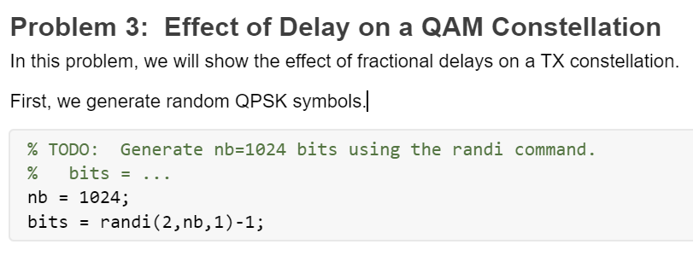
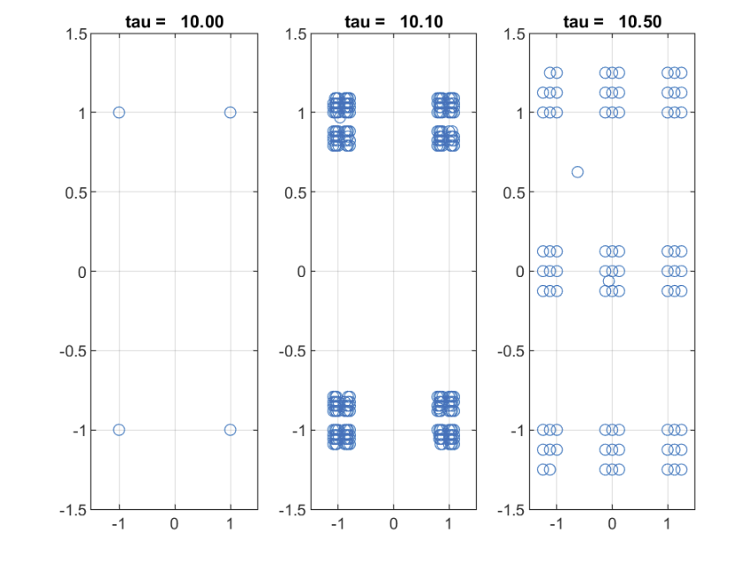
In-Class Problem: Fractional Delays on Constellations

Slide 27
Outline
Review of Up- and Downconversion
Review of TX and RX Sampling
Doppler and Multi-Path Fading
Statistical Descriptions of Fading

Slide 28
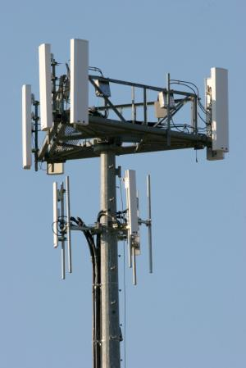

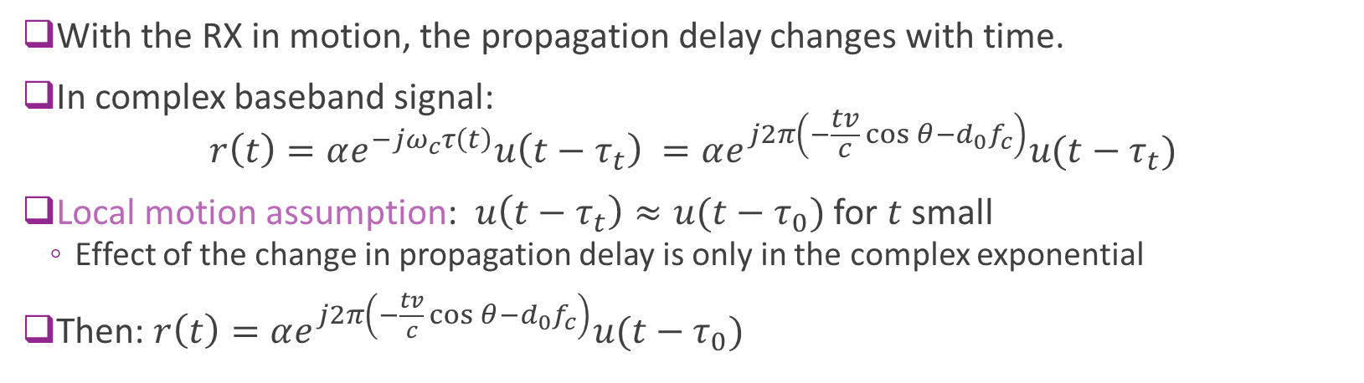
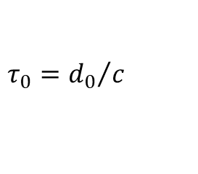

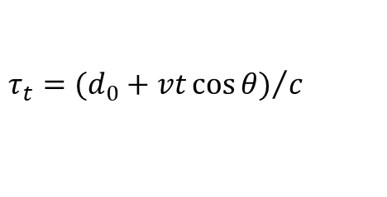

Receiver with Local Motion
$$τ_{t}={(d_{0}+vt\cos{θ)}}/c$$
Mobile velocity $v$
$$θ$$
$$τ_{0}={d_{0}}/c$$
With the RX in motion, the propagation delay changes with time.
In complex baseband signal: $r\left(t\right)=αe^{−{jω}_{c}τ\left(t\right)}u\left(t−τ_{t}\right) =αe^{j2π\left(−\frac{tv}{c}\cos{θ}−d_{0}f_{c}\right)}u(t−τ_{t})$
Local motion assumption: $u\left(t−τ_{t}\right)≈u(t−τ_{0})$ for $t$small
Effect of the change in propagation delay is only in the complex exponential
Then: $r\left(t\right)=αe^{j2π\left(−\frac{tv}{c}\cos{θ}−d_{0}f_{c}\right)}u(t−τ_{0})$

Slide 29
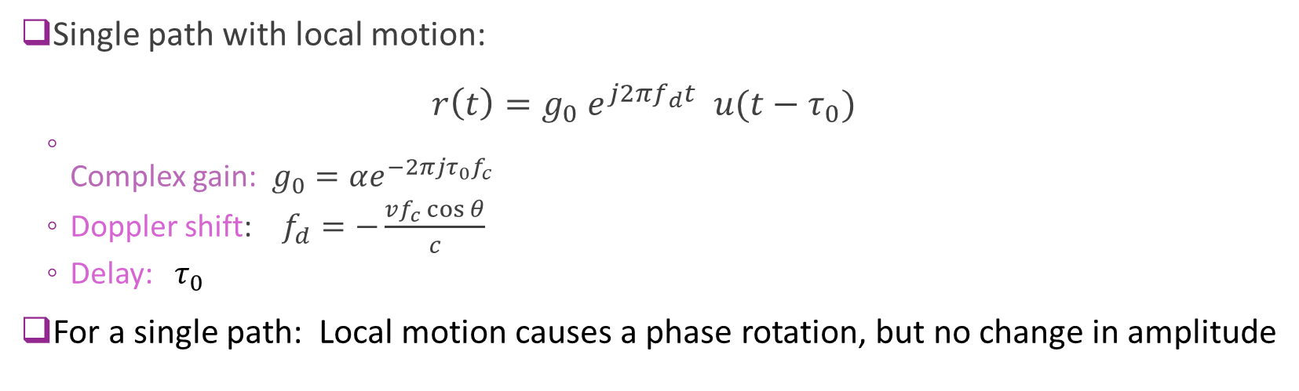


Doppler Shift
$$θ$$
Mobile velocity $v$
Single path with local motion: $r\left(t\right)=g_{0} e^{j2πf_{d}t} u(t−τ_{0})$
Complex gain: $g_{0}=αe^{−2πjτ_{0}f_{c}}$
Doppler shift: $f_{d}=−\frac{vf_{c}\cos{θ}}{c}$
Delay: $τ_{0}$
For a single path: Local motion causes a phase rotation, but no change in amplitude

Slide 30
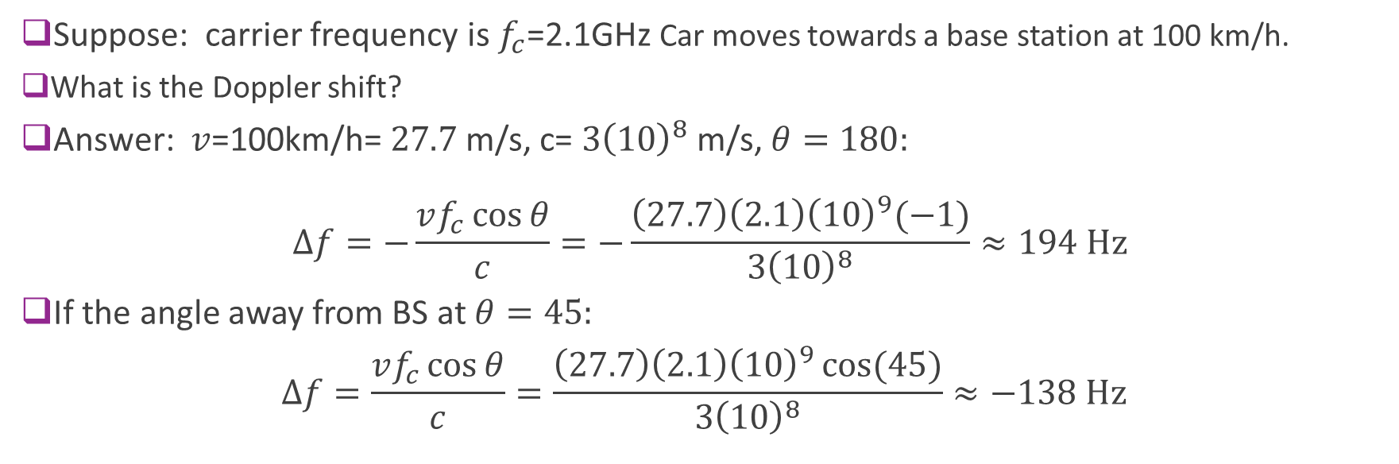


Example: Computing Doppler Shift
$v$=100 km/h
$$θ$$
Suppose: carrier frequency is $f_{c}$=2.1GHz Car moves towards a base station at 100 km/h.
What is the Doppler shift?
Answer: $v$=100km/h= $27.7$m/s, c= $3{\left(10\right)}^{8}$m/s, $θ=180:$
$$Δf=−\frac{vf_{c}\cos{θ}}{c}=−\frac{\left(27.7\right)\left(2.1\right){\left(10\right)}^{9}(−1)}{3{\left(10\right)}^{8}}≈194 \text{Hz}$$
If the angle away from BS at $θ=45:$ $Δf=\frac{vf_{c}\cos{θ}}{c}=\frac{\left(27.7\right)\left(2.1\right){\left(10\right)}^{9}\cos{(45)}}{3{\left(10\right)}^{8}}≈−138 \text{Hz}$

Slide 31
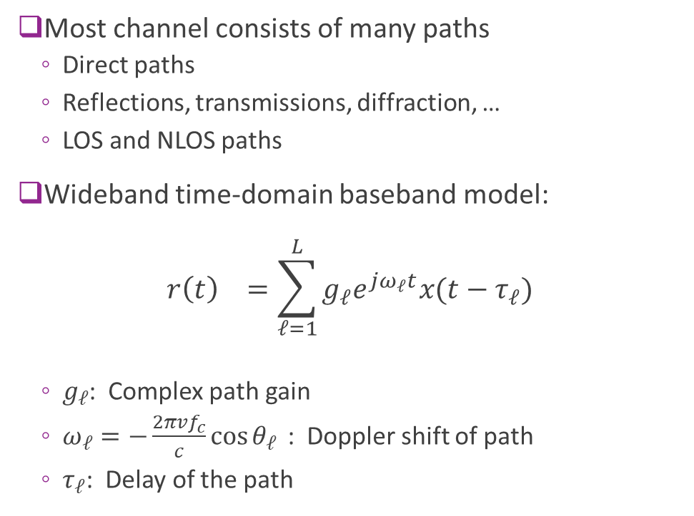

Multi-Path Models
Most channel consists of many paths
Direct paths
Reflections, transmissions, diffraction, …
LOS and NLOS paths
Wideband time-domain baseband model: $r\left(t\right) =\sum_{ℓ=1}^{L}{g_{ℓ}e^{jω_{ℓ}t}x(t−τ_{ℓ})}$
$g_{ℓ}$: Complex path gain
$ω_{ℓ}=−\frac{2πvf_{c}}{c}\cos{θ_{ℓ}}$: Doppler shift of path
$τ_{ℓ}$: Delay of the path
$$(α_{ℓ},τ_{ℓ},φ_{ℓ})$$

Slide 32
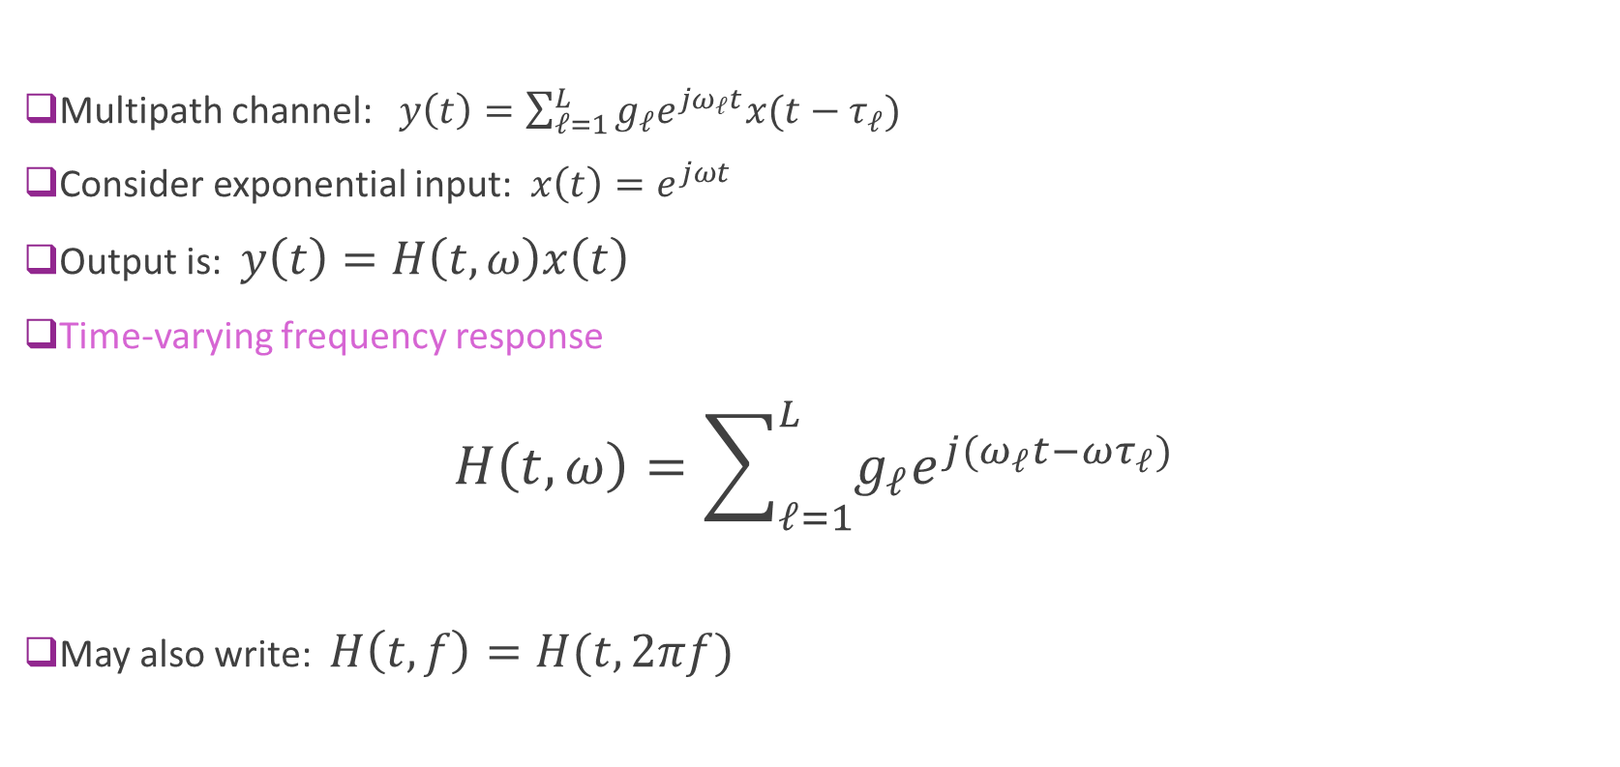
Time-Varying Frequency Response
Multipath channel: $y\left(t\right)=\sum_{ℓ=1}^{L}{g_{ℓ}e^{jω_{ℓ}t}x(t−τ_{ℓ})}$
Consider exponential input: $x\left(t\right)=e^{jωt}$
Output is: $y\left(t\right)=H\left(t,ω\right)x\left(t\right)$
Time-varying frequency response $H\left(t,ω\right)=\sum_{ℓ=1}^{L}{g_{ℓ}e^{j(ω_{ℓ}t−ωτ_{ℓ})}}$
May also write: $H\left(t,f\right)=H(t,2πf)$

Slide 33

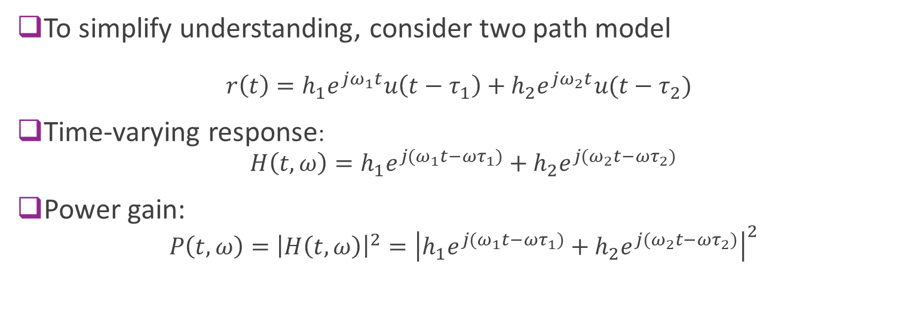


Example with Two Paths
$$τ_{1},θ_{1}$$
$$τ_{2},θ_{2}$$
To simplify understanding, consider two path model $r\left(t\right)=h_{1}e^{jω_{1}t}u\left(t−τ_{1}\right)+h_{2}e^{jω_{2}t}u(t−τ_{2})$
Time-varying response: $H\left(t,ω\right)=h_{1}e^{j{(ω}_{1}t−{ωτ}_{1})}+h_{2}e^{j{(ω}_{2}t−{ωτ}_{2})}$
Power gain: $P\left(t,ω\right)={\left|H\left(t,ω\right)\right|}^{2}={\left|h_{1}e^{j{(ω}_{1}t−{ωτ}_{1})}+h_{2}e^{j{(ω}_{2}t−{ωτ}_{2})}\right|}^{2}$
$$ω_{i}=−2 πf_{dmax}\cos{θ_{i}}$$

Slide 34
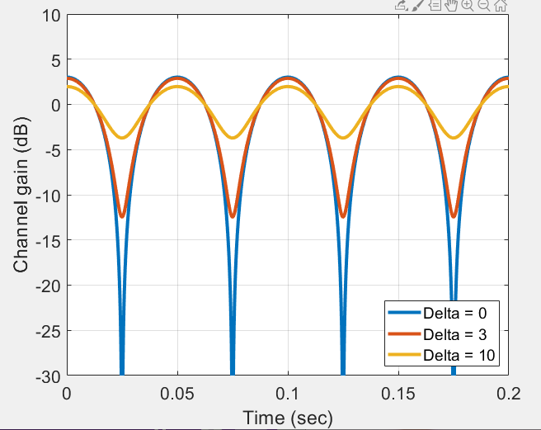

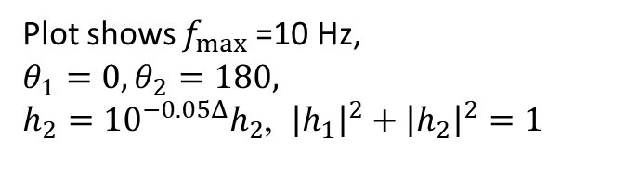
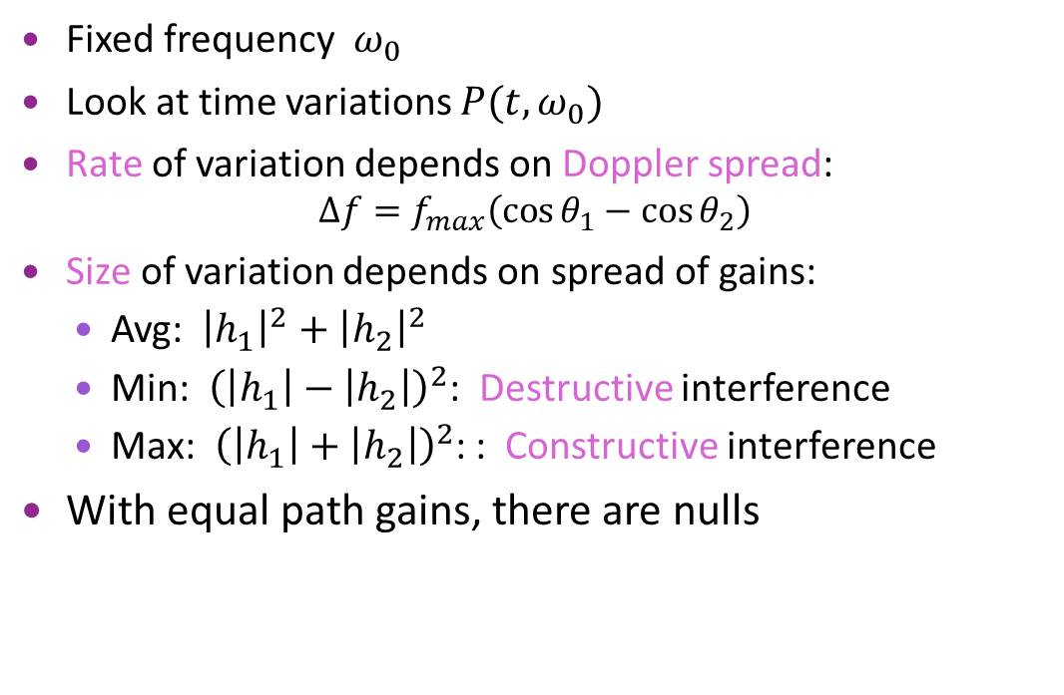
Variation in Time
$$P\left(t,ω_{0}\right)={\left|h_{1}e^{j{(ω}_{1}t+φ_{1})}+h_{2}e^{j{(ω}_{2}t+φ_{2})}\right|}^{2}$$
Fixed frequency $ω_{0}$
Look at time variations $P(t,ω_{0})$
Rate of variation depends on Doppler spread: $Δf=f_{max}\left(\cos{θ_{1}−\cos{θ_{2}}}\right)$
Size of variation depends on spread of gains:
Avg: ${\left|h_{1}\right|}^{2}+{\left|h_{2}\right|}^{2}$
Min: ${\left(\left|h_{1}\right|−\left|h_{2}\right|\right)}^{2}$: Destructive interference
Max: ${\left(\left|h_{1}\right|+\left|h_{2}\right|\right)}^{2}$: : Constructive interference
With equal path gains, there are nulls
Plot shows $f_{max}⁡$=10 Hz, $θ_{1}=0, θ_{2}=180,$ $h_{2}={10}^{−0.05Δ}h_{2}$, ${\left|h_{1}\right|}^{2}+$ ${\left|h_{2}\right|}^{2}=1$

Slide 35
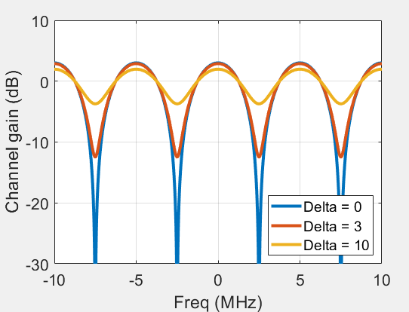



Variation in Frequency
$$P\left(t_{0},ω\right)={\left|h_{1}e^{j(ωτ_{1}+φ_{1})}+h_{2}e^{j(ωτ_{2}+φ_{2})}\right|}^{2}$$
Fixed frequency $t_{0}$
Look at time variations $P(t,ω_{0})$
Period of variation depends on delay spread: $Δf=\frac{1}{τ_{2}−τ_{1}}$
Size of variation depends on spread of gains:
Avg: ${\left|h_{1}\right|}^{2}+{\left|h_{2}\right|}^{2}$
Min: ${\left(\left|h_{1}\right|−\left|h_{2}\right|\right)}^{2}$
Max: ${\left(\left|h_{1}\right|+\left|h_{2}\right|\right)}^{2}$
Plot shows $τ_{1}=0, τ_{2}=200$ ns, $h_{2}={10}^{−0.05Δ}h_{2}$, ${\left|h_{1}\right|}^{2}+$ ${\left|h_{2}\right|}^{2}=1$

Slide 36

Fading
Over time and frequency, paths can either
Constructively interfere $⇒$ Peaks
Destructively interfere $⇒$ Nulls
Process is called fading
Intermittent channel quality
One of the most significant challenges in wireless
Later, we will discuss how to overcome fading

Slide 37











Narrowband Approximation
Multi-path channel: $r\left(t\right) =\sum_{ℓ=1}^{L}{g_{ℓ}e^{jω_{ℓ}t}x(t−τ_{ℓ})}$
Define delay spread: $δ=\max_{ℓ}{|τ_{ℓ}−τ_{0}|}$
Max path difference in seconds
Narrowband approximation: $X(f)$ is band-limited to $\left|f−f^{0}\right|≪\frac{1}{2δ}$ then $r\left(t\right)≈H(t,f^{0})x\left(t−τ_{0}\right)$
Proof below
Coherence bandwidth $=\frac{1}{2δ}$
Effective single path gain: $\overline{g}\left(t\right)=H\left(t,f^{0}\right)=\sum_{ℓ=1}^{L}{g_{ℓ}e^{jω_{ℓ}t−jω^{0}τ_{ℓ}}}$:
Channel appears as a single path channel with time-varying gain
Channel gain $\overline{g}\left(t\right)$is band-limited to max Doppler $\max_{ℓ}{ω_{ℓ}}$
$$g_{1}$$
$$g_{0}$$
$$g_{2}$$
$$τ_{0}$$
$$τ_{1}$$
$$τ_{2}$$
$$δ$$
$$\overline{g}\left(t\right)$$
$$τ_{0}$$

Slide 38




Example: 3GPP Cluster Delay Line Model
3GPP has several deterministic multi-path models
Called Cluster-Delay Line (CDL)
Can be downloaded in MATLAB 5G Toolbox
Gives the gain, delay and angles of each path
This ex: CDL-C with 24 paths
Path delay profile
Path AoA azimith profile

Slide 39






Computing the Doppler of Each Path
Computing the Doppler shift of each path
Suppose that RX has velocity vector $v=(v_{x},v_{y},v_{z})$
Doppler shift of path $ℓ$ is: $f_{ℓ}=−\frac{f_{c}}{c}v^{T}u_{ℓ}=−\frac{f_{c}}{c}\left\|v\right\|\cos{θ_{ℓ}}$
In this simulation: $v=30$ m/s in x-axis
Direction of arrival vector $u_{ℓ}$
$$θ_{ℓ}$$
RX velocity $v$

Slide 40



Computing the Narrowband Response
Narrowband response $H\left(t,f^{0}\right)=\sum_{ℓ=1}^{L}{g_{ℓ}e^{jω_{ℓ}t−jω^{0}τ_{ℓ}}}$
Plot at $f^{0}=0$ and 1 MHz
Max Doppler $f_{dmax}≈200$ Hz
See fast variation on order $\frac{1}{f_{dmax}}=5$ ms
Can see deep fades

Slide 41

Narrowband Approximation Proof
Want to show: If $X(f)$ band-limited to $\left|f−f^{0}\right|≪\frac{1}{2δ}$ then $r\left(t\right)≈H(t,f^{0})x\left(t−τ_{0}\right)$
Prove this for $f^{0}=0$. Other frequencies are similar.
Thus, $X(f)$ is bandlimited to $\left|f\right|≤\frac{1}{2δ}$.
Therefore,$x\left(s_{1}\right)≈x\left(s_{2}\right) for \left|s_{1}−s_{2}\right|≤δ$
In particular $x\left(t−τ_{i}\right)≈x(t−τ_{0})$ since $\left|τ−τ_{0}\right|≤δ$
Hence:
$$r\left(t\right)=\sum_{ℓ=1}^{L}{g_{ℓ}e^{jω_{ℓ}t)}x(t−τ_{ℓ})}≈\sum_{ℓ=1}^{L}{g_{ℓ}e^{jω_{ℓ}t}x\left(t−τ_{0}\right)}$$ $=H(t,0)x\left(t−τ_{0}\right)$
$$g_{1}$$
$$g_{0}$$
$$g_{2}$$
$$τ_{0}$$
$$τ_{1}$$
$$τ_{2}$$
$$δ$$
$$\overline{g}\left(t\right)$$
$$τ_{0}$$

Slide 42



Examples: When is Narrowband Valid?
Bluetooth
Bluetooth hops over channels of bandwidth $B=$1 MHz each.
Indoor delay spread typically $≪50$ns
Coherence bandwidth $\frac{1}{δ}=\frac{1}{50}=20$ MHz$≫$ B
Narrowband approximation valid
LTE outdoor cellular system
A typical channel is $B=$20 MHz
Outdoor delay spread $δ≈1 μs$
Coherence bandwidth $\frac{1}{δ}=\frac{1}{1}=1$ MHz $≪$ B
Narrowband approximation not valid

Slide 43



OFDM Time-Frequency Grid
Subcarrier spacing $Δf=\frac{1}{T}$
OFDM modulation: Widely-used method
4G and 5G cellular systems
Many 802.11 standards
Divide channel into sub-carriers and OFDM symbols
Resource element: One time-frequency point
Data is transmitted is an array: $X\left[n,k\right]$
$k=$ OFDM symbol index
$n$ = subcarrier index
One complex value per RE.
Called a modulation symbol
See digital communication class
We will also review again when we discuss equalization
Frequency
OFDM symbol $T_{sym}$
Time

Slide 44

OFDM Channel with Fading
OFDM channel acts as multiplication: Under normal operation (delay spread is contained in CP): $Y\left[k,n\right]=H\left[k,n\right] X[k,n]$
OFDM channel gains can be computed from the multi-path components $H\left[k,n\right]=\sum_{ℓ=1}^{L}{\sqrt{E_{ℓ}}e^{−2πj (Tkf_{ℓ}+Snτ_{ℓ}+φ_{ℓ})}}$
$T=$ OFDM symbol time, $S=$ sub-carrier spacing
For each path: $f_{ℓ}=$Doppler shift, $τ_{ℓ}=$Delay, $φ_{ℓ}=$ phase of path, $E_{ℓ}=$ path received energy
RX symbols
Channel
TX symbols

Slide 45

Summary
Single path with no motion:
Delay and constant phase shift
Local motion in single path causes Doppler
A time-varying phase rotation
But channel gain is constant
Multiple paths causes fading
Constructive and destructive interference of paths
Variation in gain over time
Described by a time-varying frequency response $H\left(t,f\right)$
Variations is time due to Doppler spread
Variations in frequency due to delay spread

Slide 46


In-Class Exercise: OFDM Channel Response

Slide 47
Outline
Review of Up- and Downconversion
Review of TX and RX Sampling
Doppler and Multi-Path Fading
Statistical Descriptions of Fading

Slide 48


Statistical Model
Fading depends on the multipath distribution
Multipath is site-specific
Statistical model:
Describes a probability distribution of channels
Trained on an ensemble of channels in some environment
Used in evaluation of communication system
Example questions:
How well does a system do on average?
What is the probability that I will obtain sufficient coverage?

Slide 49


Random Path Statistical Model
RX signal has many random, independent paths
Time-varying frequency response: $h\left(t,f\right)=\frac{1}{\sqrt{L}}\sum_{ℓ=1}^{L}{g_{ℓ}e^{2πi(tf_{d}\cos{θ_{ℓ}}+fτ_{ℓ})}}$
Assume $(g_{ℓ},τ_{ℓ},θ_{ℓ}$) i.i.d.
Path gains: $g_{ℓ}$ are zero mean and $E{\left|g_{ℓ}\right|}^{2}=G_{0}$
As $L→∞$, $h(t,f)$ is a complex Gaussian, $h\left(t,f\right)\sim CN(0,G_{0})$
Follows from Central Limit Theorem
Independent real and imaginary components
$G_{0}$: Average power gain
Variance ${G_{0}}/2$ for real and imaginary components
$$g_{ℓ},τ_{ℓ},θ_{ℓ}$$
Direction of motion

Slide 50


Rayleigh Distribution
Rayleigh fading: Channel response is $h\left(t,f\right)\sim CN\left(0,G_{0}\right)$
Let $R=|h|$ magnitude
Represents amplitude gain
Has Rayleigh distribution:
PDF: $p\left(r\right)=\frac{2r}{P}e^{−{r^{2}}/P}$
CDF: $P\left(R≤r\right)=1−e^{−{r^{2}}/P}$
Mean: $E\left(R\right)= \sqrt{\frac{G_{0}π}{2}}$
Second moment: $ER^{2}=G_{0}$
Probability distribution
https://en.wikipedia.org/wiki/Rayleigh_distribution

Slide 51



Exponential Distribution
Consider Rayleigh fading complex gain $h\sim CN(0,G_{0})$
Magnitude $R=|h|$ is Rayleigh $P\left(R≥r\right)=e^{{−r^{2}}/{G_{0}}}$
Instantaneous gain $G={\left|h\right|}^{2}$ has exponential distribution $P\left(G≥g\right)=P\left(R≥\sqrt{g}\right)=e^{{−g}/{G_{0}}}$
Average gain is $E\left(G\right)=E{\left|h\right|}^{2}=G_{0}$
For channel, $G$ represent power gain (in linear scale)
PDF for $λ=\frac{1}{E(G)}$

Slide 52

Example Calculation
Suppose the channel experiences Rayleigh fading.
What is probability gain will be 15 dB below the average?
Called a 15 dB fade.
Answer:
Gain is 15 dB below average when $G≤{10}^{−0.1\left(15\right)}G_{0}$
From exponential distribution: $P\left(G≤βG_{0}\right)=1−e^{−{βG_{0}}/{G_{0}}}=1−e^{−β}$
For small $β$, $P\left(G≤βG_{0}\right)≈β$
For 15 dB fade, $β={10}^{−0.1(15)}≈0.032.$

Slide 53

Doppler Spectra
Consider statistical model: $h\left(t,f\right)=\frac{1}{\sqrt{L}}\sum_{ℓ=1}^{L}{g_{ℓ}e^{2πi(tf_{d}\cos{θ_{ℓ}}+fτ_{ℓ})}}$
Paths are i.i.d. and $g_{ℓ}$ are zero mean, $E{\left|g_{ℓ}\right|}^{2}=G_{0}$
Assume $L$ is large
For a given $(t,f)$, complex gain $h\left(t,f\right)\sim CN(0,G_{0})$
As varies $(t,f)$, $h\left(t,f\right)$ is a Gaussian random process
Auto-correlation: $R\left(δt,δf\right)=E\left[h\left(t,f\right)h^{∗}\left(t+δt,f+δf\right)\right]$ $=G_{0} E\left\{e^{2πi(δtf_{d}\cos{θ_{ℓ}}+δfτ_{ℓ})}\right\}$
Describes how correlated the process is over time and frequency
Depends on the distribution of angles $θ_{ℓ}$ and delays $τ_{ℓ}$

Slide 54



Jakes Model
At a fixed frequency $f_{0}$: $h\left(t,f_{0}\right)=\frac{1}{\sqrt{L}}\sum_{ℓ=1}^{L}{g_{ℓ}e^{2πi(tf_{d}\cos{θ_{ℓ}}+f_{0}τ_{ℓ})}}$ $=\frac{1}{\sqrt{L}}\sum_{ℓ=1}^{L}{g_{ℓ}^{′}e^{2πitf_{d}\cos{θ_{ℓ}}}}$
Complex Gaussian process
Statistics depend on angular distribution
Jakes model:
Angles uniform from $[0,2π]$
Asymmetric Jakes:
$θ∈[θ_{1},θ_{2}]$ uniform
Angular spread:
Arises from diffuse reflection
Gain (dB)
Angle (rads)
Jakes
Angles unif $[0,2π]$
Asym Jakes
$\cos{θ}∈[0.9,1]$
Asym Jakes
$\cos{θ}∈[−0.1,0.1]$

Slide 55

Fading Models in MATLAB
Comm Toolbox:
Efficient, general fading models
Create a comm.RayleighChannel object
Run the channel to get:
Output and gain

Slide 56


Auto-Correlation
Fix a frequency $f_{0}$ and consider auto-correlation over time: $R(δt)=E\left[h\left(t,f_{0}\right)h^{∗}\left(t+δt,f_{0}\right)\right]=G_{0} E\left\{e^{2πi(δtf_{d}\cos{θ_{ℓ}})}\right\}$
Expectation is over angle $θ_{ℓ}$
Depends on distribution of $θ_{ℓ}$
Plot: $R(δt)$ for $θ$ uniform in $\left[−θ_{m},θ_{m}\right]$
Computed numerically in MATLAB (see demo)
Plotted vs normalized delay $f_{d}δt$
For $θ_{m}={180}^{∘}⇒$ Jakes spectra
Uncorrelated at $δt≈\frac{1}{2f_{d}}$
As angular distribution is smaller:
Correlation is higher with delay
Highly directional channel vary slower

Slide 57


Computing Auto-Correlation Numerically
Correlation in previous slide $R(δt)=G_{0} E\left\{e^{2πi(δtf_{d}\cos{θ_{ℓ}})}\right\}$
Expectation is over angle $θ_{ℓ}$
Generally, no analytic solution
Compute via numerical integration
See demo

Slide 58


Coherence Time and Frequency
Consider time varying frequency response $H\left(t,f\right)$
Coherence time:
Max interval $Δt$ where $H\left(t,f\right)≈H\left(t+Δt,f\right)$
How fast channel changes in time
Related to Doppler spread$≈\frac{1}{f_{max}−f_{min}}$
Coherence bandwidth
Max interval $Δf$ where $H\left(t,f\right)≈H\left(t,f++Δf\right)$
How fast channel changes in frequency
Related to delay spread$≈\frac{1}{τ_{max}−τ_{min}}$
Critical for many procedures:
Channel estimation, tracking, coding, ARQ, …
More on this later
Realization of a Jakes process with 1/f_{max} = 0.1 sec

Slide 59
Winner-3GPP-Spatial Cluster Model
From 3GPP SCM-132
Paths arrive in clusters.
Clusters have subpaths (also called rays)
Each cluster has:
Center angle and a statistical model for the delay and angular spread

Slide 60
Fading at Different Time Scales
Three mechanisms for path loss variations
Distance-based path loss
Shadowing
Small-scale multi-path fading
Slower
Faster
From Goldsmith, “Wireless Communications”

Slide 61
Fading at Different Scales Models
Source of variation | Mathematical model | Typical spatial coherence | Typical temporal coherence
Small-scale fading from multi-path fading | Rayleigh or Rician distribution | ~ 1 wavelength | 15 ms (v=10m/s, fc=2GHz)
Large-scale fading from variations in shadowing | Lognormal distribution | 10 to 100 m | 1 to 10 sec
Path loss variations | Path loss exponent | 100 m or larger | 10 sec
Different fading processes and variations occur at much different time / space scales
Methods to combat these are different

