Slide 1
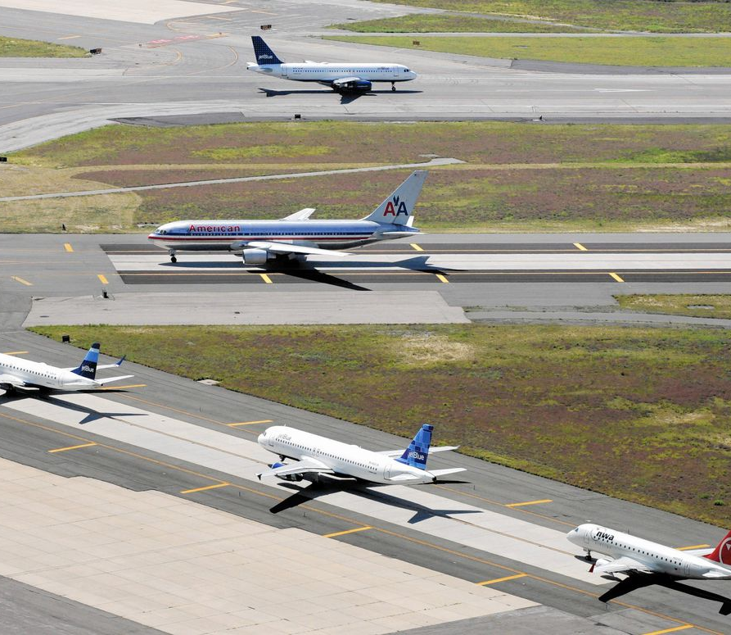
Aircraft Taxi Route Scheduling
Fatih Selim YAKAR
CSE424
Optimization Term Project
Instructor:
Prof. Dr. Fatih Erdoğan SEVİLGEN

Slide 2
CoNTENT
PROJECT DESCRIPTION
optimization problem definition
Population Based Algorithm (GA)
Trajectory based algorıthm (sa)
Tests and Hyperparameter Optimization
Comparison
References

Slide 3
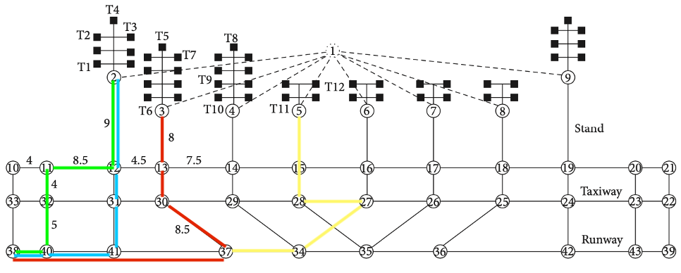

Project descrıptıon
At the airport, until the flight takes off, there are operations such as the aircraft landing on the runway and going to the parking lot and going to the runway from the parking lot. The displacement that takes place outside of this flight is called a taxi. In this problem, we are trying to find the shortest total time for the taxi process that starts for more than one aircraft at the same time.

Slide 4
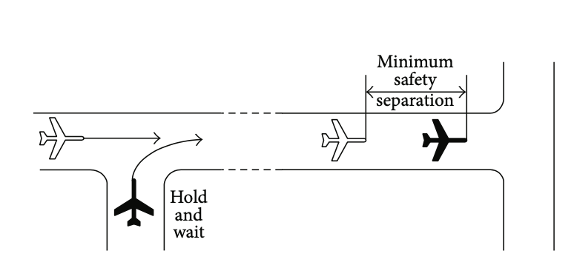
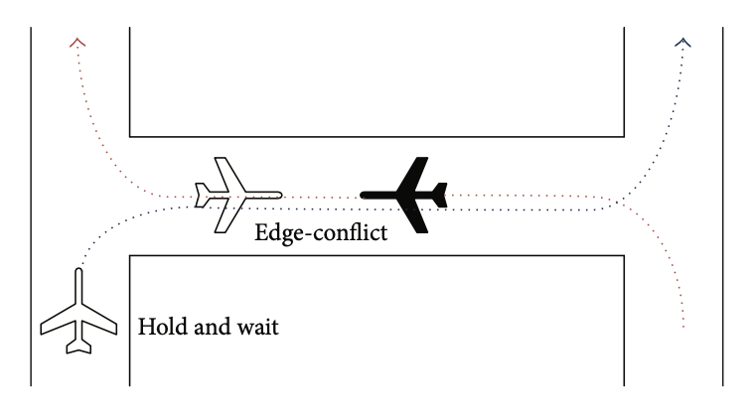
Node Conflict
Node-conflict happens when two or more than two aircrafts taxi through a common node without keeping the minimum safety separation
Edge Conflict
Edge-conflict happens when two or more than two aircrafts taxi through the common segment but with opposite direction. One aircraft must hold and wait at the entrance node if the minimum safety separation is not satisfied

Slide 5
Three assumptions are made for the model:
Generally, all the aircrafts taxi at the same maximum speed.
When it is likely to conflict, aircrafts can adjust speed rapidly. So the acceleration is ignored.
When node-conflict happens, hold and wait strategy is always efficient whether the aircraft is large or small.

Slide 6
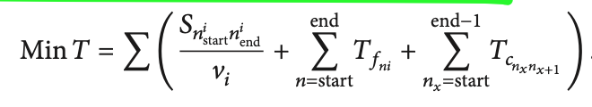
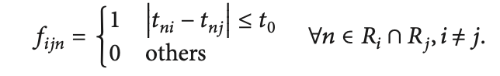
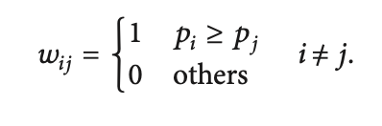
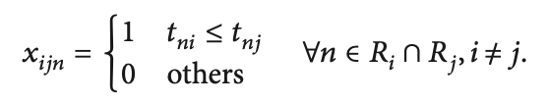
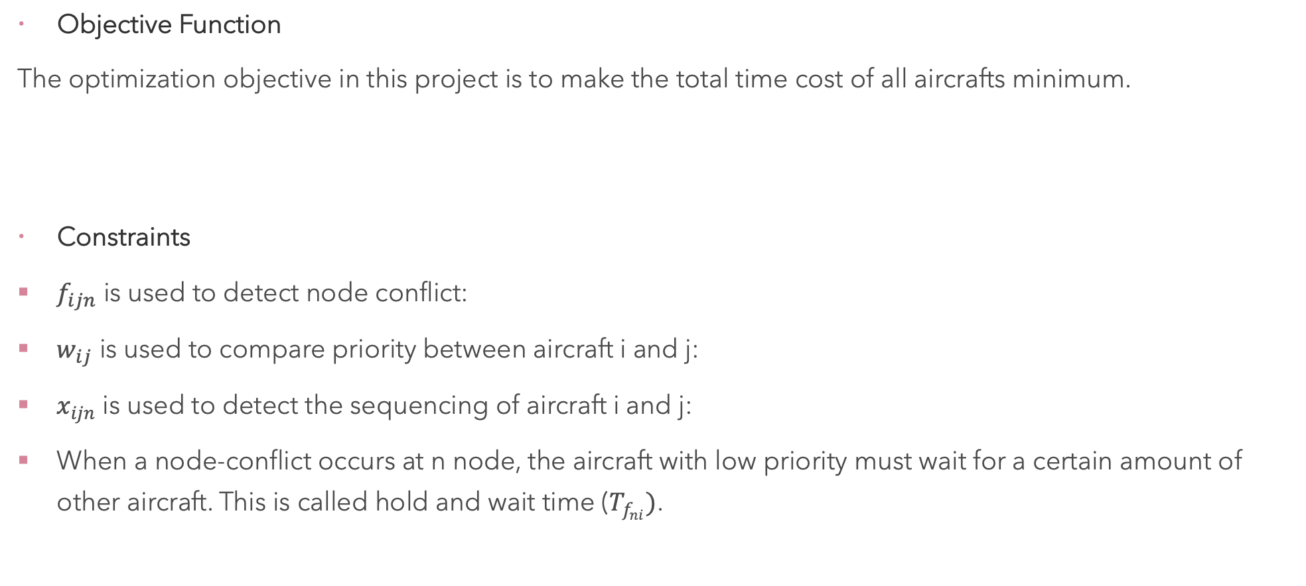
optimization problem definition
Objective Function
The optimization objective in this project is to make the total time cost of all aircrafts minimum.
Constraints
$f_{ijn}$ is used to detect node conflict:
$w_{ij}$ is used to compare priority between aircraft i and j:
$x_{ijn}$ is used to detect the sequencing of aircraft i and j:
When a node-conflict occurs at n node, the aircraft with low priority must wait for a certain amount of other aircraft. This is called hold and wait time ($T_{f_{ni}})$.

Slide 7
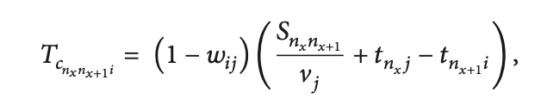
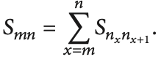
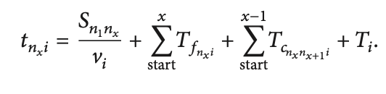


Constraints (Continues)
When a edge-conflict occurs at n node, the aircraft with low priority must wait for a certain amount of other aircraft. This is called hold and wait time ($T_{c_{n_{x}n_{x+1}i}})$.
$S_{mn}$, the path length from node m to node n:
The time of arrival at node $n_{x},t_{n_{x }i}$:
The minimum safety time constraint:

Slide 8
Population Based Algorithm (Genetic Algorithm)
Solution Representation
Have an airport in the form of graph. At this airport, 2 planes will taxi between 5-1 nodes and 2 planes between 1-5 nodes at the same time. In this case, the solution demonstration is as follows. -1 was used as the padding character.
Cost Of A Solution
The program calculates the time taken for all taxiways in the chromosome, taking into account edge conflicts and node conflicts. So it calculates the objective function.

Slide 9
Initial Solution Generation:
Path pools were created using DFS separately for the requested source and destination. It was creating a solution by choosing a random path among these pools. For example, there are planes that want to go between 1-7 and 9-2.
First of all, a pool is created by searching the paths containing 1 as source and 7 as destinations with DFS. A random path is then chosen. This path is 1,8,7.
Then, a pool is created by searching the paths containing 9 as source and 2 as destinations by DFS. A random path is then chosen. This path is 9,3,2.
Finally, these two paths are combined using the -1 pad and an initial solution is created.
1 | 8 | 7 | -1 | 9 | 3 | 2 | -1

Slide 10
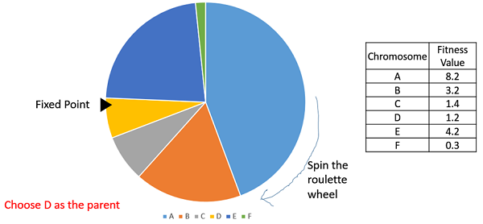
Population Generation:
The chromosome was created and added together with the method used to create the initial solution in random order as much as the population size considered as a hyperparameter.
Mating Pool/Population Selection:
Roulette wheel selection is used. Fitness was found with the 1/objective function.

Slide 11
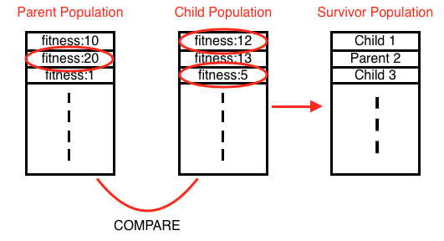
Survivor selection:
Survivors were selected by choosing the best choice for each chromosome value as a result of the comparisons.

Slide 12
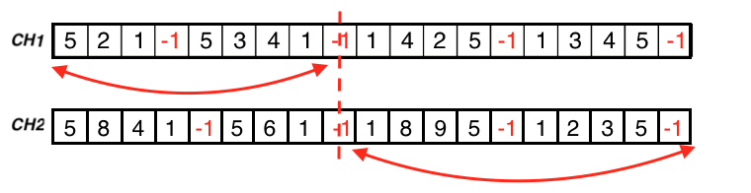
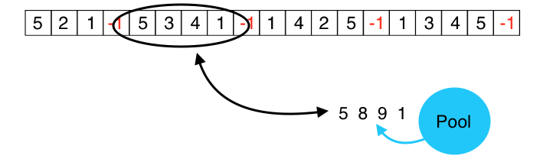
Crossover:
Each taxiway was considered as a gene and a 1 point crossover was applied.
Mutation
A randomly selected taxiway path and a randomly selected path from the pool created for the initial solution were changed.

Slide 13
Trajectory Based Algorithm (Sımulated annealıng)
Solution Representation For This Problem:
Same method used as GA (-1 padding)
Cost Of A Solution:
The objective function was used as in GA.
Initial Solution Generation:
Same method used as GA. Path pools were created using DFS separately for the requested source and destination. It was creating a solution by choosing a random path among these pools. For example, there are planes that want to go between 1-7 and 9-2.
1 | 8 | 7 | -1 | 9 | 3 | 2 | -1

Slide 14
Neighborhood:
A randomly selected taxiway path and a randomly selected path from the pool created for the initial solution were changed.

Slide 15
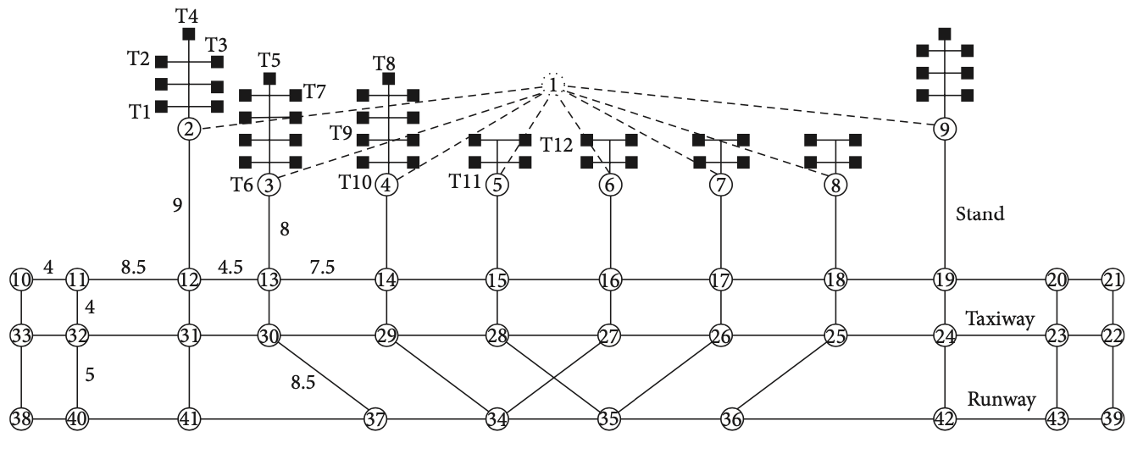
Tests and Hyperparameter Optimization
Used Graph →
1 unit: 75m
Speed of Aircraft: 36km/h
Minimum Safety Time: 30sec
Flight no. | Source | Destination | Priority
MU5178 | 2 | 38 | 4
CZ3118 | 2 | 38 | 4.5
CZ6218 | 3 | 38 | 4.5
MU2078 | 4 | 38 | 4
CA1605 | 3 | 38 | 5
CA1802 | 37 | 2 | 3.5
MF8115 | 37 | 4 | 3
HU7196 | 37 | 5 | 2.5
GS6574 | 37 | 5 | 2
Used Scheduling Problem →

Slide 16
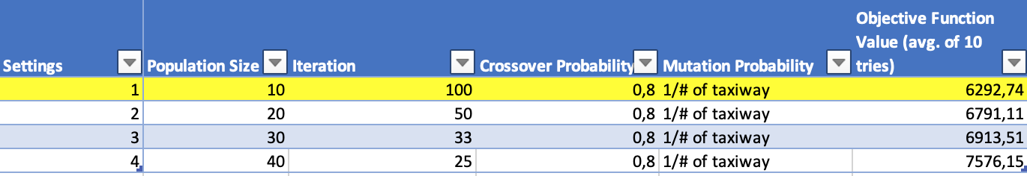
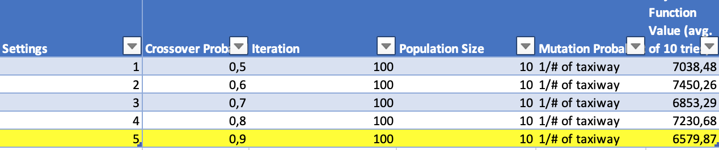
GA Hyperparameter Tests
Population size:10-40
Crossover Probability: 0.5-0.9

Slide 17
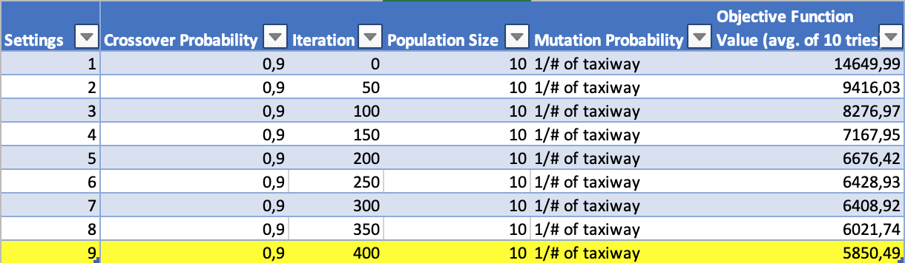
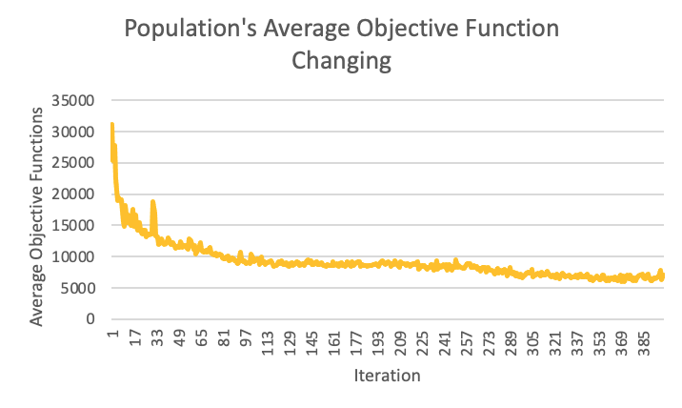
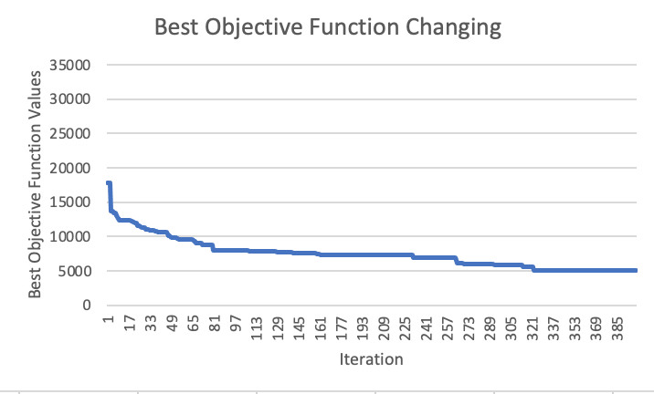
Iteration Size: 0-400
Result: Population size: 10, crossover probability: 0.9, iteration size: 400, mutation probability: 1/taxiway #.

Slide 18
SA Hyperparameter Tests
Initial Temperature
The objective function value of the solution determined as the initial solution was used as the Initial temperature.
Reheat Cooling Coefficient
The constant was set at 0.9.
Coldest Temperature
0.05 was used as the coldest temperature. The reason why this coldest temperature is lower than normal is to make a little more intensification.

Slide 19
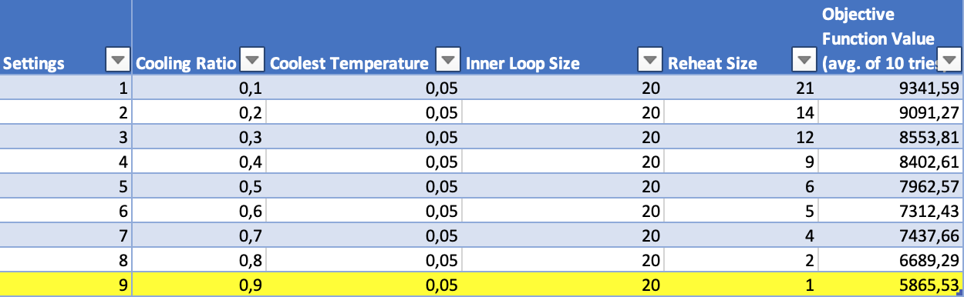
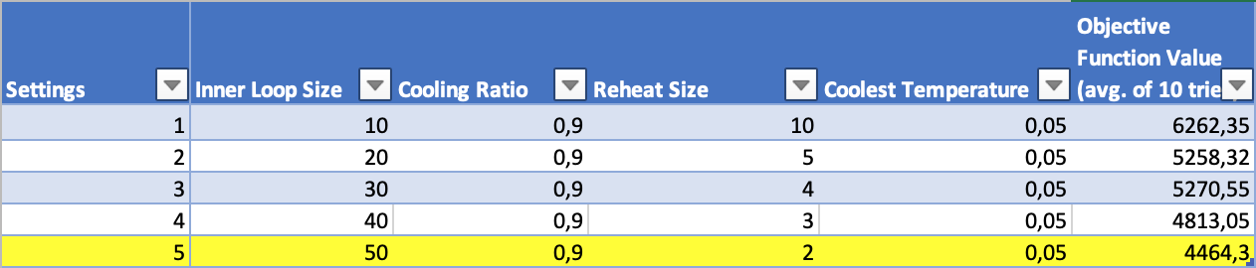
Cooling Coefficient:0.1-0.9
Inner Loop: 10-50

Slide 20
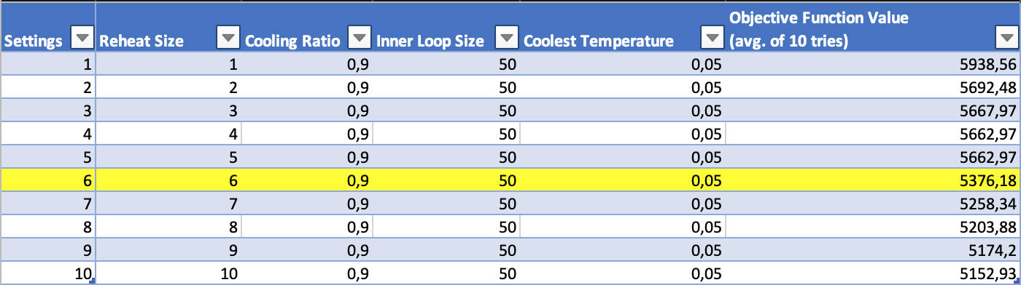
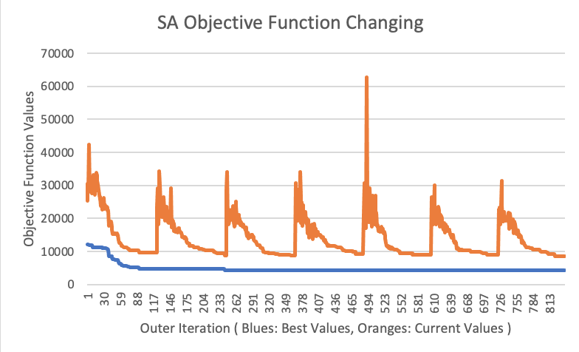
Reheat Size:1-10
Result: Cooling coefficient: 0.9, Inner loop size: 50, coldest temperature: 0.05, reheat size: 6.

Slide 21
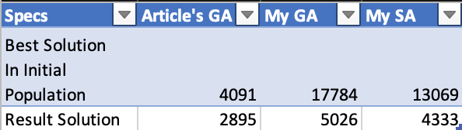
COMPARISON
In the written GA and SA, the problem mentioned in the article and developed was used. However, since the initial solutions given by the article are much better than the initial solutions we use, they did not achieve good results. But improvements have been achieved in the following table.

Slide 22
REFERENCES
Una Benlic ,Alexander E.I. Brownlee , Edmund K. Burke, Heuristic search for the coupled runway sequencing and taxiway routing problem,Transportation Research Part C, (2016).
Xuan Wang, and Qinghai Zuo, Aircraft taxiing route planning based on airport hotspots, AIP Conference Proceedings 1839, (2017).
Yu Jiang, Zhihua Liao, and Honghai Zhang. A Collaborative Optimization Model for Ground Taxi Based on Aircraft Priority , Hindawi Publishing Corporation Mathematical Problems in Engineering Volume 2013, (2013).
Yu Jiang, Xinxing Xu, Honghai Zhang, and Yuxiao Luo. Taxiing Route Scheduling between Taxiway and Runway in Hub Airport, Hindawi Publishing Corporation Mathematical Problems in Engineering Volume 2015, (2015).
Prof.Dr. Fatih Erdoğan Sevilgen. Optimization(CSE424), Course Presentations, (2021)

