Slide 1



PROJECT – I CARS
CME1252 – PROJECT BASED LEARNING - II
BY:
2015510134 | Safa Çevik
2018510110 | Büşra Turan
2019510036 | Ceren Ersöz
2019510068 | Fatih Semirgin

Slide 2
OUTLINE
INTRODUCTION
PROGRESS SUMMARY
Requirements
Task Sharing & Scheduling
Completed Tasks
Incomplete Tasks
Additional Improvements
PROBLEMS ENCOUNTERED
ALGORITHMS AND SOLUTION STRATEGIES
SCREENSHOTS
CONCLUSION
REFERENCES

Slide 3
INTRODUCTION
Purpose of this project is to create a simulation which is about a car rental company.
CENG Car Rental is a car rental company simulation that you can rent a car between three car class options which are economy, sports and luxury.
In this simulation, you can hire and fire employees, open offices wherever you want and claim your own customer populace.
In the simulation, all activities are daily based and simulation money unit is cp.
This system keeps track of offices, employees, customers, cars and other necessary structures.

Slide 4
PROGRESS SUMMARY
REQUIREMENTS
ECLIPSE IDE
JAVA SYNTAX KNOWLEDGE
OBJECT ORIENTED PROGRAMMING

Slide 5
TASK SHARING & SCHEDULING
First Week: Discussing and designing solution alternatives. Creating the necessary variables, structures. Screen.
Second Week: Class designs. Attributes/methods. Add and list commands for office/employee.
Third Week: Add and list commands for car/customer. Delete commands for office/employee.
Fourth Week: Add and list for CarRequest commands. Making contracts. listContract command.
Fifth Week: Command nextday operations (Office profits, statistics and system recommendations). Testing/Debugging.
We did each phase of Project together.

Slide 6

COMPLETED TASKS
Add and list commands for office employee car customer car request
Delete commands for offices and employees
Making and listing contracts
Nextday operations
Profits statistics
System recommendations

Slide 7
INCOMPLETED TASKS
All tasks are completed regarding the Project.

Slide 8
PROBLEMS ENCOUNTERED
Counter of employee and car
Class and method designs
NullPointerException error while displaying cars and employees array

Slide 9

ALGORITHMS AND SOLUTION STRATEGIES
We made Office’s and Customer’s add and list commands to the Company class. We made the commands to add and list cars and employees to the Office class.
In the main class, we created the object where the company’s capacities are given. And we wrote the code that calls loop.
An important point is that in the listing part, each employee id does not progress specific to Office. For example, there are two employees in the first Office. Let there be one employee in the second Office. The id of the employee in the second Office is processed as three. We kept another counter in it.
We kept the office statistics in the office class because we had to write special calculations and suggestions suitable for each office.

Slide 10
ALGORITHMS AND SOLUTION STRATEGIES (Cont’D)
We added the nextday method to the company class. We created methods in office class for statistics and profits and called these methods in command the next day. Thus, when the next day command is called, statistics and profit calculations are made. Finally, we create a company object in the main class and call the read method. Thus, the program starts to receive commands.
While typing the deleteOffice and deleteEmployee commands, instead of removing the deleted element completely, we kept it in the background by adding the phrase deleted".

Slide 11
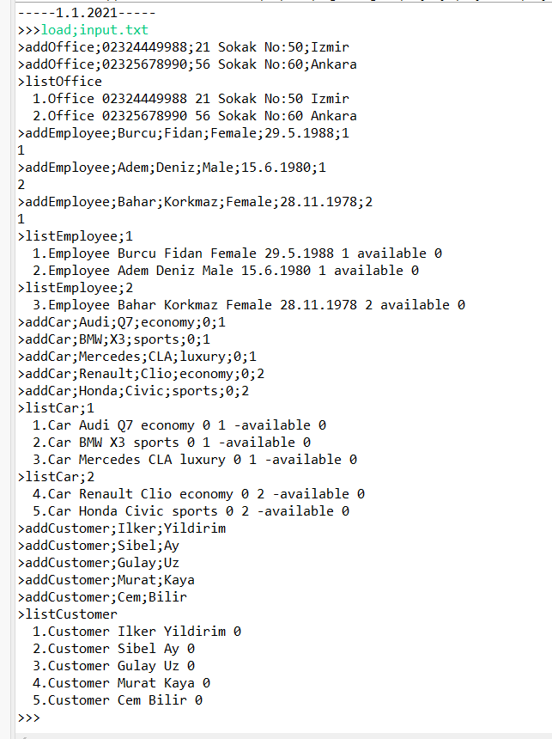
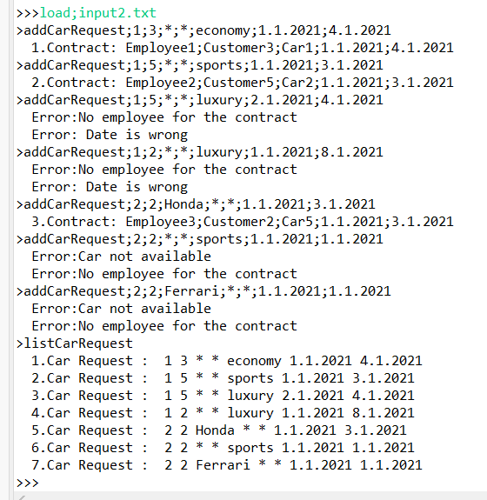
SCREENSHOTS

Slide 12
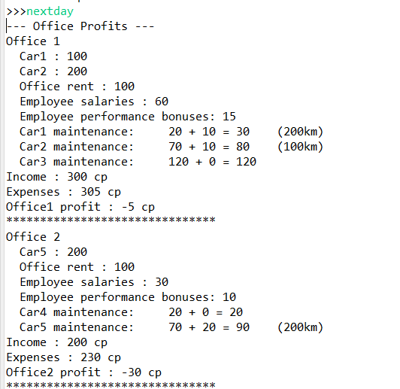
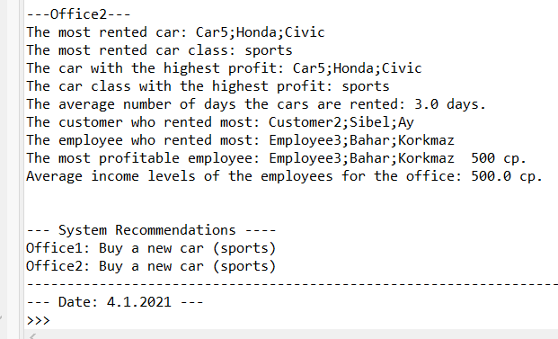
SCREENSHOTS (Cont’d)

Slide 13
CONCLUSION
We have finished our car rental system project.It was a long and busy period for us. It was a 5-week process. In the first weeks we were new to object oriented programming and java. As time passed, we made progress both in object oriented programming and in java.
As for their social contributions, we have adapted more to how the project will be carried out as a team. It was like an example to our future life.
To summarize in short, this project has contributed to us both technically and socially as we mentioned above.

Slide 14
REFERENCES
https://docs.oracle.com/javase/tutorial/essential/io/file.html
https://www.w3schools.com/java/java_oop.asp
https://stackoverflow.com/questions/19426758/basic-object-oriented-programming
https://www.canva.com/

