Slide 1
WEB SCRAPING
Scrape and analyse customer review data to uncover findings for British Airways

Slide 2
Data Collection & Cleaning
DATA COLLECTION
For a complete coverage and analysis of BA data, web scraping was done until zero reviews were left
Keeping a page size of 100, a total of 37 pages were scraped and 3568 reviews were collected
The data collected was stored in a Pandas dataframe and saved in a .csv file
DATA CLEANING
In the data cleaning step, stopwords were removed, text was converted to lowercase and unnecessary words like “Trip Verified” were removed

Slide 3
Data Analysis
TOPIC MODELING
KEY-PHRASE EXTRACTION (100 reviews)
Topic #0 : ['flight', 'ba', 'check', 'luggage', 'hours', 'staff', 'time', 'airport', 'boarding', 'london']
Topic #1 : ['flight', 'good', 'crew', 'service', 'food', 'time', 'lounge', 'cabin', 'ba', 'london']
Topic #2 : ['flight', 'ba', 'service', 'crew', 'food', 'cabin', 'staff', 'airline', 'london', 'british']
Topic #3 : ['flight', 'airways', 'british', 'ba', 'london', 'service', 'seats', 'customer', 'seat', 'booked']
Topic #4 : ['seat', 'ba', 'class', 'seats', 'business', 'food', 'economy', 'flight', 'cabin', 'club']
Topic Distribution :
4 -> 1077 , 1 -> 902 , 2 -> 593 , 0 -> 518 , 3 -> 478
['uncomfortable flight', 'conditions', 'person', 'front', 'it', 'ba', 'economy uncomfortable encourage customers', 'me', 'ba future', 'onward flight latam', '787 aircraft room rows', 'return flight santiago lights', 'cabin crew', 'service', 'curtains', 'first country trip', 'husband surprise trip monaco', 'us', '3 hours', 'flight home heathrow', 'flight', 'seattle hour', 'us', 'connecting flight', 'us', 'flight', 'food tickets type reimbursement', 'additionally sat customer service line hour half see', 'us', 'customers', 'queue', 'france airport', 'rental car desk', 'found cab', 'us', '85 euros', 'hotel', 'something', 'way', 'flight nice heathrow', '2.5 hour layover', 'flight', 'unfortunately long security lines', '1.5 hr delay', 'arriving ba closed doors', 'plane', '15mins departure', 'heathrow airport', 'security', 'us', 'back customer service queue', 'first statement', 'us', 'another airline', 'time', 'bags transferred flight delta', '8 pounds snacks', '13 hours heathrow airport', '8 pound each', 'drama', 'two bags', 'delta flight', 'file claim delta', 'last part', 'them', 'home', 'airline pointing finger', 'who', 'figure', 'luggage', '$500 reimbursement', 'bag', 'close memories stuff', 'british airways', 'delta’s baggage people', 'husband', 'seats', 'premium economy booking', 'outward journey', '12 february return', 'served food', 'choices', 'one occasion', 'available option curry', 'me', 'flights', 'undue focus curry', 'spicy food', 'us', 'poor opinion british airways', 'seattle heathrow edinburgh', 'ba', 'purchase golf shoes', 'club rentals', 'tees', 'balls', 'two courses st. andrews', 'months', 'promised bag', 'occurred expenses', 'ba state', 'toiletries', 'ba', 'notice', 'two weeks scheduled flight', 'contacted corporate travel team', 'informed ba', 'return reservation', 'flight', 'ba customer service', 'false promises', 'airlines', 'british airways’, 'flight gold members', 'three flights', 'destination', 'ba flights', 'exception', 'way destination back destination understandable extent', 'what', 'understandable prepared one flights', 'missing flight', '24h', 'accommodation', '30 hours', 'hope hotel', 'extra room', 'ba', 'them', 'ba', 'chance', 'correct mistake', 'flights', 'serious complaints', 'that', 'airline', 'excellent flight club world british airways’]

Slide 4
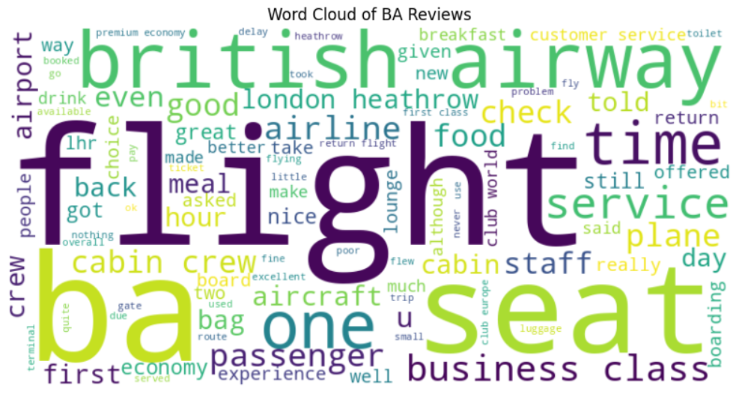
Data Analysis
WORDCLOUD VISUALIZATION

Slide 5
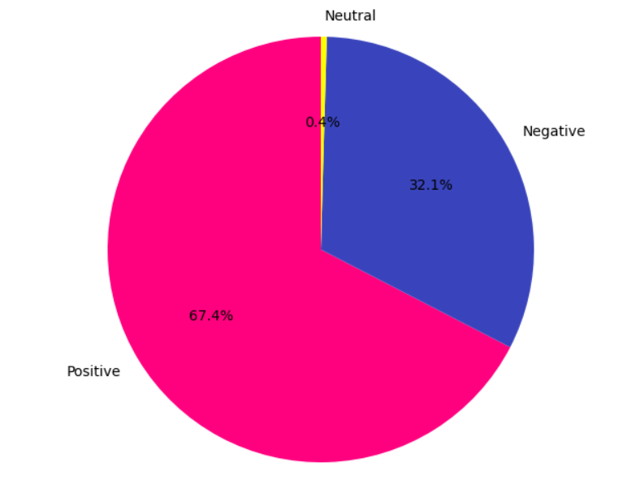
Data Analysis
SENTIMENT ANALYSIS
PIE-CHART VISUALIZATION
Sentiment score > 0 : Positive
Sentiment score < 0 : Negative
Sentiment score = 0 : Neutral
Total number of reviews: 3568
Number of positive reviews: 2405
Number of negative reviews: 1147
Number of neutral reviews: 16

Slide 6
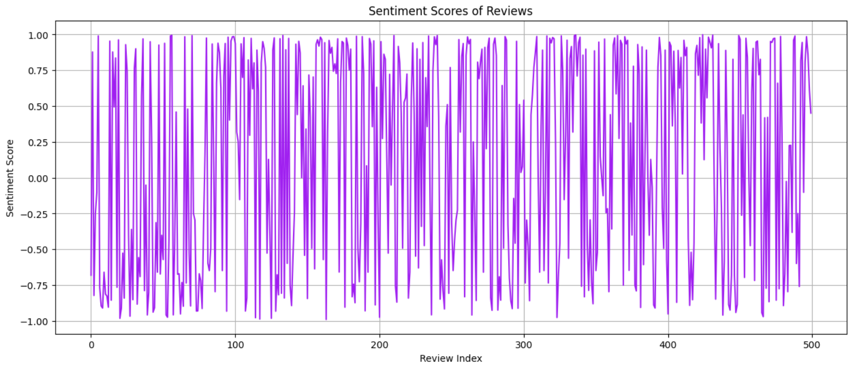
Data Analysis
LINE PLOT VISUALIZATION

