Slide 1

University Timetable Conflict Detection
A Discrete Structures Project Using Relations
& Functions
Manal Amir & Fatima Zehra
Subject: Discrete Structures (DS)
Discrete Structures
• Relations & Functions
• Automated Conflict Detection

Slide 2
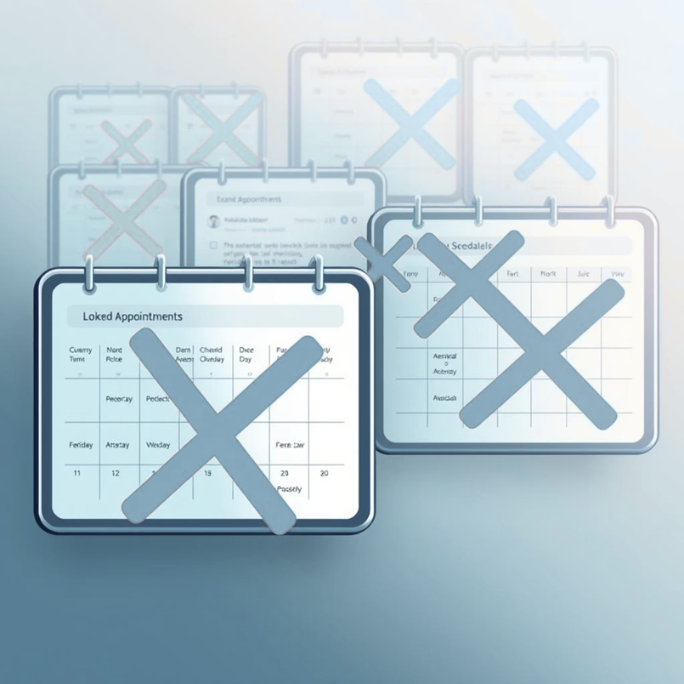
Introduction:
The Challenge of Timetables
Timetable Complexity
University timetable scheduling is a complex and critical task.
Manual Limitations
Manual scheduling often results in overlapping classes and student inconvenience.
Conflict Detection
Detecting timetable conflicts manually is time-consuming and prone to errors.
Discrete Relations
Discrete Structures provides mathematical tools such as relations to solve such problems.
Automated Scheduling
This project focuses on automated timetable conflict detection using relations.

Slide 3
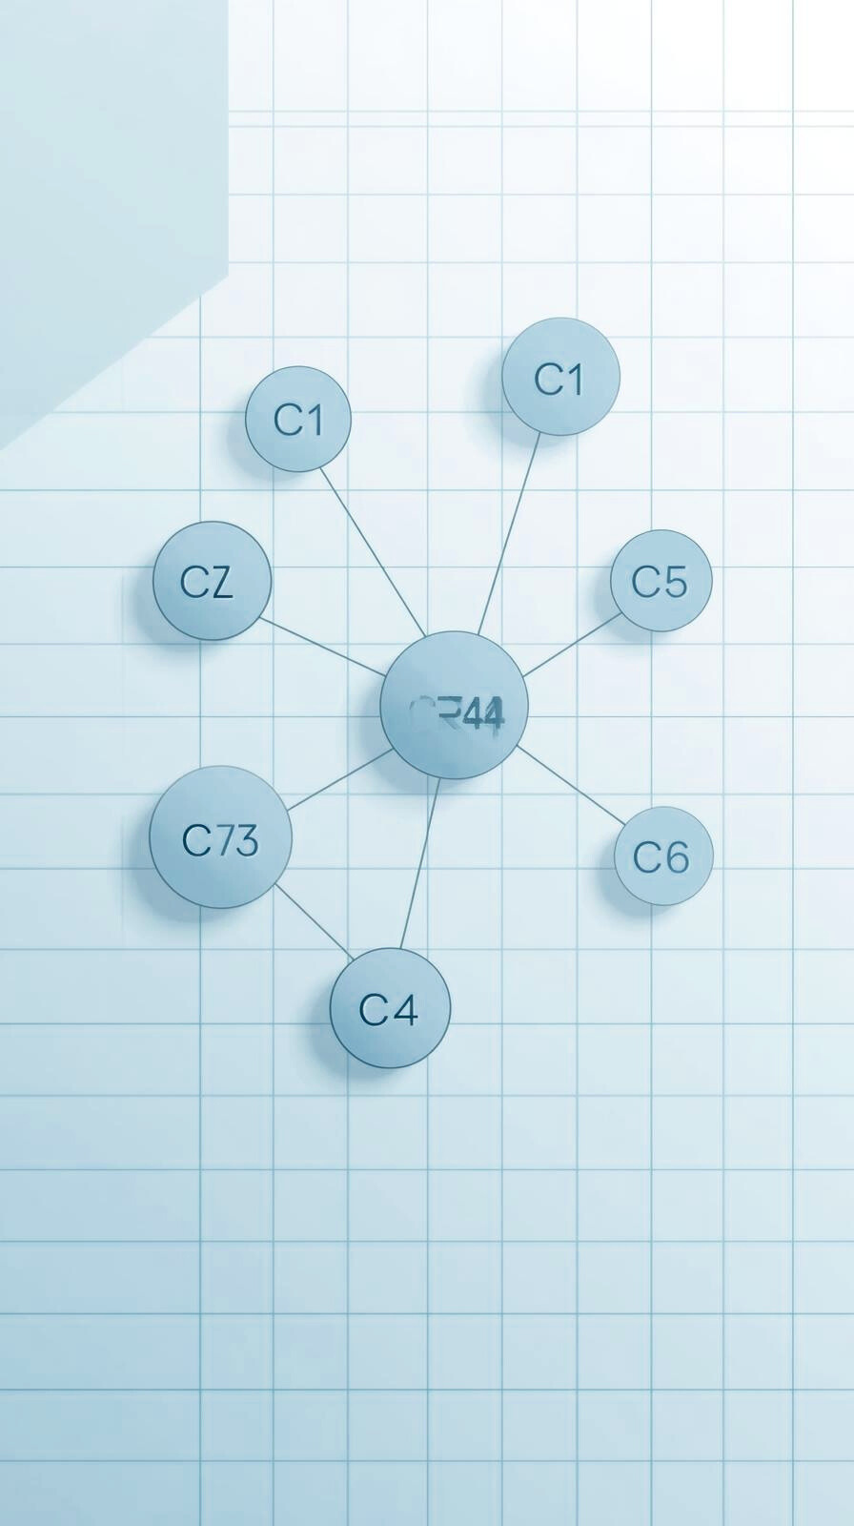
Background:
Discrete Structures is a fundamental subject in computer science.
Relations define connections between elements of a set.
In this project, courses are treated as elements of a set.
Time clashes between courses are modeled using a binary relation.
This approach allows systematic and accurate conflict detection.

Slide 4

The Problem: Manual Scheduling Headaches
University timetables are often created manually.
Manual scheduling leads to frequent course time clashes.
Identifying conflicts becomes difficult as the number of courses increases.
There is a need for an automated system to detect and analyze timetable conflicts.

Slide 5
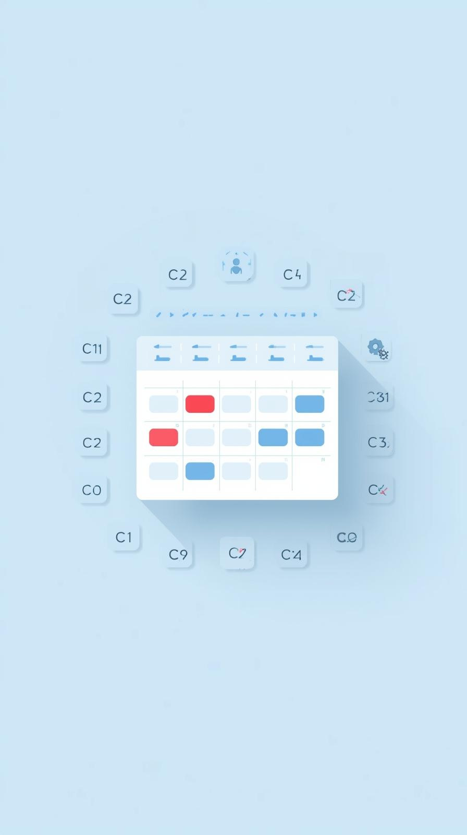
Objectives for Optimizing Course Scheduling
01
To apply Discrete Structures concepts in a real-world problem.
02
To define a relation between courses based on time overlap.
03
To detect pairwise and multi-course clashes automatically.
04
To generate a conflict-free timetable.
05
To improve efficiency and accuracy in scheduling.

Slide 6



How the System Works: A 5-Step Process
1. Course Input
User enters course names and time slots (24-hour format).
2. Build Relation R
A relation R is defined between courses.
3. Clash Matrix
Displays R as a table (0=safe, 1=clash)
4. Overlap Checking
Checks symmetry and detects potential 3-way clashes.
5. Timetable Generation
Outputs a conflict-free schedule, sorted by start time.

Slide 7
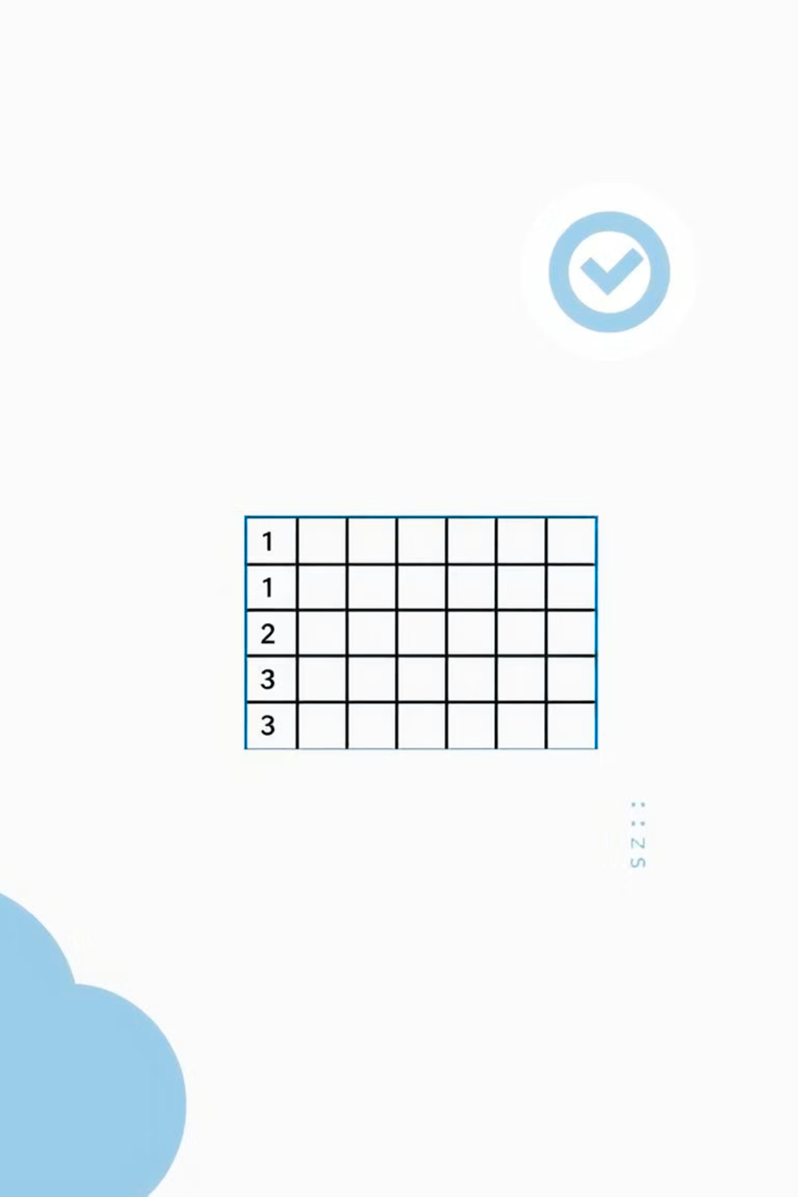
Model Architecture
Our system leverages discrete mathematics to efficiently identify and resolve timetable conflicts.
1
2
Input Module:
Processing Module:
Accepts course data and time slots.
Builds relation R and clash matrix.
3
4
Analysis Module:
Output Module:
Detects conflicts and checks
relation properties.
Displays conflicts and
conflict-free timetable.
- The system follows a step-by-step modular design.

Slide 8


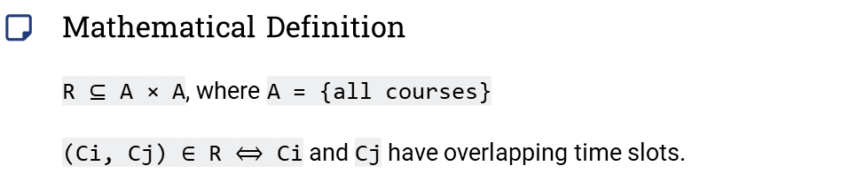
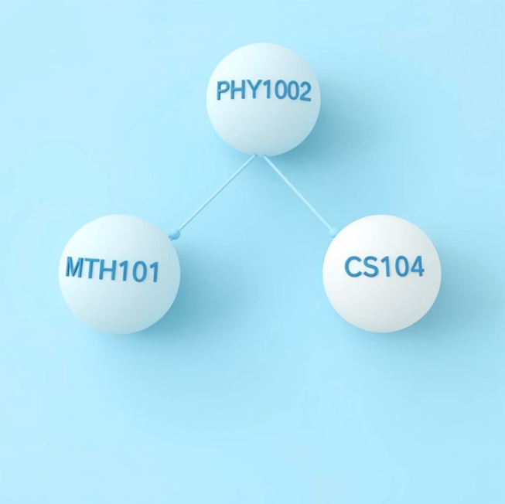
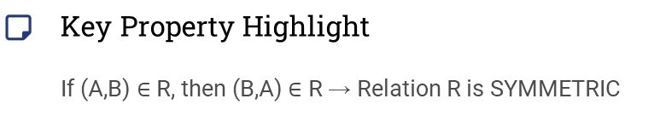
Core Concept: What is a Relation?
Consider the following courses: MTH101 (9:00 - 11:00), PHY102 (9:00 - 11:00), and CS104 (11:00 - 13:00). The diagram below visually represents the clash relation.

Slide 9
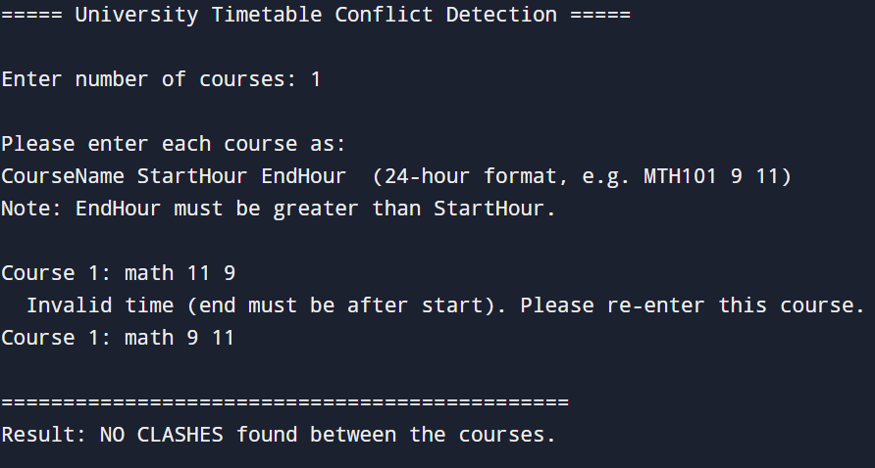
Sample Run: Invalid Time Entered

Slide 10
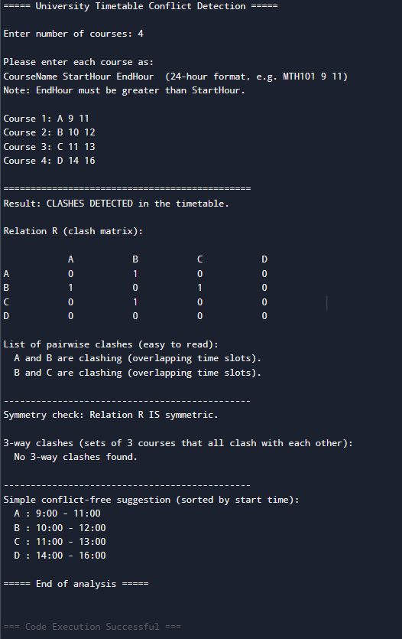
Sample Run: Clashes Detected

Slide 11
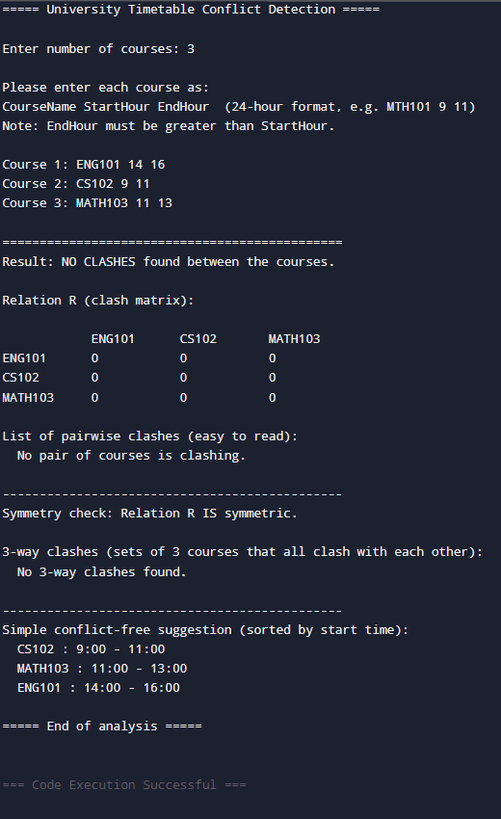
Sorted Time Table Output

Slide 12

Results and Discussion
The system correctly detects single and multiple clashes.
Symmetric relations confirm mutual course conflicts.
Three-way clashes are identified efficiently.
Output timetable is sorted and conflict-free.
Results show improved reliability over manual scheduling.

Slide 13

Conclusion and Outcomes​
Relation Application
Automated Detection
Efficient Clashes
The project successfully applies relations to timetable scheduling.
Automated conflict detection reduces errors and effort.
Complex clashes are detected efficiently.
Practical Implementation
Objectives Achieved
Discrete Structures concepts are practically implemented.
The system achieves all project objectives.

Slide 14



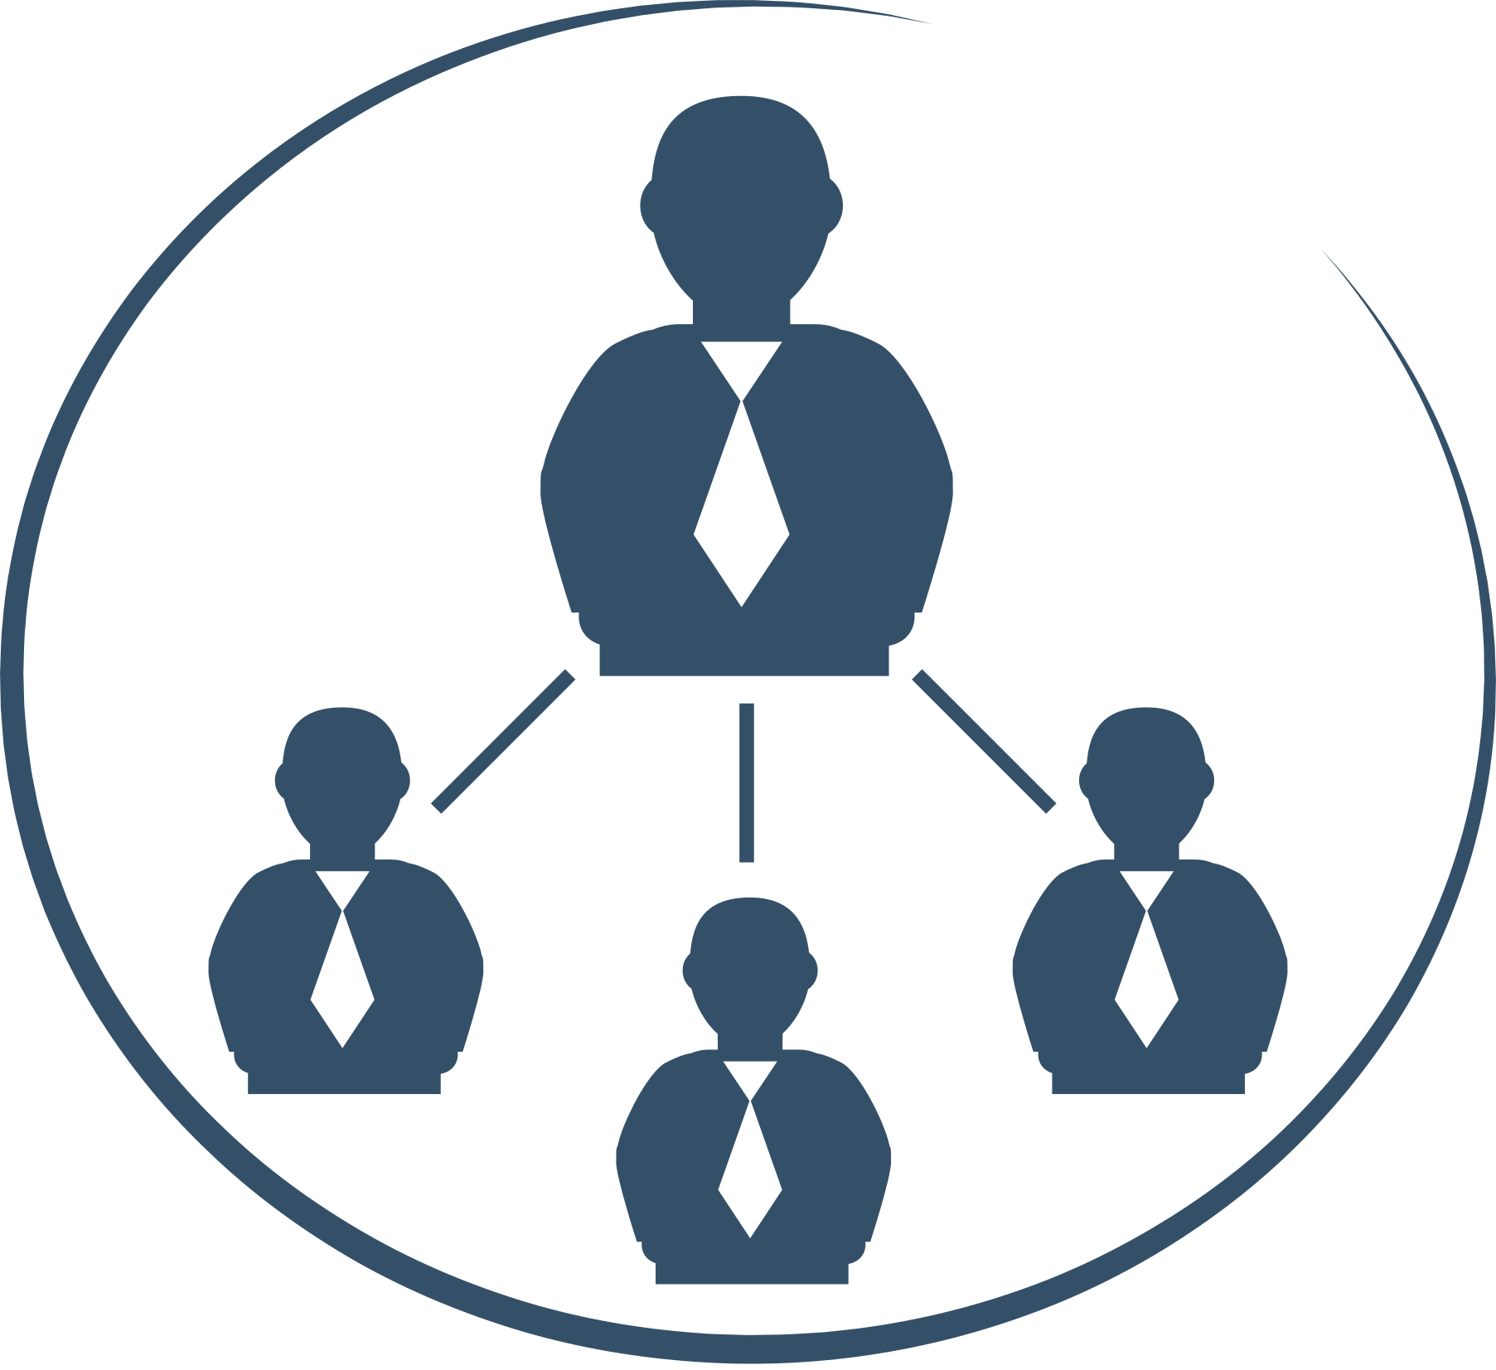

Why This Matters: 4 Real-World Applications
The same underlying relational logic can be applied across diverse scheduling challenges.
University Scheduling
Exam Planning
Hospital Staff Shifts
Meeting Room Booking
Same relation R logic, different real-world objects

Slide 15

Future Work and Enhancements
Inclusion of classroom and faculty constraints.
Graph-based visualization of clashes.
Development of a web or mobile application.
Use of optimization techniques.
Integration with full university systems.

Slide 16
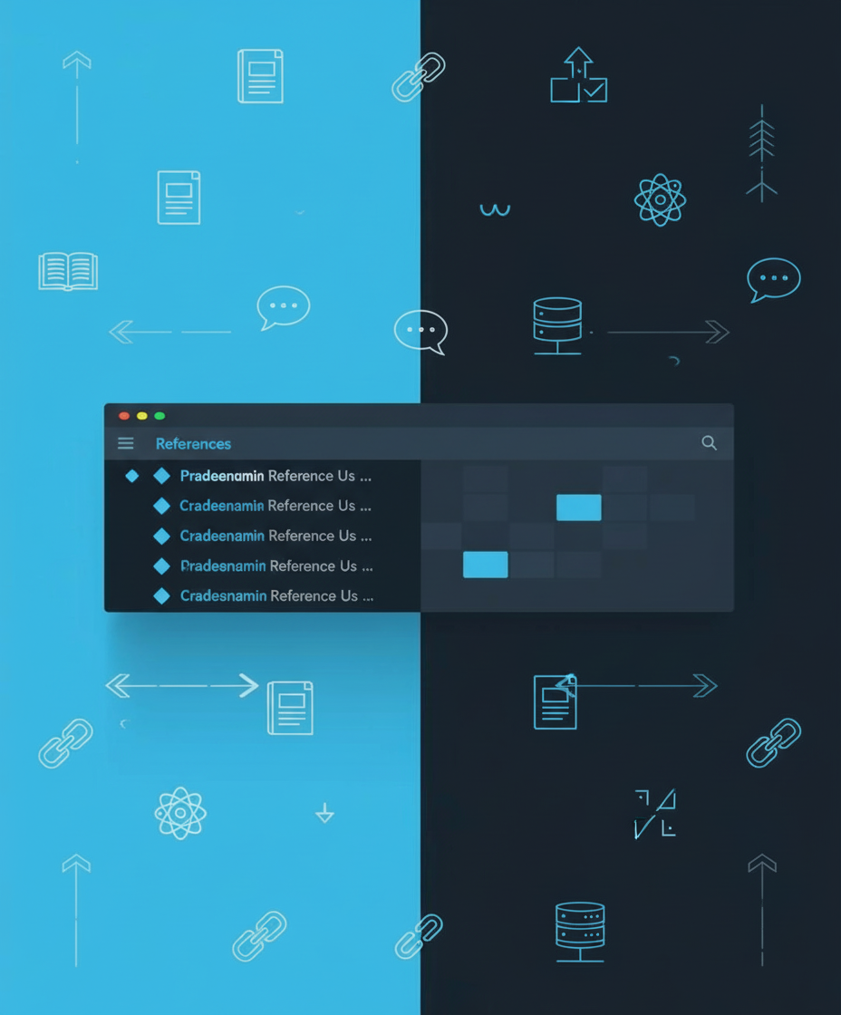
References
Rosen, K. H., Discrete Mathematics and Its Applications
Class notes on Sets, Relations, and Functions
Basic timetable examples online

Slide 17
Thank You For Your Attention!
Have a great day ahead.

