Slide 1
DEP202 ASSIGNMENT
ARFO FATIMA IBRAHIM
24C-SCT-SEN-0215
EMPLOYEE PERFORMANCE

Slide 2
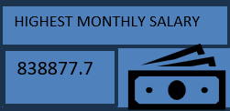
What is the highest Monthly Salary in the dataset?

Slide 3
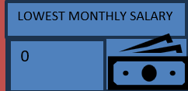
What is the lowest monthly salary in the dataset?

Slide 4
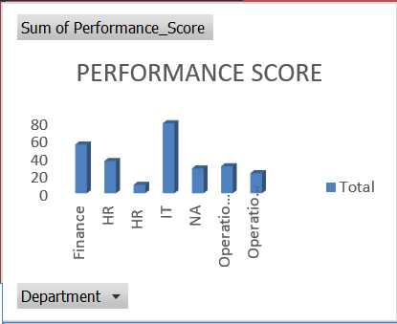
Which Department has the highest total Performance Score?
The department with the highest performance score is the IT department

Slide 5
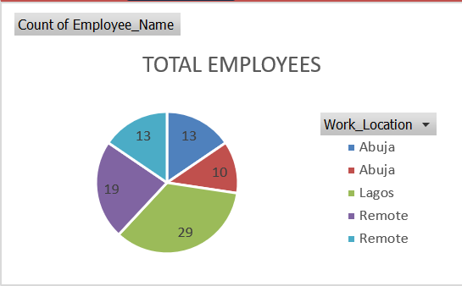
How many employees work in each Work Location?
Using the pie chart you can see the number of employees in each location

Slide 6
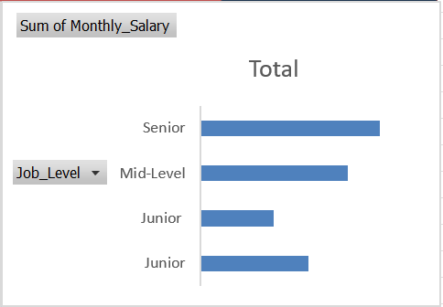
Which Job Level has the highest total salary paid?
The highest salary paid is from the senior job level.

