Slide 1
ECO346 / DATA VISUALIZATION TECHNIQUES FOR ECONOMISTS
INTRODUCTION · 1 / 04
PSLM 2019–20 / RURAL KHYBER PAKHTUNKHWA
Education, seen through data.
What do spending and literacy reveal about rural KP?
The story of this analysis — and why the way we show the data matters.
01
SPENDING
02
LITERACY
03
VISUALIZATION
Where does annual education spending cluster — and how wide is the spread?
How do weighted literacy rates vary by age and between women and men?
How much clearer is the same literacy data after a graph makeover?
DATA
Person + household PSLM files
MATCH
hhid
WEIGHT
hhweight
PRESENTER
FA24-BED-028
PSLM 2019–20 · RURAL KP / VARIANT 4 · FATIMA SHAHID
1 / 04

Slide 2
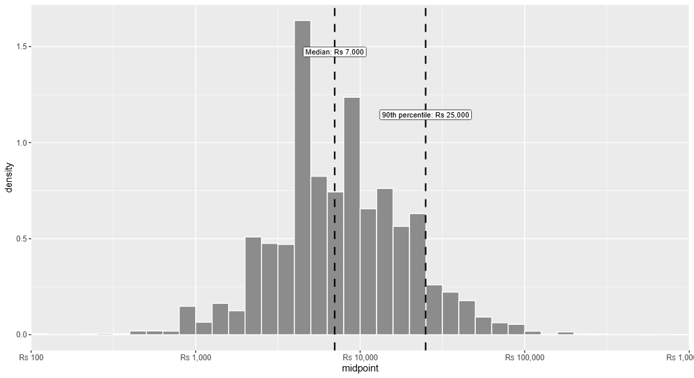
ECO346 / DATA VISUALIZATION TECHNIQUES FOR ECONOMISTS
EDUCATION SPENDING · 2 / 04
Education spending varies widely.
Rural KP students with positive annual spending · Survey-weighted density on a log10 rupee scale
THE DISTRIBUTION / RURAL KP
4,912
eligible person records
Rs 7,000
weighted = unweighted median
P10 / Rs 2,500
P90 / Rs 25,000
10.00×
P90 / P10 ratio
Only 3 observations fall outside the required Rs 100–1,000,000 graph range.
READ THE BARS | Weighted density, not student count · Dashed lines: median and P90.
PSLM 2019–20 · RURAL KP / VARIANT 4 · FATIMA SHAHID
2 / 04

Slide 3
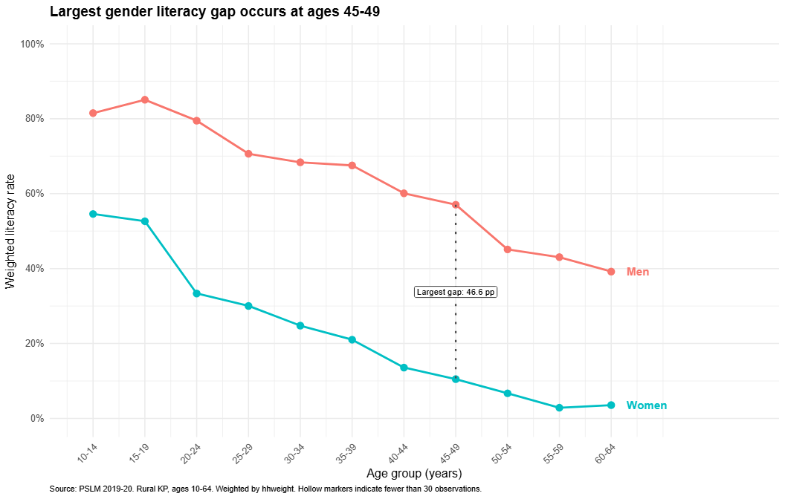
ECO346 / DATA VISUALIZATION TECHNIQUES FOR ECONOMISTS
LITERACY BY AGE · 3 / 04
The largest literacy gap is at ages 45–49.
Survey-weighted literacy rates · Rural KP residents aged 10–64 · Eleven five-year bands
WOMEN VS MEN
Ages 15–19
Men 85.1% · Women 52.6%
Ages 45–49
Men 57.0% · Women 10.5%
46.6 pp
largest gap (from unrounded rates)
Ages 55–59
Men 43.0% · Women 2.9%
HOW TO READ | Separate lines show estimated group percentages; this compares different age groups, not the same people over time.
PSLM 2019–20 · RURAL KP / VARIANT 4 · FATIMA SHAHID
3 / 04

Slide 4
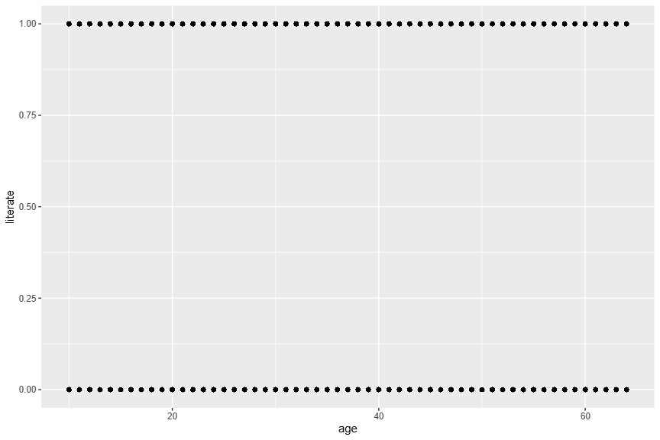
ECO346 / DATA VISUALIZATION TECHNIQUES FOR ECONOMISTS
MAKEOVER & CROSS-CHECK · 4 / 04
Same literacy data. A much clearer story.
From overlapping individual dots to comparable weighted rates — then independently verified in Python.
BEFORE / DEFAULT SCATTERPLOT
AFTER / WEIGHTED AGE–SEX RATES
01
LESS OVERPLOTTING
02
EASIER COMPARISONS
03
CLEARER TAKEAWAY
Group-level rates replace stacked 0/1 dots.
Two series on one percentage scale.
Direct labels flag the 45–49 gap.
VERIFIED
R & Python match 22/22 rates
LIMITATION
Cross-sectional data describe gaps; they do not explain their causes.
PSLM 2019–20 · RURAL KP / VARIANT 4 · FATIMA SHAHID
4 / 04

