Slide 1

Automatic Evaluation of Layout Quality of UML Class Diagrams Using ML
Name: Memoona
Roll No: MSSE71F23S009

Slide 2
Table of Contents
1- Introduction
2- Aims & Objectives
3- Contribution
4- Research Problem
5- Related Work
6- Prior work
7- Data
8- Data Statistics
9- Features
10- ML Algorithm
11- Framework Diagram
12- Results

Slide 3
INTRODUCTION
RESEARCH MAIN AREA: Evaluation of the quality of UML class diagrams using ML
RESEARCH SUB-AREA: Evaluating the layout quality of UML class diagrams
IMPORTANCE OF AREA:
Industry Setting
Educational Setting

Slide 4
AIMS AND OBJECTIVES
Create an automatic evaluator of the layout quality of the UML class
Finding good aspects of a diagram
Which aspects could be improved?

Slide 5
CONTRIBUTION
A novel automated evaluator for assessing the layout quality of UML class diagrams.
Identify and disclose the most crucial aesthetics influencing the layout quality of class diagrams.
Evaluate the performance of the layout evaluator.

Slide 6
RESEARCH PROBLEM
Main Problem:
How to automatically evaluate the layout quality of UML Class Diagrams Using ML?
Sub Problems:
What is the performance of an automatic layout quality evaluator?
Which features are important for determining the layout quality of UML Class Diagrams?

Slide 7
RELATED WORK
Automatic evaluation of the layout of (class) diagrams.
Gustav Bergström, Fadhl Hujainah, Truong Ho-Quang, Rodi Jolak, Satrio Adi Rukmono, Arif Nurwidyantoro, Michel R.V. Chaudron,
Evaluating the layout quality of UML class diagrams using machine learning,
Journal of Systems and Software, Volume 192,2022, 111413, ISSN 0164-1212,
https://doi.org/10.1016/j.jss.2022.111413.
(https://www.sciencedirect.com/science/article/pii/S016412122200125X)
Some works are related to different parts of this study:
Estimating layout quality
Finding the most important layout aesthetics.

Slide 8
PRIOR WORK
B. Karasneh and M. R. V. Chaudron, "Extracting UML models from images," 2013 5th International Conference on Computer Science and Information Technology, Amman, Jordan, 2013, pp. 169-178, doi: 10.1109/CSIT.2013.6588776. & B. Karasneh and M. R. V. Chaudron, "Img2UML: A System for Extracting UML Models from Images," 2013 39th Euromicro Conference on Software Engineering and Advanced Applications, Santander, Spain, 2013, pp. 134-137, doi: 10.1109/SEAA.2013.45.
image processing to find features of UML diagrams
reads an image of a UML diagram
extracts its semantic meaning
creates an XMI file of the UML model from this information.

Slide 9
PRIOR WORK
T. Ho-Quang, M. R. V. Chaudron, I. Samúelsson, J. Hjaltason, B. Karasneh and H. Osman, "Automatic Classification of UML Class Diagrams from Images," 2014 21st Asia-Pacific Software Engineering Conference, Jeju, Korea (South), 2014, pp. 399-406, doi: 10.1109/APSEC.2014.65.
Automatic classifier that recognize an image as a UML class diagram
It uses image processing to find features in images
ML to train a model that can distinguish if an image is a class diagram or not.

Slide 10
PRIOR WORK
Nikiforova, Oksana, et al. "Several issues on the layout of the UML sequence and class diagram." Proc. of the 9th Int. Conf. on Software Engineering Advances. 2014.
Create a list of layout principles
Analyze how different some popular UML modeling uses layout algorithms.
Layouts of both class and sequence diagrams

Slide 11
DATA
Lindholmen-dataset of images created by Hebig et al. (2016)
Data Year: (2016).
Total Data: 100,000 UML Diagrams
Assembled through mining open source repositories on GitHub for images.
The initial subset of 3000 diagrams was selected randomly.

Slide 12
DATA STATISTICS
Total : 100000 UML Diagrams.
Initial Subset: 3000 UML Diagrams.
654 diagrams after filtering.
Total of 609 diagrams in the final dataset.

Slide 13
FEATURES
Aspects of Quality of Layout
Set of Image Features

Slide 14
Aspects of Quality of Layout
A1 — line crossings
A2 — Line bends
A3 — Orthogonality.
A4 — Line lengths
A5 — Diagram drawing size
A6 — Symmetry.
A7 — Line angular distances
A8 — Class placement
A9 — Overlapping
A10 — Node sizes.

Slide 15
Set of Image Features
F1 — Line crossings.
F2 — Crossing angles
F3 — Line bends
F4 — Line angles.
F5 — Line orthogonality.
F6 — Rectangle orthogonality
F7 — Average line length
F8 — Line length variation
F9 — Longest line

Slide 16
Set of Image Features
F10 — Shortest line
F11 — Rectangle coverage
F12 — Aspect ratio
F13 — Rectangle distribution
F14 — Rectangle proximity
F15 — Rectangle size
F16 — Rectangle size variation.
F17 — Number of rectangles
F18 — Number of lines

Slide 17
ML ALGORITHM
Random Forest: The Random Forest algorithm has been chosen as the primary machine learning model.
Random Forest's strength lies in its ability to aggregate the predictions of multiple decision trees, each trained on a random subset of the dataset.
Let’s See Code.

Slide 18
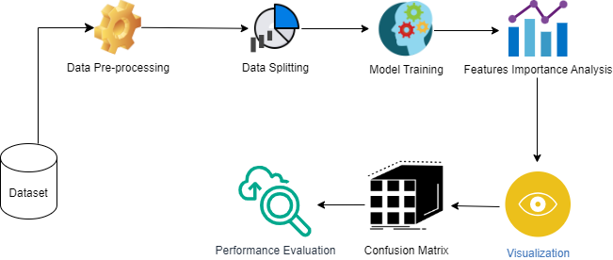
FRAMEWORK DIAGRAM

Slide 19
RESULTS
sr.no | Features | Importance
1 | LongestLine | 0.2
2 | RectOrth | 0.17
3 | RectOrth2 | 0.1
4 | AvgCrossingAngle | 0.08
5 | AvgLineAngle | 0.05
6 | RectStDev | 0.04
7 | AspectRatio | 0.04
8 | OrthLinesRatio | 0.04
9 | RectCoverage | 0.03
10 | AvgRectArea | 0.03
11 | AvgLineLength | 0.03
13 | ShortestLine | 0.03
14 | AvgShortestDistance | 0.03
15 | AvgLineBends | 0.02
16 | LineLengthStDev | 0.02
17 | LineCrossings | 0.02
18 | RectDistribution | 0.02

Slide 20
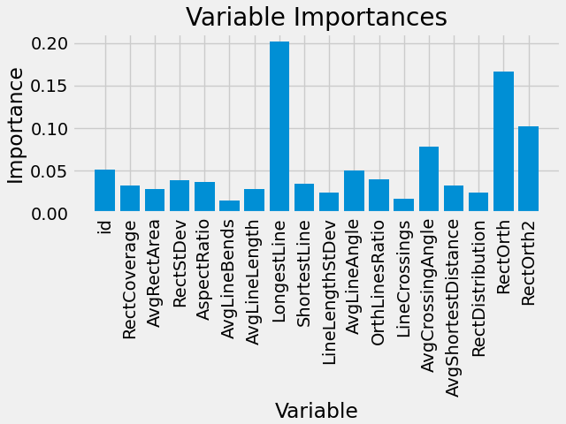
RESULTS
It provides a comprehensive overview of the feature importance derived from the Random Forest model, shedding light on the influential factors contributing to the evaluation of layout quality in UML class diagrams.

Slide 21
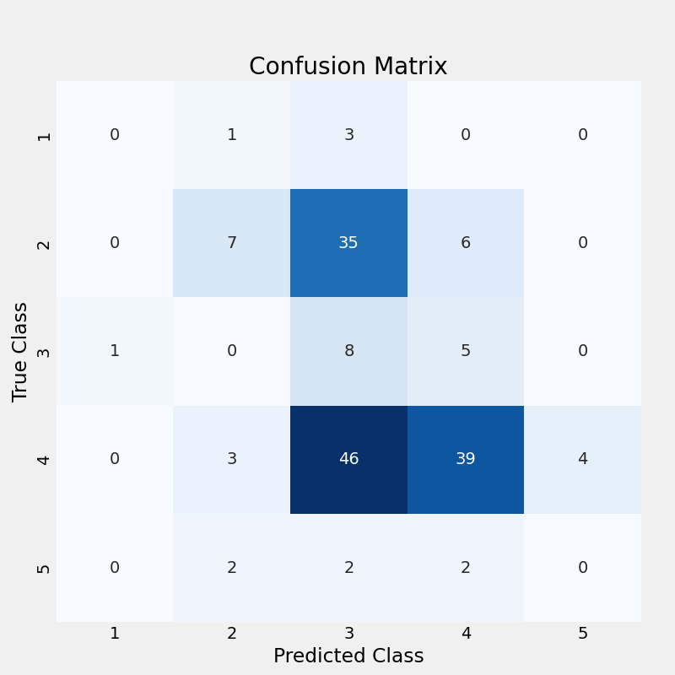
RESULTS
It presents the Confusion Matrix, a pivotal visualization illustrating the performance of the machine learning model in classifying UML class diagrams based on their layout quality.

Slide 22
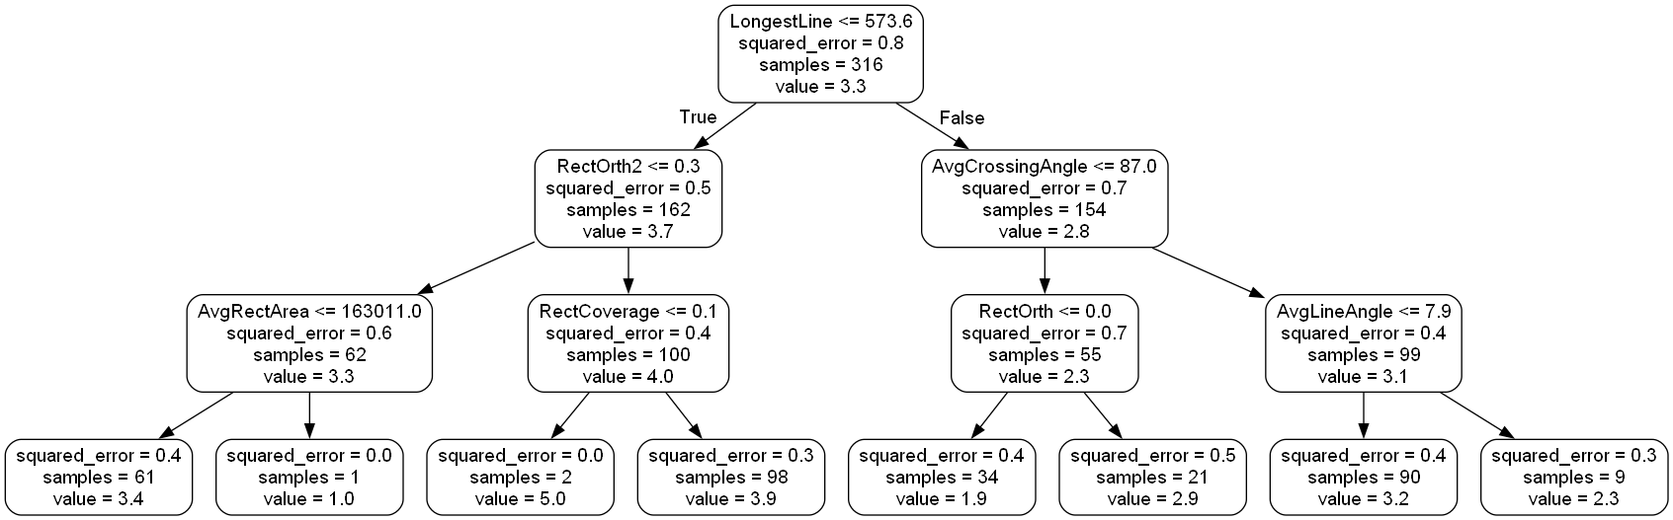
RESULTS
Random Forest Tree Reduced Tree with 3 Levels

Slide 23
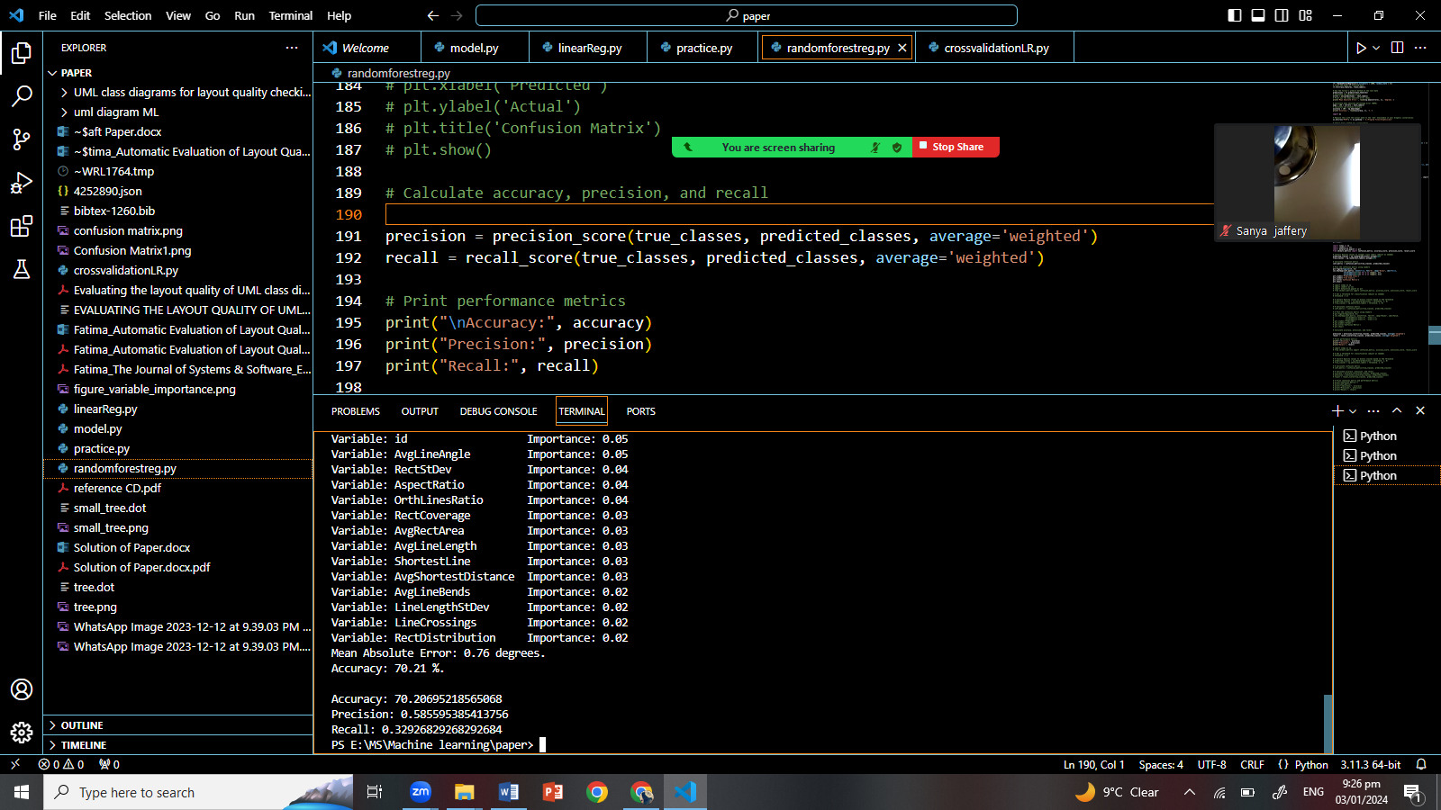
RESULTS

Slide 24
THANK YOU

