Slide 1
Data Structures project
Haifa Almutairi, Fatima Alobayah

Slide 2
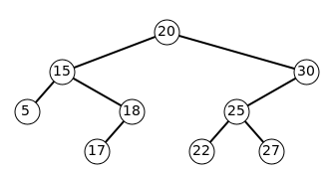
Tree-set
Implements of sorted set, data stored in tree
Natural order
tree traversal (in-order) ,
String (alphabetical order)
numbers (lowest to highest)
- You can use comparator to change the order
No duplicates

Slide 3
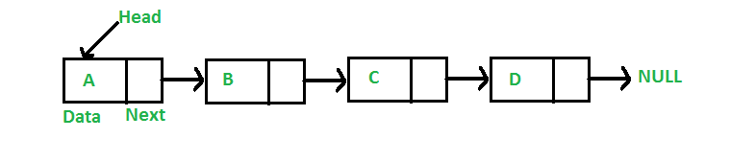
LinkedList
- Is an implementation of list interface
- Each node is linked to the next node
Maintains insertion order
allows duplicates

Slide 4
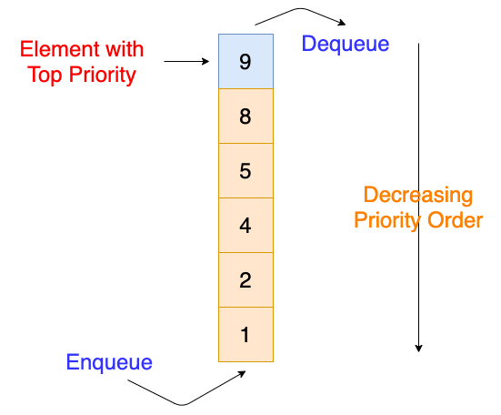
Priority queue
A type of queue each element is associated with a priority value
- Orders elements based on priority value, not insertion order
The top element(first out) is the one with the highest priority

Slide 5
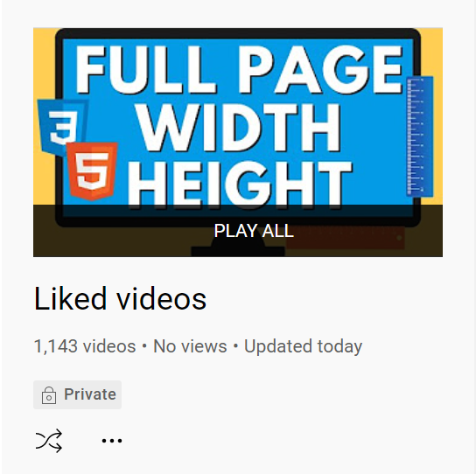
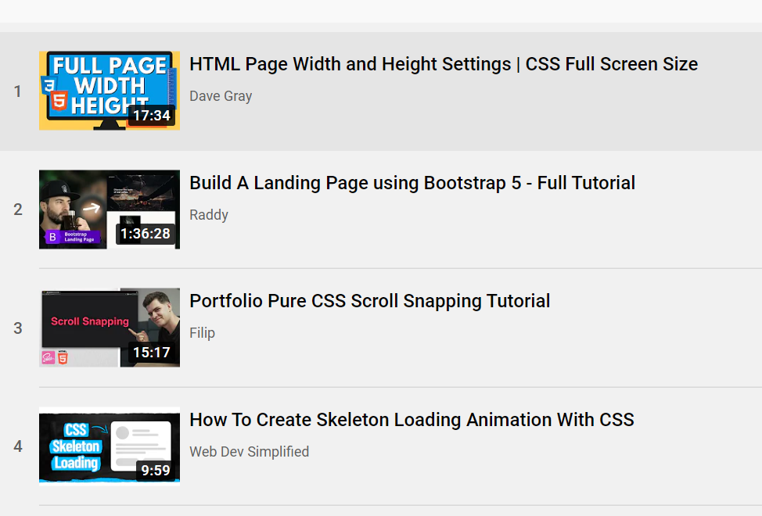
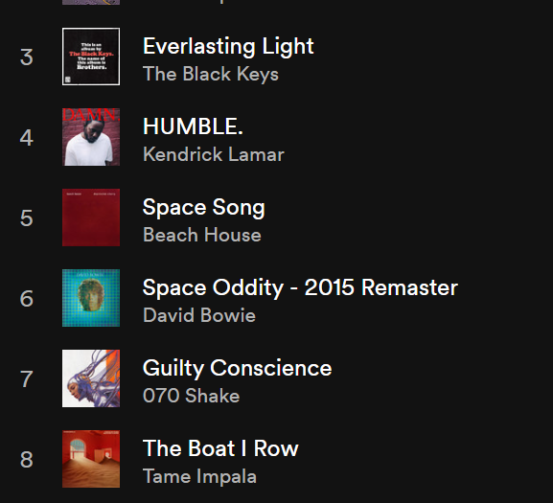
Project Idea
Music players need to group songs in different playlists
A playlist is just a dataset, for example a set of song or video objects
we can use tree sets, priority que and linked lists to create , organize, and play these playlists
EXAMPLES:

Slide 6
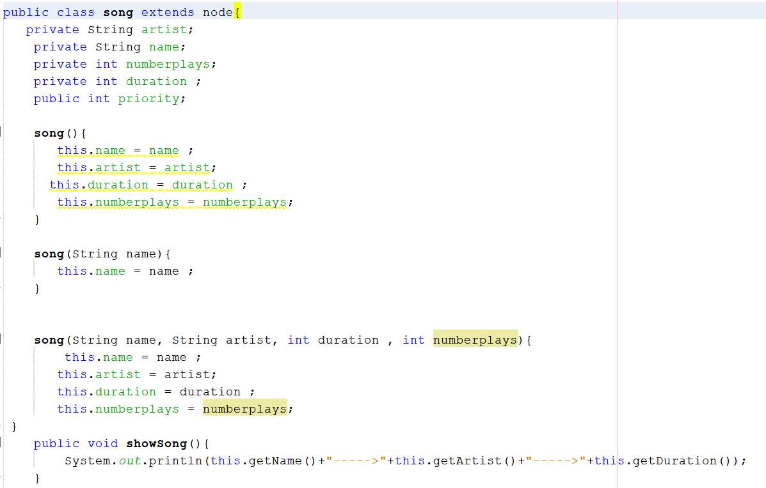
Create a Song class:
name (string) ,
artist name (string) ,
number of streams (int) ,
length of the song (int),
priority(int)

Slide 7
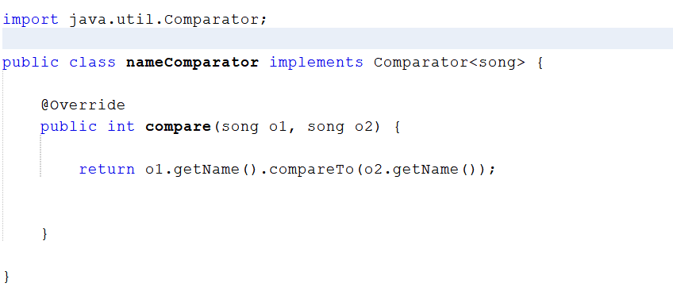
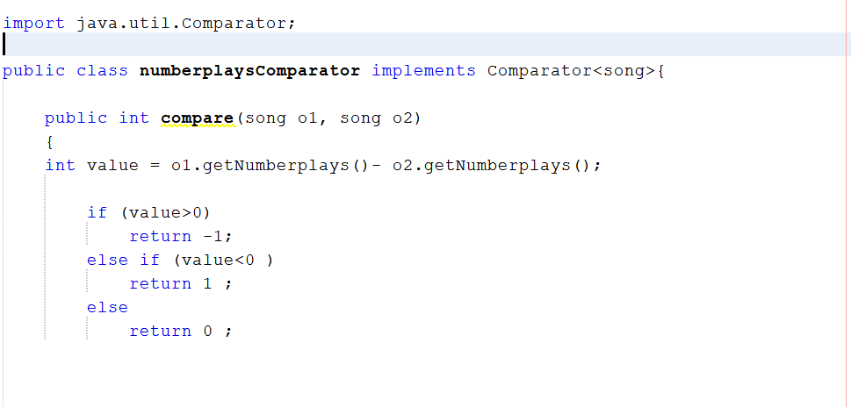
Make comparator classes for each attribute to sort the song objects by any attribute

Slide 8
Implementing tree set

Slide 9
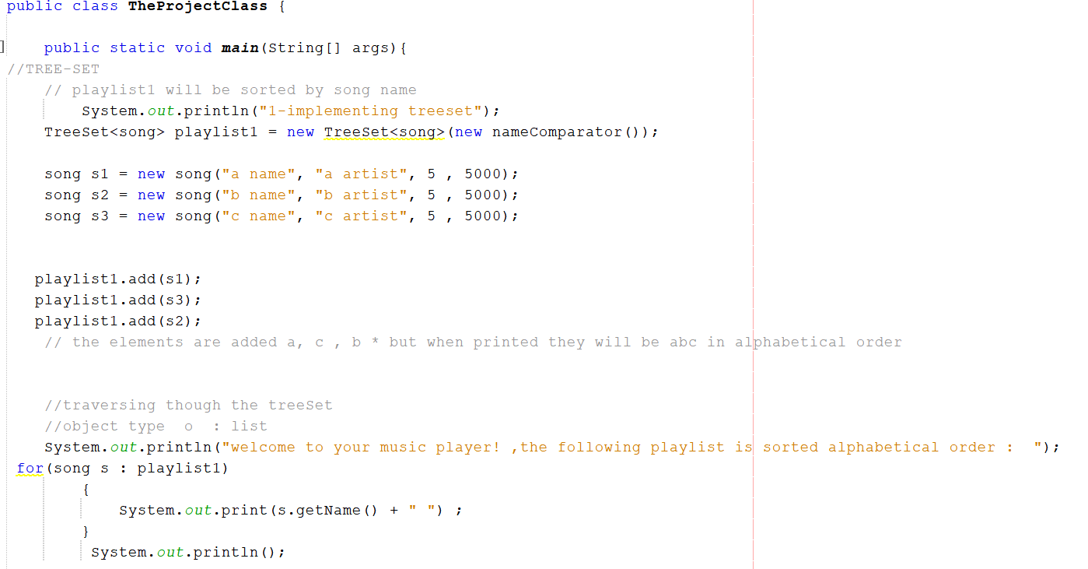
Make a class that imports Tree Set , Linked list , and Priority Que
Create a tree set using comparator
Create song objects , add them , display

Slide 10
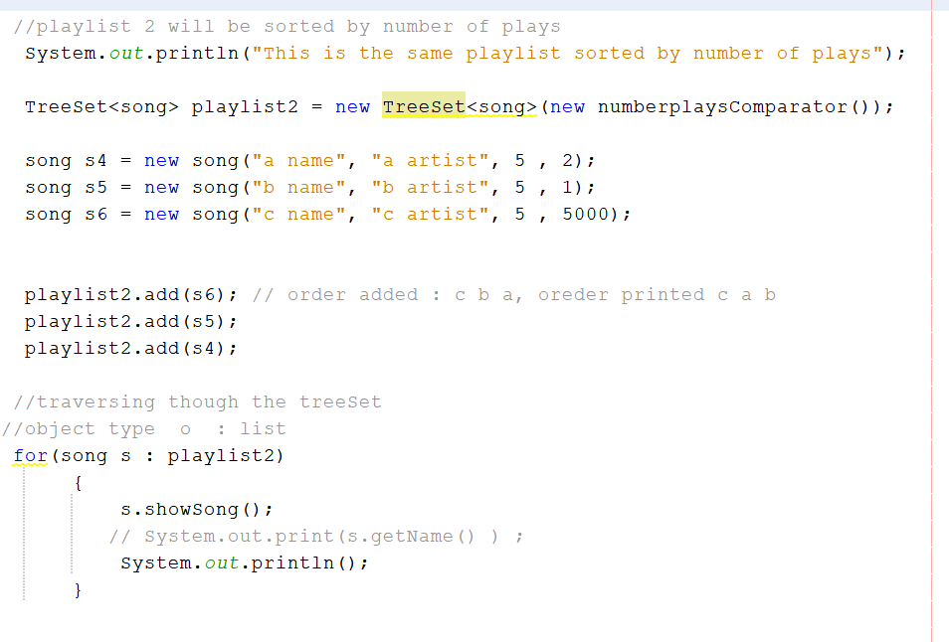
*tree set ordered by number of plays

Slide 11
Implementing Linked List

Slide 12
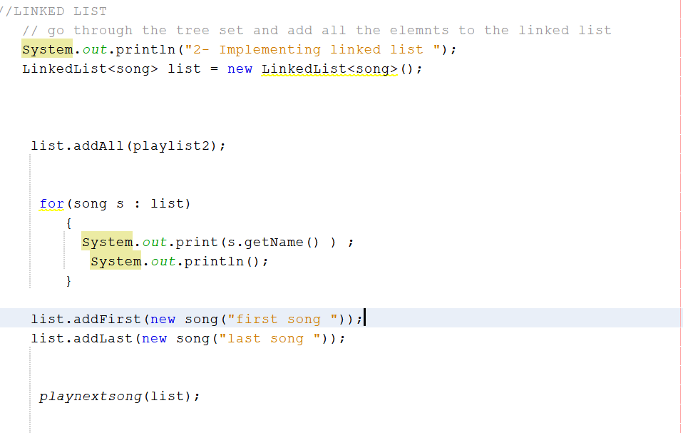
copy the data from the tree set to a linked list
Add items to the linked list. Display the new playlist
PlaynextSong() Shows the user the currently playing song allow them to play the next one by entering 1, or stop by entering 0

Slide 13
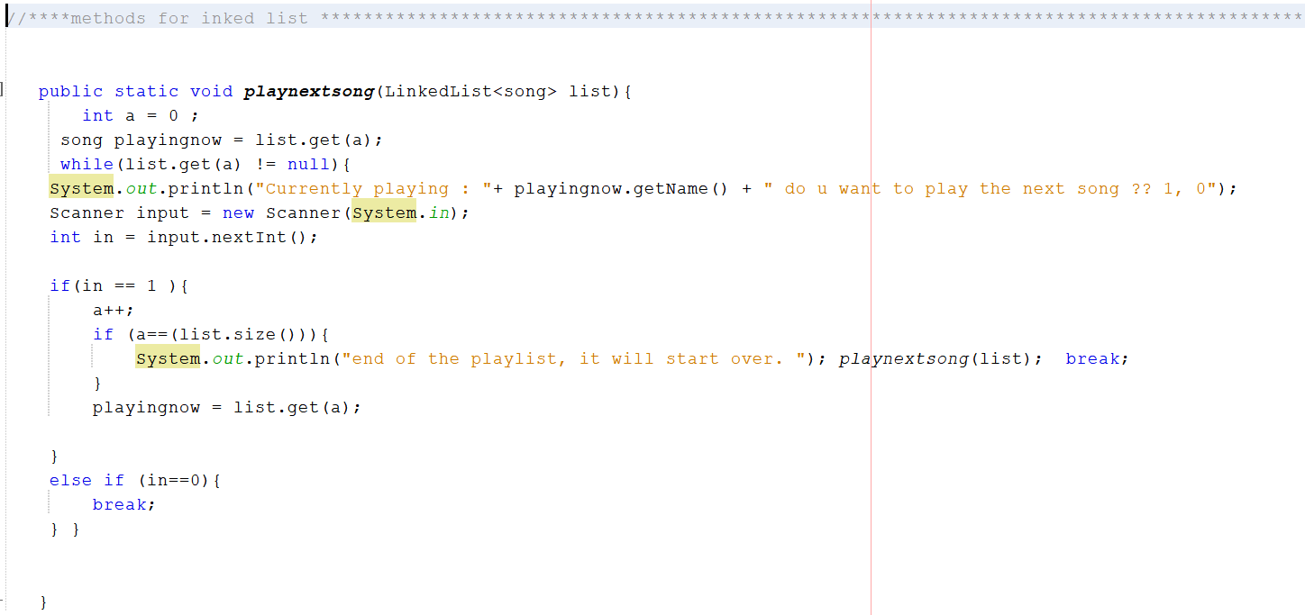

Slide 14
Implementing Priority Queue

Slide 15
Import the data from the linked list into a new Priority queue
Add songs to the queue, then display the elements in the queue with the priority of each
Show the user the currently playing song allow them to play the next one by entering 1, or add a song of their choice by entering 2, or stop by entering 0

Slide 16
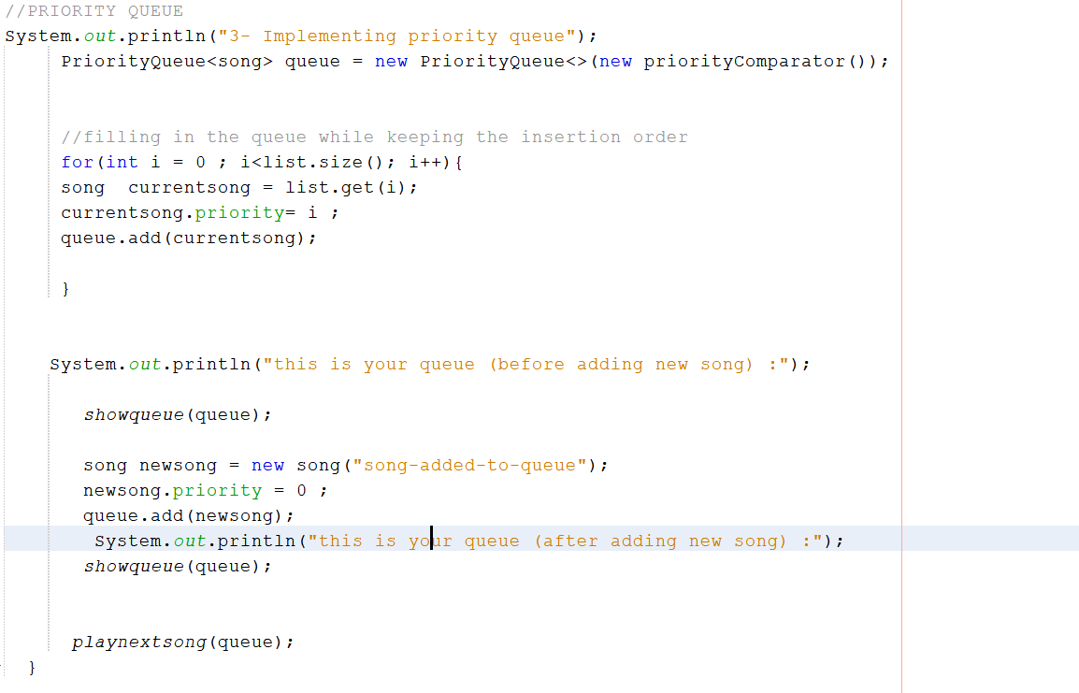
Import the data from the linked list into a new Priority queue
Add songs to the queue, then display the elements in the queue with the priority of each
Show the user the currently playing song allow them to play the next one by entering 1, or add a song of their choice by entering 2, or stop by entering 0

Slide 17
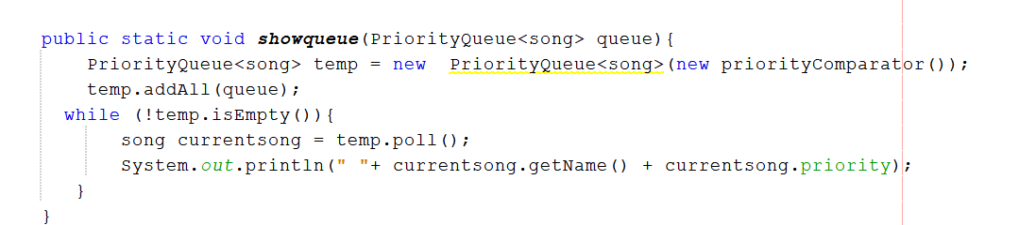

Slide 18
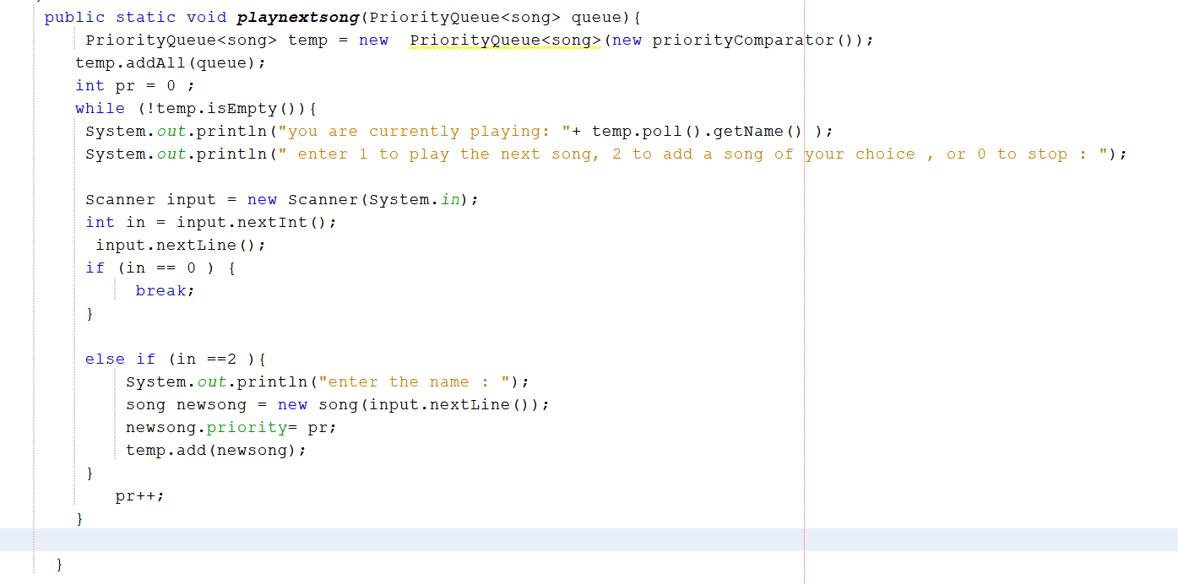

Slide 19
Coding Resources:
A Simple Song Playlist Using Linked list in Java | abhijeetvermayash (coderspacket.com)
https://www.geeksforgeeks.org/how-to-sort-a-treeset-with-user-defined-objects-in-java/
https://www.freecodecamp.org/news/priority-queue-implementation-in-java/
https://www.programiz.com/java-programming/treeset

