Slide 1
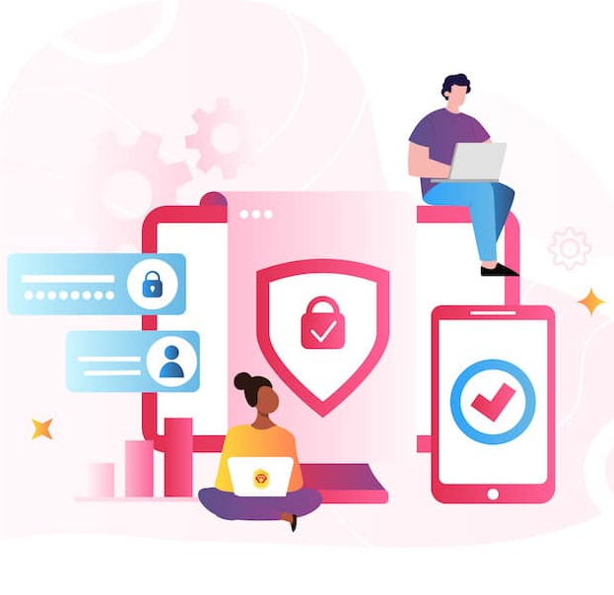
Phishing Awareness
Recognizing and Avoiding Phishing Attacks

Slide 2


Summary
Introduction to Phishing
Types of Phishing Attacks
Recognizing Phishing Attempts
Preventive Measures
Case Studies
Interactive Activities
Conclusion
Resources and Further Reading

Slide 3
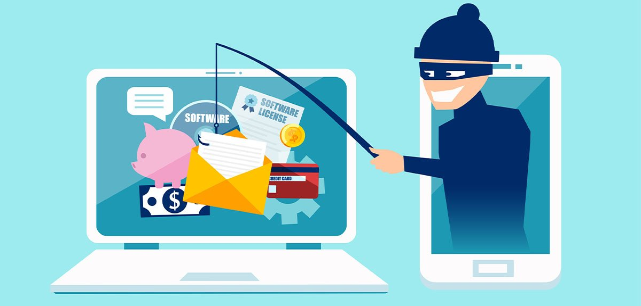
Introduction to Phishing
Definition of Phishing: Phishing is a type of cyberattack that uses fraudulent emails, text messages, phone calls or websites to trick people into sharing sensitive data, downloading malware or otherwise exposing themselves to cybercrime.
Importance of Awareness: Understanding the impact of phishing attacks.

Slide 4
Types of Phishing Attacks
Email Phishing: Deceptive emails tricking users into clicking malicious links or providing sensitive info.
Spear Phishing: Spear phishing is a targeted phishing attack on a specific individual. The target is usually someone with privileged access to sensitive data or special authority that the scammer can exploit, such as a finance manager who can move money from company accounts.
Whaling: Targeting high-profile individuals within an organization.
Smishing and Vishing: SMS-based and voice-based phishing techniques.
Clone Phishing: Cloning legitimate emails to trick users.

Slide 5
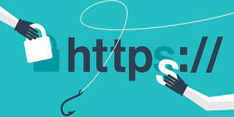

Recognizing Phishing Attempts
Red Flags in Emails: Suspicious sender addresses, generic greetings, errors, urgency.
Phishing Websites: Look for slight URL changes, SSL certificate issues, poor design.
Social Engineering Tactics: Manipulation and psychological tricks to gain trust.

Slide 6
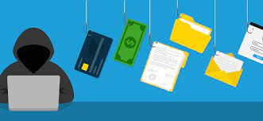
Preventive Measures
Email Security: Don't click unknown links or download attachments from unknown sources.
Password Security: Use strong, unique passwords and enable multi-factor authentication.
Network Security: Use a VPN on public Wi-Fi, ensure firewalls and anti-malware are up-to-date.
Reporting Phishing: How and why to report phishing attempts within your organization.

Slide 7
Case Studies
Real-life Examples: Notable phishing attacks and their impact.
What Went Wrong: Analyzing the mistakes that led to successful phishing attacks.

Slide 8
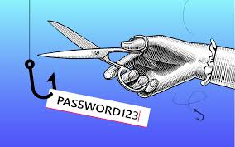
Interactive Activities
Phishing Quiz: Identify phishing emails and websites.
Simulation Exercises: Test participants in a controlled environment with a phishing simulator.

Slide 9
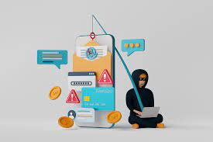
Conclusion
Key Takeaways: Importance of vigilance and reporting.
Ongoing Education: Encourage continuous learning on phishing tactics.

Slide 10
Resources and Further Reading
Links to cybersecurity blogs, official security guidelines, etc.

