Slide 1
FEATURE EXTRACTION OF BOTH PHISHING AND LEGITIMATE URLS:
Imported necessary libraries
Read URLs in text form
Made a class of Feature Extraction
Made necessary functions
Extract features
Store features in numeric form
Save in csv format as extracted URLs
*Note we have used representation ‘1’ for phishing and ‘0’ for legitimate URLs

Slide 2
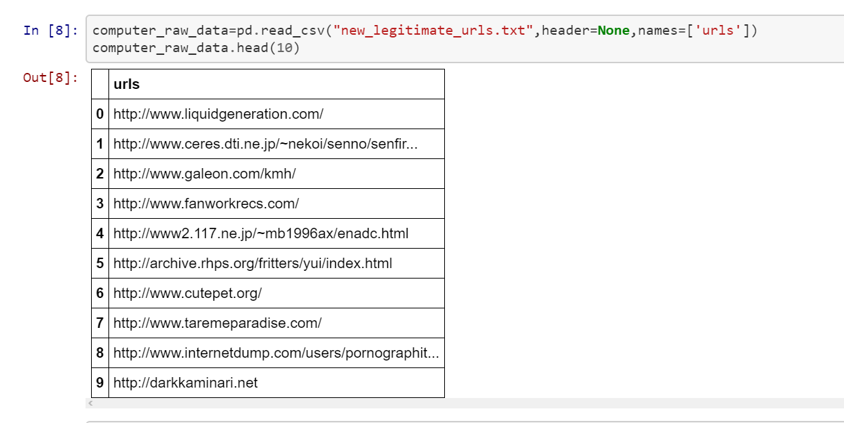
IMPLEMENTATION: READING:

Slide 3
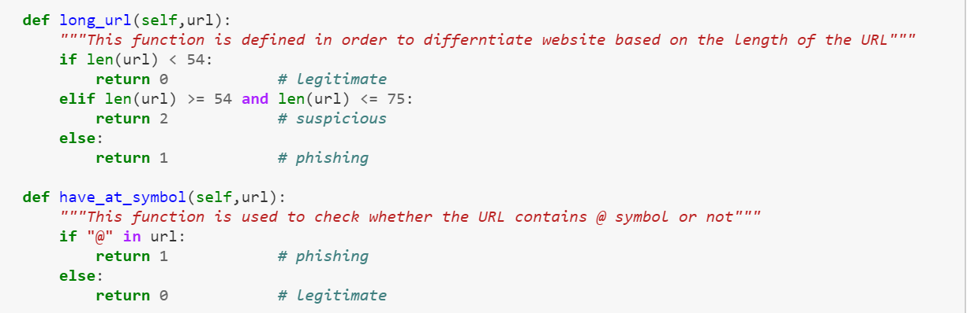
CLASS for feature extraction:
NECESSARY FUNCTIONS:

Slide 4
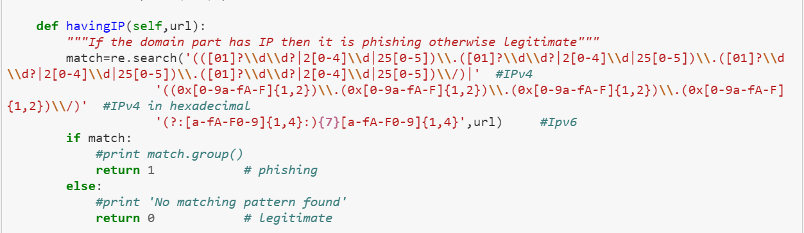
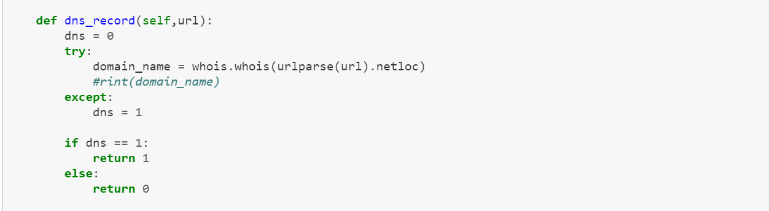

Slide 5
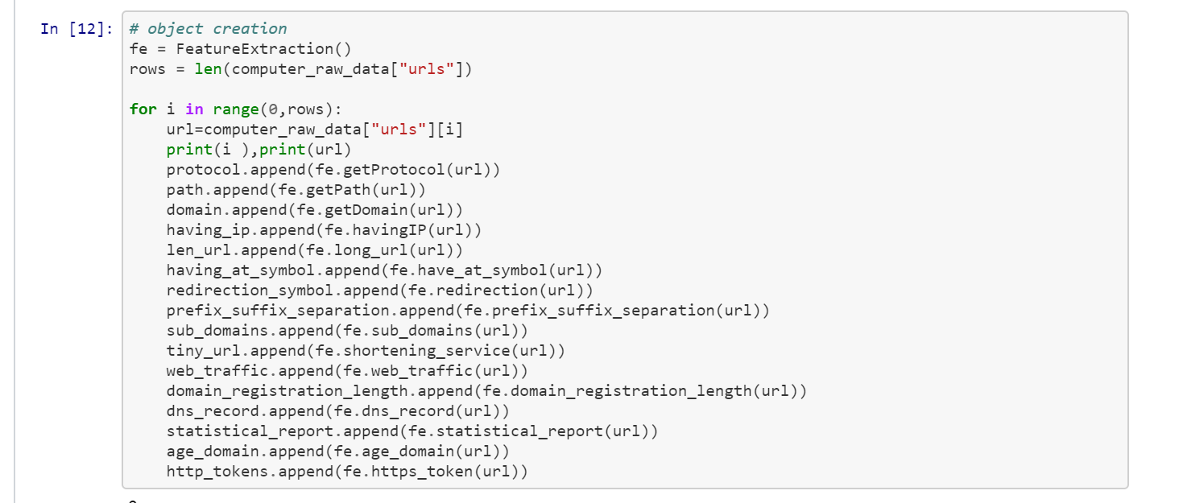
Feature EXTRACTION:

Slide 6
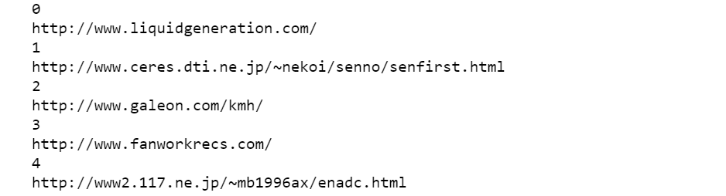
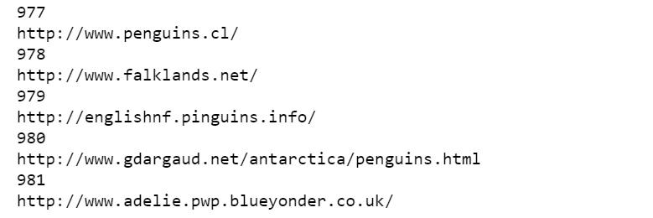
Feature EXTRACTION:

Slide 7
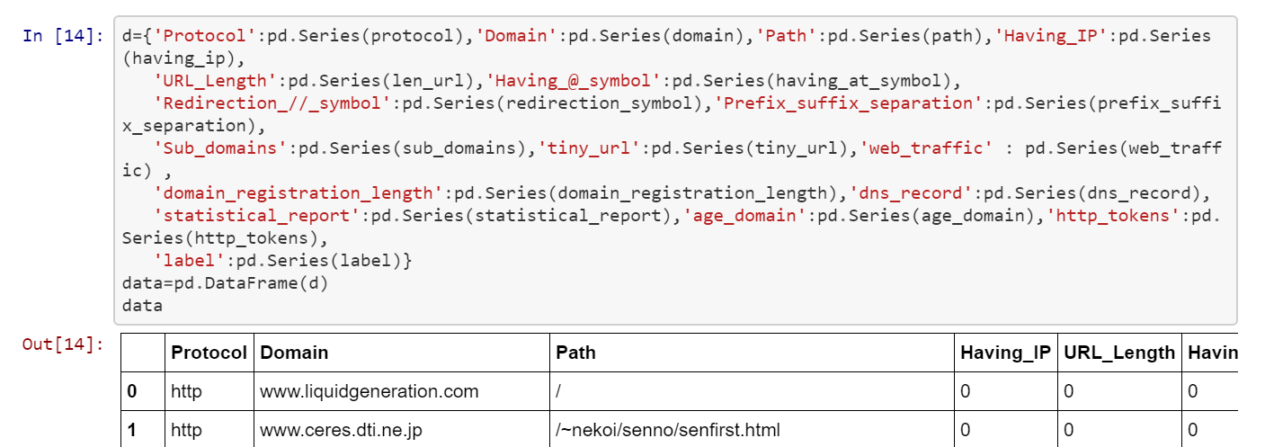
MAKING DATAFRAME & STORING IN CSV:

Slide 8
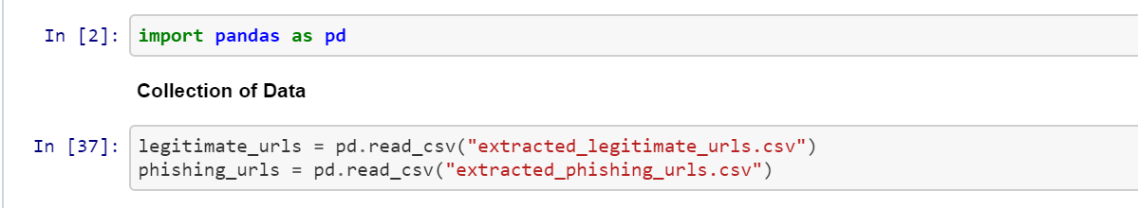
IMPLEMENTATION OF RANDOM FOREST ALGORITHM:

Slide 9
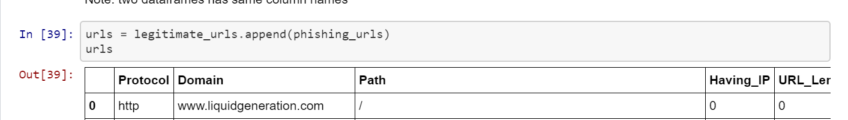
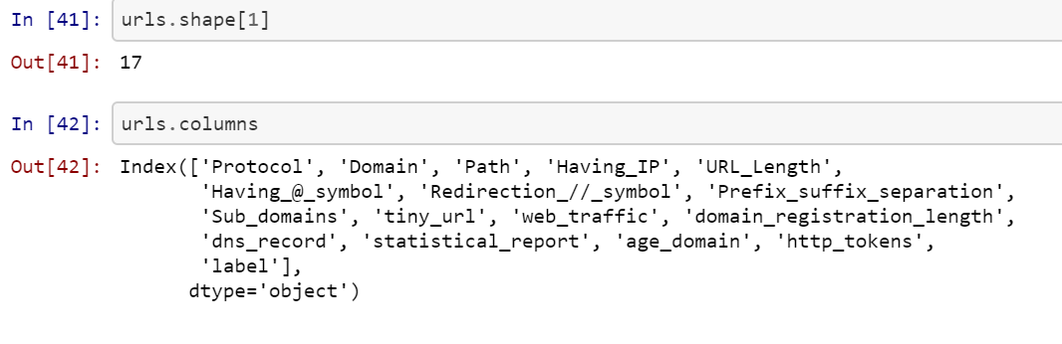
DATA PRE-PROCESSING:

Slide 10
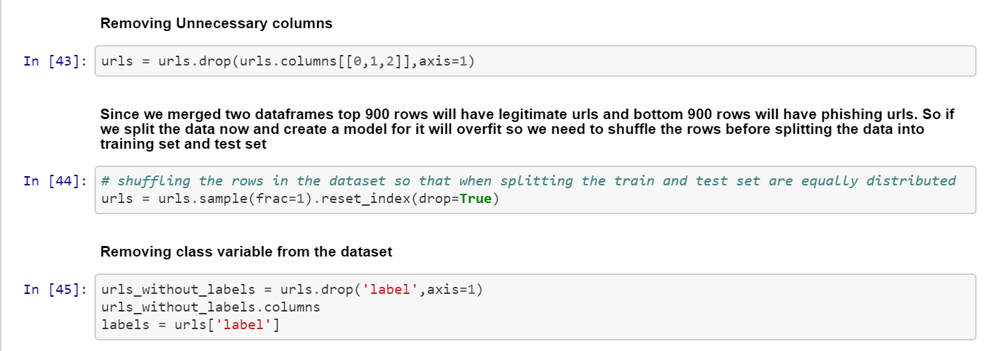

Slide 11
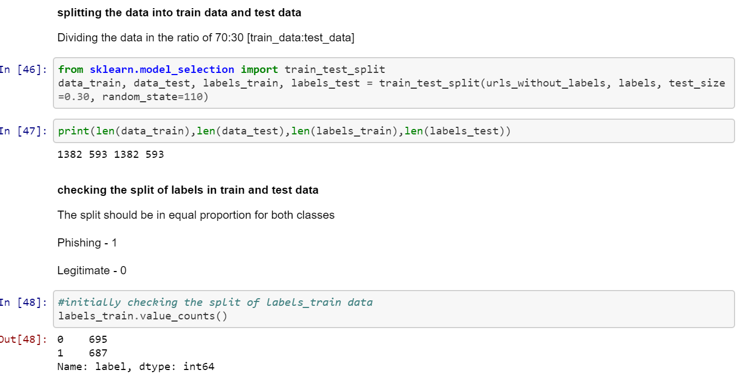

Slide 12
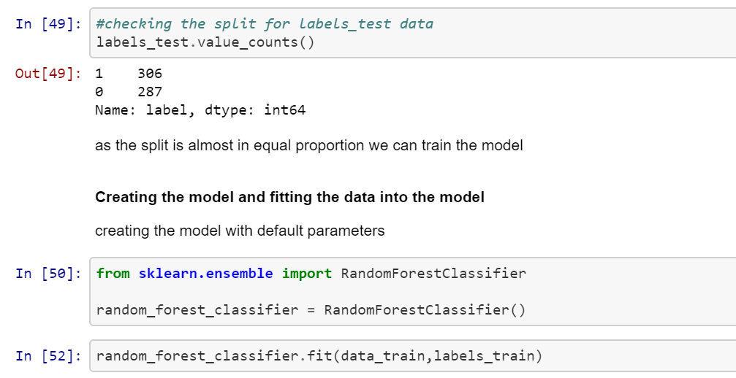

Slide 13
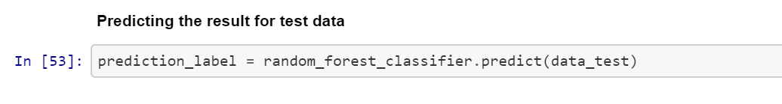
PREDICTING RESULT :

