Slide 1
Chapter 6:
Capturing the Requirements

Slide 2
Objectives
Describe/discuss/define:
Req. process, why & how important
Char. of functional & non-functional req.
Qualities of good req.
Completeness & consistency
Ways of defining req.
Static & dynamic methods
Key issues

Slide 3
Objectives
Describe/discuss/define:
Evolutionary & throw-away prototypes
Req. definition document
Req. specification document
Techniques for reviewing req.
Appropriate req. specification method

Slide 4
The Requirements Process
Definition of Requirement
  Feature of system
  Description of system
Process
  Action to determine the req.
Capable of doing
There is a purpose

Slide 5
The Requirements Process :
2 Documents
Req. definition
  Complete listing of customer’s system expectations
  High-level abstract description of req.
  Natural language + simple diagrams
  Limitations & constraints
  From customer-supplied info.
  Written for customers

Slide 6
The Requirements Process :
2 Documents
Req. specification
  Restates req. definition in technical terms
  For sys. designers to follow
  Detailed desc. → ? system should do
  Sets out sys. services in detail
  A.k.a. Functional Spec.
  Cust./User/Developer contract
  Written as a contract between customer and developer

Slide 7
The Requirements Process
S/W specification
  More detailed description
  Bridge req. process & design activities
  S/W abstracts → basis: design & implementation

Slide 8
The Requirements Process
Req^{n} Elicitation and Analysis
Req^{n} Definition and Specification
Problem
Analysis
Problem
Description
Prototyping
and testing
Documentation & Validation
Have we captured
all the user need?
Are we using
the right
techniques
or views?
Is this function
feasible?
Have we captured
what the user expects?
Feasibility study
Req^{n} Analysis
Req^{n} Definition
Req^{n} Specification
Feasibility Report
System models
Definition of req^{n}
Req^{n} Document
Specification of req^{n}

Slide 9
The Requirements Process
Req. elicitation
  Developers work with cust. :
    Asking questions
    Demonstrating similar systems
    Developing prototypes
  Problem analysis → identify:
    People
    Processes
    Resources
Req^{n} Elicitation and Analysis
Problem
Analysis
Problem
Description
Prototyping
and testing
Have we captured
all the user need?
Are we using
the right
techniques
or views?
Is this function
feasible?

Slide 10
The Requirements Process
Req. definition & spec.
  3 categories of req.:
    Must be met
    Highly desirable but not necessary
    Possible but could be eliminated
Req^{n} Definition and Specification
Documentation & Validation
Have we captured
what the user expects?

Slide 11
The Requirements Process
Req. definition & specification
  Doc. → formal agreement
    Req. → specific descriptions of functions/charateristics
    Req. → does not specify “how”
    (E.g. what DBMS or pgm. Lang. to use)

Slide 12
The Requirements Process
2 steps → ensuring req. fully mapped & understood:
  Verification → complete, correct & consistent requirements
  Validation → developers described what customer intends

Slide 13
Functional & Non
Functional req.
  Capture the intended behavior of the system ie. tasks or functions the system is required to perform.
  Use cases have quickly become a widespread practice for capturing functional requirements
  E.g. engine for a vehicle & invoice generation for a Debtors accounting system

Slide 14
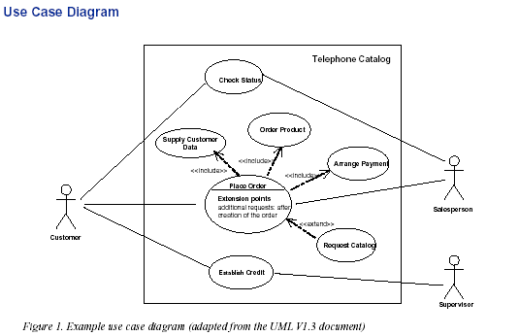
Functional & Non
Functional req.

Slide 15
Functional & Non
Non-functional req.
  Describes a restriction on the system
  Split into two types:
    performance and development.
Performance Constraints
  The response time for information to appear to a user.
  The number of hours a system should be available.
  The number of records a system should be able to hold.
  The capacity for growth of the system.
  The length of time a record should be held for auditing purposes.

Slide 16
Functional & Non
For the customer records example these might be:
  Information should be made available and be stored in a maximum of 3 seconds.
  The system should be available from 9am to 5 pm Monday to Friday.
  The system should be able to hold a 100,000 customer records initially.
  The system should be able to add 10,000 records a year for 10 years.
  A record should be fully available on the system for at least 7 years.

Slide 17
Functional & Non
Development constraints:
  Time - When a system should be delivered is the obvious time constraint.
  Resource - How much money is available to develop the system is obvious, but a key resource would be the amount of time business staff could spend in briefing system development staff.
  Quality - Any standards which are used to develop the system including project management, development methods etc.

Slide 18
Characteristics of Req.
Not only info. inflow & outflow& data transformation
Define systems constraints as well
Serves 3 purposes: -
  Enable understanding explanation to cust. needs (feedback tool)

Slide 19
Characteristics of Req.
Serves 3 purposes: -
  Outline req. functionalities & char. to designers (design req.)
  Test team → ? To demo. when convincing cust. (especially in User Acceptance Test)
Important → high quality

Slide 20
Characteristics of Req.
Characteristics:
  Are the req. correct?
    Ensure req. stated without error
    Developers & customer involved in the review
  Are the req. consistent?
    Making sure no conflicting or ambiguous req.

Slide 21
Characteristics of Req.
Characteristics:
  Are the req. complete?
    All possible states, state changes, inputs, products & constraints are described
    A system description can be:
      Externally complete – meets the environment desired by customer
      Internally complete – no undefined requirements

Slide 22
Characteristics of Req.
Characteristics:
  Are the req. realistic?
    Can it be done?
    Logic behind the req.
  Does each req. describe what cust. wants?
    Unjustifiable req. restricts developers unnecessarily
    Non-related functions?

Slide 23
Characteristics of Req.
Characteristics:
  Are the req. verifiable?
    Possibilities of test data sets generation
    To demonstrate that the req. have been met
  Are the req. traceable?
    Can each system function be traced to a set of req. that mandates it?
    Is it easy to find the set of req. that deals with a specific aspect of the system

Slide 24
How to Express Req.?
Natural language
  Problem
    Not precise & unambiguous
    Not easily separated system elements
    Difficult to trace back
  Solution
    Formal notation
    Automated tools

Slide 25
How to Express Req.?
Static Descriptions
  Indirect Reference
  Recurrence Relations
  Axiomatic Definition
  Expression as a Language
  Data Abstraction
    F(0)=1
    F(1)=1
    F(n+1)=F(n) + F(n-1)

Slide 26
How to Express Req.?
Dynamic Descriptions
  Decision Tables
  Functional Descriptions & Transition Diagrams
  Event Tables
  Petri Nets
  Object-oriented Specification

Slide 27
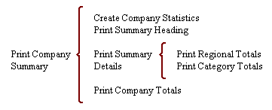
How to Express Req.?
Additional Req^{n} Notations
  Hierarchical Techniques (Warnier-Orr Diagram)
  Data Flow Diagrams (DFD)
  Software Req. Engineering Methodology (SREM)
  Structured Analysis & Design Technique (SADT)
  Formal Specification (Z)

Slide 28
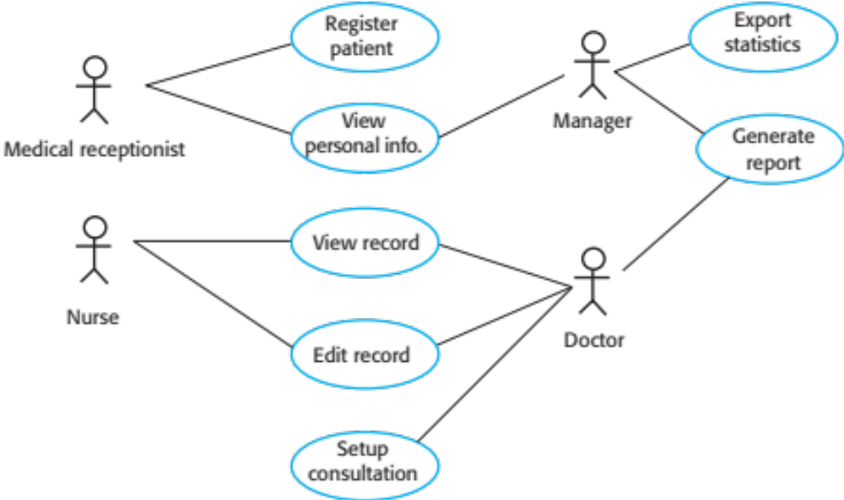
How to Express Req.?
UML

Slide 29
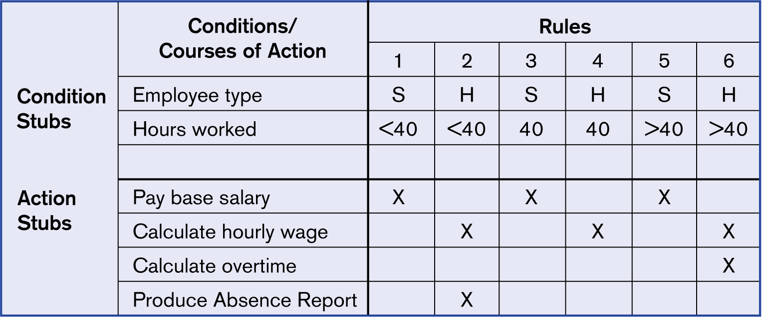
How to Express Req.?
Decision Tables

Slide 30
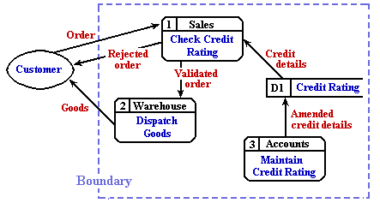
How to Express Req.?
Data Flow Diagram (DFD)
  You already know

Slide 31
Prototyping Req.
Throw-away prototype
  Problem learning
  Feasibility & solutions exploration
  Not intended for actual part of system
Evolutionary prototype
  Incremental in nature
  Intended for actual part of system
Both → rapid prototyping
Evaluate choices before design begins
Notes:
A throw-away prototype is software developed to learn more about a problem or explore the feasibility or desirability of possible solutions.
A throw-away prototype is exploratory and it is not intended to be used as an actual part of the delivered software.
Evolutionary prototype is developed to learn about a problem and form the basis for some or all of the delivered software.
Both techniques are sometimes called rapid prototyping because they build sections of the proposed system to determine the necessity, desirability or feasibility of reqns.
In rapid prototyping choices are evaluated before the design is created; the purpose of rapid prototype is to help us understand reqns and decide on the final design.
Prototyping helps us to select the right “look and feel” for the system’s interaction with users. Non functional and behavioural reqns can also involve prototypes.

Slide 32
Req. Process: Participants
Contract Monitors
Customers & Users
Business Managers
Designers
Testers

Slide 33
Req. Validation
Determine that
  Spec. consistent with definition
  Req. meet cust. needs
2 steps
  Trace: spec. → def.
  Trace: def. → spec.
Techniques
  Manual techniques – Eg. review
  Automated techniques

Slide 34
Choosing Req. Spec. Technique
No technique for all
Criteria:
  Applicability : Can the technique describe real-world problems and solutions in a natural and realistic way?
  Implementability : Can the specification be refined or translated into an implementation?

Slide 35
Choosing Req. Spec. Technique
Criteria:
  Testability : Can the specification be used to test the implementation?
  Checkability : Can someone who understands the problem being solved check the specification for accuracy?
  Maintainability : Will the specification be useful for maintenance activities ?

Slide 36
Choosing Req. Spec. Technique
Criteria:
  Modularity : Does the method allow a large specification to be decomposed into smaller parts that are more easily understood?
  Level of abstraction : From the user’s point of view, how closely and expressively can the specification elements describe the actual objects, actions and environment in the user’s domain?

Slide 37
Choosing Req. Spec. Technique
Criteria:
  Soundness : Either manually or with tool support, can we detect inconsistencies or ambiguities in the specification?
  Verifiability : Can we demonstrate formally that the specification satisfies the properties stated at each level of abstraction?

Slide 38
Choosing Req. Spec. Technique
Criteria:
  Run-time safety : If code can be generated automatically from the specification, does the code degrade gracefully under unexpected situations?
  Tools maturity : For any tools supporting the specification technique are they of high quality?
  Looseness : Can the specification be incomplete?

Slide 39
Choosing Req. Spec. Technique
Criteria:
  Learning Curve : Can a new user learn quickly the technique’s concept, syntax, semantics?
  Technique maturity : Has the technique been certified or standardized?

Slide 40
Choosing Req. Spec. Technique
Criteria:
  Data Modelling : Does the technique represent data, relationships or abstractions?
  Discipline : Does the technique force its users to write well-structured, understandable specifications?

