Slide 1

Database Systems Final Project
Fatima alsaadeh(fya7)

Slide 2
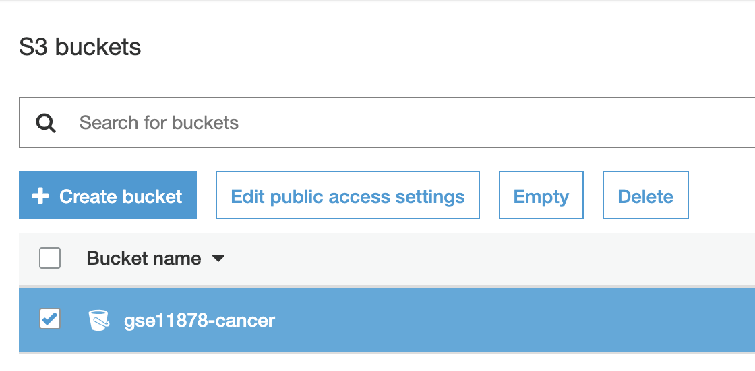

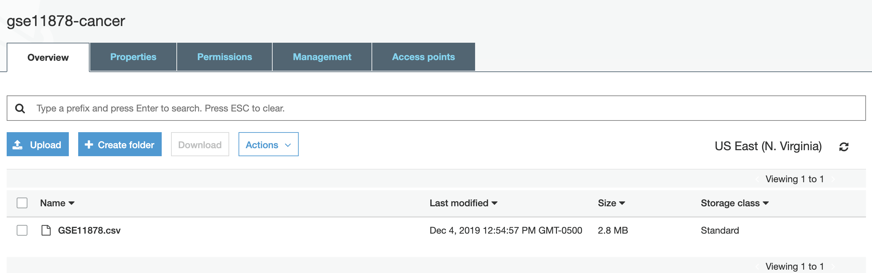
CREATE S3 Bucket and upload the GSE11878.csv File to it

Slide 3
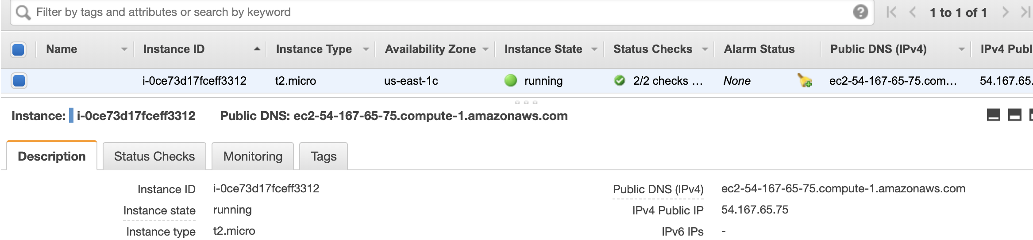
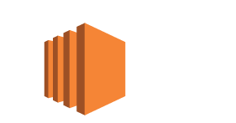

Create Ec2 instance and download the permission keys file

Slide 4
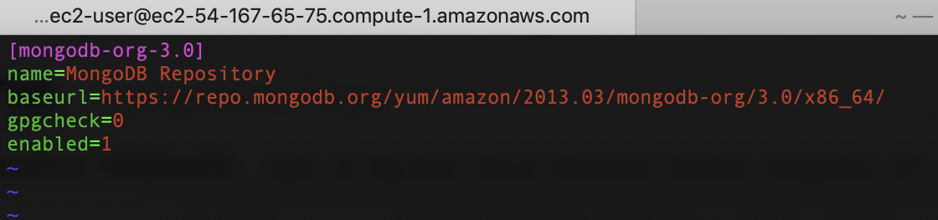
fatimaalsaadeh$ ssh -i"ec2mongo.pem" ec2-user@ec2-54-167-65-75.compute-1.amazonaws.com [ec2-user@ip-172-31-92-255 ~]$sudo vim /etc/yum.repos.d/mongodb-org-3.0.repo
[ec2-user@ip-172-31-92-255 ~]$ sudo yum install -y mongodb-org
[ec2-user@ip-172-31-92-255 ~]$ sudo service mongod start
Starting mongod (via systemctl): [ OK ]
Install mongodb on the ec2 instance

Slide 5
[ec2-user@ip-172-31-92-255 ~]$ mongo > use cancer switched to db cancer
- Install MONGODB COMPASS https://www.mongodb.com/products/compass
- Connect it to the ec2 instance and it will help you with checking the data in a nice GUI with dashboards
Create Database

Slide 6
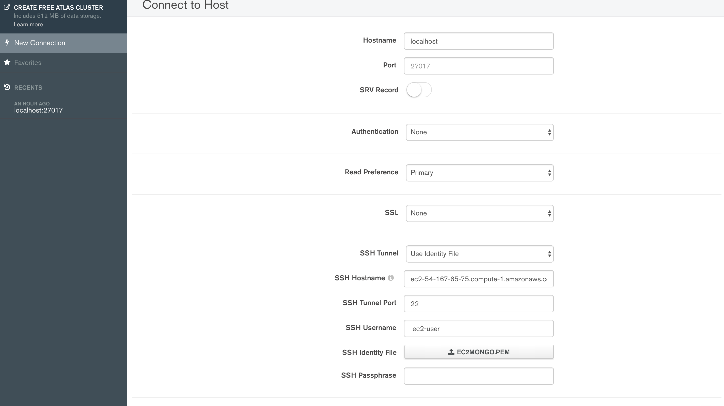
MONGODB COMPASS

Slide 7
[ec2-user@ip-172-31-92-255 ~]$ aws s3 cp s3://gse11878-cancer/GSE11878.csv . download: s3://gse11878-cancer/GSE11878.csv to ./GSE11878.csv [ec2-user@ip-172-31-92-255 ~]$ mongoimport -d cancer -c GSE11878 --type csv --file GSE11878.csv –headerline [ec2-user@ip-172-31-92-255 ~]$ mongo > .
Download s3 file and import to mongodb as csv

Slide 8
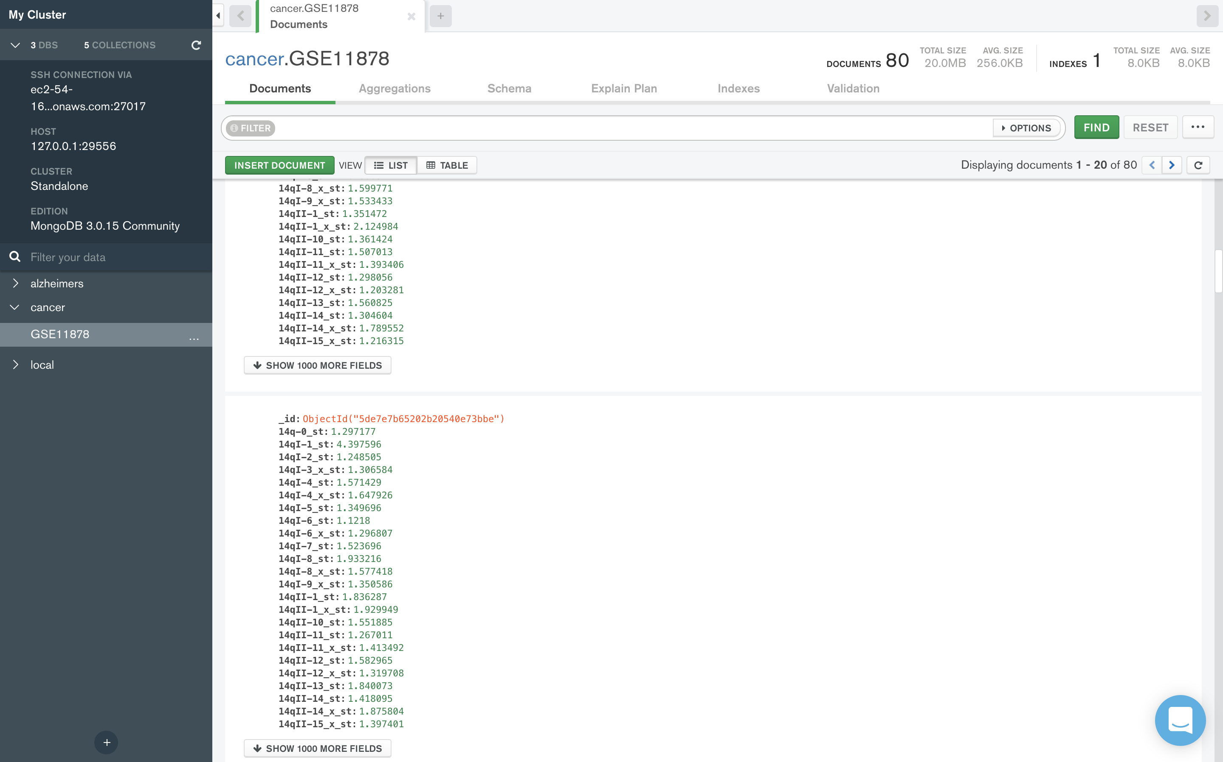
Check the database, collection and the data in mongodb compass

Slide 9
[ec2-user@ip-172-31-92-255 ~]$ mongo switched to db cancer > db.GSE11878.aggregate( ... [ ... { ... $group : ... { ... _id : "$target_actual", ... Avg14g : { $avg: "$14q-0_st" } ... ... } ... } ... ] ... ) { "_id" : "2-Cancer", "Avg14g" : 1.3777833 } { "_id" : "1-Control", "Avg14g" : 1.3986889 }
Aggregation and Results

Slide 10
Results
{ "_id" : "2-Cancer", "Avg14g" : 1.3777833 } { "_id" : "1-Control", "Avg14g" : 1.3986889 }

Slide 11
Thanks

