Slide 1

Database Systems OLAP and Data Mining
Harsha Mangnani Fatima alsaadeh

Slide 2
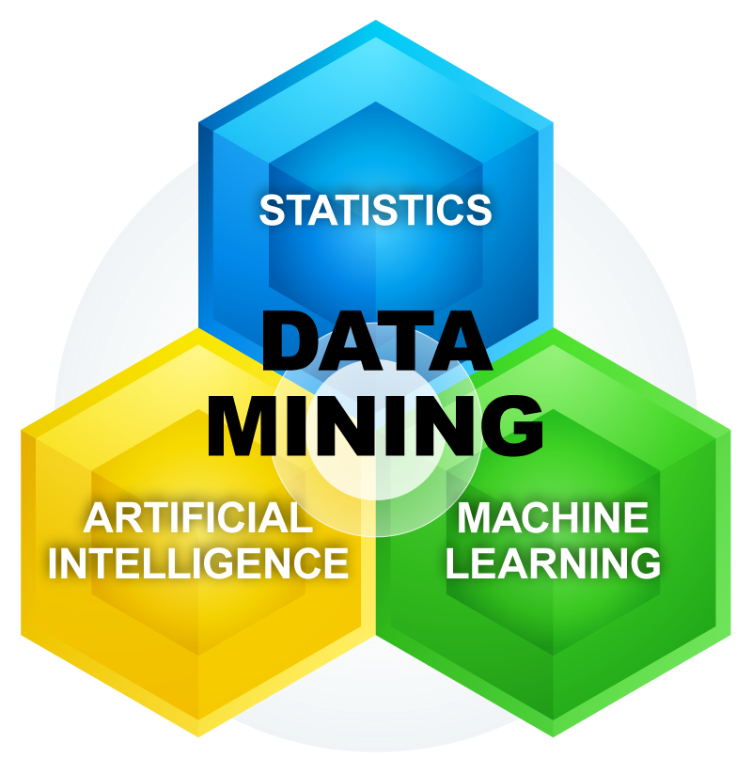


Slide 3
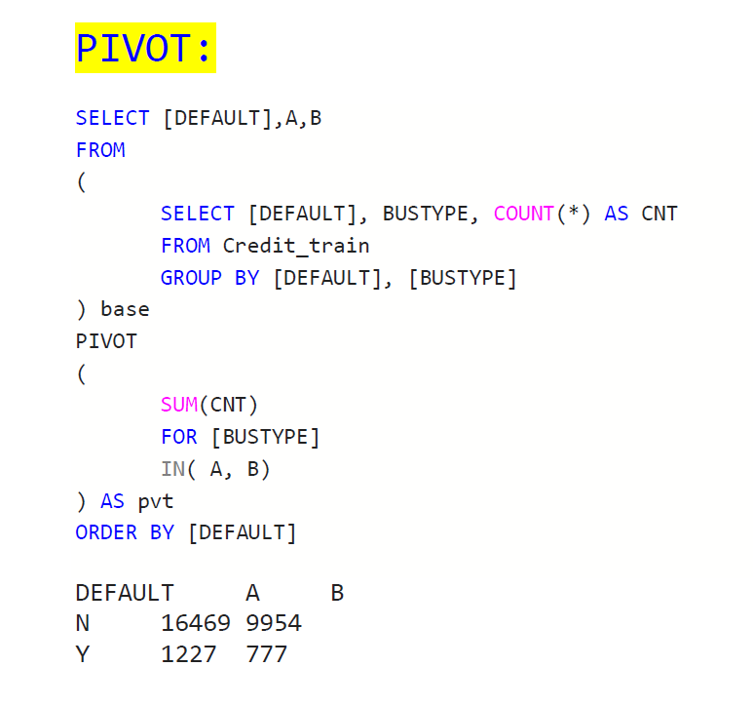
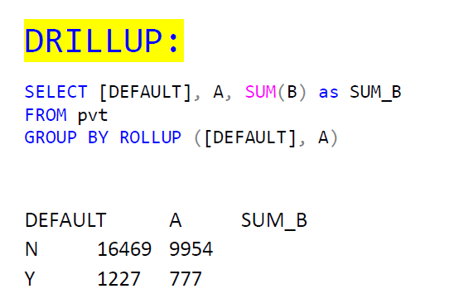
A pivot or cross-table is a popular data summarization tool
It essentially cross-tabulates a set of dimensions in such a way that multidimensional data can be represented in a two-dimensional tabular format
Drill-up (Roll-up) refers to aggregating the current set of fact values within or across one or more dimensions.

Slide 4
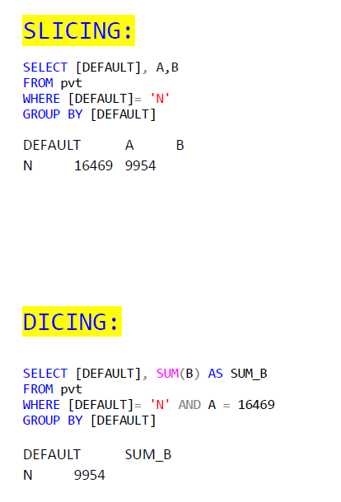
Slicing represents the operation whereby one of the dimensions is set at a particular value
Dicing corresponds to a range selection on one or more dimensions

Slide 5
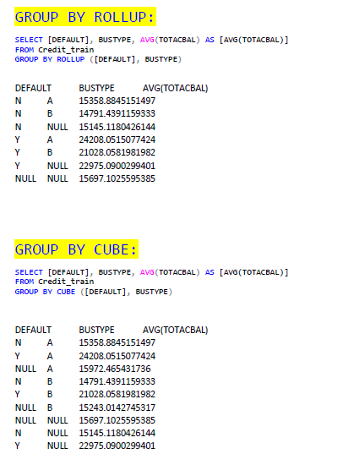
ROLLUP operator computes the union on every prefix of the list of specified attribute types, from the most detailed up to the grand total
ROLLUP operator computes the union on every prefix of the list of specified attribute types, from the most detailed up to the grand total
Key difference between the ROLLUP and CUBE operator is that the former generates a result set showing the aggregates for a hierarchy of values of the specified attribute types, whereas the latter generates a result set showing the aggregates for all combinations of values of the selected attribute types
Key difference between the ROLLUP and CUBE operator is that the former generates a result set showing the aggregates for a hierarchy of values of the specified attribute types, whereas the latter generates a result set showing the aggregates for all combinations of values of the selected attribute types
The CUBE operator computes a union of GROUP BY’s on every subset of the specified attribute types
The CUBE operator computes a union of GROUP BY’s on every subset of the specified attribute types

Slide 6
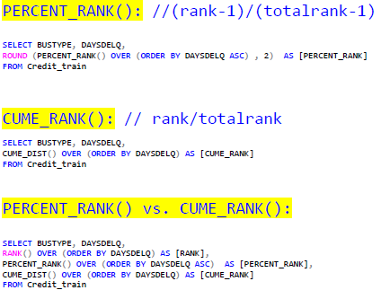
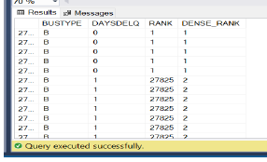
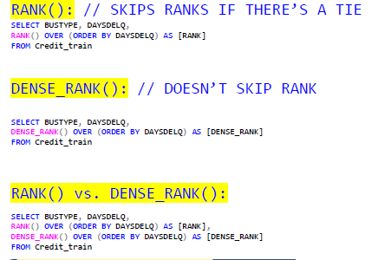
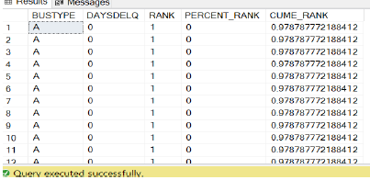

Slide 7
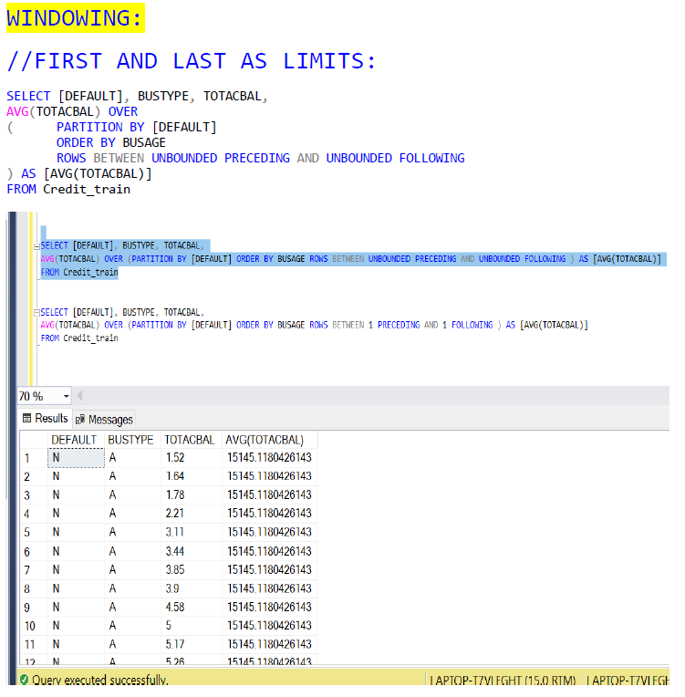
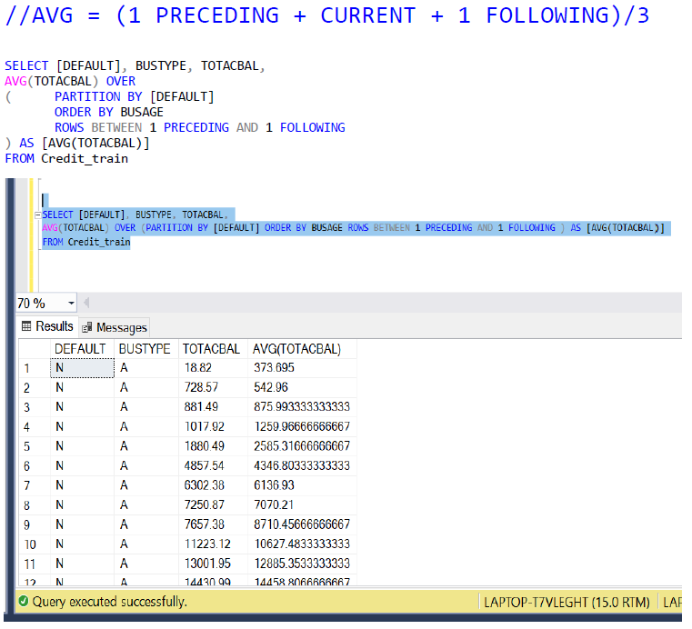

Slide 8


Slide 9
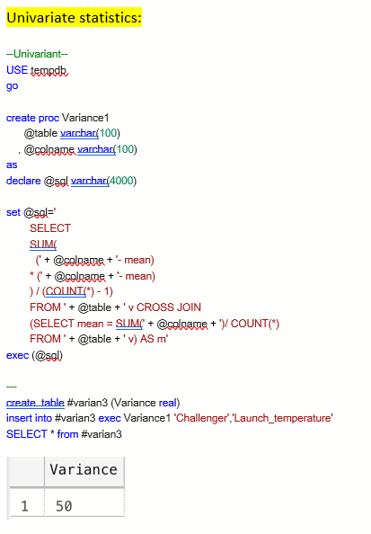
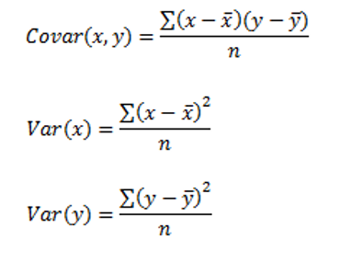

Slide 10
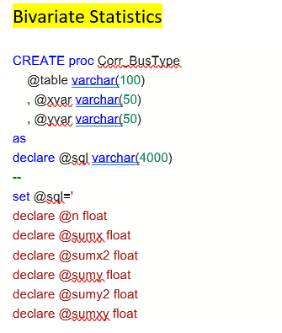
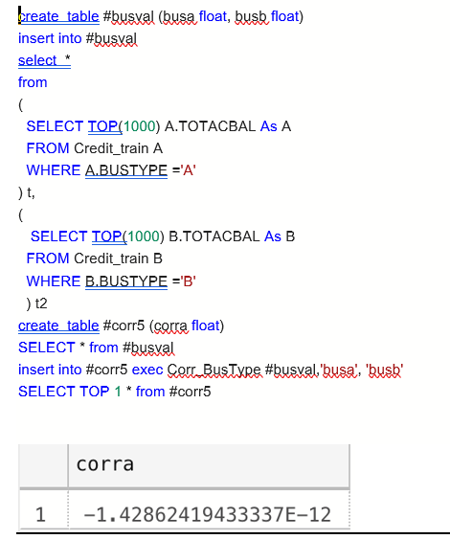
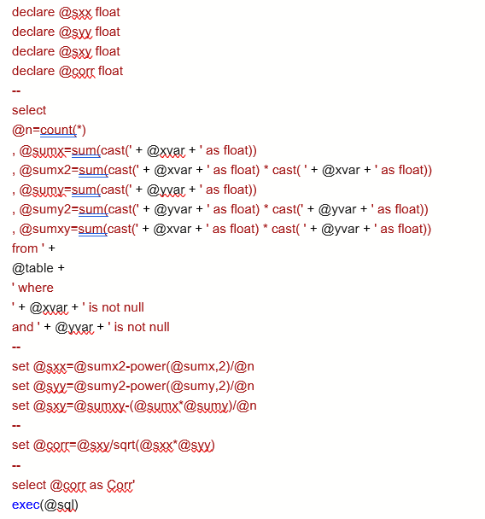

Slide 11
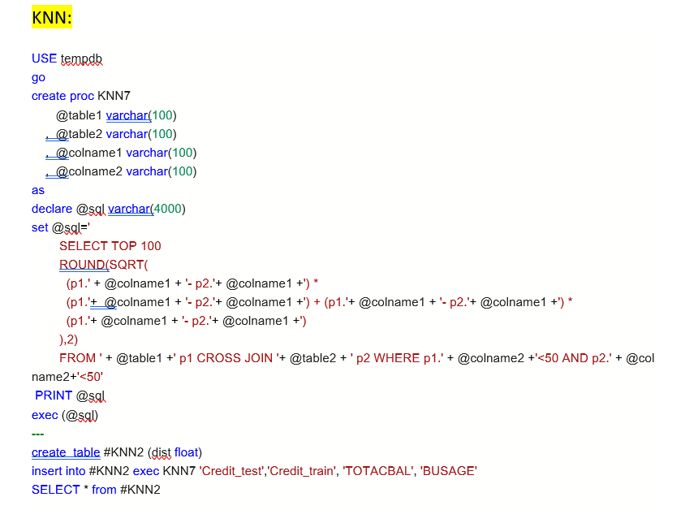
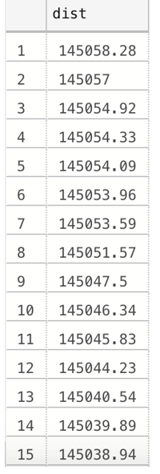
ROLLUP operator computes the union on every prefix of the list of specified attribute types, from the most detailed up to the grand total
Key difference between the ROLLUP and CUBE operator is that the former generates a result set showing the aggregates for a hierarchy of values of the specified attribute types, whereas the latter generates a result set showing the aggregates for all combinations of values of the selected attribute types
The CUBE operator computes a union of GROUP BY’s on every subset of the specified attribute types

Slide 12
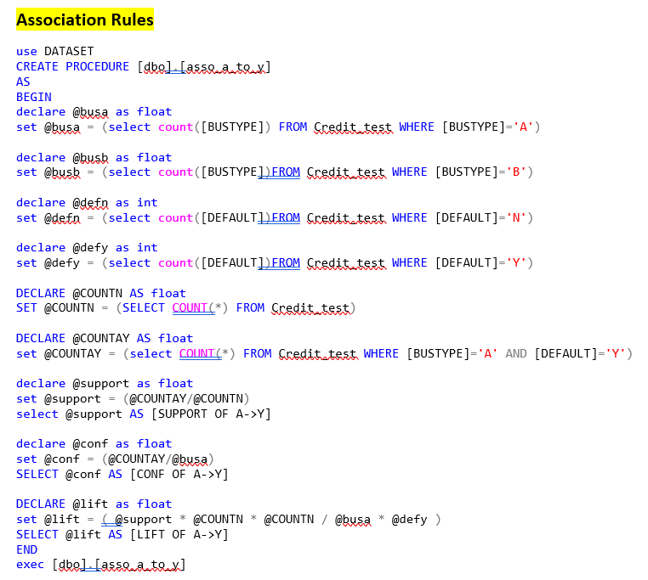
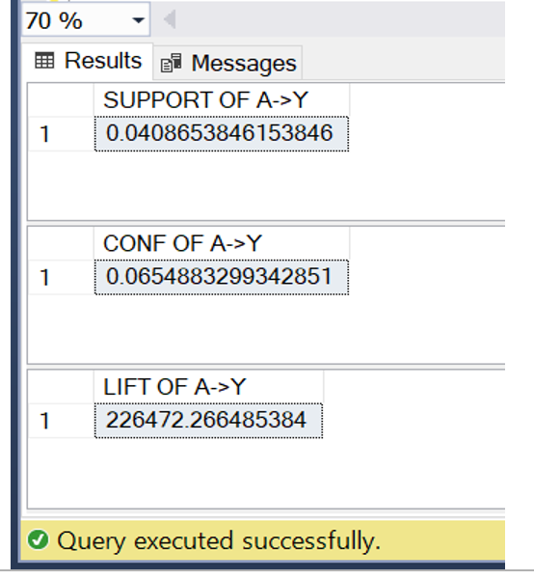
ROLLUP operator computes the union on every prefix of the list of specified attribute types, from the most detailed up to the grand total
Key difference between the ROLLUP and CUBE operator is that the former generates a result set showing the aggregates for a hierarchy of values of the specified attribute types, whereas the latter generates a result set showing the aggregates for all combinations of values of the selected attribute types
The CUBE operator computes a union of GROUP BY’s on every subset of the specified attribute types

Slide 13
Questions ?
Thanks

