Slide 1
Predicting Diabetics in Pima Indians
Fatima AlSaadeh – fya7
Naveen Narayanan M – nm941

Slide 2
Project Goals
Diabetes is a disease that occurs when blood glucose, also called blood sugar, is too high.
We propose to design and develop a supervised learning model for predicting whether a patient has diabetes or not
The data set for this project is taken from the National Institute of Diabetes and Digestive and Kidney Diseases.
All patients in this data set are females at least 21 years old of Pima Indian heritage.
The Pima Indians are a group of Native Americans living in an area consisting of what is now central and southern Arizona.

Slide 3
Data Dictionary
Column Names | Description
Pregnancies | Number of times pregnant
Glucose | Plasma glucose concentration a 2 hours in an oral glucose tolerance test
Blood Pressure | Diastolic blood pressure (mm Hg)
Skin Thickness | Triceps skin fold thickness (mm)
Insulin | 2-Hour serum insulin (mu U/ml)
BMI | Body mass index (weight in kg/(height in m)^2)
Diabetes Pedigree Function | A function which scores likelihood of diabetes based on family history
Age | Age (years)
Outcome | Class variable (0 or 1) 268 of 768 are 1 (Diabetic), the others are 0 (Non Diabetic)

Slide 4
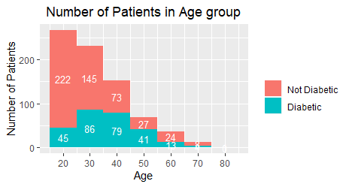
Findings and Insights

Slide 5
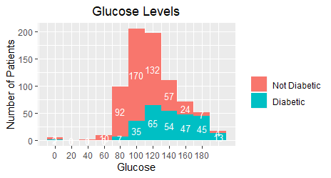
Findings and Insights

Slide 6
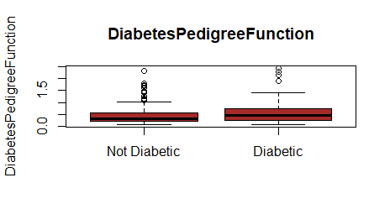
Findings and Insights

Slide 7
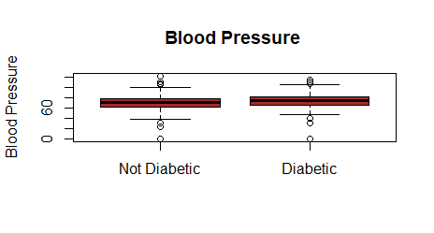
Findings and Insights

Slide 8
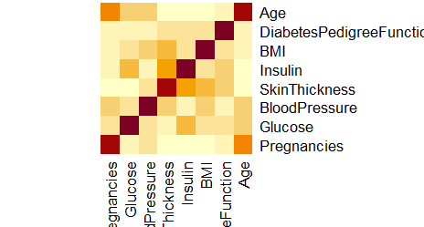
Findings and Insights

Slide 9
Logistic Regression Model
Coefficients | Estimate | Std. Error | z value | Pr(>|z|)
Intercept | -8.289381 | 1.154763 | -7.178 | 7.05e-13 ***
Pregnancies | 0.121318 | 0.042238 | 2.872 | 0.00408 **
Glucose | 0.031757 | 0.005699 | 5.572 | 2.52e-08 ***
Blood Pressure | -0.0115309 | 0.0066064 | -1.745 | 0.08091 .
Skin Thickness | 0.003796 | 0.008498 | 0.447 | 0.65507
Insulin | -0.001240 | 0.001112 | -1.115 | 0.26478
BMI | 0.103080 | 0.024031 | 4.290 | 1.79e-05 ***
Diabetes Pedigree Function | 0.943684 | 0.368775 | 2.559 | 0.01050 *
Age | 0.006497 | 0.012229 | 0.531 | 0.59526

Slide 10
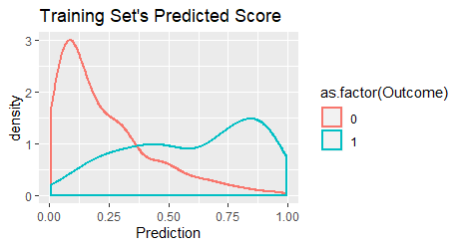
Logistic Regression Model - Plots

Slide 11
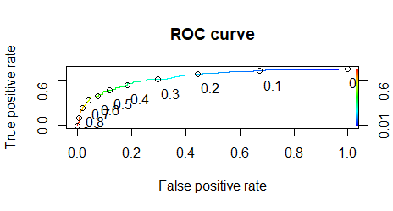
Logistic Regression Model - Results

Slide 12
Logistic Regression Model - Results
Confusion Matrix – Train Data
 | Reference - 0 |  | Reference - 1
Prediction – 0 | 249 |  | 36
Prediction – 1 | 96 |  | 137
Accuracy |  | 74.22%
Sensitivity |  | 78.44%
Specificity |  | 72.17%
Confusion Matrix – Test Data
 | Reference - 0 |  | Reference - 1
Prediction – 0 | 118 |  | 23
Prediction – 1 | 37 |  | 78
Accuracy |  | 76.56%
Sensitivity |  | 77.23%
Specificity |  | 76.13%

Slide 13
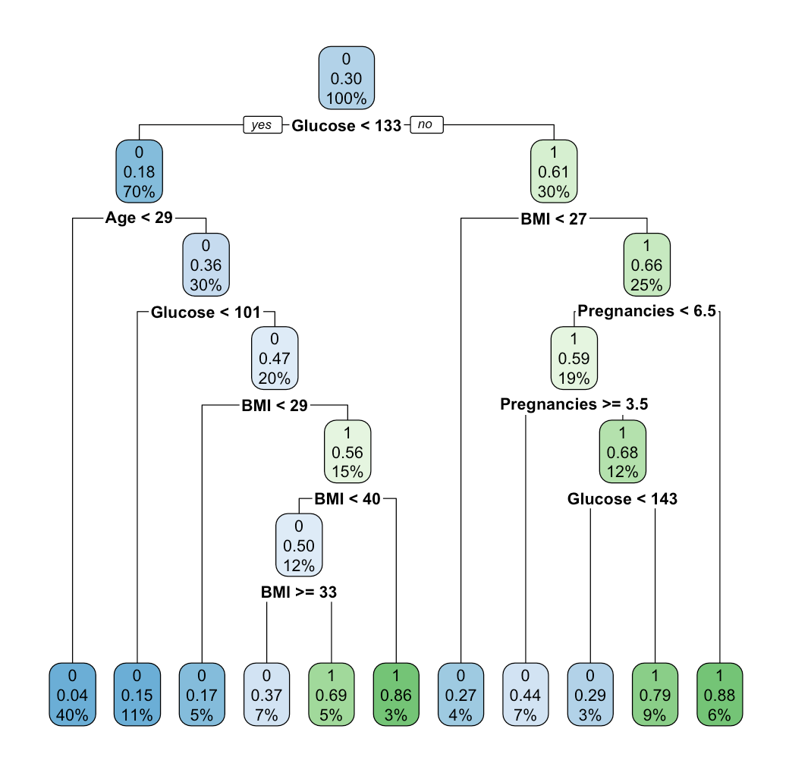
Decision Trees

Slide 14
Decision Tree Model - Results
Confusion Matrix – Train Data
 | Reference - 0 |  | Reference - 1
Prediction – 0 | 317 |  | 48
Prediction – 1 | 28 |  | 108
Accuracy |  | 85.16%
Sensitivity |  | 71.26%
Specificity |  | 91.88%
Confusion Matrix – Test Data
 | Reference - 0 |  | Reference - 1
Prediction – 0 | 140 |  | 50
Prediction – 1 | 15 |  | 51
Accuracy |  | 74.61%
Sensitivity |  | 50.50%
Specificity |  | 90.32%

Slide 15
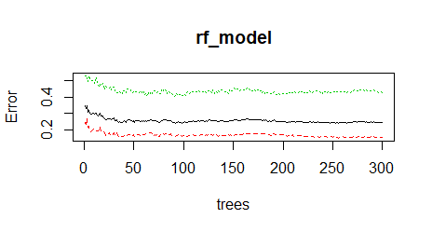
Random Forest

Slide 16
Random Forest Model - Results
Confusion Matrix – Train Data
 | Reference - 0 |  | Reference - 1
Prediction – 0 | 345 |  | 0
Prediction – 1 | 0 |  | 167
Accuracy |  | 100.00%
Sensitivity |  | 100.00%
Specificity |  | 100.00%
Confusion Matrix – Test Data
 | Reference - 0 |  | Reference - 1
Prediction – 0 | 135 |  | 32
Prediction – 1 | 27 |  | 62
Accuracy |  | 76.95%
Sensitivity |  | 83.33%
Specificity |  | 65.96%

Slide 17
Future Work
We can improve these models by adding extra features and fine tuning them
In the logistic regression model, we can choose a cost function and that can be used to set a more accurate threshold value
Apart from the 3 model we could have tried other advanced models such as Ada Boosting trees, Gradient Boosting in Random forest, Deep Learning and Neural Network models

Slide 18
References
https://www.niddk.nih.gov/health-information/diabetes/overview/what-is-diabetes
https://www.endocrineweb.com/conditions/type-1-diabetes/what-insulin
https://en.wikipedia.org/wiki/Pima_people
https://bmcendocrdisord.biomedcentral.com/articles/10.1186/s12902-019-0436-6
https://www.geeksforgeeks.org/confusion-matrix-machine-learning/

Slide 19
References
https://www.dataschool.io/simple-guide-to-confusion-matrix-terminology/
https://webfocusinfocenter.informationbuilders.com/wfappent/TLs/TL_rstat/source/LogisticRegression43.htm
https://discuss.analyticsvidhya.com/t/what-is-null-and-residual-deviance-in-logistic-regression/2605
https://stats.stackexchange.com/questions/110969/using-the-caret-package-is-it-possible-to-obtain-confusion-matrices-for-specific
https://www.healthnewsreview.org/toolkit/tips-for-understanding-studies/understanding-medical-tests-sensitivity-specificity-and-positive-predictive-value/

Slide 20
Thank You

