Slide 1
INTERNAL · CREATOR STRATEGY
Bambora's Creator
Partnership Strategy
September 2026
Notes:
Framing: this is our creator partnership strategy for the next two months.

Slide 2
THE PREMISE
Every brand follows a
different playbook.
Notes:
No universal right answer. Two examples that sit at opposite extremes.

Slide 3
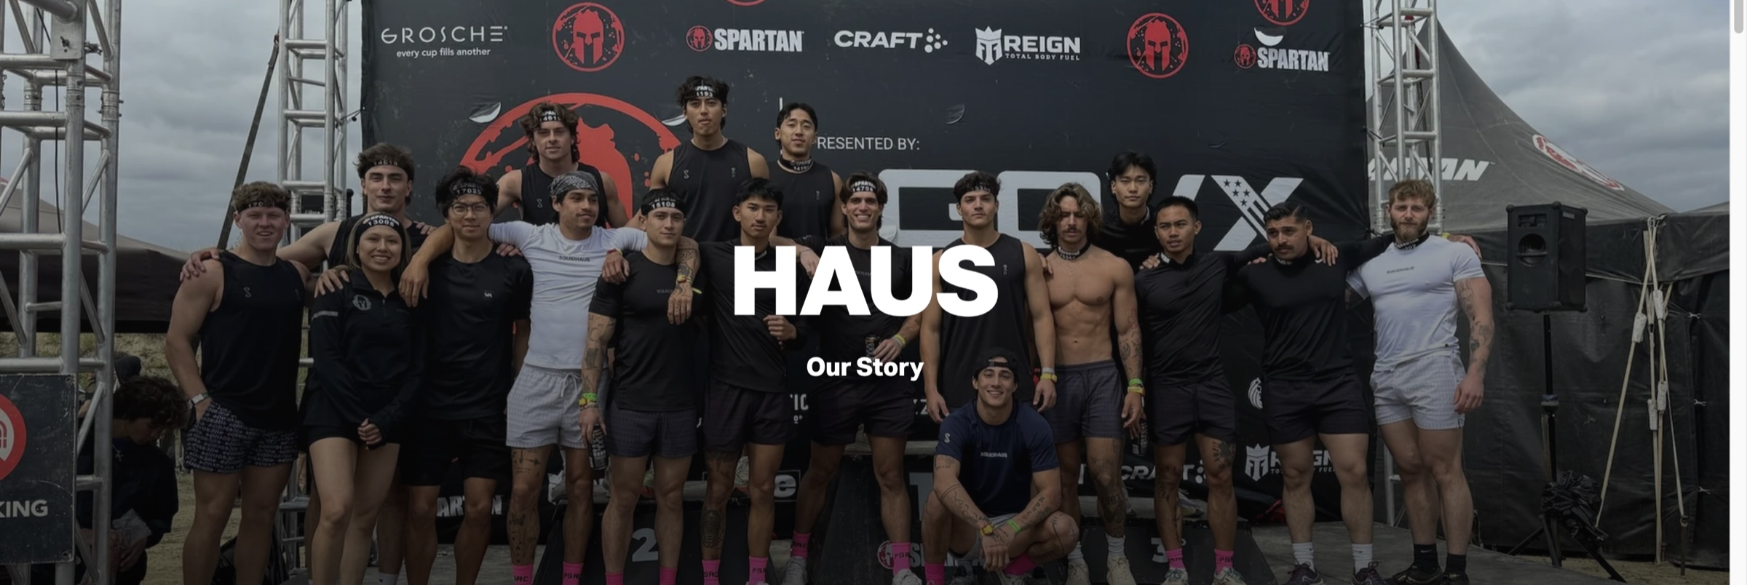
PLAYBOOK ONE
Haus
A very high barrier to entry.
15%
of ad spend — the commission he puts on the table.
$2,000
retainer for every creator who made it into his Discord.
6 months
of zero revenue, spent training instead of selling.
HAUS — gohaus.com
Notes:
High barrier, heavy upfront investment, revenue deliberately deferred.

Slide 4
THE PHILOSOPHY
You don't hire a
good creator.
You train a
good creator.
Potential over polish
He filtered for upside, not for skill that already existed.
The retainer bought focus
Mortgage paid, bills paid — now they can concentrate on learning.
Not everyone gets in
For a while he cast only jacked guys; testing skinny guys did not work out.
— Haus's founder
The trade: profit deferred for six months, creators paid out of his own pocket.
Notes:
He is bullish that good creators are trained, not hired.

Slide 5
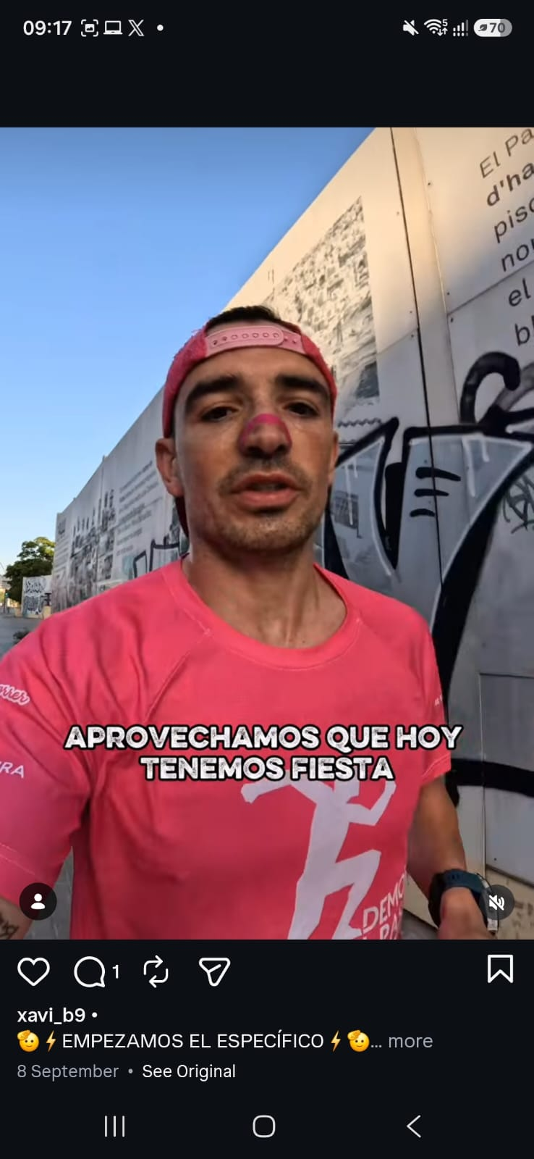
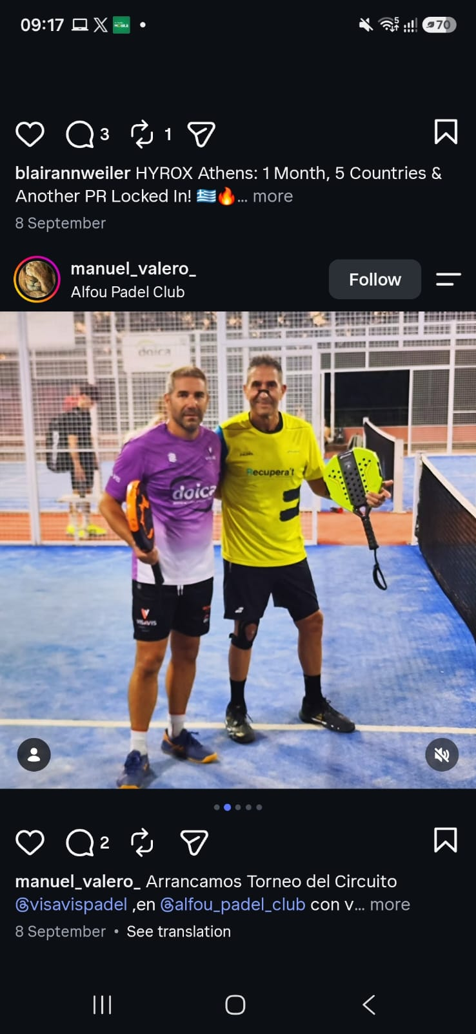
PLAYBOOK TWO
Hi Strips
Say yes to everybody.
Never
a retainer has been paid — not even to their best on TRYBE.
5%
commission. That is the entire deal, top to bottom.
Zero views
and they still get product. Entirely on purpose.
Creators at any scale, posting anyway.
Notes:
They refuse nobody and pay nobody a retainer. It is working — they are a big brand.

Slide 6
WHY IT WORKS
It isn't about creator ROI.
It's about retail.
1
2
3
Product to everyone
Volume creates demand
Retail opens
Any creator, any scale, no filter — it all goes out.
A constant stream of content makes the brand look like it is everywhere.
Buyers watch what is trending. They walk into those rooms already known.
The good ones graduate to TRYBE. Still no retainer.
Notes:
From the masterclass: being everywhere is what opened the retail doors.

Slide 7
SIDE BY SIDE
Neither one is wrong.
It depends on where we are in our journey.
HAUS
HI STRIPS
Barrier to entry
Very high
None
Retainer
$2,000 per creator
Never, at any level
Commission
15% of ad spend
5%
Time to revenue
Six months of nothing
Immediate reach
The endgame
A trained, elite bench
Retail distribution
Notes:
There is no right or wrong strategy — only the one that fits the stage we are at.

Slide 8
OUR PLAYBOOK
We sit in between.
Earning from day one, and still investing in our creators.
BAMBORA
HI STRIPS
HAUS
No barrier
Very high barrier
Revenue from day one
We invest in our creators
A filter, not a wall
Not six months from now.
Unlike Hi Strips, we put something in.
The bar is not high. It is not low either.
Notes:
Not Haus, not Hi Strips. The middle, for at least the next two months.

Slide 9
THE CREATORS WE HAVE
Where we start.
01
Keep the top 10
Our ten best creators of all time stay on exactly the rate they are on today: 12%.
02
Let the rest go
Nobody holds that level of quality for a 5% commission. That is human psychology.
03
No retainers on top
At 12% commission, adding a retainer makes a creator unprofitable for us.
04
Train deeper
Fewer creators, far more specific direction from me on every brief.
Notes:
Goal: make money from the very beginning rather than waiting six months.

Slide 10
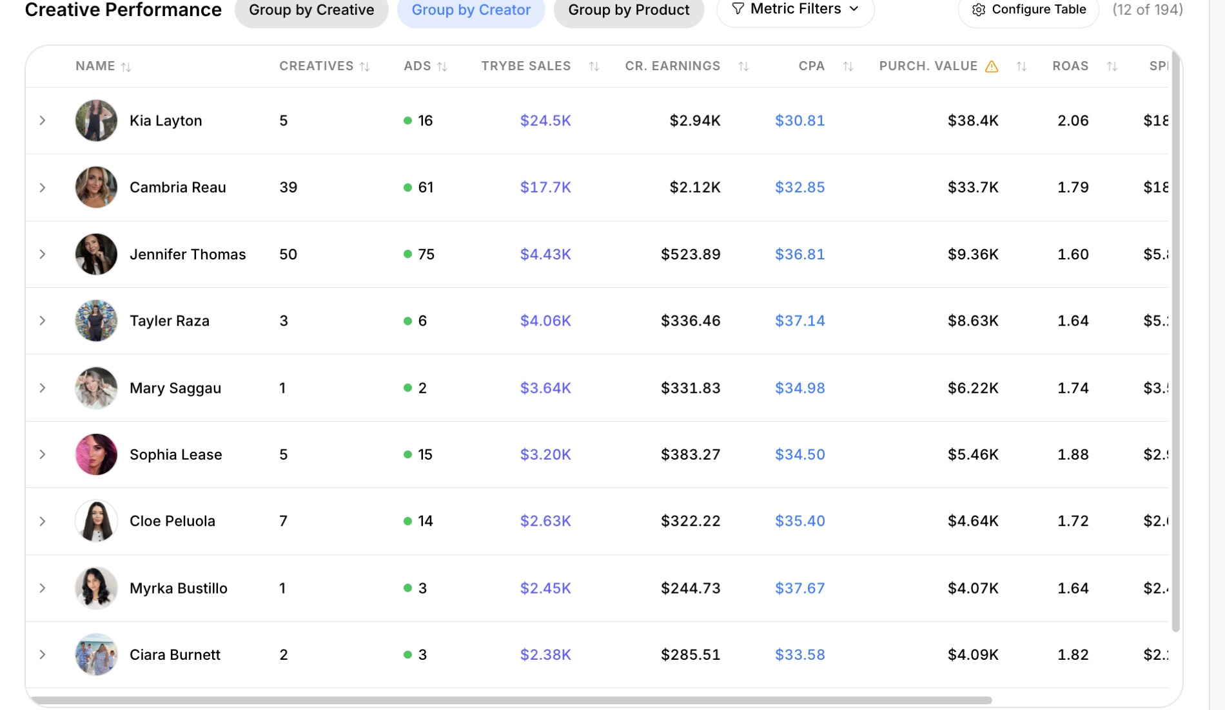
THE TOP 10
The ten we keep.
Notes:
Creative Performance grouped by creator, ranked on TRYBE sales. These are the ten that stay on 12%.

Slide 11
CONCENTRATION
Two creators are most of it.
TRYBE sales, all time. Within the top nine, two creators are 65% of the total.
Notes:
Only the top nine are shown, out of 194 creators. Kia Layton and Cambria Reau together are about 65% of this group.

Slide 12
HOW WE INVEST
We train them.
The barrier is the training, not the rate.
The checklist tool
Weekly drops
Dos and don'ts they fill in, not a document they read. Interactive, and quick. Live Thursday.
New inspiration, new hooks and fresh data. Every single week, without fail.
My calendar, open
Real feedback
A Calendly link they can use to book a call with me whenever they want one.
Notes, redos and explanations on every submission through the whole first month.
Creators who think you are just a UGC manager never feel prioritised. That is not how I run it.
Notes:
The tool is a checklist they fill in rather than a doc they read. Built by Thursday.

Slide 13
MONTH ONE
Who we onboard.
A new campaign: 5% of GMV, paid weekly.
Cast a wide net, approve only the good
Anyone I see real potential in gets a shot at 5%.
Portfolio over GMV
I would normally gate on a GMV threshold. Our TAM is too small for that, so I judge the videos in their portfolio instead.
Men and women, deliberately
Not only women. The reason is on the next slide.
The clock starts on delivery
Month one means 30 days from the product landing, not from signing. Shipping takes one to two weeks, and we keep talking to them throughout.
Notes:
Wide net, but only the good get approved. Judged on portfolio because our TAM is small.

Slide 14
FROM THE DATA
25%
Most of our customers are women. But put a man in the video and we unlock an audience we are not reaching today.
of buyers on the ads Isla walked me through were men.
That is why the new campaign onboards both.
Men 25%
Women 75%
Notes:
From the data Isla walked me through. Real room to grow the male audience.

Slide 15
TIERS
Not yet.
Tiers only work if there is something to aspire to.
1
2
3
4
Onboard at 5%
Product ships
Creatives go live
First results
Then — and only then — we introduce tiers.
Introducing them now means giving the current TRYBE and Discord batch more incentive on an already thin margin. We cannot offer 15%, and 12% is already too much.
Notes:
Tiers arrive once the first batch has product, creatives up, and results in.

Slide 16
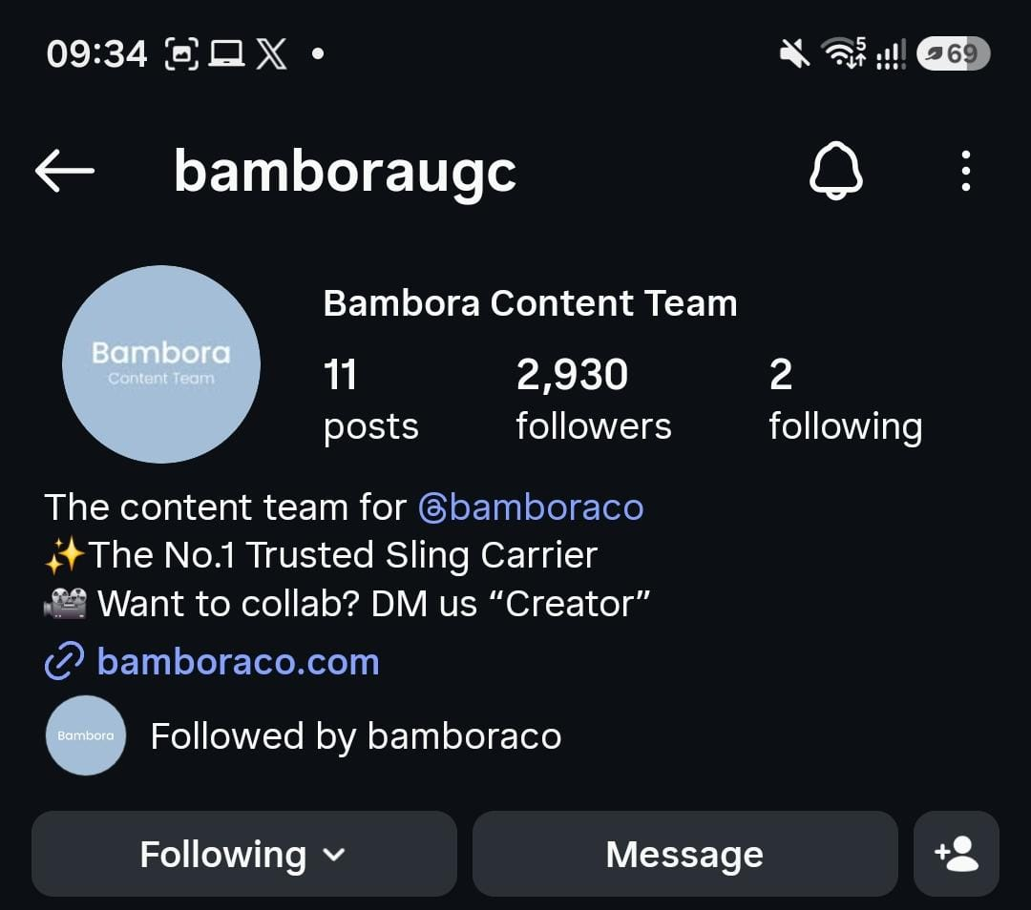
THE PIPELINE
Instagram
feeds TRYBE.
Good creators should not be making videos for free.
1
They come to us
The DMs we already get, plus outreach Yelly and I refine together.
2
We vet them
TikTok Shop experience, and a portfolio worth backing.
3
They join TRYBE
On the 5% campaign, with the whole training stack behind them.
@bamboraugc — 2,930 followers
Notes:
Instagram becomes the top of the funnel for TRYBE rather than a free-video channel. I need access to the account to run this properly.

Slide 17
OPEN
Four things to decide.
1
Are we on board?
2
Jennifer
5% of GMV, paid weekly, onboarding men and women. I need a yes before I build the new campaign.
Still on TRYBE. Liam raised moving her back to a straight retainer. Tell me which way and I will have that conversation.
3
Instagram access
4
The creators we move on from
I want to be hands-on with the messaging and the outreach, working alongside Yelly.
We have already told them exciting things were coming. We need to agree how we land that.
Notes:
The sign-off I need before building the campaign, plus the three open conversations.

