Slide 1
Creative Engine
Updates &
Next Steps
Fatima · September 2026

Slide 2
Updates
01
Creative engine workspace
Built the Notion workspace for the creative engine.
What got done
02
Ad account audit
Watched all of our existing ads to learn what's working, what isn't, and how our customers talk.
03
Team alignment
Internal creative strategy with Isla. Creator outreach strategy with Yelly.
04
Trybe strategy
New creator brief, a safety guidelines checklist, and inspo.
05
Miscellaneous
Team comms, Shopify website builder skills for Liam, and automating part of Yelly's reporting.

Slide 3
Trybe strategy
The 10 staying on 12%
# | Creator | Trybe sales | Sales per $1
1 | Cambria Reau | $15,670 | 0.96
2 | Tayler Raza | $3,863 | 0.82
3 | Mary Saggau | $3,640 | 1.02
4 | Sophia Lease | $3,040 | 1.10
5 | Myrka Bustillo | $2,450 | 0.98
6 | Ciara Burnett | $2,376 | 1.06
7 | Carissa Lyman | $2,250 | 0.72
8 | Cassie Avery Charvat | $2,010 | 1.17
9 | Tasha Clay | $1,920 | 1.20
10 | Lilly Clark | $1,861 | 0.81
Who stays on which commission
12%
Only 10 creators stay here: our top 10 non-sale ads creators.
5%
Everyone else moves to the 5% program.
Out
Creators who haven't agreed to 5% get dropped, and we move on to new creators.
Non-sale ads, Trybe attribution only.

Slide 4
Who goes where
We work both channels, and spend the time where the leverage is
Trybe
Social Snowball
Creators with TikTok Shop experience, plus IG creators with good yapper content.
Everyone else gets our Social Snowball link. Ties back to the strategy Histrips is following.
Both get our training material and top performing angles. There's potential to train them into good retainer-based creators eventually.
Efficiency rule: the bulk of our time goes to high GMV, high potential creators on Trybe. Everyone else gets something automated, like the weekly inspo on the inspo site.

Slide 5
Weekly cadence
The loop that runs every week
01
02
03
04
05
Grow the inspo site
Personalize outreach
Give feedback
File approved work
Sort creators
Add more inspo to our inspo site.
Message each creator with the inspo relevant to them, not one size fits all.
Respond to what creators delivered.
Upload approved files to the drive with the correct naming convention.
With Yelly, keep a healthy number of Social Snowball creators in the mix.
05 ties back to the SC strategy of diversifying channels.

Slide 6
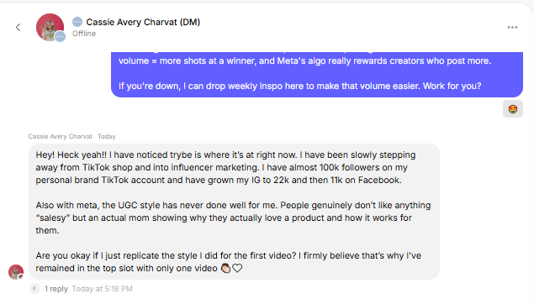
Next steps
Last week was foundations. This week:
01
Invite more creators to Trybe
02
More 1:1s with high potential creators
Encouraging them to do 20 to 30 videos a month.
03
Help Cassie hit that volume
Cassie's reply on Trybe
She has agreed, so the bulk of my time now goes to helping her fulfil it.

Slide 7
Open to discussion
01
Recharm
02
Influee
Connect all of our internal footage. Only 590 clips are in there today.
Set it up for more internal b-roll. Trybe's brand guidelines don't let us use commissioned creators' footage internally without paying commission wherever it runs.
03
Isla's side
04
Your comments
Any updates from Isla.
Anything on the updates or the weekly cadence.

