Slide 1
CRIME ANALYSIS IN LOS ANGELES
2020 – 2024
Fatima Awachi
General Assembly — Data Science Bootcamp
GitHub Repository →
Notes:
Good morning everyone. Today I'll be presenting my exploratory data analysis project on crime patterns in Los Angeles between 2020 and 2024. My name is Fatima Awachi, and this project was completed as part of the General Assembly Data Science Bootcamp. The full project is available on my GitHub, linked here.

Slide 2
Introduction
Crime affects communities, public safety, and decision-making every day
This project analyzes crime incidents reported by the LAPD between 2020 and 2024
The dataset includes the date, time, area, and type of each reported crime
Goal: identify crime patterns that support better public safety decisions
2
Notes:
Crime affects public safety and community decision-making every day. This project analyzes LAPD crime incidents from 2020 to 2024, using the date, time, area, and type of each reported crime, with the goal of finding patterns that support better public safety decisions.

Slide 3
Problem Statement
1,004,904
With this much data, it's difficult to pinpoint which crime types, areas, and time periods need the most attention
Without clear patterns, public safety planning and resource allocation become harder
This project uses Exploratory Data Analysis (EDA) to uncover these patterns and support data-driven decisions
CRIME INCIDENTS — LA, 2020–2024
3
Notes:
Here's the problem: over one million crime incidents were reported across Los Angeles in this period. With that much data, it's hard to know which crime types, areas, and time periods need the most attention — and without that clarity, public safety planning and resource allocation become much harder. That's where exploratory data analysis comes in.

Slide 4
Objectives
Questions guiding this analysis:
1
What are the most common types of crimes reported in Los Angeles?
2
Which areas recorded the highest number of crime incidents?
3
How have crime incidents changed between 2020 and 2024?
4
At what times of day are crimes reported most frequently?
5
What are the most common crime types within the highest-crime area?
4
Notes:
To tackle this, I framed five guiding questions: what are the most common crime types, which areas have the most crime, how have incidents changed over time, when do crimes happen most, and what crimes are most common in the highest-crime area.

Slide 5
Dataset Overview
LAPD Crime Data, 2020–2024
1,004,904
10
2020–2024
CRIME RECORDS
VARIABLES
TIME COVERAGE
Los Angeles
0
0
LOCATION
MISSING VALUES
DUPLICATE RECORDS
5
Notes:
Here's a quick look at the dataset. It contains just over one million crime records with ten variables, covering Los Angeles from 2020 through 2024. There were no missing values and no duplicate records, so the data was clean and ready to analyze.

Slide 6
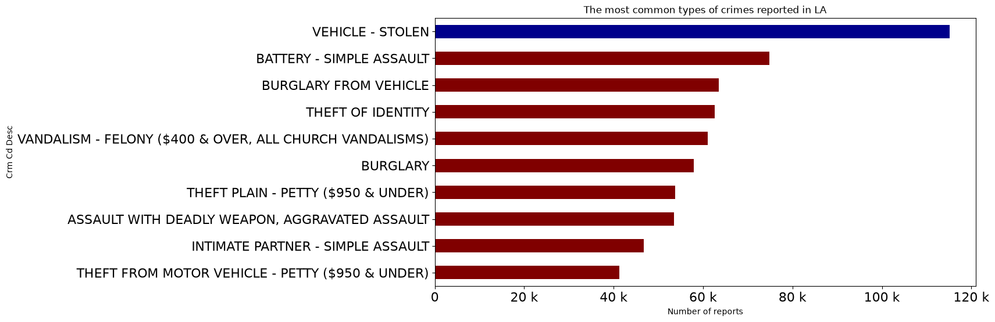
KEY FINDING
Vehicle Theft was the most frequently reported crime (~115.5K incidents)
Followed by Battery – Simple Assault and Burglary from Vehicle
6
Notes:
This chart shows the top ten reported crime types. Vehicle theft clearly stands out at the top with about 115.5 thousand incidents, followed by battery simple assault and burglary from vehicle.

Slide 7
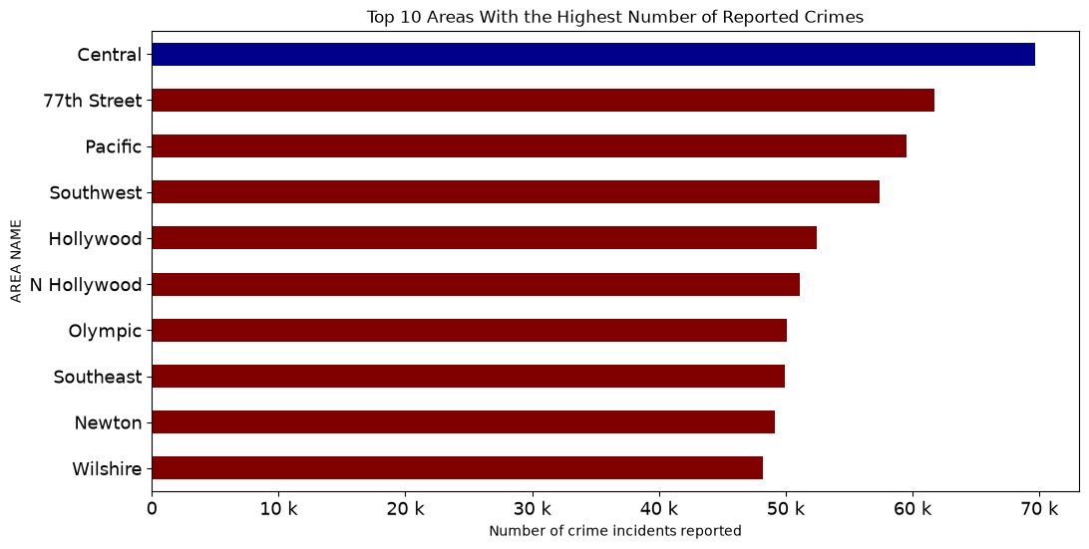
KEY FINDING
Central recorded the highest number of reported crimes
Followed by 77th Street and Pacific
7
Notes:
Next, here are the areas with the most reported crime. Central recorded the highest number of incidents, followed by 77th Street and Pacific.

Slide 8
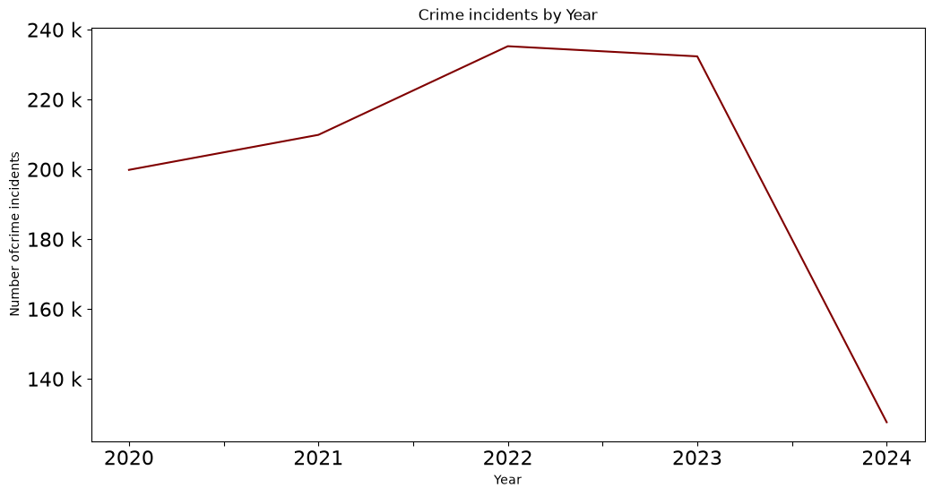
KEY FINDING
Crime incidents rose from 2020 to 2022, the peak year
Remained high in 2023, then declined in 2024
8
Notes:
This line chart shows how crime changed year by year. Incidents rose steadily until 2022, stayed high in 2023, then declined in 2024.

Slide 9
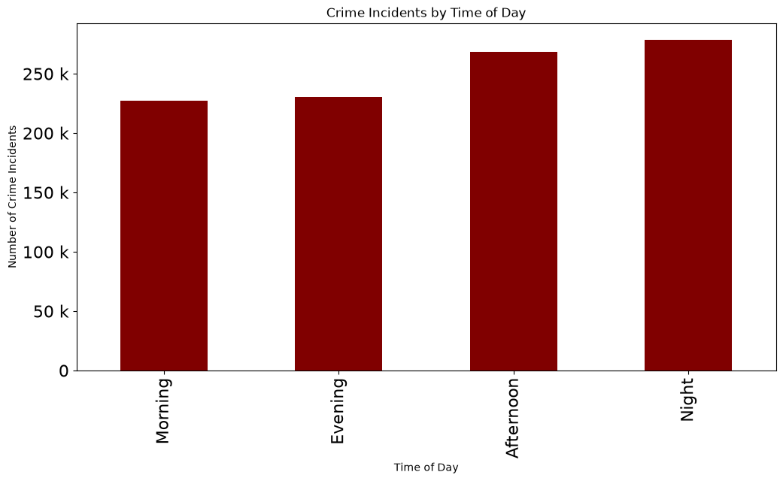
KEY FINDING
Most crimes were reported at Night, followed by Afternoon
Morning recorded the fewest incidents
9
Notes:
I also broke incidents down by time of day. Most crimes were reported at night, followed by the afternoon, with mornings recording the fewest incidents.

Slide 10
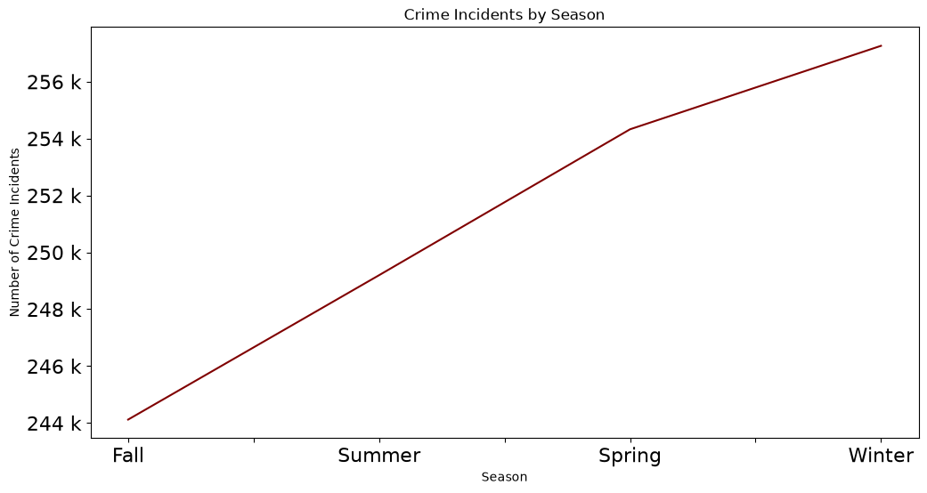
KEY FINDING
Summer recorded the highest number of crime incidents
Winter recorded the lowest — crime is generally higher in warmer months
10
Notes:
I took this a step further and looked at seasons. Summer recorded the highest number of crime incidents, while winter recorded the lowest — crime is generally higher during the warmer months.

Slide 11
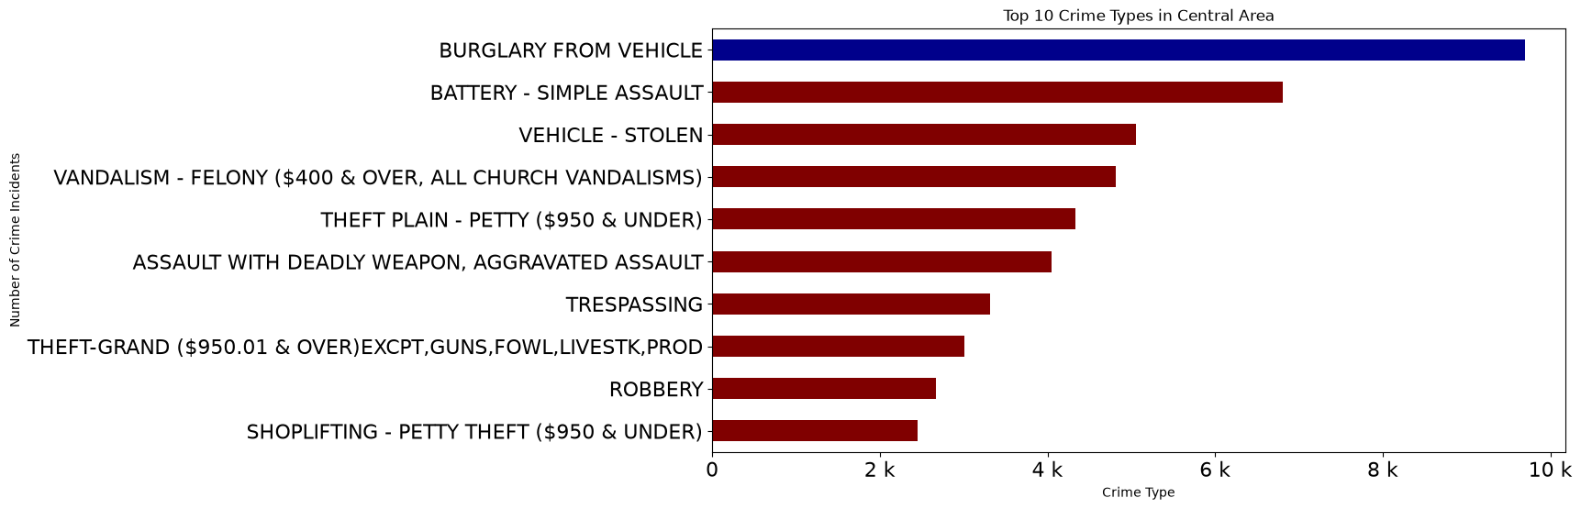
KEY FINDING
Burglary from Vehicle was the most frequent crime in Central
Followed by Battery – Simple Assault and Vehicle Theft
Vehicle-related crime dominates this area
11
Notes:
Finally, since Central had the highest crime rate, I zoomed into that area specifically. Burglary from vehicle was the most common crime there, followed by battery simple assault and vehicle theft — vehicle-related crime clearly dominates in Central.

Slide 12
Summary
More than one million crime incidents were analyzed
Vehicle Theft was the most common crime
Central recorded the highest crime rate
Crime peaked in 2022
Most crimes occurred at night, and in summer
Vehicle-related crimes were common in Central
12
Notes:
To summarize: I analyzed over one million crime incidents. Vehicle theft was the most common crime overall, Central had the highest crime rate, crime peaked in 2022, most incidents happened at night and during summer, and vehicle-related crime was especially common in Central.

Slide 13
Recommendations
1
Increase police patrols in high-crime areas, especially Central
2
Improve vehicle theft prevention through public awareness campaigns
3
Increase police presence during nighttime hours
4
Continue monitoring crime trends to support future decision-making
Similar strategies — targeted night patrols and vehicle theft-prevention campaigns — are already used in many major U.S. cities, supporting the practicality of these recommendations.
13
Notes:
Based on these findings, I recommend increasing police patrols in high-crime areas like Central, improving vehicle theft prevention through public awareness, increasing nighttime police presence, and continuing to monitor crime trends. It's worth noting that similar strategies are already used successfully in many major U.S. cities, which supports how practical these recommendations are.

Slide 14
Next Steps
1
Build an interactive Streamlit dashboard for real-time monitoring
2
Bring in 2025 data as the year becomes fully available
3
Add demographic and victim data for deeper analysis
4
Investigate what drives the summer crime spike
14
Notes:
Looking ahead, next steps include building a live Streamlit dashboard, bringing in full 2025 data once it's available, adding demographic detail, and digging into what's driving that summer spike in crime.

Slide 15
CONCLUSION
EDA can uncover real crime patterns from over a million records
Findings point to clear priorities: Central, nighttime, vehicle crime, summer months
Data-driven decisions support smarter resource allocation
Thank you
GitHub Repository →
Notes:
In conclusion, this project showed how exploratory data analysis can uncover meaningful crime patterns and support better public safety planning in Los Angeles. Data-driven decisions like these can help allocate resources more effectively. Thank you — and feel free to check out the full project on my GitHub.

